Slide 1


Digital Electronics
STEVTA -Training of Trainers Project
Lecture-4
Logic gates and Architecture
Dr. Imtiaz Hussain
Assistant Professor
Mehran University of Engineering & Technology Jamshoro
email: imtiaz.hussain@faculty.muet.edu.pk
URL :http://imtiazhussainkalwar.weebly.com/

Slide 2
Lecture Outline
Introduction
Binary Numbers
Binary Logic
Logic Levels
Logic Circuits
Combinational
Boolean Logic
Logic Gates
Sequential
Digital World
Binary Arithmetic
Design

Slide 3
Digital systems
A digital system is a system whose inputs and outputs fall within a discrete, finite set of values
Two main types
  Combinational
    Outputs dependent only on current input
  Sequential
    Outputs dependent on both past and present inputs
1
7
3

Slide 4


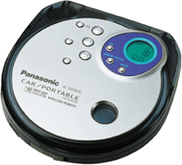
Boolean Logic (Basis of Digital Electronics)
Computer
CD & DVD players
IPod
Cell phone
HDTV
Digital cameras

Slide 5
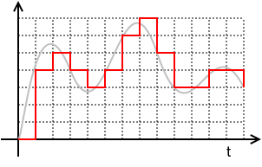
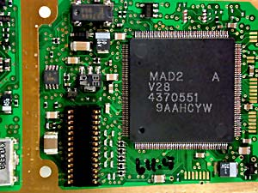
Digital Electronics
Sound is an analog signal.
On a CD, digital sound is encoded as 44.1 kHz, 16 bit audio.
  The original wave is 'sliced' 44,100 times a second - and an average amplitude level is applied to each sample.
  16 bit means that a total of 65,536 different values can be assigned, or quantized to each sample.
DVD-Audio can be 96 or 192 kHz and up to 24 bits resolution

Slide 6
Binary Numbers
Decimal is base 10 and has 10 digits: 0,1,2,3,4,5,6,7,8,9
Binary is base 2 and has 2 digits:
0,1
9

Slide 7
Binary Numbers
Binary | Decimal
000 | 0
001 | 1
010 | 2
011 | 3
100 | 4
101 | 5
110 | 6
111 | 7
100 | 8
1001 | 9
1010 | 10
16

Slide 8
Converting Binary to Decimal
What is the decimal equivalent of the binary number 010110?
1 x 2⁶ = 1 x 64 = 64
+ 1 x 2⁵ = 1 x 32 = 32
+ 0 x 2⁴ = 0 x 16 = 0
+ 1 x 2³ = 1 x 8 = 8
+ 1 x 2² = 1 x 4 = 4
+ 1 x 2¹ = 1 x 2 = 2
+ 0 x 2º = 0 x 1 = 0
= 112 in base 10
13

Slide 9
Arithmetic in Binary
Remember: there are only 2 digits in binary:
0 and 1
Position is key, carry values are used:
1 1 1 1 1 1
1 0 1 0 1 1 1
+1 0 0 1 0 1 1
1 0 1 0 0 0 1 0
Carry Values
14

Slide 10
Subtracting Binary Numbers
1 - 0 = 1
11 - 10 = 1
1011 - 10 = 1001
110 - 101 = ?
1⁰1¹⁰0 - 101 = 001
15

Slide 11
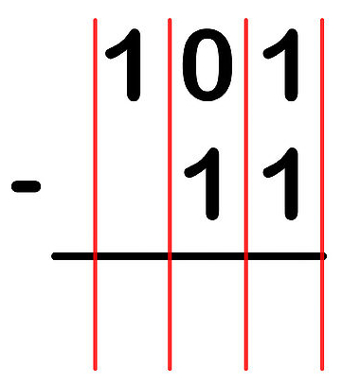
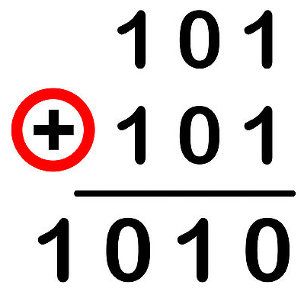
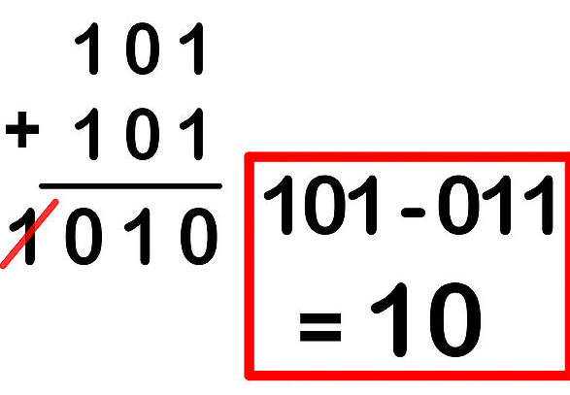
Subtracting Binary Numbers
Method 2: Using the Complement Method
15

Slide 12
Subtracting Binary Numbers
Exercise:
11000 – 111=?
15

Slide 13
Binary and Computers
Binary computers have storage units called binary digits or bits:
Low Voltage = 0
High Voltage = 1 all bits have 0 or 1
22

Slide 14
Binary and Computers
8 bits = 1 byte
The number of bytes in a word determines the word length of the computer:
32-bit machines
64-bit machines etc.
23

Slide 15
George Boole
George Boole, a British mathematician (1815-1864).
  Logic and math are equivalent.
All math functions can be determined using these 3 primary Boolean logic operators: AND, OR, and NOT.

Slide 16
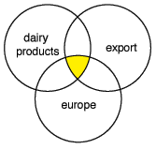
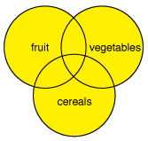
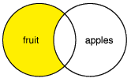
Logic operators
  AND narrows your search,
  OR broadens your search, and
  NOT is used to exclude concepts.
fruit AND vegetables AND cereal
fruit OR vegetables OR cereal
fruit NOT apples
Fruit
Vegetables
cereals

Slide 17
Boolean Algebra
Boolean algebra provides the operations and the rules for working with the set {0, 1}.
These are the rules that underlie electronic circuits, and the methods we will discuss are fundamental to Digital design.
We are going to focus on following operations:
  Boolean complementation,
  Boolean sum
  Boolean Product

Slide 18
Boolean Operations
The complement is denoted by a bar. It is defined by
The Boolean sum, denoted by + or by OR, has the following values:
1 + 1 = 1, 1 + 0 = 1, 0 + 1 = 1, 0 + 0 = 0
The Boolean product, denoted by ⋅ or by AND, has the following values:
1 ⋅ 1 = 1, 1 ⋅ 0 = 0, 0 ⋅ 1 = 0, 0 ⋅ 0 = 0

Slide 19
Boolean Functions and Expressions
Definition: Let B = {0, 1}. The variable x is called a Boolean variable if it assumes values only from B.
Boolean functions can be represented using expressions made up from the variables and Boolean operations.

Slide 20
Write out logic statements using Boolean operators for these.
You have a buzzer in your car that sounds when your keys are in the ignition and the door is open.
You have a fire alarm installed in your house. This alarm will sound if it senses heat or smoke.
There is an election coming up. People are allowed to vote if they are a citizen and they are 18.
To complete an assignment the students must do a presentation or write an essay.

Slide 21
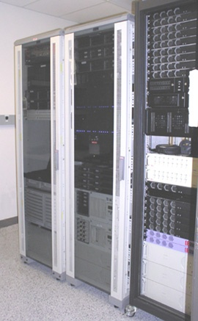
Basis for digital computers
The true-false nature of Boolean logic makes it compatible with binary logic used in digital computers.
Electronic circuits can produce Boolean logic operations.
Circuits are called gates.
  NOT
  AND
  OR

Slide 22
Logic Gates
There are three basic types of gates:
Inverter (NOT gate)
x
x+y
OR gate
y
x
xy
AND gate
y

Slide 23
Truth Tables and Boolean Notation
Circuits with one input
  Buffer P = A
  Not P = A
A P
0 0
1 1
A
P
A P
0 1
1 0
Notes:
Buffer can be used to drive a device requiring more power than available, also for delays and isolation of components

Slide 24
Basic AND / OR
Circuits with two Inputs
  AND P = A.B
  OR P=A+B
A B P
0 0 0
0 1 0
1 0 0
1 1 1
A
P
B
A B P
0 0 0
0 1 1
1 0 1
1 1 1
Notes:
Define the and (.) and or(+) functions
Show NAND as AND followed by an inverter

Slide 25
Basic NAND / NOR
Problems with two Inputs
  NAND P = A.B
  NOR P=A+B
A B P
0 0 1
0 1 1
1 0 1
1 1 0
A
P
B
A B P
0 0 1
0 1 0
1 0 0
1 1 0

Slide 26
Basic XOR / XNOR
Circuits with two Inputs:
  XOR P = A ⊕ B
  XNOR P = A ⊕ B
A B P
0 0 0
0 1 1
1 0 1
1 1 0
A B P
0 0 1
0 1 0
1 0 0
1 1 1
Notes:
Show how to implement XOR gate using AND gates and inverters

Slide 27
Logic Gates
Example: How can we build a circuit that computes the function ?
x
xy
y
xy + (-x)y
x
-x
(-x)y
y

Slide 28
Boolean Functions and Expressions
Example: Give a Boolean expression for the Boolean function F(x, y) as defined by the following table:
x | y | F(x, y)
0 | 0 | 0
0 | 1 | 0
1 | 0 | 0
1 | 1 | 1
solution: F(x, y) = x.y

Slide 29
Boolean Functions and Expressions
Give a Boolean expression for the Boolean function F(x, y) as defined by the following table:
x | y | F(x, y)
0 | 0 | 0
0 | 1 | 1
1 | 0 | 0
1 | 1 | 0

Slide 30
Boolean Functions and Expressions
Another Example:
x
y
z
F(x, y, z)
0
0
0
1
0
0
1
1
Possible solution II:
F(x, y, z) = (-(xz))(-y)
0
1
0
0
0
1
1
0
1
0
0
1
1
0
1
0
Possible solution III:
F(x, y, z) = -(xz + y)
1
1
0
0
1
1
1
0

Slide 31
Definition of a Boolean Algebra
Definition: A Boolean algebra is a set B with two binary operations + and ., elements 0 and 1, and a unary operation – such that the following properties hold for all x, y, and z in B:
x + 0 = x and x . 1 = x (identity laws)
x + x’ = 1 and x . x’ = 0 (domination laws)
(x + y) + z = x + (y + z) and
(x . y) . z = x . (y . z) and (associative laws)
x + y = y + x and x . y = y . x (commutative laws)
x + (y . z) = (x + y) . (x + z) and
x . (y + z) = (x . y) + (x . z) (distributive laws)

Slide 32
Order of precedence of Boolean operators
The order of operations is: AND, NOT, OR, XOR
Parentheses are used to override priority.
Expressions in parentheses are processed first.
Parentheses are used to organize the sequence and groups of concepts.

Slide 33
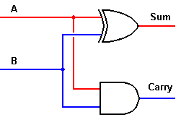
How do we use gates to add two binary numbers?
Binary numbers are either 1 or 0.
Have two outputs.
Need a gate to produce each output.
0 | 0 | 1 | 1
+ 0 | + 1 | + 0 | + 1
00 | 01 | 01 | 10
A | B | Q | CO
0 | 0 | 0 | 0
0 | 1 | 1 | 0
1 | 0 | 1 | 0
1 | 1 | 0 | 1

Slide 34
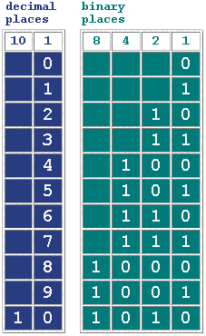
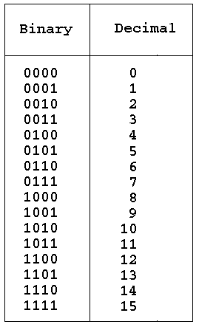
How do I add larger numbers?
You can write any number in binary.

Slide 35
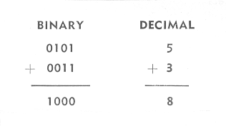
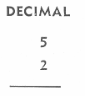
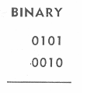
Add binary numbers.
Adding larger number just adds more columns.

Slide 36
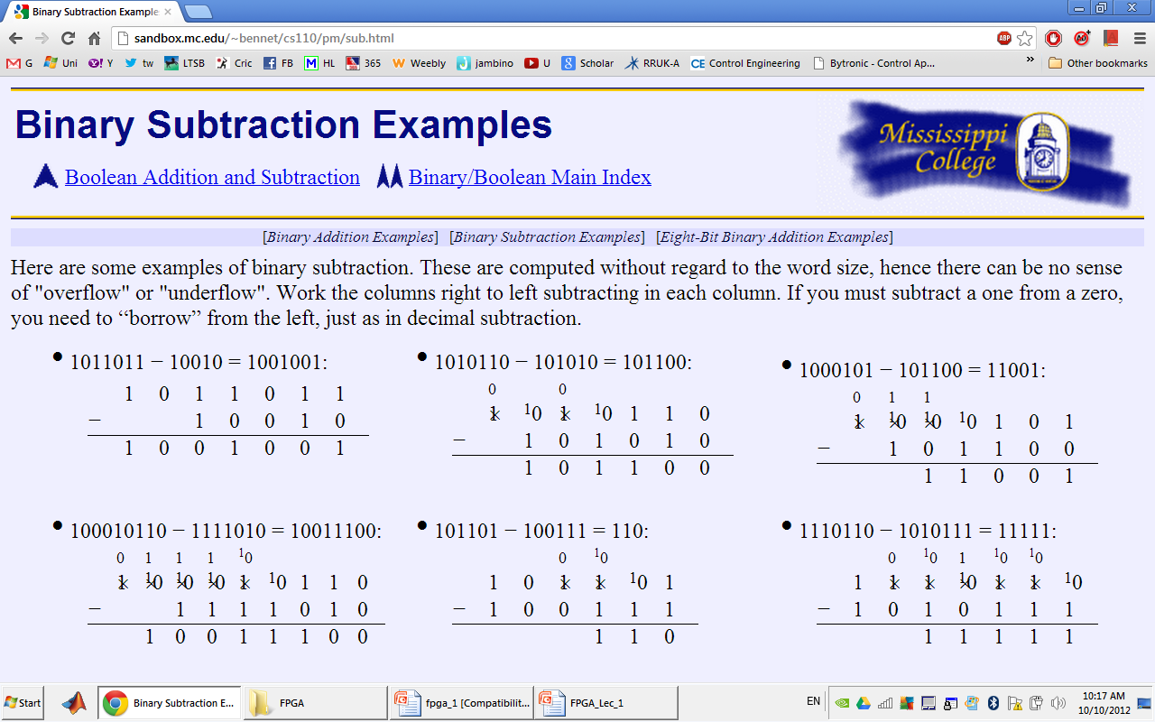
Binary Subtraction
Work the columns right to left subtracting in each column. If you must subtract a one from a zero, you need to “borrow” from the left, just as in decimal subtraction.
Subtract
11 from 9
7 from 10

Slide 37
Binary Multiplication
As an example of binary multiplication we have 101 times 11,
101
x11
First we multiply 101 by 1, which produces 101. Then we put a 0 as a placeholder as we would in decimal multiplication, and multiply 101 by 1, which produces 101.
101
x11
101
1010 <-- the 0 here is the placeholder
The next step, as with decimal multiplication, is to add. The results from our previous step indicates that we must add 101 and 1010, the sum of which is 1111.
101
x11
101
1010
1111

Slide 38
Binary Division
Binary is almost as easy, and involves our knowledge of binary multiplication. Take for example the division of 1011 into 11.
11
11 )1011
-11
101
-11
10 <-- remainder, R

Slide 39
Types of Logic Circuits
Combinational
Sequential

Slide 40
Combinational Logic Circuits
Fundamental circuits that are the basic building blocks of most larger digital circuits.
They are reusable and are common to many systems.
Examples of these logic circuits are
  Decoders
  Encoders
  Code converters
  Multiplexers

Slide 41
Where they are used?
Multiplexers
  Selectors for routing data to the processor, memory, I/O
  Multiplexers route the data to the correct bus or port.
Decoders
  are used for selecting things like a bank of memory and then the address within the bank. This is also the function needed to ‘decode’ the instruction to determine the operation to perform.
Encoders
  are used in various components such as keyboards.

Slide 42
Combinational Logic Design
A process with 5 steps
  Specification
  Formulation
  Optimization
  Technology mapping
  Verification
1st three steps and last best illustrated by example

Slide 43
Specifications step
Write a specification for the circuits
Specification includes
  What are the inputs: how many, how many bits in a given output, how are they grouped,, are they control, are they active high?
  What are the outputs: how many and how many bits in a each, active high, active low, tristate output?
  The functional operation that takes place in the chip, i.e., for given inputs what will appear on the outputs.

Slide 44
Formulation step
Convert the specifications into a variety forms for optimal implementation.
  Possible forms
    Truth Tables
    Expressions
    K-maps
    Binary Decision Diagrams
IF THE SPECIFCATION IS ERRONOUS OR INCOMPLETE (open for various interpretation) then the circuit will perform as specified but will not perform as desired.

Slide 45
Last 3 steps
Best illustrated by example
  A BCD to Excess-3 code converter
  BCD-to-7-segment decoder

Slide 46
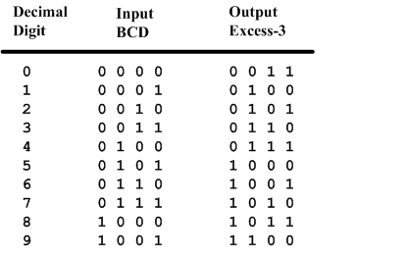
BCD-to-Excess-3 Code converter
BCD is a code for the decimal digits 0-9
Excess-3 is also a code for the decimal digits

Slide 47
Specification of BCD-to-Excess3
Inputs: a BCD input, A,B,C,D with A as the most significant bit and D as the least significant bit.
Outputs: an Excess-3 output W,X,Y,Z that corresponds to the BCD input.
Internal operation – circuit to do the conversion in combinational logic.

Slide 48
Formulation of BCD-to-Excess-3
Excess-3 code is easily formed by adding a binary 3 to the binary or BCD for the digit.
There are 16 possible inputs for both BCD and Excess-3.
It can be assumed that only valid BCD inputs will appear so the six combinations not used can be treated as don’t cares.

Slide 49
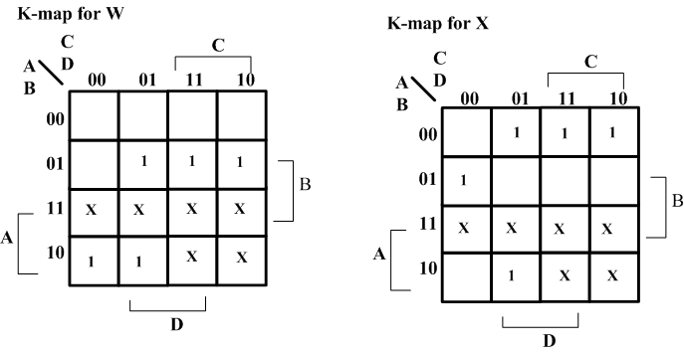
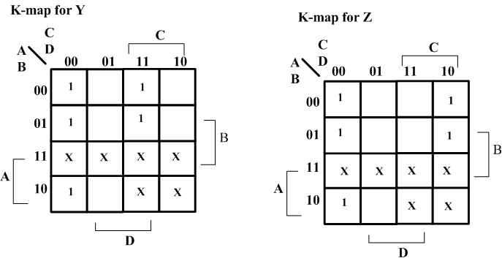
Optimization – BCD-to-Excess-3
Lay out K-maps for each output, W X Y Z
A step in the digital circuit design process.

Slide 50
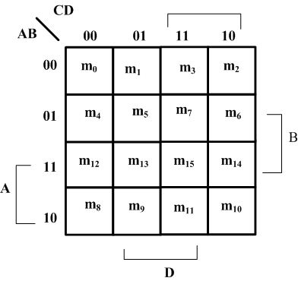
Placing 1 on K-maps
Where are the minterms located on a K-Map?

Slide 51
Expressions for W X Y Z
W(A,B,C,D) = Σm(5,6,7,8,9) +d(10,11,12,13,14,15)
X(A,B,C,D) = Σm(1,2,3,4,9) +d(10,11,12,13,14,15)
Y(A,B,C,D) = Σm(0,3,4,7,8) +d(10,11,12,13,14,15)
Z(A,B,C,D) = Σm(0,2,4,6,8) +d(10,11,12,13,14,15)

Slide 52
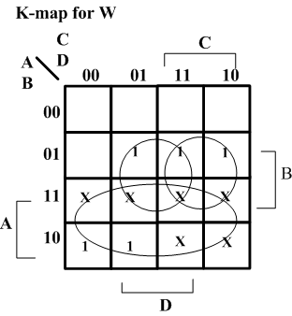
Minimize K-Maps
W minimization
Find W = A + BC + BD

Slide 53
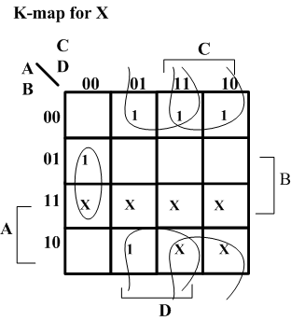
Minimize K-Maps
X minimization
Find X = BC’D’+B’C+B’D

Slide 54
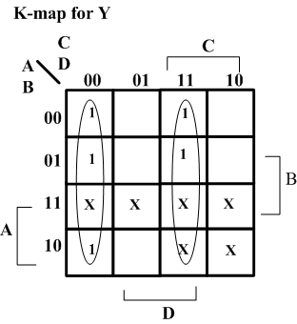
Minimize K-Maps
Y minimization
Find Y = CD + C’D’

Slide 55
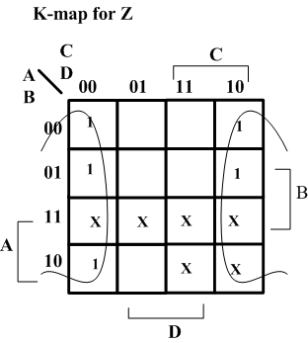
Minimize K-Maps
Z minimization
Find Z = D’

Slide 56
Two level circuit implementation
Have equations
  W = A + BC + BD = A + B(C+D)
  X = B’C + B’D + BC’D’ = B’(C+D) + BC’D’
  Y = CD + C’D’
  Z = D’
Factoring out (C+D) and call it T
Then T’ = (C+D)’ = C’D’
  W = A + BT
  X = B’T + BT’
  Y = CD + T’
  Z = D’

Slide 57
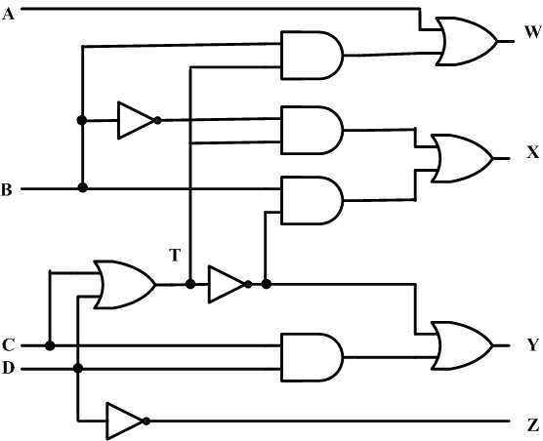
Create the digital circuit
Implementing the second set of equations where T=C+D results in a lower gate count.
This gate has a fanout of 3

Slide 58
BCD-to-Seven-Segment Decoder
Specification
  Digital readouts on many digital products often use LED seven-segment displays.
  Each digit is created by lighting the appropriate segments. The segments are labeled a,b,c,d,e,f,g
  The decoder takes a BCD input and outputs the correct code for the seven-segment display.

Slide 59
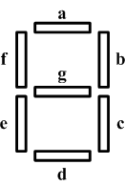
Specification
Input: A 4-bit binary value that is a BCD coded input.
Outputs: 7 bits, a through g for each of the segments of the display.
Operation: Decode the input to activate the correct segments.

Slide 60
BCD to 7-Segment
e.g to display 2 a, b, g, e and d

Slide 61
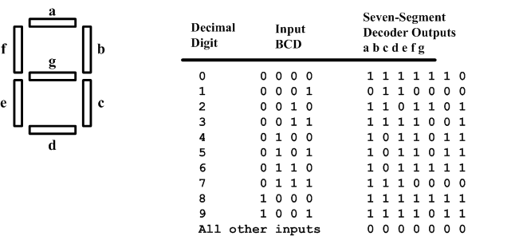
Formulation
Construct a truth table

Slide 62
Optimization
Create a K-map for each output and get
  A = A’C+A’BD+B’C’D’+AB’C’
  B = A’B’+A’C’D’+A’CD+AB’C’
  C = A’B+A’D+B’C’D’+AB’C’
  D = A’CD’+A’B’C+B’C’D’+AB’C’+A’BC’D
  E = A’CD’+B’C’D’
  F = A’BC’+A’C’D’+A’BD’+AB’C’
  G = A’CD’+A’B’C+A’BC’+AB’C’

Slide 63
4-bit Equality Checker
Specification
  Input: Two vectors, A(3:0) and B(3:0) each being 4-bits. The msb bits the A(3) and B(3).
  Output: E which has a value of 1 when A=B and 0 if any bit of A/=B.
  Operation: Combinational logic to compare the 4 bits of A with the 4 bits of B to produce E

Slide 64
4-bit Equality Checker
Formulation
  For each bit position A_{i} will be compared with B_{i} and if they are equal, a 0 will be output. If they differ a 1 will be output.
  Thus, if any bit position indicates a 1 then the values are different. These 1st level comparators outputs can then be Ored together.
  The ORed output is inverted to produce a 1 when they are equal.

Slide 65
End of Lecture-4
To download this lecture visit
http://imtiazhussainkalwar.weebly.com/

