Slide 1


Basic Electronics
STEVTA -Training of Trainers Project
Lecture-1
Semiconductor Diode & its Applications
Dr. Imtiaz Hussain
Assistant Professor
Mehran University of Engineering & Technology Jamshoro
email: imtiaz.hussain@faculty.muet.edu.pk
URL :http://imtiazhussainkalwar.weebly.com/

Slide 2
Lecture Outline
Semiconductor Theory
Band Theory of Solids
Semiconductor Diodes
Diodes
Characteristics
Practical
Characteristics of Silicon and Germanium Diode
Doping
Diode models

Slide 3
What is Electronics?
General Definition
  The science dealing with the development and application of devices and systems involving the flow of electrons in a vacuum, in gaseous media, and in semiconductors.
Modern Definition
  The science dealing with the development and application of devices and systems involving the flow of electrons in semiconductors.

Slide 4
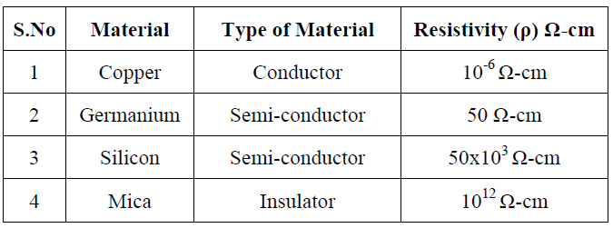
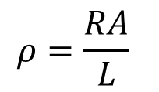

Semiconductors
A semiconductor is a material that has intermediate conductivity between a conductor and an insulator.
The term resistivity ($ρ$) is often used when comparing the resistance level of materials.
$$ρ=\frac{RA}{L}$$

Slide 5
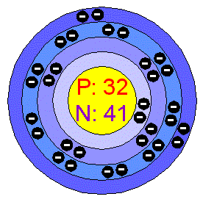
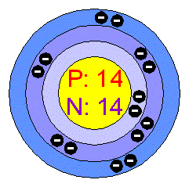
Semiconductors
Silicon (Si) and Germanium (Ge) are two most commonly used semiconductor materials.
Silicon Atom
Germanium Atom

Slide 6
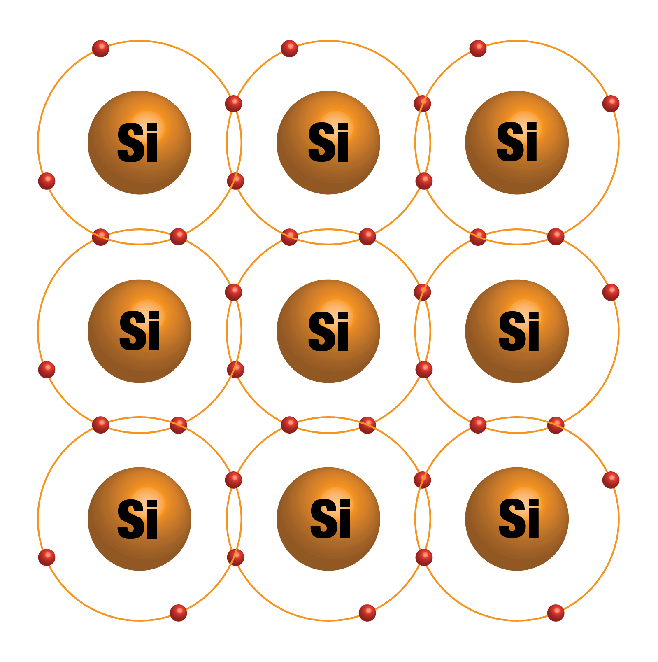
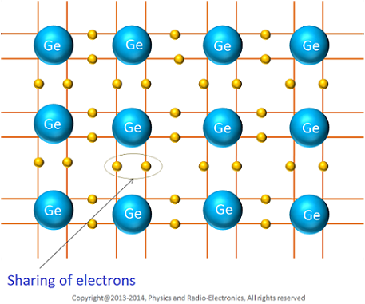
Semiconductors
Silicon and Germanium crystals

Slide 7
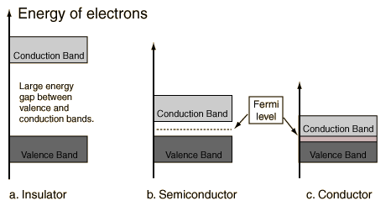
Band Theory of Solids
A useful way to visualize the difference between conductors, insulators and semiconductors is to plot the available energies for electrons in the materials.

Slide 8
Band Theory of Solids
An important parameter in the band theory is the Fermi level, the top of the available electron energy levels at low temperatures. The position of the Fermi level with the relation to the conduction band is a crucial factor in determining electrical properties.

Slide 9
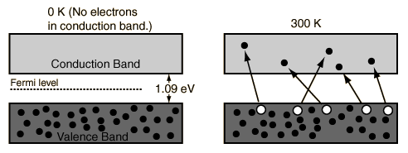
Silicon and Germanium Energy Bands
At finite temperatures, the number of electrons which reach the conduction band and contribute to current can be modeled by the Fermi function. That current is small compared to that in doped semiconductors under the same conditions.
Silicon Energy Bands at different Temperature levels

Slide 10
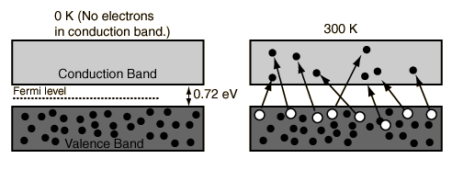
Silicon and Germanium Energy Bands
At finite temperatures, the number of electrons which reach the conduction band and contribute to current can be modeled by the Fermi function. That current is small compared to that in doped semiconductors under the same conditions.
Germanium Energy Bands at different Temperature levels

Slide 11
Doping of Semiconductors
A pure semi-conductor can conduct current only to a limited extent. Because in intrinsic state it has limited number of free electrons in the conduction band.
But this ratio can be increased by adding a certain amount of impurity atoms to the semi- conductor crystals in a process called doping.
By introducing impurities with a different number of valence electrons, the number of available charge carriers in the semi-conductor can be increased.

Slide 12
N-Type Material
When extra valence electrons are introduced into a semiconductor n-type material is produced.
The extra valence electrons are introduced by putting impurities or dopants into the silicon.
+4
+4
+4
+4
+5
+4
+4
+4
+4

Slide 13
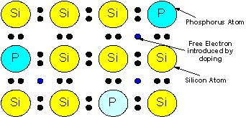
N-Type Material
The dopants used to create an n-type material are Group V elements. The most commonly used dopants from Group V are arsenic, antimony and phosphorus.
The 2D diagram to the left shows the extra electron that will be present when a Group V dopant is introduced to a material such as silicon. This extra electron is very mobile.

Slide 14
P-Type Material
P-type material is produced when the dopant that is introduced is from Group III.
Group III elements have only 3 valence electrons and therefore there is an electron missing.
This creates a hole (h+), or a positive charge that can move around in the material. Commonly used Group III dopants are aluminum, boron, and gallium.
The 2D diagram to the left shows the hole that will be present when a Group III dopant is introduced to a material such as silicon. This hole is quite mobile in the same way the extra electron is mobile in a n-type material.
+4
+4
+4
+4
+3
+4
+4
+4
+4

Slide 15
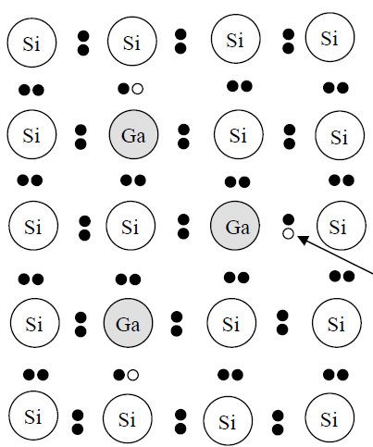
P-Type Material
This creates a hole (h+), or a positive charge that can move around in the material. Commonly used Group III dopants are aluminum, boron, and gallium.
The 2D diagram to the left shows the hole that will be present when a Group III dopant is introduced to a material such as silicon. This hole is quite mobile in the same way the extra electron is mobile in a n-type material.

Slide 16
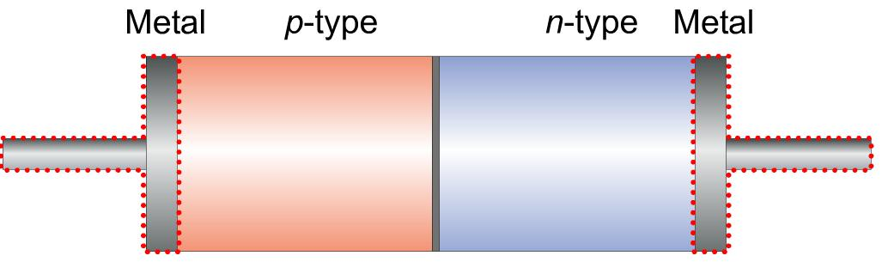
Semiconductor Diodes
Diode is constructed by fusing two different types extrinsic semiconductors (P-type and N-type) together.

Slide 17
The PN Junction in Steady State
Metallurgical Junction
Na
Nd
- - - - - -
- - - - - -
- - - - - -
- - - - - -
- - - - - -
+ + + + + +
+ + + + + +
+ + + + + +
+ + + + + +
+ + + + + +
P
n
Space Charge Region
ionized acceptors
ionized donors
E-Field
+
+
_
_
h+ drift
=
h+ diffusion
e- diffusion
=
e- drift

Slide 18
The Biased PN Junction
Metal Contact
“Ohmic Contact”
(Rs~0)
P
Applied Electric Field
n
I
_
+
V_{applied}

Slide 19
The Biased PN Junction
Forward Bias:
In forward bias the depletion region shrinks slightly in width. With this shrinking the energy required for charge carriers to cross the depletion region decreases exponentially.
Therefore, as the applied voltage increases, current starts to flow across the junction.
The barrier potential of the diode is the voltage at which appreciable current starts to flow through the diode. The barrier potential varies for different materials.
V_{applied} > 0
Reverse Bias:
Under reverse bias the depletion region widens.
This causes the electric field produced by the ions to cancel out the applied reverse bias voltage.
A small leakage current, Is (saturation current) flows under reverse bias conditions.
This saturation current is made up of electron-hole pairs being produced in the depletion region.
V_{applied} < 0

Slide 20
Diode Characteristics
I_{D}
(mA)
V_{D} = Bias Voltage
I_{D} = Current through Diode. I_{D} is Negative for Reverse Bias and Positive for Forward Bias
I_{S} = Saturation Current
V_{BR} = Breakdown Voltage
V_{φ} = Barrier Potential Voltage
I_{S}
V_{BR}
~V_{φ}
V_{D}
(nA)

Slide 21
Diodes Characteristics
The transconductance curve on the previous slide is characterized by the following equation:
I_{D} = I_{S}(e^{VD/ηVT} – 1)
V_{T} is the thermal equivalent voltage and is approximately 26 mV at room temperature. The equation to find V_{T} at various temperatures is:
V_{T} = kT
q
k = 1.38 x 10⁻²³ J/K T = temperature in Kelvin q = 1.6 x 10⁻¹⁹ C
η is the emission coefficient for the diode. It is determined by the way the diode is constructed. It somewhat varies with diode current. For a silicon diode η is around 2 for low currents and goes down to about 1 at higher currents

Slide 22
Diode Circuit Models
The Ideal Diode Model
The diode is designed to allow current to flow in only one direction. The perfect diode would be a perfect conductor in one direction (forward bias) and a perfect insulator in the other direction (reverse bias). In many situations, using the ideal diode approximation is acceptable.
Example: Assume the diode in the circuit below is ideal. Determine the value of I_{D} if a) V_{A} = 5 volts (forward bias) and b) V_{A} = -5 volts (reverse bias)
R_{S} = 50 Ω
a) With V_{A} > 0 the diode is in forward bias and is acting like a perfect conductor so:
I_{D} = V_{A}/R_{S} = 5 V / 50 Ω = 100 mA
b) With V_{A} < 0 the diode is in reverse bias and is acting like a perfect insulator, therefore no current can flow and I_{D} = 0.
I_{D}
+
V_{A}
_

Slide 23
Diode Circuit Models
The Ideal Diode with Barrier Potential
This model is more accurate than the simple ideal diode model because it includes the approximate barrier potential voltage.
+
V_{φ}
Example: To be more accurate than just using the ideal diode model include the barrier potential. Assume V_{φ} = 0.3 volts (typical for a germanium diode) Determine the value of I_{D} if V_{A} = 5 volts (forward bias).
R_{S} = 50 Ω
With V_{A} > 0 the diode is in forward bias and is acting like a perfect conductor so write a KVL equation to find I_{D}:
V_{A} = I_{D}R_{S} + V_{φ}
I_{D} = V_{A} - V_{φ} = 4.7 V = 94 mA
R_{S} 50 Ω
I_{D}
+
V_{A}
_
+
V_{φ}

Slide 24
Diode Circuit Models
The Ideal Diode with Barrier Potential and Linear Forward Resistance
This model is the most accurate of the three. It includes a linear forward resistance that is calculated from the slope of the linear portion of the transconductance curve. However, this is usually not necessary since the R_{F} (forward resistance) value is pretty constant. For low-power germanium and silicon diodes the R_{F} value is usually in the 2 to 5 ohms range, while higher power diodes have a R_{F} value closer to 1 ohm.
I_{D}
+
V_{φ}
R_{F}
Linear Portion of transconductance curve
R_{F} = V_{D}
I_{D}
I_{D}
V_{D}
V_{D}

Slide 25
Diode Circuit Models
The Ideal Diode with Barrier Potential and Linear Forward Resistance
Example: Assume the diode is a low-power diode with a forward resistance value of 5 ohms. The barrier potential voltage is still: V_{φ} = 0.3 volts (typical for a germanium diode) Determine the value of I_{D} if V_{A} = 5 volts.
R_{S} = 50 Ω
I_{D}
+
Once again, write a KVL equation for the circuit:
V_{A} = I_{D}R_{S} + V_{φ} + I_{D}R_{F}
I_{D} = V_{A} - V_{φ} = 5 – 0.3 = 85.5 mA
R_{S} + R_{F} 50 + 5
V_{A}
_
+
V_{φ}
R_{F}

Slide 26
Diode Circuit Models
Values of I_{D} for the Three Different Diode Circuit Models
 | Ideal Diode Model | Ideal Diode Model with Barrier Potential Voltage | Ideal Diode Model with Barrier Potential and Linear Forward Resistance
I_{D} | 100 mA | 94 mA | 85.5 mA

Slide 27
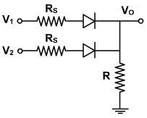
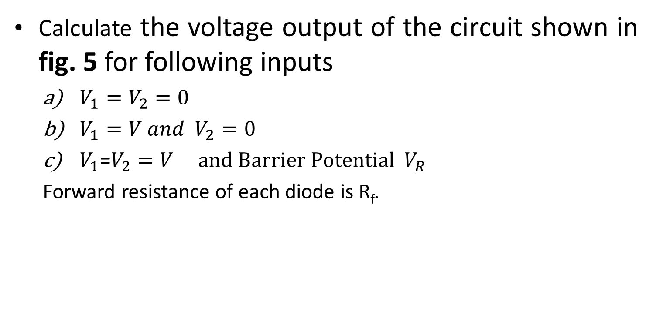
Exercise
Training Manual Electronics Level-1 Page-8
Calculate the voltage output of the circuit shown in fig. 5 for following inputs
  $V_{1}=V_{2}=0$
  $V_{1}=V and{ V}_{2}=0$
  $V_{1}$=$V_{2}=V and Barrier Potential$ $V_{R}$
  Forward resistance of each diode is R_{f}.
fig. 5

Slide 28
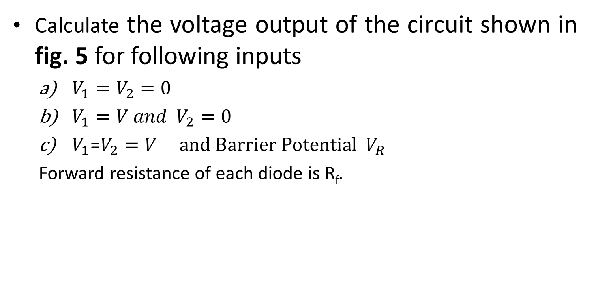
Exercise
Calculate the voltage output of the circuit shown in fig. 5 for following inputs
  $V_{1}=V_{2}=0$
  $V_{1}=V and{ V}_{2}=0$
  $V_{1}$=$V_{2}=V and Barrier Potential$ $V_{R}$
  Forward resistance of each diode is R_{f}.
Solution:
fig. 5
(a). When both V1 and V2 are zero , then the diodes are unbiased. Therefore, V_{o} = 0 V

Slide 29
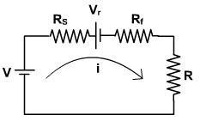

Exercise
Calculate the voltage output of the circuit shown in fig. 5 for following inputs
  $V_{1}=V_{2}=0$
  $V_{1}=V and{ V}_{2}=0$
  $V_{1}$=$V_{2}=V and Barrier Potential$ $V_{R}$
  Forward resistance of each diode is R_{f}.
Solution:
fig. 5
(b). When V1 = V and V2 = 0, then one upper diode is forward biased and lower diode is unbiased. The resultant circuit using third approximation of diode will be as shown in fig. 6.
Applying KVL, we get
Fig. 6

Slide 30
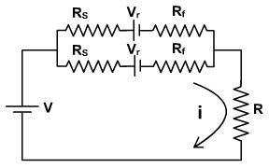
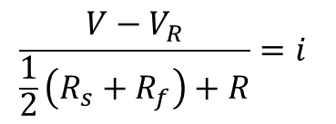
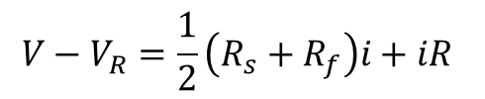
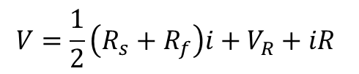
Exercise
Calculate the voltage output of the circuit shown in fig. 5 for following inputs
  $V_{1}=V_{2}=0$
  $V_{1}=V and{ V}_{2}=0$
  $V_{1}$=$V_{2}=V and Barrier Potential$ $V_{R}$
  Forward resistance of each diode is R_{f}.
Solution:
fig. 5
(c) When both V₁ and V₂ are same as V, then both the diodes are forward biased and conduct. The resultant circuit using third approximation of diode will be as shown in Fig. 7.
Applying KVL, we get
$$V=\frac{1}{2}\left(R_{s}+R_{f}\right)i+V_{R}+iR$$
$$\frac{V−V_{R}}{\frac{1}{2}\left(R_{s}+R_{f}\right)+R}=i$$
$$V−V_{R}=\frac{1}{2}\left(R_{s}+R_{f}\right)i+iR$$
Fig. 7

Slide 31
Practical session
Diode Characteristics

Slide 32
Objective
To develop the forward and reverse characteristics of semiconductor diode.
REQUIRED COMPONENTS
1) Bread-board
2) Silicon diode
3) Germanium diode
4) 2 Resistors (10KΩ each)

Slide 33
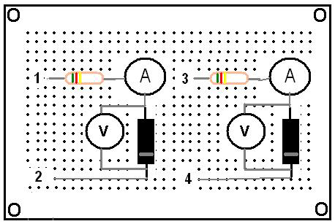
Circuit Diagram

Slide 34
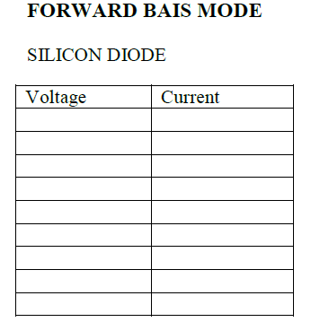
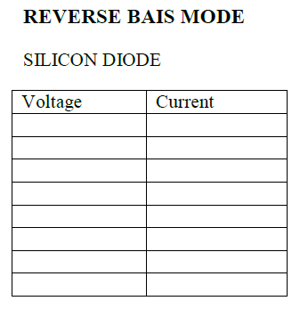
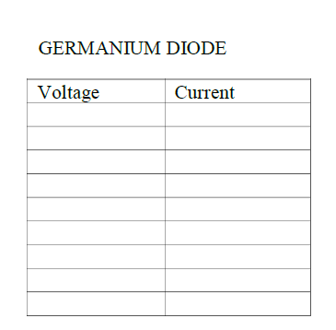
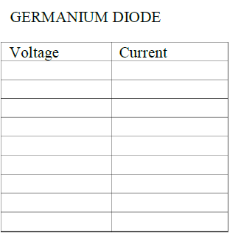
Readings

Slide 35
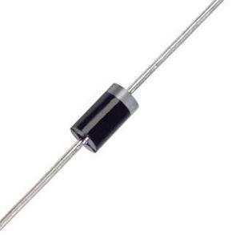
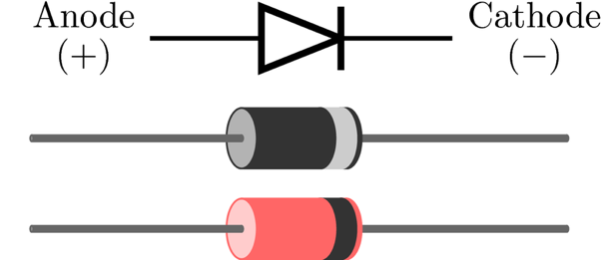
Diode Terminals

Slide 36
Light Emitting Diode (LED)
A compound that is commonly used for LEDs construction is Gallium Arsenide (GaAs), because of it’s large bandgap.
Gallium is a group 3 element while Arsenide is a group 5 element.
When put together as a compound, GaAs creates a zincblend lattice structure.

Slide 37
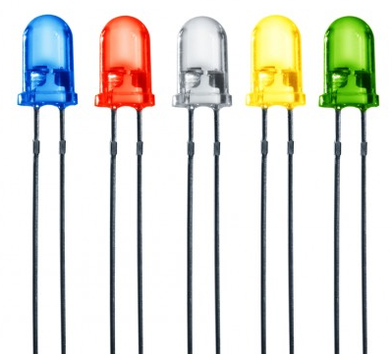
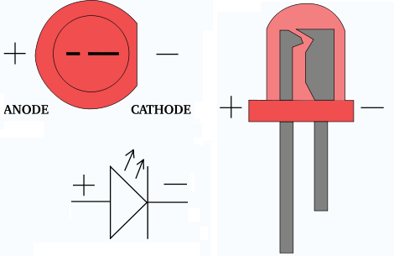
Light Emitting Diode (LED)

Slide 38
End of Lecture-1
To download this lecture visit
http://imtiazhussainkalwar.weebly.com/

