Slide 1
Control Systems (CS)
Lecture-8-9
Block Diagram Representation of Control Systems
Dr. Imtiaz Hussain
Associate Professor
Mehran University of Engineering & Technology Jamshoro, Pakistan
email: imtiaz.hussain@faculty.muet.edu.pk
URL :http://imtiazhussainkalwar.weebly.com/

Slide 2
Introduction
A Block Diagram is a shorthand pictorial representation of the cause-and-effect relationship of a system.
The interior of the rectangle representing the block usually contains a description of or the name of the element, or the symbol for the mathematical operation to be performed on the input to yield the output.
The arrows represent the direction of information or signal flow.

Slide 3
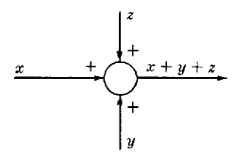
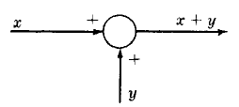
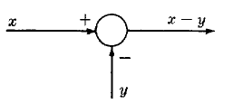
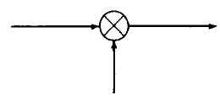
Introduction
The operations of addition and subtraction have a special representation.
The block becomes a small circle, called a summing point, with the appropriate plus or minus sign associated with the arrows entering the circle.
The output is the algebraic sum of the inputs.
Any number of inputs may enter a summing point.
Some books put a cross in the circle.

Slide 4
Introduction
In order to have the same signal or variable be an input to more than one block or summing point, a takeoff point is used.
This permits the signal to proceed unaltered along several different paths to several destinations.

Slide 5
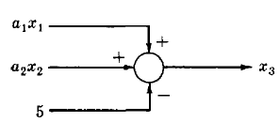
Example-1
Consider the following equations in which x₁, x₂, x₃, are variables, and a₁, a₂ are general coefficients or mathematical operators.

Slide 6
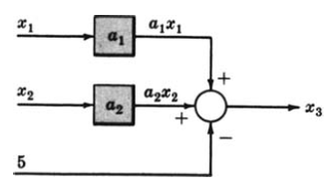
Example-1
Consider the following equations in which x₁, x₂, x₃, are variables, and a₁, a₂ are general coefficients or mathematical operators.

Slide 7
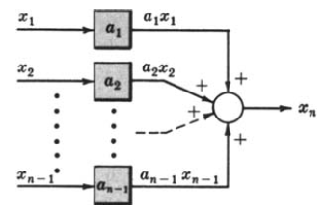
Example-2
Consider the following equations in which x₁, x₂,. . . , x_{n}, are variables, and a₁, a₂,. . . , a_{n} , are general coefficients or mathematical operators.

Slide 8
Example-3
Draw the Block Diagrams of the following equations.

Slide 9
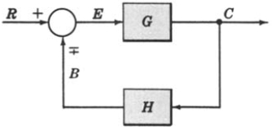
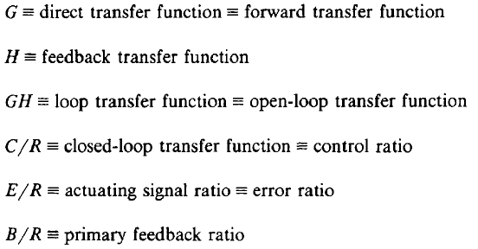
Canonical Form of A Feedback Control System

Slide 10
Characteristic Equation
The control ratio is the closed loop transfer function of the system.
The denominator of closed loop transfer function determines the characteristic equation of the system.
Which is usually determined as:

Slide 11
Example-4
Open loop transfer function
Feed Forward Transfer function
control ratio
feedback ratio
error ratio
closed loop transfer function
characteristic equation
closed loop poles and zeros if K=10.

Slide 12
Reduction of Complicated Block Diagrams
The block diagram of a practical control system is often quite complicated.
It may include several feedback or feedforward loops, and multiple inputs.
By means of systematic block diagram reduction, every multiple loop linear feedback system may be reduced to canonical form.

Slide 13
Reduction techniques
1. Combining blocks in cascade
2. Combining blocks in parallel

Slide 14
Reduction techniques
3. Moving a summing point behind a block
4. Moving a summing point ahead of a block

Slide 15
5. Moving a pickoff point behind a block
6. Moving a pickoff point ahead of a block

Slide 16
7. Eliminating a feedback loop
8. Swap with two neighboring summing points

Slide 17
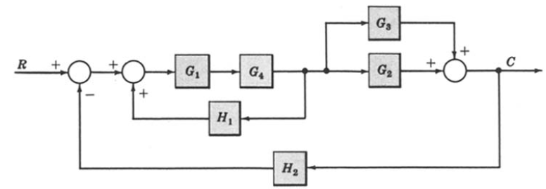
Example-5: Reduce the Block Diagram to Canonical Form.
Combine all cascade block using rule-1
Combine all parallel block using rule-2

Slide 18
Example-5: Reduce the Block Diagram to Canonical Form.
$$G_{2}+G_{3}$$
$$G_{1}G_{4}$$

Slide 19
Example-5: Continue.
Eliminate all minor feedback loops using rule-7
After the elimination of minor feedback loop the block diagram is reduced to as shown below
Again blocks are in cascade are removed using rule-1

Slide 20
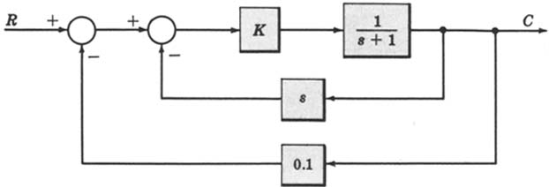
Example-6
For the system represented by the following block diagram determine:
Open loop transfer function
Feed Forward Transfer function
control ratio
feedback ratio
error ratio
closed loop transfer function
characteristic equation
closed loop poles and zeros if K=10.

Slide 21
Example-6
First we will reduce the given block diagram to canonical form

Slide 22
Example-6

Slide 23
Example-6
Open loop transfer function
Feed Forward Transfer function
control ratio
feedback ratio
error ratio
closed loop transfer function
characteristic equation
closed loop poles and zeros if K=10.

Slide 24
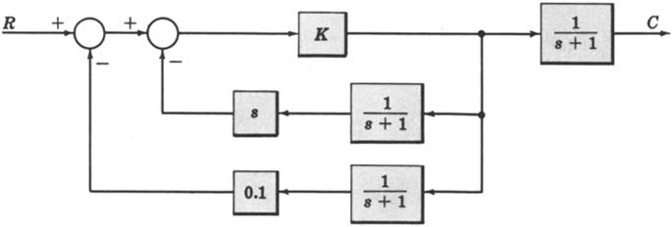
Example-7
For the system represented by the following block diagram determine:
Open loop transfer function
Feed Forward Transfer function
control ratio
feedback ratio
error ratio
closed loop transfer function
characteristic equation
closed loop poles and zeros if K=100.

Slide 25
Example-8
_
+
_
+
+
+

Slide 26
Example-8
_
+
+
+
_
+

Slide 27
Example-8
_
+
+
+
_
+

Slide 28
Example-8
_
+
_
+
+
+

Slide 29
block diagram: reduction example
_
+
_
+

Slide 30
block diagram: reduction example
_
+
_
+

Slide 31
block diagram: reduction example
+
_

Slide 32
Example 9
Find the transfer function of the following block diagram
R
(
s
)

Slide 33
Solution:
1. Moving pickoff point A ahead of block
2. Eliminate loop I & simplify

Slide 34
3. Moving pickoff point B behind block

Slide 35
4. Eliminate loop III

Slide 36
Example 10
Find the transfer function of the following block diagrams

Slide 37
Solution:
1. Eliminate loop I
2. Moving pickoff point A behind block
Not a feedback loop

Slide 38
3. Eliminate loop II

Slide 39
Example 11
Find the transfer function of the following block diagrams

Slide 40
Solution:
1. Moving pickoff point A behind block

Slide 41
2. Eliminate loop I and Simplify
feedback
Not feedback

Slide 42
3. Eliminate loop II & IIII

Slide 43
Example 12
Find the transfer function of the following block diagrams

Slide 44
Solution:
1. Moving pickoff point A behind block

Slide 45
2. Eliminate loop I & Simplify

Slide 46
3. Eliminate loop II

Slide 47
Example-13: Multiple Input System. Determine the output C due to inputs R and U using the Superposition Method.

Slide 48
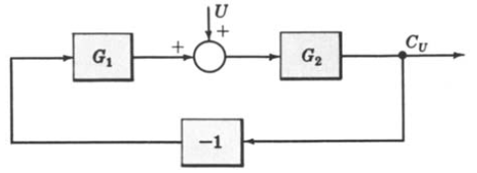
Example-13: Continue.

Slide 49
Example-13: Continue.

Slide 50
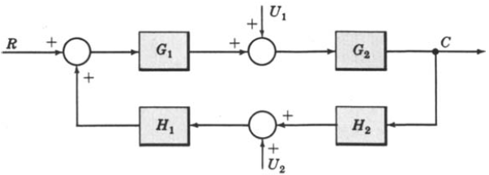
Example-14: Multiple-Input System. Determine the output C due to inputs R, U1 and U2 using the Superposition Method.

Slide 51
Example-14: Continue.

Slide 52
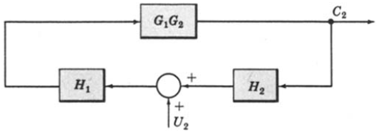
Example-14: Continue.

Slide 53
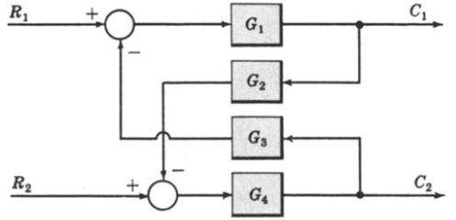
Example-15: Multi-Input Multi-Output System. Determine C1 and C2 due to R1 and R2.

Slide 54
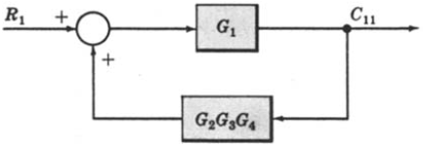
Example-15: Continue.

Slide 55
Example-15: Continue.
When R1 = 0,
When R2 = 0,

Slide 56
Block Diagram of Armature Controlled D.C Motor
R_{a}
L_{a}
c
i_{a}
V_{a}
e_{b}
T
J
ω
V_{f}=constant

Slide 57
Block Diagram of Armature Controlled D.C Motor

Slide 58
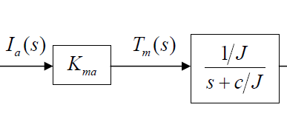
Block Diagram of Armature Controlled D.C Motor

Slide 59
Block Diagram of Armature Controlled D.C Motor

Slide 60
End of Lectures-8-9
To download this lecture visit
http://imtiazhussainkalwar.weebly.com/

