Slide 1
Control Systems (CS)
Lecture-7
Routh-Herwitz Stability Criterion
Dr. Imtiaz Hussain
Associate Professor
Mehran University of Engineering & Technology Jamshoro, Pakistan
email: imtiaz.hussain@faculty.muet.edu.pk
URL :http://imtiazhussainkalwar.weebly.com/
6th Semester 14ES (SEC-I)
Note: I do not claim any originality in these lectures. The contents of this presentation are mostly taken from the book of Ogatta, Norman Nise, Bishop and B C. Kuo and various other internet sources.

Slide 2
Routh-Hurwitz Stability Criterion
It is a method for determining continuous system stability.
The Routh-Hurwitz criterion states that “the number of roots of the characteristic equation with positive real parts is equal to the number of changes in sign of the first column of the Routh array”.

Slide 3
Routh-Hurwitz Stability Criterion
This method yields stability information without the need to solve for the closed-loop system poles.
Using this method, we can tell how many closed-loop system poles are in the left half-plane, in the right half-plane, and on the jw-axis. (Notice that we say how many, not where.)
The method requires two steps:
Generate a data table called a Routh table.
interpret the Routh table to tell how many closed-loop system poles are in the LHP, the RHP, and on the jw-axis.

Slide 4
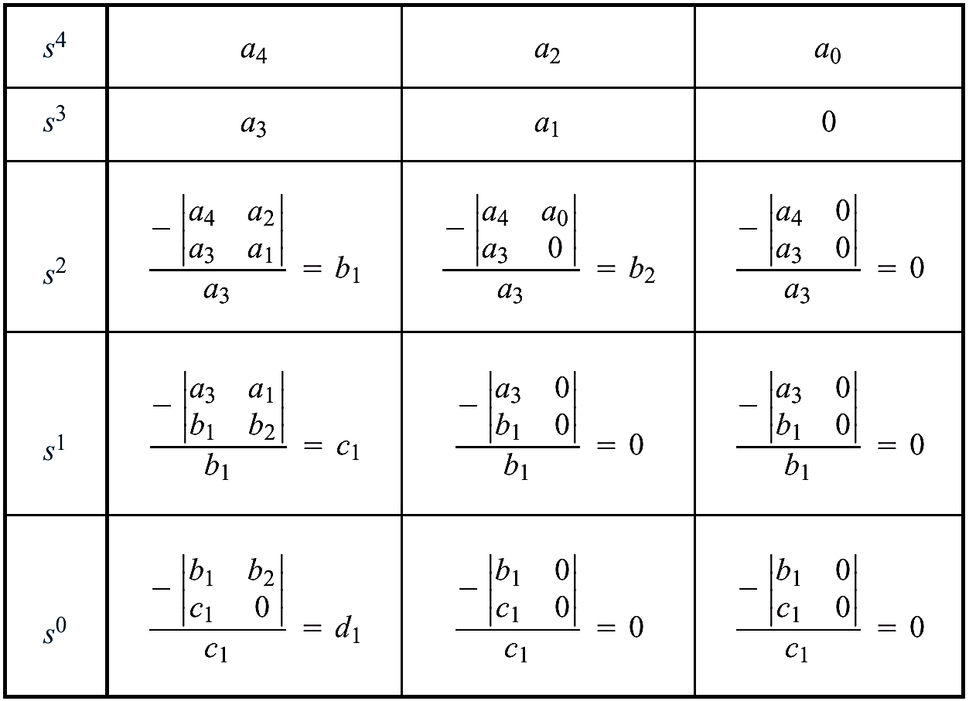
Example: Generating a basic Routh Table.
Only the first 2 rows of the array are obtained from the characteristic eq. the remaining are calculated as follows;

Slide 5
Four Special Cases or Configurations in the First Column Array of the Routh’s Table:
Case-I: No element in the first column is zero.
Case-II: A zero in the first column but some other elements of the row containing the zero in the first column are nonzero.
Case-III: Entire Row is zero

Slide 6
Case-I: No element in the first column is zero.

Slide 7
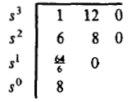
Example-1: Find the stability of the continues system having the characteristic equation of
The Routh table of the given system is computed as;
Since there are no sign changes in the first column of the Routh table, it means that all the roots of the characteristic equation have negative real parts and hence this system is stable.

Slide 8
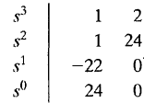
Example-2: Find the stability of the continues system having the characteristic polynomial of a third order system is given below
The Routh array is
Because TWO changes in sign appear in the first column, we find that two roots of the characteristic equation lie in the right hand side of the s-plane. Hence the system is unstable.

Slide 9
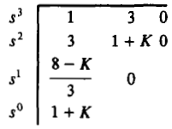
Example-3: Determine a rang of values of a system parameter K for which the system is stable.
The Routh table of the given system is computed and shown is the table below;
For system stability, it is necessary that the conditions 8 – k >0, and 1 + k > 0, must be satisfied. Hence the rang of values of a system parameter k must be lies between -1 and 8 (i.e., -1 < k < 8).

Slide 10
Example-4: Find the stability of the system shown below using Routh criterion.
The close loop transfer function is shown in the figure
The Routh table of the system is shown in the table
Because TWO changes in sign appear in the first column, we find that two roots of the characteristic equation lie in the right hand side of the s-plane. Hence the system is unstable.

Slide 11
Example-5: Find the stability of the system shown below using Routh criterion.
The Routh table of the system is
System is unstable because there are two sign changes in the first column of the Routh’s table. Hence the equation has two roots on the right half of the s-plane.

Slide 12
Case-II: A Zero Only in the First Column
There are TWO methods in case-II.
Stability via Epsilon Method.
Stability via Reverse Coefficients (Phillips, 1991).

Slide 13
Case-II: Stability via Epsilon Method
If the first element of a row is zero, division by zero would be required to form the next row.
To avoid this phenomenon, an epsilon, ε, (a small positive number) is assigned to replace the zero in the first column.
The value ε is then allowed to approach zero from either the positive or the negative side, after which the signs of the entries in the first column can be determined.

Slide 14
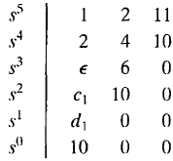
Case-II: Stability via Epsilon Method
Example-6: Determine the stability of the system having a characteristic equation given below;
The Routh array is shown in the table;
Where
There are TWO sign changes due to the large negative number in the first column,
Therefore the system is unstable, and two roots of the equation lie in the right half of the s-plane.

Slide 15
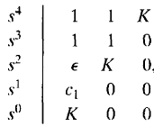
Example-7: Determine the range of parameter K for which the system is unstable.
The Routh array of the above characteristic equation is shown below;
Where
Therefore, for any value of K greater than zero, the system is unstable.
Also, because the last term in the first column is equal to K, a negative value of K will result in an unstable system.
Consequently, the system is unstable for all values of gain K.

Slide 16
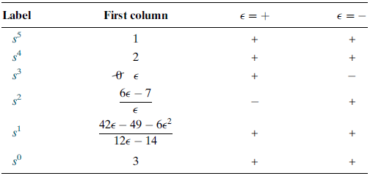
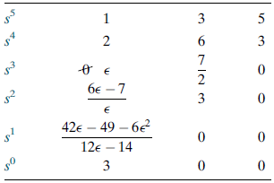
Example-8: Determine the stability of the of the closed-loop transfer function;
Table-1: The complete Routh table is formed by using the denominator of the characteristic equation T(s).
Table-2: shows the first column of Table-1 along with the resulting signs for choices of ε positive and ε negative.
A zero appears only in the first column (the s3 row).
Next replace the zero by a small number, ε, and complete the table.
Assume a sign, positive or negative, for the quantity ε.
When quantity ε is either positive or negative, in both cases the sign in the first column of Routh table is changes twice.
Hence, the system is unstable and has two poles in the right half-plane.

Slide 17
Case-II: Stability via Reverse Coefficients (Phillips, 1991).
A polynomial that has the reciprocal roots of the original polynomial has its roots distributed the same—right half-plane, left half plane, or imaginary axis—because taking the reciprocal of the root value does not move it to another region.
If we can find the polynomial that has the reciprocal roots of the original, it is possible that the Routh table for the new polynomial will not have a zero in the first column.
The polynomial with reciprocal roots is a polynomial with the coefficients written in reverse order.
This method is usually computationally easier than the epsilon method.

Slide 18
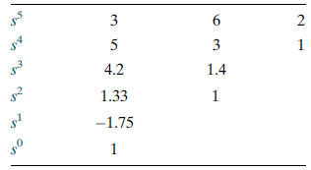
Example-9: Repeated example-8: Determine the stability of the closed-loop transfer function;
First write a polynomial that has the reciprocal roots of the denominator of T(s).
This polynomial is formed by writing the denominator of T(s) in reverse order. Hence,
The Routh table is
Since there are TWO sign changes, the system is unstable and has TWO right-half-plane poles.
This is the same as the result obtained in the previous Example.
Notice that Table does not have a zero in the first column.

Slide 19
Case-III: Entire Row is Zero.
Sometimes while making a Routh table, we find that an entire row consists of zeros.
This happen because there is an even polynomial that is a factor of the original polynomial.
This case must be handled differently from the case of a zero in only the first column of a row.

Slide 20
Example-10
Determine the number of right-half-plane poles in the closed-loop transfer function.
First we return to the row immediately above the row of zeros and form an auxiliary polynomial, using the entries in that row as coefficients.
Next we differentiate the polynomial with respect to s and obtain
Finally, we use the coefficients of above equation to replace the row of zeros. Again, for convenience, the third row is multiplied by 1/4 after replacing the zeros.

Slide 21
Example-10
The remainder of the table is formed in a straightforward manner by following the standard form .
All the entries in the first column are positive. Hence, there are no right–half-plane poles.

Slide 22
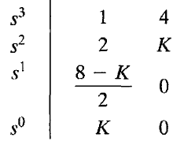
Example-11: Determine the stability of the system.
The characteristic equation q(s) of the system is
Where K is an adjustable loop gain. The Routh array is then;
For a stable system, the value of K must be;
When K = 8, the two roots exist on the jω axis and the system will be marginally stable.
Also, when K = 8, we obtain a row of zeros (case-III).
The auxiliary polynomial, U(s), is the equation of the row preceding the row of Zeros.
The U(s) in this case, obtained from the s² row.
The order of the auxiliary polynomial is always even and indicates the number of symmetrical root pairs.

Slide 23
Case-III: Entire Row is Zero
Let us look further into the case that yields an entire row of zeros.
An entire row of zeros will appear in the Routh table when a purely even or purely odd polynomial is a factor of the original polynomial.
For example, s⁴ + 5s² + 7 is an even polynomial; it has only even powers of s.
Even polynomials only have roots that are symmetrical about the origin.

Slide 24
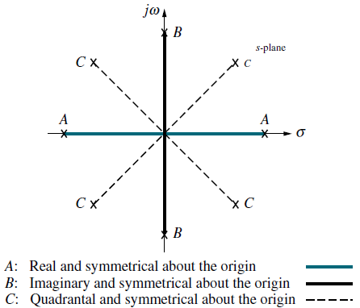
Case-III: Entire Row is Zero
This symmetry can occur under three conditions of root position:
The roots are symmetrical and real,
The roots are symmetrical and imaginary,
The roots are quadrantal.
Each case or combination of these cases will generate an even polynomial.

Slide 25
Case-III: Entire Row is Zero
The row of zeros tells us of the existence of an even polynomial whose roots are symmetric about the origin.
Some of these roots could be on the jw-axis.
On the other hand, since jw roots are symmetric about the origin, if we do not have a row of zeros, we cannot possibly have jw roots.
Another characteristic of the Routh table for this case is that the row previous to the row of zeros contains the even polynomial that is a factor of the original polynomial.
Finally, everything from the row containing the even polynomial down to the end of the Routh table is a test of only the even polynomial.

Slide 26
Example-12
For the transfer function tell how many poles are in the right half-plane, in the left half-plane, and on the jw-axis.

Slide 27
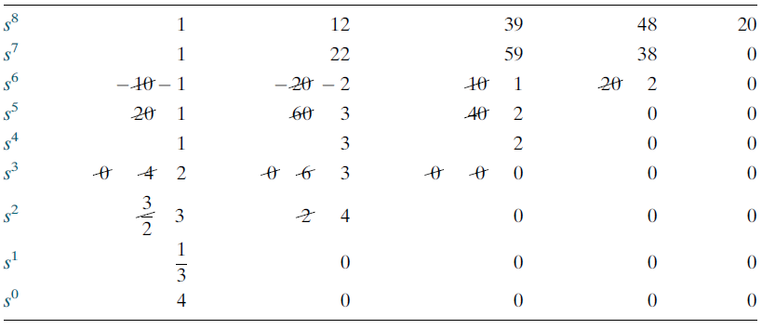
Example-12

Slide 28
Example-12

Slide 29
Example-12
How do we now interpret this Routh table? Since all entries from the even polynomial at the s⁴ row down to the s⁰ row are a test of the even polynomial, we begin to draw some conclusions about the roots of the even polynomial.
No sign changes exist from the s⁴ row down to the s⁰ row. Thus, the even polynomial does not have right–half-plane poles.
Since there are no right–half-plane poles, no left–half-plane poles are present because of the requirement for symmetry.
Hence, the even polynomial must have all four of its poles on the jw-axis.
These results are summarized in the following table.

Slide 30
End of Lecture-7
To download this lecture visit
http://imtiazhussainkalwar.weebly.com/

