Slide 1
Control Systems With Embedded Implementation (CSEI)
Lecture-6
Case Study: Microcontroller based Lag-Lead Control of Inverted Pendulum
Dr. Imtiaz Hussain
Assistant Professor
email: imtiaz.hussain@faculty.muet.edu.pk
URL :http://imtiazhussainkalwar.weebly.com/

Slide 2
Outline
Case Study-1: Inverted Pendulum

Slide 3
Introduction
The transfer function of the pendulum is given below
where R is the input position error and T is the output torque.
$ω_{n}=6.28 rad/sec$
$ζ=0.055$
$$\frac{T\left(s\right)}{R\left(s\right)}=\frac{1}{s^{2}+2ζω_{n}s−{ω_{n}}^{2}}$$
$$\frac{T\left(s\right)}{R\left(s\right)}=\frac{1}{s^{2}+0.69s−39.4}$$

Slide 4
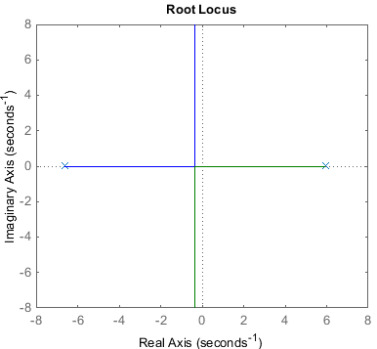
Root Locus of the System
-6.62
5.93
$$\frac{T\left(s\right)}{R\left(s\right)}=\frac{1}{s^{2}+0.69s−39.4}$$

Slide 5
Design Requirements
The desired parameters are:
Rise time of 0.5 seconds or less
Damping ratio of 0.32
Lag gain of 92
These parameters will be used as a guide to the design of a lead and lag compensator.

Slide 6
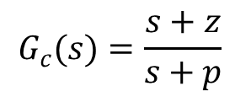
Lead Control
The lead compensator is of the form
where $z$ is the location of the lead zero and $p$ is the location of the lead pole.
The final design of the lead compensator is given below
$$G_{c}(s)=\frac{s+z}{s+p}$$
$$G_{c}(s)=\frac{s+7}{s+17.5}$$

Slide 7
Combined Response
The root locus of the plant transfer function with the effects of the lead compensator is shown in following figure.

Slide 8
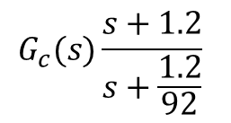
Lag Control
The pole and zero of the lag compensator should be close together so as not to cause the poles to shift right, which could cause instability or slow convergence.
Additionally, since their purpose is to affect the low frequency range they should be near zero
$$G_{c}(s)\frac{s+1.2}{s+\frac{1.2}{92}}$$

Slide 9
Lag-Lead Control
The root locus of the transfer function with the lead-lag compensator is show in Figure

Slide 10
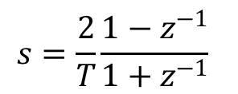
Discrete-time Transfer Function
Up to this point the entire controller design has been in continuous-time. However, the microcontroller only works in discrete-time.
Therefore the controller must be converted from continuous-time to discrete-time.
The Tustin method allows us to switch from continuous time to discrete time by substituting in the following equation for $s$,
$$s=\frac{2}{T}\frac{1−z^{−1}}{1+z^{−1}}$$

Slide 11
Error Calculation
The error is calculated by subtracting the current position from the desired position and then multiplying by a scale factor which includes the gain.
This value is then divided by the approximate maximum position which non-dimensionalized the error.
$$R=k\left(pos_{desired}−pos\right)\left(\frac{1000}{{pos}_{max}}\right)$$

Slide 12
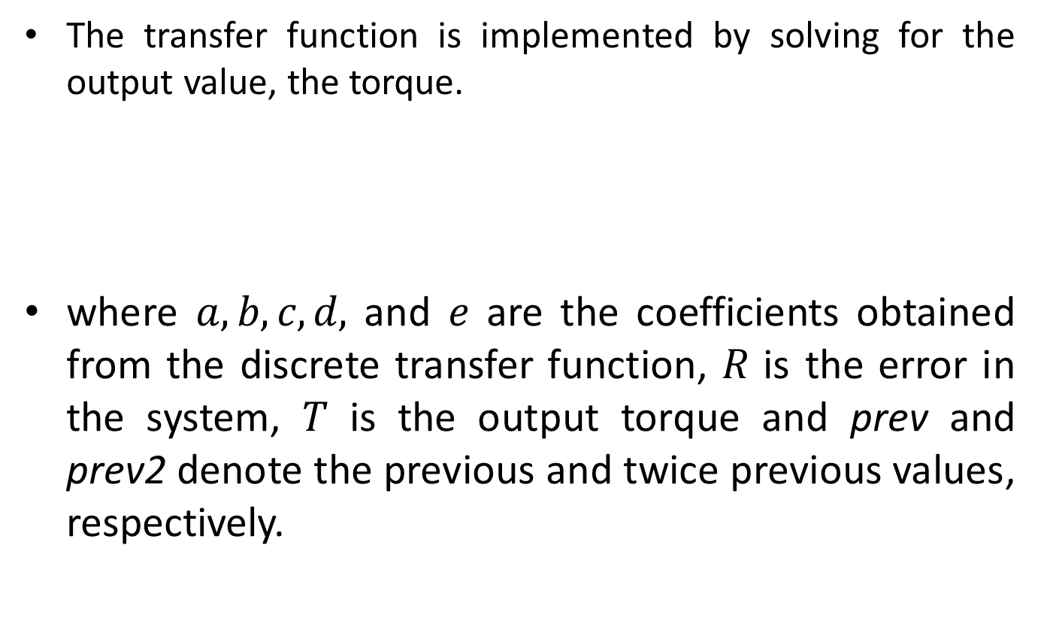
Transfer Function Implementation
The transfer function is implemented by solving for the output value, the torque.
where $a, b, c, d,$ and $e$ are the coefficients obtained from the discrete transfer function, $R$ is the error in the system, $T$ is the output torque and prev and prev2 denote the previous and twice previous values, respectively.
$$T=aR+bR_{prev}+cR_{prev2}+dT_{prev}+eT_{prev2}$$

Slide 13
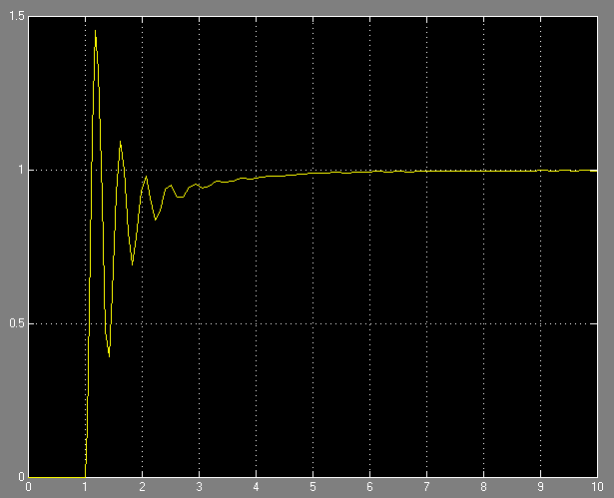
Simulation of Continuous time Model

Slide 14
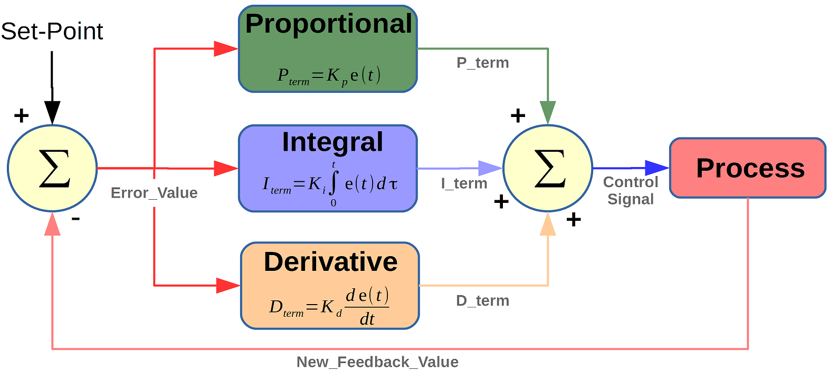
Analog PID Controller
$$e\left(t\right)$$
$$u\left(t\right)$$
$$u\left(t\right)=K\left[e\left(t\right)+\frac{1}{T_{i}}\int{e\left(t\right)dt}+T_{d}\frac{dr(t)}{dt}\right]$$

Slide 15
Digitally implemented PID Controller
$$U\left(z\right)=\left[\frac{\left(K_{p}+K_{i}+K_{d}\right)+\left(−K_{p}−2K_{d}\right)z^{−1}+K_{d}z^{−1}}{1−z^{−1}}\right]E(z)$$
$$u\left(k\right)=u\left[k−1\right]+K_{1}e\left[k\right]+K_{2}e\left[k−1\right]+K_{3}e\left[k−2\right]$$

Slide 16
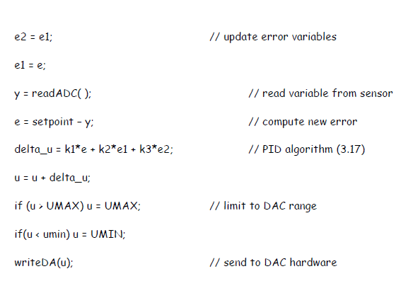
Digitally implemented PID Controller (Microcontrollers)
$$u\left(k\right)=u\left[k−1\right]+K_{1}e\left[k\right]+K_{2}e\left[k−1\right]+K_{3}e\left[k−2\right]$$

Slide 17
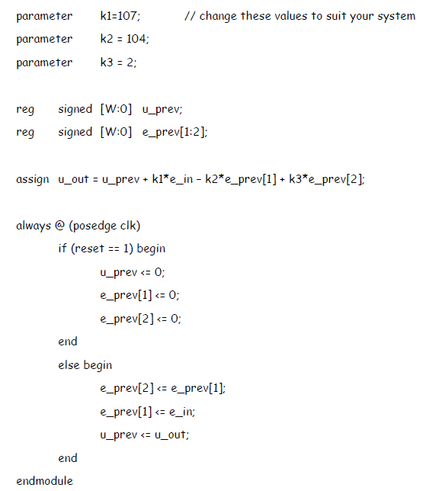
Digitally implemented PID Controller (CPLD or FPGA)
$$u\left(k\right)=u\left[k−1\right]+K_{1}e\left[k\right]+K_{2}e\left[k−1\right]+K_{3}e\left[k−2\right]$$

Slide 18
End of Lecture-6
To download this lecture visit
http://imtiazhussainkalwar.weebly.com/

