Slide 1
Power Electronics
Lecture-4
Diode Circuits
Dr. Imtiaz Hussain
Assistant Professor
email: imtiaz.hussain@faculty.muet.edu.pk
URL :http://imtiazhussainkalwar.weebly.com/

Slide 2
Lecture Outline
Snubber Circuits for Diode
Diode With RC
Diode with RL Load
Diode as a Rectifier
Single Phase Rectifiers
Three Phase Rectifiers

Slide 3
t_{RR} and I_{RR} Calculations
In practice, a design engineer frequently needs to calculate t_{RR} and I_{RR} .
This is in order to evaluate the possibility of high frequency switching.
As a thumb rule, the lower t_{RR} the faster the diode can be switched.
$$t_{RR}=t_{a}+t_{b}$$
In abrupt recovery diodes $t_{b}$ is negligible
Following expression can be used o calculate the reverse recovery time
where Q_{RR} is the storage charge and can be calculated from the area enclosed by the path of the recovery current.
Reverse Recovery current can be calculated as
$$t_{RR}=\sqrt{\frac{2Q_{RR}}{{di}/{dt}}}$$
$$I_{RR}=\sqrt{\frac{di}{dt}2Q_{RR}}$$

Slide 4
Example-1
The manufacturer of a selected diode gives the rate of fall of the diode current di/dt=20 A/μs, and its reverse recovery time t_{rr} =5μs. What value of peak reverse current do you expect?
SOLUTION. The peak reverse current is given as:
$$I_{RR}=\sqrt{\frac{di}{dt}2Q_{RR}}$$
The storage charge Q_{RR} is calculated as:
$$t_{RR}=\sqrt{\frac{2Q_{RR}}{{di}/{dt}}}$$

Slide 5
Example-1 (contd…)
$$t_{RR}=\sqrt{\frac{2Q_{RR}}{{di}/{dt}}}$$
$$Q_{RR}=\frac{1}{2}\frac{di}{dt}t_{RR}^{2}$$
$$Q_{RR}=\frac{1}{2}×\frac{20A}{μs}×\left(5×{10}^{−6}\right)$$
$$Q_{RR}=50μC$$
Hence,
$$I_{RR}=\sqrt{\frac{di}{dt}2Q_{RR}}$$
$$I_{RR}=\sqrt{\frac{20A}{μs}2×50μC}$$
$$I_{RR}=44.72 A$$

Slide 6
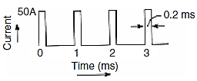
Example-2
The current waveform passing through a diode switch in a switch mode power supply application is shown in following figure. Find the average, rms, and the peak current.
SOLUTION. The current pulse duration is shown to be 0.2 ms within a period of 1 ms and with a peak amplitude of 50 A. Hence the required currents are:
$$I_{av}=50×\frac{0.2}{1}=10A$$
$$I_{RMS}=\sqrt{{50}^{2}×\frac{0.2}{1}}=22.36A$$
$$I_{pk}=50A$$

Slide 7
Snubbers
In general, snubbers are used for:
turn-on: to minimise large overcurrents through the device at turn-on
turn-off: to minimise large overvoltages across the device during turn-off.
Stress reduction: to shape the device switching waveform such that the voltage and current associated with the device are not high simultaneously.
Switches and diodes requires snubbers. However, new generation of IGBT, MOSFET and IGCT do not require it.

Slide 8
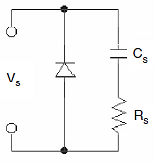
Snubber Circuits for Diode
Snubber circuits are essential for diodes used in switching circuits.
It can save a diode from overvoltage spikes, which may arise during the reverse recovery process.
A very common snubber circuit for a power diode consists of a capacitor and a resistor connected in parallel with the diode as shown in following figure.

Slide 9
Snubber Circuits for Diode
When the reverse recovery current decreases, the capacitor by virtue of its property will try to hold the voltage across it, which, approximately, is the voltage across the diode.
The resistor on the other hand will help to dissipate some of the energy stored in the inductor, which forms the I_{RR} loop. The dv/dt across a diode can be calculated as:
$$v=\frac{1}{C_{s}}\int{idt}$$
$$v=\frac{1}{C_{s}}\int{\frac{0.632×V_{s}}{R_{s}}dt}$$
$$\frac{dv}{dt}=\frac{0.632×V_{s}}{R_{s}C_{s}}$$

Slide 10
Snubber Circuits for Diode
$$\frac{dv}{dt}=\frac{0.632×V_{s}}{R_{s}C_{s}}$$
Usually the dv/dt rating of a diode is given in the manufacturers datasheet. Knowing dv/dt and the R_{S} , one can choose the value of the snubber capacitor C_{S}.
The R_{S} can be calculated from the diode reverse recovery current:
The designed dv/dt value must always be equal or lower than the dv/dt value found from the datasheet.
$$R_{s}=\frac{V_{s}}{I_{RR}}$$

Slide 11
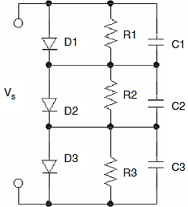
Series and Parallel Connection of Power Diodes
For specific applications, when the voltage or current rating of a chosen diode is not enough to meet the designed rating, diodes can be connected in series or parallel.
Connecting them in series will give the structure a high voltage rating that may be necessary for high-voltage applications.

Slide 12
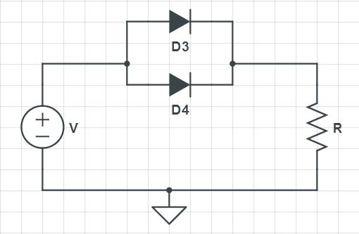
Series and Parallel Connection of Power Diodes
If a selected diode cannot match the required current rating, one may connect several diodes in parallel.
In order to ensure equal current sharing, the designer must choose diodes with the same forward voltage drop properties.

Slide 13
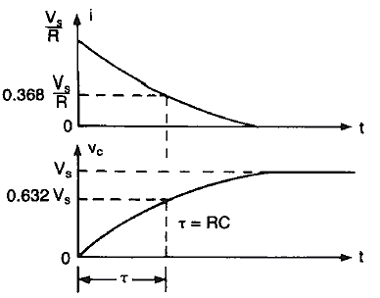
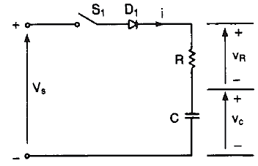
Diode With RC Load
Following Figure shows a diode with RC load.
When switch S₁ is closed at t=0, the charging current that flows through the capacitor and voltage drop across it are found from
$$i\left(t\right)=\frac{V_{s}}{R}e^{{−t}/{RC}}$$
$$v_{c}=V_{s}\left(1−e^{{−t}/{RC}}\right)$$

Slide 14
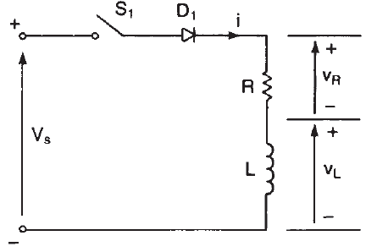
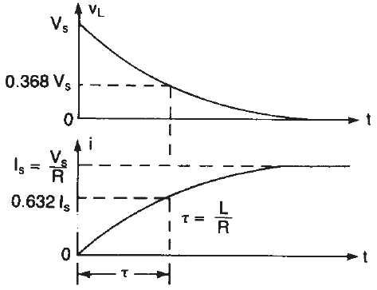
Diode With RL Load
Following Figure shows a diode with RL load.
When switch S₁ is closed at t=0, the current through the inductor is increased
$$V_{s}=v_{L}+v_{R}$$
$$V_{s}=L\frac{di}{dt}+Ri$$
$$i=\frac{V_{s}}{R}\left(1−e^{{−tR}/L}\right)$$

Slide 15
Diode With RL Load
The waveform shows when t>>T, the voltage across inductor tends to be zero and its current reaches maximum value.
If an attempt is made to open S₁ energy stored in inductor (=0.5Li²) will be transformed into high reverse voltage across diode and switch.

Slide 16
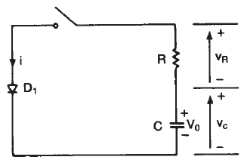
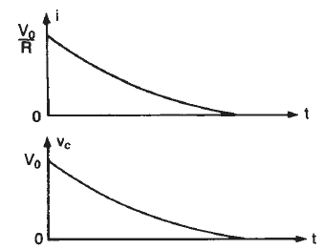
Example#3
A diode circuit is shown in figure, with R=44Ω and C=0.1μF. The capacitor has an initial voltage V_{o}=220 v. If S₁ is closed at t=0 determine:
Peak Diode Current
Energy Dissipated in resistor
Capacitor voltage at t=2 μs

Slide 17
Example#3
A diode circuit is shown in figure, with R=44Ω and C=0.1μF. The capacitor has an initial voltage V_{o}=220 v. If S₁ is closed at t=0 determine:
Peak Diode Current
Energy Dissipated in Resistor
$$I_{P}=\frac{V_{o}}{R}$$
$$I_{P}=\frac{220}{44}=5 A$$
$$E=\frac{1}{2}CV_{o}^{2}=2.42×{10}^{−3}J$$

Slide 18
Example#3
A diode circuit is shown in figure, with R=44Ω and C=0.1μF. The capacitor has an initial voltage V_{o}=220 v. If S₁ is closed at t=0 determine:
Capacitor voltage at t=2 μs
$$RC=0.1μ×44=4.4μs$$
$$v_{c}=V_{s}e^{{−t}/{RC}}$$
$$v_{c}\left(@t=2μs\right)=220×e^{{−2}/{4.4}}$$
$$v_{c}\left(@t=2μs\right)=139.7V$$

Slide 19
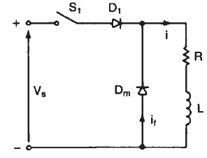
Freewheeling Diode
If switch S₁ is closed a current is established through the load, and then, if the switch is open, a path must be provided for the current in the inductive load.
This is normally done by connecting a diode D_{m}, called a freewheeling diode.

Slide 20
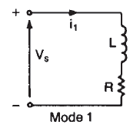
Freewheeling Diode
The circuit operation is divided into two modes.
Mode 1 begins when the switched is closed.
During this mode the current voltage relation is
$$i_{1}=\frac{V_{s}}{R}\left(1−e^{{−tR}/L}\right)$$
$$V_{s}=L\frac{di_{1}}{dt}+Ri_{1}$$

Slide 21
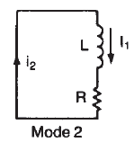
Freewheeling Diode
Mode 2 starts when the S₁ is opened and the load current starts to flow through D_{m}.
$$0=L\frac{di_{2}}{dt}+Ri_{2}$$
$$i_{2}={i_{1}^{}e}^{{−tR}/L}$$

Slide 22
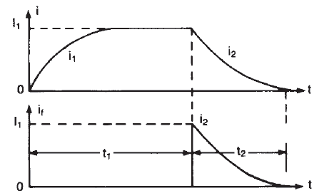
Freewheeling Diode
The waveform of the entire operation is given below.
S₁ Closed
S₁ Open

Slide 23
Rectification
Converting AC (from mains or other AC source) to DC power by using power semiconductor devices is called rectification.
Two Categories
Uncontrolled Rectifiers
Controlled Rectifiers

Slide 24
Properties of an Ideal Rectifier
It is desired that the rectifier present a resistive load to the ac power system.
This leads to
Unity power factor
ac line current has same wave shape as voltage
An ideal rectifier should have η = 100%, V_{ac} = 0, RF = 0, TUF = 1, HF = THD = 0, and PF = PDF = 1.

Slide 25
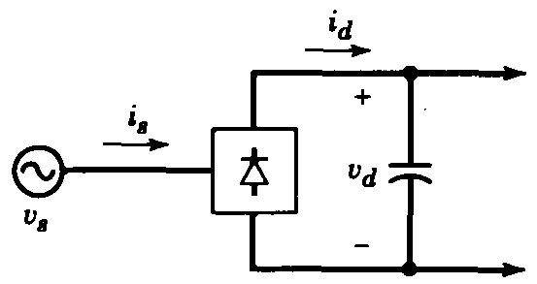
Uncontrolled Rectifiers
In most power Electronic systems, the power input is in the form of a 50Hz or 60Hz sine wave ac voltage.
The general trend is to use inexpensive diode rectifiers to convert ac into dc in an uncontrolled manner.

Slide 26
Rectifier Performance Parameters
Parameter | Equation
Efficiency ($η$) | $$η=\frac{P_{odc}}{P_{orms}}=\frac{V_{odc}I_{odc}}{V_{orms}I_{orms}}$$
Form Factor (FF) | $$FF=\frac{V_{orms}}{V_{odc}}$$
Crest Factor (CF) | $$CF=\frac{V_{omax}}{V_{orms}}$$
Ripple Factor (RF) | $$RF=\frac{V_{oac}}{V_{odc}}=\frac{\sqrt{V_{orms}^{2}−V_{odc}^{2}}}{V_{odc}}=\sqrt{\frac{V_{orms}^{2}−V_{odc}^{2}}{V_{odc}^{2}}}=\sqrt{{FF}^{2}−1}$$

Slide 27
Rectifier Performance Parameters
Parameter | Equation
Transformer Utilization Factor (TUF) | $$TUF=\frac{P_{odc}}{P_{ac(rated)}}=\frac{P_{odc}}{V_{s}I_{s}}=\frac{V_{odc}I_{odc}}{V_{s}I_{s}}$$
Power Factor (PF) | $$PF=\frac{P_{R}}{P_{rms}}=\frac{V_{rms}I_{rms}\cos{∅}}{V_{rms}I_{rms}}$$
Peak Inverse Voltage (PIV) | $$PIV=V_{m}$$
Total Harmonic Distortion (THD)

Slide 28
Transformer Utilization Factor (TUF)
The transformer utilization factor (TUF), which is a measure of the merit of a rectifier circuit, is defined as the ratio of the dc output power to the transformer volt–ampere (VA) rating required by the secondary winding
where V_{s} and I_{s} are the rms voltage and rms current ratings of the secondary transformer.
$$TUF==\frac{P_{odc}}{P_{ac(rated)}}=\frac{P_{odc}}{V_{s}I_{s}}=\frac{V_{odc}I_{odc}}{V_{s}I_{s}}$$

Slide 29
Peak Inverse Voltage (PIV)
Peak inverse voltage is an important parameter in the design of rectifiers.
PIV is the maximum voltage that appears across the diode during its blocking state.

Slide 30
Total Harmonic Distortion (THD)
This is a measure of the distortion of a waveform, which characterized the difference between the total rms ac current ( secondary current I_{s}) and fundamental component of ac source current (I_{s1}), which can be defined by decomposing the secondary current into Fourier series.
In the case of pure sinusoidal source current I_{s}=I_{s1}, therefore HF=0.

Slide 31
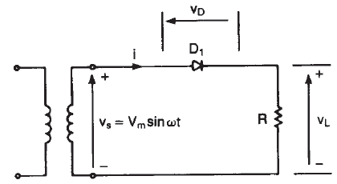
Single Phase Half Wave Uncontrolled Rectifier
A single Phase half wave rectifier is the simplest type and is not normally used in industrial or domestic applications.

Slide 32
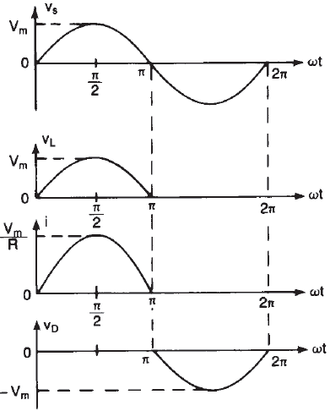
Single Phase Half Wave Rectifier
Although output voltage is D.C, it is discontinuous and contains Harmonics.

Slide 33
1-Phase Half Wave Rectifier Performance Parameters
Voltage Relationships
Average Value of Load voltage ($V_{odc}$)
RMS value of Load Voltage ($V_{orms}$)
$$V_{odc}=\frac{1}{2π}\int_{0}^{π}{V_{m}\sin{ωt}dωt=\frac{V_{m}}{π}}$$
$$V_{orms}=\sqrt{\frac{1}{2π}\int_{0}^{π}{V_{m}^{2} \sin^{2}ωt}dωt}=\frac{V_{m}}{2}$$

Slide 34
1-Phase Half Wave Rectifier Performance Parameters
Current Relationships
Average Value of Load Current ($I_{odc}$)
RMS value of Load Current ($I_{orms}$)
Load and Diode Currents
$$I_{odc}=\frac{V_{odc}}{R}=\frac{V_{m}}{πR}$$
$$I_{orms}=\frac{V_{orms}}{R}=\frac{V_{m}}{2R}$$
$$I_{s}=I_{L}=I_{D}=I_{orms}=\frac{V_{m}}{2R}$$

Slide 35
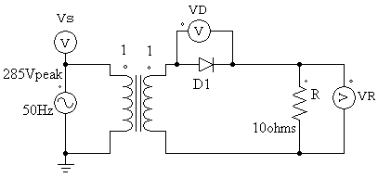
Example 4: The rectifier shown in figure has a pure resistive load of 10Ω. Determine (a) The efficiency, (b) Form factor (c) Crest Factor (d) Ripple factor (e) Transformer Utilization Factor (f) PIV
.
Solution

Slide 36
Example-4
(a) Efficiency
(c) Crest Factor
(b) Form Factor
(d) Ripple Factor

Slide 37
Example-4
(e) Transformer Utilization Factor
$$TUF=\frac{P_{odc}}{V_{s}I_{s}}=\frac{V_{odc}I_{odc}}{V_{s}I_{s}}$$
$$TUF=\frac{90.7×9.07}{0.707V_{m}×14.25}=0.286$$
The poor TUF of a half-wave rectifier signifies that the transformer employed must have a 3.496 (1/0.286) VA rating in order to deliver 1W dc output power to the load.
If the transformer rating is 1 KVA (1000VA) then the half-wave rectifier can deliver 1000 X0.287 = 287 watts to resistance load.
In addition, the transformer secondary winding has to carry a dc current that may cause magnetic core saturation.
As a result, half-wave rectifiers are used only when the current requirement is small.
.

Slide 38
Example-4
(f) Peak Inverse Voltage (PIV)
$$PIV=V_{m}$$
$$PIV=285V$$
.

Slide 39
Example-4(Conclusion)
Taking into account the obtained rectifier parameters we conclude that this type of rectifier is characterized with bad parameters presented by :
Low (poor) transform utilization 28.6%, which means that the transformer must be 1/0.286=3.49 times larger that when it is used to deliver power from a pure ac voltage.
Low ( poor) rectification efficiency = 40.5%
Presence of current dc component in the secondary current causing additional losses ( winding and core heating).
High ripple factor (1.21), which means that a filter with large capacitance is required for smoothing the output voltage, therefore this yield high capacitor starting current problem.
Therefore this type of rectifier is rarely used due to the weakness in quality of it's power and signal parameters.

Slide 40
Exercise#1
A diode whose internal resistance is 20Ω is to supply power to a 100Ω load from 110V(rms) ac source. Calculate (a) peak load current (b) the dc load current (c) the rms load current (d) TUF (e) TUF when R_{f}=0Ω (f) Conclusion.
Solution:
Given a half-wave rectifier circuit R_{f} =20Ω, R_{L}=100Ω
Given an ac source with rms voltage of 110V
Therefore the maximum amplitude of sinusoidal input is given by
$$V_{m}=\sqrt{2}{ V}_{rms}=1.41×110=155.56V$$
(a) Peak load current ($I_{m}$)
$$I_{m}=\frac{V_{m}}{R_{f}+R_{L}}=\frac{155.56}{20+100}=1.29A$$

Slide 41
Exercise#1
(b) the dc load current ($I_{odc}$)
(c) the rms load current ($I_{orms}$)
$$I_{odc}=\frac{I_{m}}{π}=0.41A$$
$$I_{orms}=\frac{I_{m}}{2}=0.645A$$
(d) TUF
$$TUF=\frac{P_{odc}}{V_{s}I_{s}}=\frac{V_{odc}I_{odc}}{V_{s}I_{s}}$$
$$TUF=\frac{(I_{odc}×R_{L})×0.41}{110×0.645}$$
$$TUF=\frac{(0.41×100)×0.41}{110×0.645}=0.23$$

Slide 42
Exercise#1
(e) TUF when $R_{f}=0Ω$
$$I_{m}=\frac{V_{m}}{R_{L}}=\frac{155.56}{100}=1.55A$$
$$I_{odc}=\frac{I_{m}}{π}=0.49A$$
$$I_{orms}=\frac{I_{m}}{2}=0.775A$$
$$TUF=\frac{V_{odc}I_{odc}}{V_{s}I_{s}}$$
$$TUF=\frac{(I_{odc}×R_{L})×0.49}{110×0.775}$$
$$TUF=\frac{(0.49×100)×0.49}{110×0.775}=0.28$$

Slide 43
Exercise#2
An AC supply of 230V rms is applied to a half wave rectifier circuit through a transformer of turn ratio 5:1. Assume the diode is an ideal one. The load resistance is 300Ω.
Find
(a) peak load current
(b) the dc load current
(c) the rms load current
(d) TUF
(e) PIV
(f) FF
(g) RF
(h) power delivered to load

Slide 44
Half Wave Diode Rectifier With R-L Load
When a rectifier supply power to RL load, the conduction period of the diode D₁ will extend beyond 180º until the current becomes zero at $ωt=π+σ$.
The diode will conduct in the negative half cycle for the time of $σ$, therefore the average output voltage decreases due to load inductance.

Slide 45
Half Wave Diode Rectifier With R-L Load
The average output voltage is given by
$$V_{odc}=\frac{V_{m}}{2π}\int_{0}^{π+σ}{\sin{ωt} dωt}$$
$$V_{odc}=\frac{V_{m}}{2π}{\left[−\cos{ωt}\right]}_{0}^{π+σ}$$
$$V_{odc}=\frac{V_{m}}{2π}\left[1−\cos{(π+σ)}\right]$$
$$where, σ=\tan^{−1}{\frac{ωL}{R}}$$
The average output current is given by
$$I_{odc}=\frac{V_{odc}}{R}$$

Slide 46
Half Wave Diode Rectifier With R-L Load
The addition of a freewheeling diode
$$V_{dc}=\frac{V_{m}}{2π}\left[1−\cos{(π+σ)}\right]$$
The average dc voltage varies proportionately to [1 - cos(π + σ)].
This can be made maximum by decreasing σ (ideally σ = 0 ).
We can make σ = 0 with the addition of a freewheeling diode given by D_{m} as shown with the dotted line.

Slide 47
Single Phase Full Wave Rectifier
A full-wave rectifier converts an ac voltage into a pulsating dc voltage using both half cycles of the applied ac voltage.
In order to rectify both the half cycles of ac input, two diodes are used in this circuit. Both diodes feed a common load With the help of a center-tap transformer.
A center-tap transformer is the one which produces two sinusoidal waveforms of same magnitude and frequency but out of phase with respect to the ground in the secondary winding of the transformer.

Slide 48
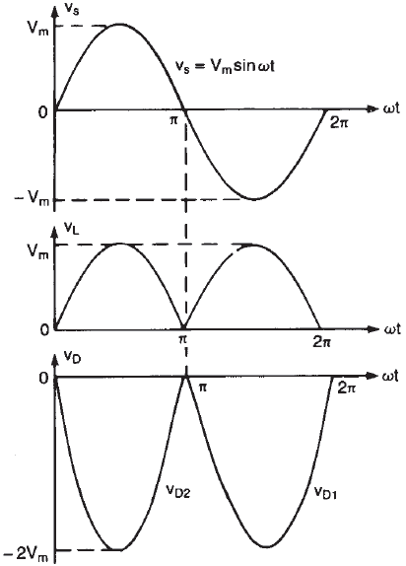
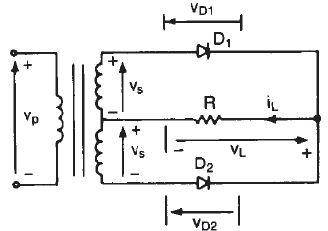
Single Phase Full Wave Rectifier
Each half of the transformer with its associated acts as a half wave rectifier.

Slide 49
$$PIV={2V}_{m}$$

Slide 50
Example 5. The rectifier in shown in figure has a purely resistive load of R Determine (a) The efficiency, (b) Form factor (c) Ripple factor (d) Crest Factor (e) TUF (f) PIV
2:1
V_{m}=220v
10Ω

Slide 51
Example-5

Slide 52
Example-5
The average TUF in centre-tap full-wave rectifying circuit is determined by considering the primary and secondary winding separately.
There are two secondary windings here. Each secondary is associated with one diode. This is just similar to secondary of half-wave rectifier. Each secondary has TUF as 0.287.
$${TUF}_{P}=\frac{P_{0dc}}{P_{ac(rated)}}=\frac{70.06×7}{0.707V_{m}×7.77}=0.81$$
$${TUF}_{av}=\frac{{TUF}_{P}+{TUF}_{s}+{TUF}_{s}}{3}=0.693$$

Slide 53
Exercise-3
A Full-Wave rectifier circuit is fed from a transformer having a center-tapped secondary winding. The rms voltage from end of secondary to center tap is 30V. if the diode forward resistance is 5Ω and that of the secondary is 10Ω for a load of 900Ω, Calculate:
Power delivered to load
Ripple Factor
3. Efficiency at full-load
4. TUF

Slide 54
Exercise-4
A Full-wave rectifier circuit uses two silicon diodes with a forward resistance of 20Ω each. A dc voltmeter connected across the load of 1kΩ reads 55.4volts. Calculate
Rms value of load current
Average voltage across each diode
Ripple factor
Transformer secondary voltage rating

Slide 55
Exercise-5
A 230V, 60Hz voltage is applied to the primary of a 5:1 step down, center tapped transformer used in the Full-wave rectifier having a load of 900Ω. If the diode resistance and the secondary coil resistance together has a resistance of 100Ω. Determine:
dc voltage across the load
dc current flowing through the load
dc power delivered to the load
ripple factor

Slide 56
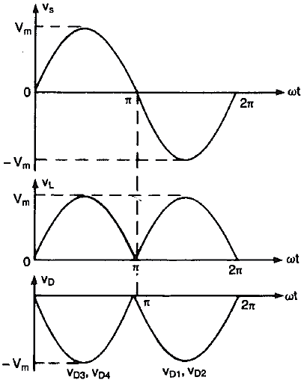
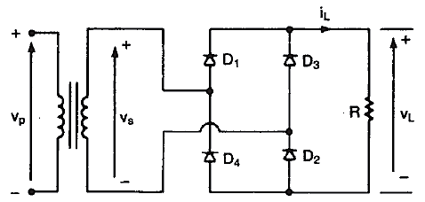
Single Phase Full Wave Bridge Rectifier
Instead of using centre-tapped transformer we could use four diodes.

Slide 57
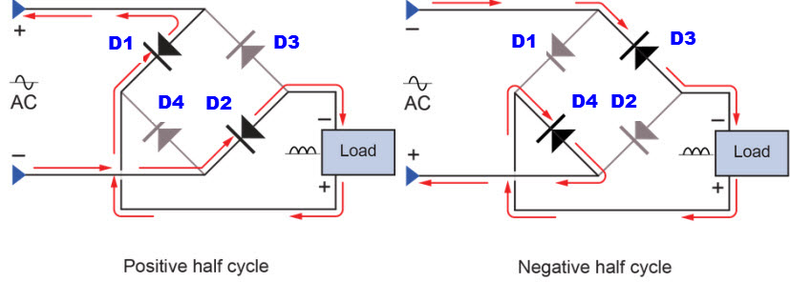
Single Phase Full Wave Bridge Rectifier

Slide 58
Single Phase Full Wave Bridge Rectifier
Advantages of Bridge rectifier circuit:
No center-tapped transformer is required
The TUF is considerably high
PIV is reduced across the diode.
Disadvantages of Bridge rectifier circuit:
The only disadvantage of bridge rectifier is the use of four diodes as compared to two diodes for center-tapped FWR.
This reduces the output voltage

Slide 59
Example 6 single-phase diode bridge rectifier has a purely resistive load of R=15 ohms and, VS=300 sin ωt and unity transformer ratio. Determine (a) The efficiency, (b) Form factor, (c) Ripple factor, (d) Input power factor.
The PIV=300V
Input power factor =

Slide 60
Exercise-6
A bridge rectifier uses four identical diodes having forward resistance of 5Ω and the secondary voltage of 30V (rms). Determine the dc output voltage for I_{DC}=200mA and the value of the ripple voltage.

Slide 61
Exercise-7
In a bridge rectifier the transformer is connected to 220V, 60Hz mains and the turns ratio of the step down transformer is 11:1. Assuming the diode to be ideal, find:
I_{dc}
voltage across the load
PIV assume load resistance to be 1kΩ

Slide 62
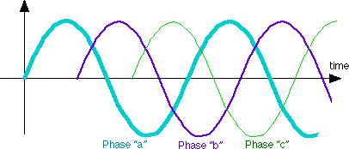
Three Phase Supply
4 wires
3 “active” phases, A, B, C
1 “ground”, or “neutral”
Color Code
Phase A Red
Phase B Black
Phase C Blue
Neutral White or Gray
Three phase voltages with respect to Neutral.
$$v_{b}=V_{m}\sin\left(ω_{o}t−\frac{2π}{3}\right)$$
$$v_{c}=V_{m}\sin\left(ω_{o}t−\frac{4π}{3}\right)$$
$$v_{a}=V_{m}\sin{ω_{o}t}$$

Slide 63
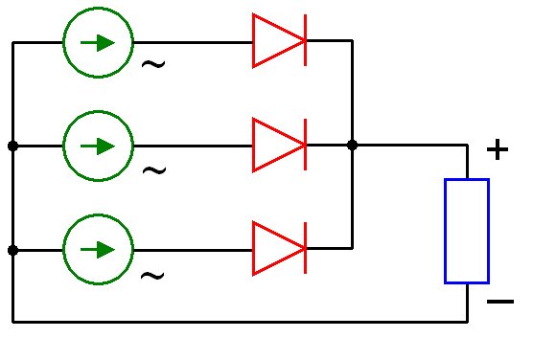
Three Phase Half Wave Rectifier
$$v_{a}$$
$$v_{b}$$
$$N$$
$$v_{c}$$

Slide 64
Three Phase Half Wave Rectifier
Average output voltage for one pulse (120º or $\frac{2π}{3}$) is given as
Similarly rms value of load voltage for one pulse is given as
Peak Inverse Voltage of Diode is given as

Slide 65
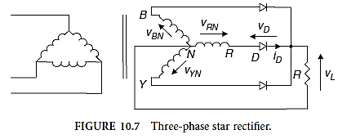
Example 7 The rectifier shown in following figure is operated from 460 V 50 Hz rms supply at secondary side and the load resistance is R=20 Ω. If the source inductance is negligible, determine (a) Rectification efficiency, (b) Form factor (c) Ripple factor (d) Crest Factor (e) Peak inverse voltage (PIV) of each diode.

Slide 66
Example-7
Phase to neutral voltage is given by
Peak voltage now can be calculated as
Average value of load voltage and current now can be calculated as

Slide 67
Example-7
RMS value of load voltage and current
(a) Rectifier efficiency

Slide 68
Example-7
(b) Form Factor
(c) Ripple Factor
(d) Crest Factor
(e) PIV

Slide 69
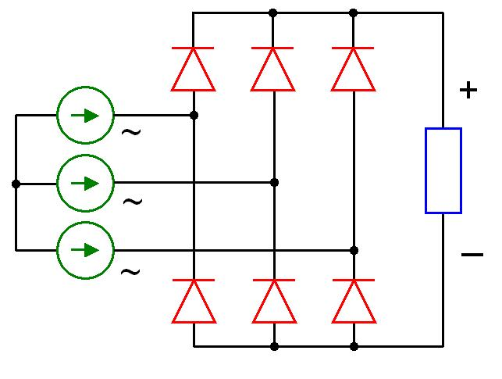
Three Phase Bridge Rectifier
Three Phase bridge rectifier is very common in high power applications because they have the highest possible transformer utilization factor for a three-phase system.
It can operate with or without transformer and give six-pulse ripple on the out.
Diodes D₁, D₃, D₅ will conduct when the supply voltage is most positive.
Diodes D₂, D₄, D₆ will conduct when the supply voltage is most negative.
$$D_{1}$$
$$D_{3}$$
$$D_{5}$$
$$v_{a}$$
$$N$$
$$v_{b}$$
$$v_{c}$$
$$D_{2}$$
$$D_{4}$$
$$D_{6}$$

Slide 70
1 cycle
$$D_{5}$$
$$D_{1}$$
$$D_{3}$$
$$D_{5}$$
$$D_{1}$$
$$D_{4}$$
$$D_{6}$$
$$D_{2}$$
$$D_{4}$$
$$D_{6}$$
At instant marked 1, diode D₄ is already on and the conduction of diode D₅ stops and that of D₁ begins. The magnitude of load voltage $V_{1}$ at instant 1 is then given by
At instant marked 2, the magnitude of load voltage $V_{2}$ is given by
$$V_{1}=V_{m}\sin{30°}+V_{m}\sin{90°}{=1.5V}_{m}$$
$$V_{2}=V_{m}\sin{60°}+V_{m}\sin{120°=\sqrt{3}V_{m}}$$

Slide 71
$$D_{5}$$
$$D_{1}$$
$$D_{3}$$
$$D_{5}$$
$$D_{1}$$
$$D_{4}$$
$$D_{6}$$
$$D_{2}$$
$$D_{4}$$
$$D_{6}$$
$$\sqrt{3}V_{m}$$
$${1.5V}_{m}$$

Slide 72
Three Phase Bridge Rectifier
Average output voltage for one pulse (60º or $\frac{2π}{6}$) is given as
Similarly rms value of load voltage for one pulse is given as
Peak Inverse Voltage of Diode is given as

Slide 73
Example 8 The 3-phase bridge rectifier is operated from 460 V 50 Hz supply and the load resistance is R=20ohms. If the source inductance is negligible, determine (a) The efficiency, (b) Form factor (c) Ripple factor (d) Crest Factor (e) Peak inverse voltage (PIV) of each diode .

Slide 74
Example-8
(a) The efficiency
(b) Form factor
(c) Ripple factor
(d) Crest Factor
(e) Peak inverse voltage (PIV) of each diode

Slide 75
Comparison of Diode Rectifiers
Performance Parameters | Single Phase Half Wave Rectifier | Single Phase full Wave (Centre Tap) | Single phase full Wave (Bridge) | 3 Phase Star Rectifier | 3 Phase Bridge Rectifier
Efficiency (%) | 40.5 | 81 | 81 | 96.7 | 99.83
Form Factor | 1.57 | 1.11 | 1.11 | 1.01 | 1
Ripple Factor | 1.21 | 0.48 | 0.48 | 0.18 | 0.04
TUF (%) | 28.6 | 69.3 | 81.2 | 66.42 | 95.42
PIV | $$V_{m}$$ | $${2V}_{m}$$ | $$V_{m}$$ | $${\sqrt{3}V}_{m}$$ | $${\sqrt{3}V}_{m}$$
Crest Factor | 2 | 1.414 | 1.414 | 1.19 | 1.04

Slide 76
End of Lecture-4
To download this lecture visit
http://imtiazhussainkalwar.weebly.com/

