Slide 1
Modern Control Systems (MCS)
Lecture-41-42
Design of Control Systems in Sate Space
Quadratic Optimal Control
Dr. Imtiaz Hussain
email: imtiaz.hussain@faculty.muet.edu.pk
URL :http://imtiazhussainkalwar.weebly.com/

Slide 2
Outline
Introduction
Quadratic Cost Function
Optimal Control System based on Quadratic Performance Index
Optimization by Second Method of Liapunov
Quadratic Optimal Control
  Examples

Slide 3
Introduction
Optimization is the selection of a best element(s) from some set of available alternatives.
In control Engineering, optimization means minimizing a cost function by systematically choosing parameter values from within an allowed set of tunable parameters.
A cost function or loss function or performance index is a function that maps an event or values of one or more variables onto a real number intuitively representing some "cost" associated with the event (e.g. error function).

Slide 4

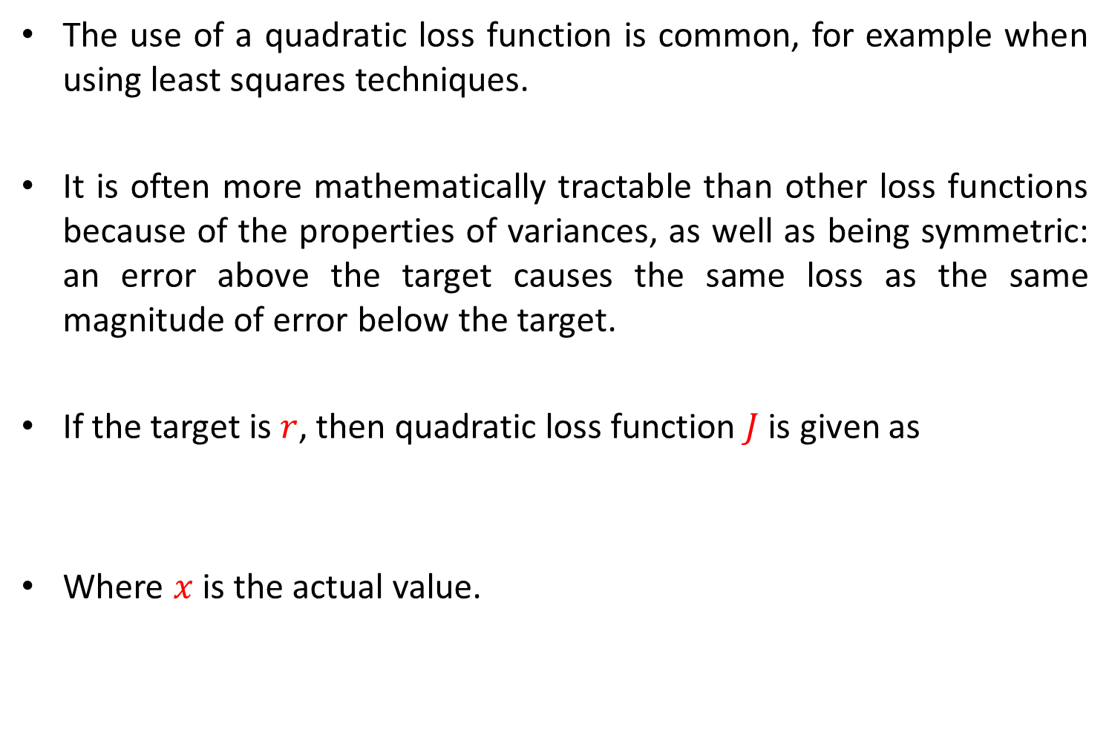
Quadratic Cost Function
The use of a quadratic loss function is common, for example when using least squares techniques.
It is often more mathematically tractable than other loss functions because of the properties of variances, as well as being symmetric: an error above the target causes the same loss as the same magnitude of error below the target.
If the target is $r$, then quadratic loss function $J$ is given as
Where $x$is the actual value.
$$J=C{(r−x)}^{2}$$

Slide 5

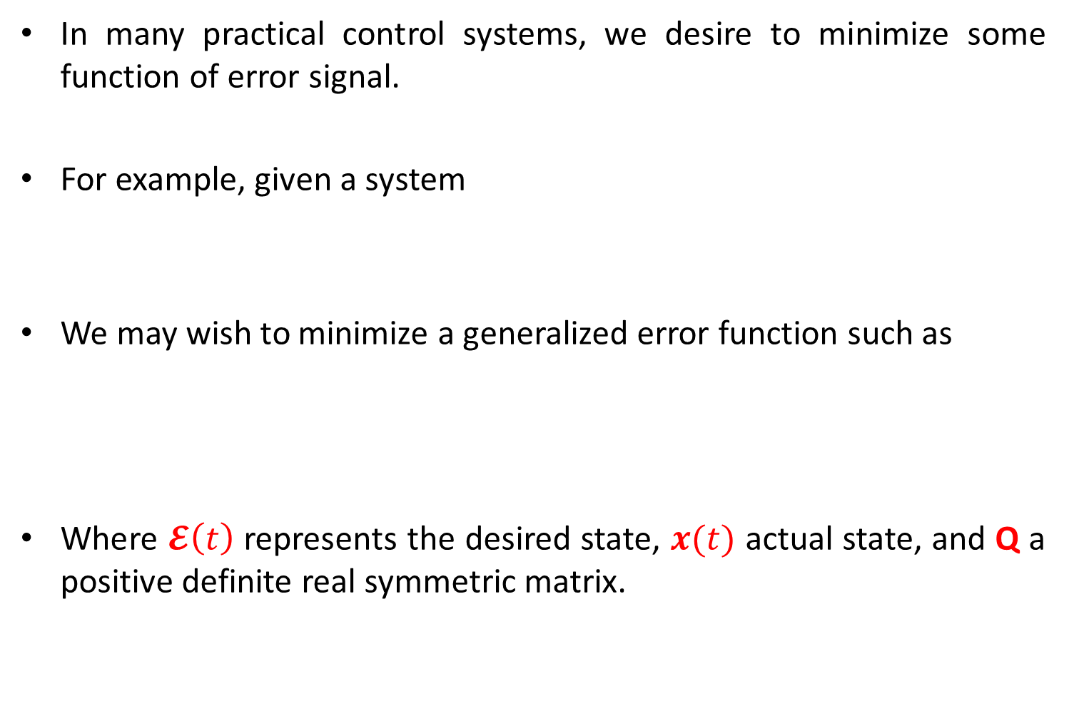
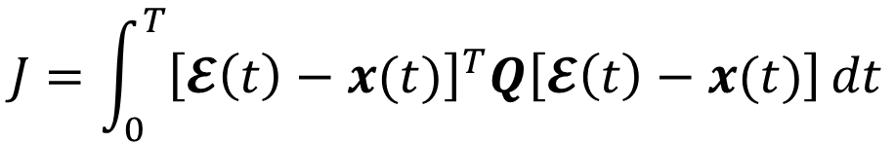
Optimal Control System based on Quadratic Performance Index
In many practical control systems, we desire to minimize some function of error signal.
For example, given a system
We may wish to minimize a generalized error function such as
Where $𝓔\left(t\right)$ represents the desired state, $x(t)$ actual state, and Q a positive definite real symmetric matrix.
$$\dot{x}=Ax+Bu$$
$$J=\int_{0}^{T}{{\left[𝓔\left(t\right)−x(t)\right]}^{T}Q\left[𝓔\left(t\right)−x(t)\right]}dt$$

Slide 6

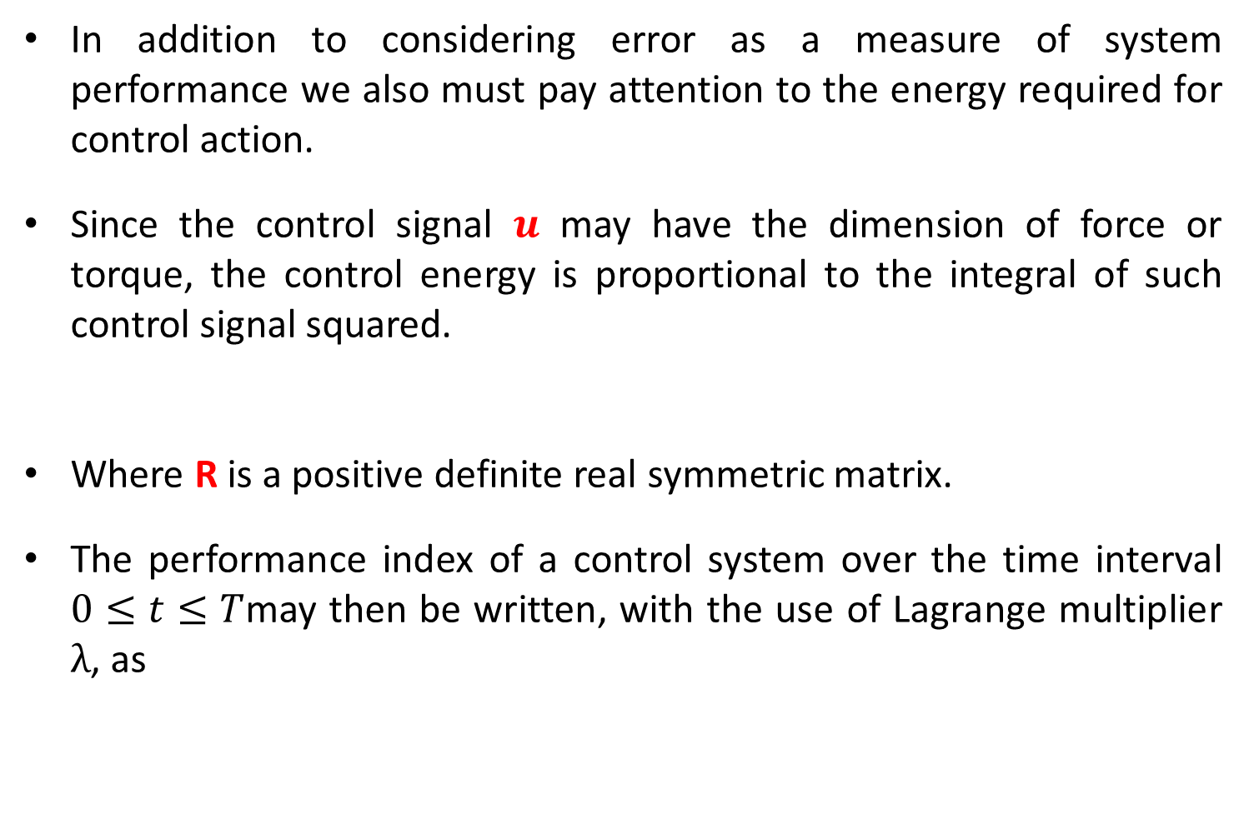
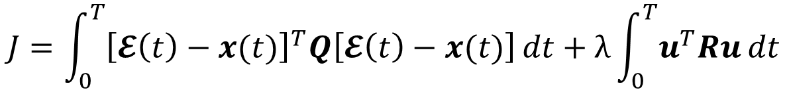
Optimal Control System based on Quadratic Performance Index
In addition to considering error as a measure of system performance we also must pay attention to the energy required for control action.
Since the control signal $u$ may have the dimension of force or torque, the control energy is proportional to the integral of such control signal squared.
Where R is a positive definite real symmetric matrix.
The performance index of a control system over the time interval $0≤t≤T$may then be written, with the use of Lagrange multiplier $λ$, as
$$\int_{0}^{T}{u^{T}Ru}dt$$
$$J=\int_{0}^{T}{{\left[𝓔\left(t\right)−x(t)\right]}^{T}Q\left[𝓔\left(t\right)−x(t)\right]}dt+λ\int_{0}^{T}{u^{T}Ru}dt$$

Slide 7
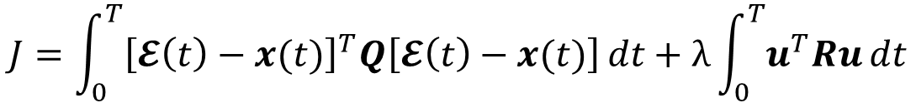
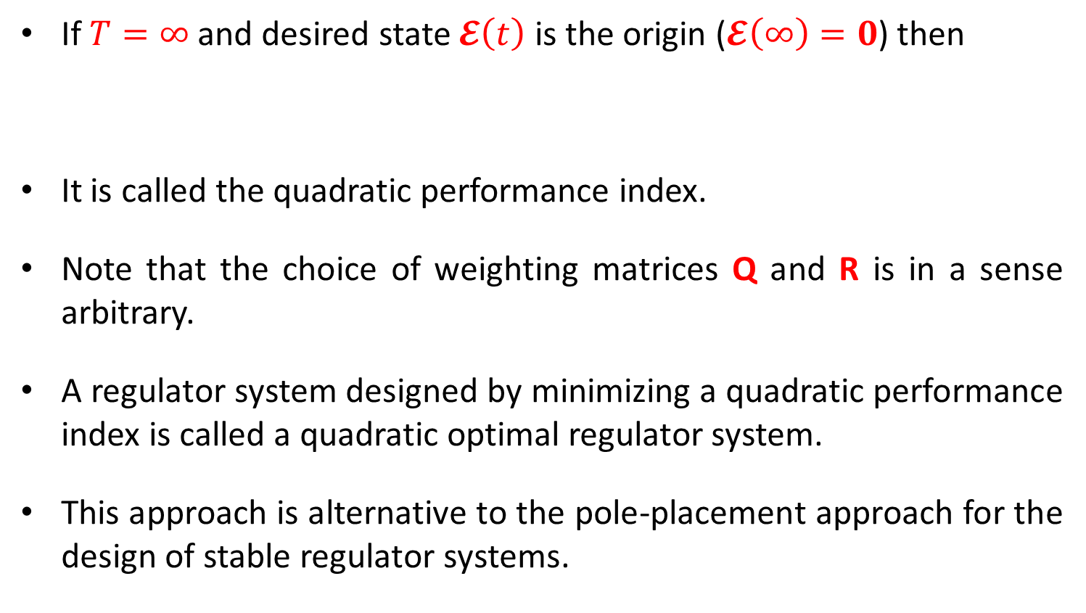
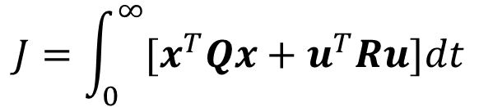
Optimal Control System based on Quadratic Performance Index
$$J=\int_{0}^{T}{{\left[𝓔\left(t\right)−x(t)\right]}^{T}Q\left[𝓔\left(t\right)−x(t)\right]}dt+λ\int_{0}^{T}{u^{T}Ru}dt$$
If $T=∞$ and desired state $𝓔\left(t\right)$ is the origin ($𝓔\left(∞\right)=0$) then
It is called the quadratic performance index.
Note that the choice of weighting matrices Q and R is in a sense arbitrary.
A regulator system designed by minimizing a quadratic performance index is called a quadratic optimal regulator system.
This approach is alternative to the pole-placement approach for the design of stable regulator systems.
$$J=\int_{0}^{∞}{{[x}^{T}Qx}+u^{T}Ru]dt$$

Slide 8

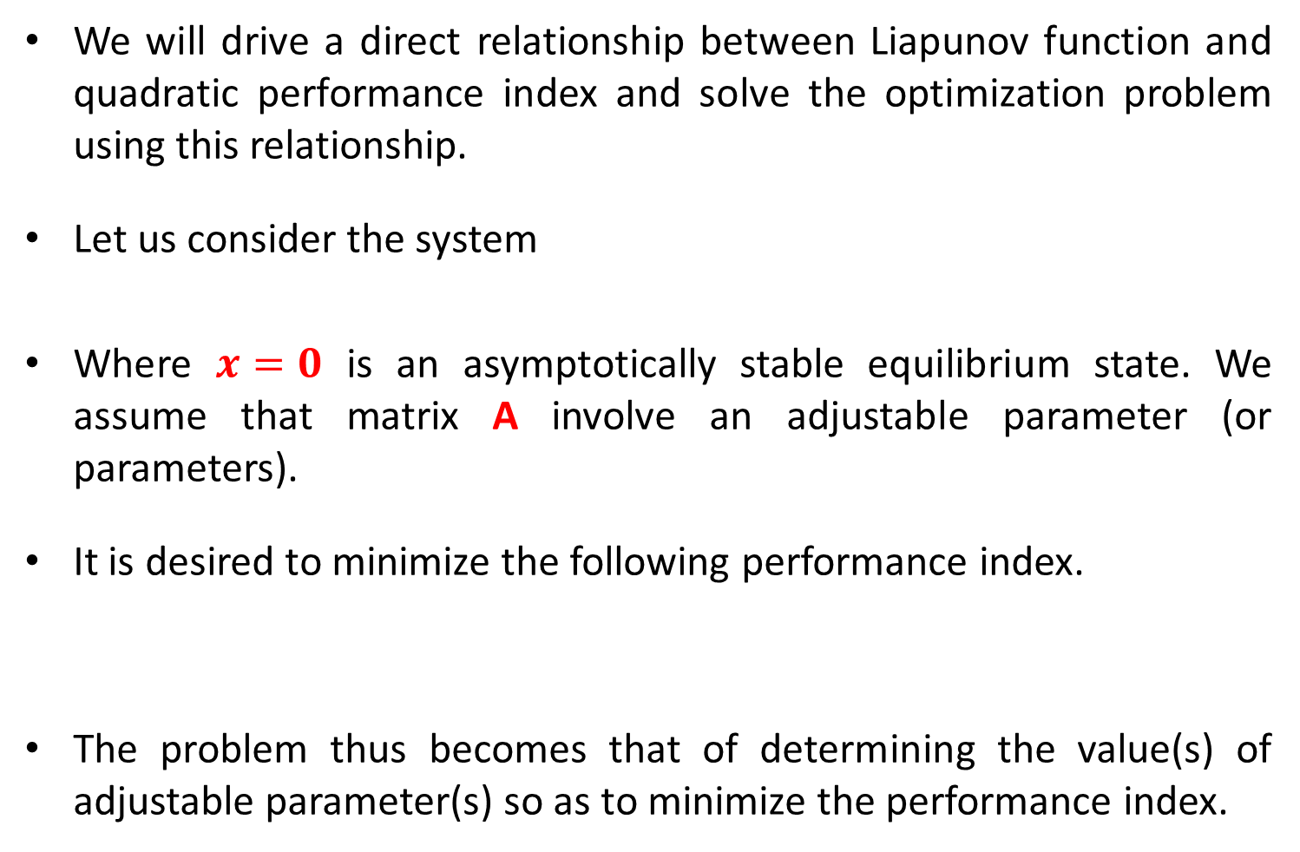

Optimization by Second Method of Liapunov
We will drive a direct relationship between Liapunov function and quadratic performance index and solve the optimization problem using this relationship.
Let us consider the system
Where $x=0$ is an asymptotically stable equilibrium state. We assume that matrix A involve an adjustable parameter (or parameters).
It is desired to minimize the following performance index.
The problem thus becomes that of determining the value(s) of adjustable parameter(s) so as to minimize the performance index.
$$\dot{x}=Ax$$
$$J=\int_{0}^{∞}{x^{T}Qx}dt$$

Slide 9

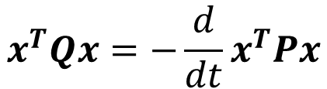






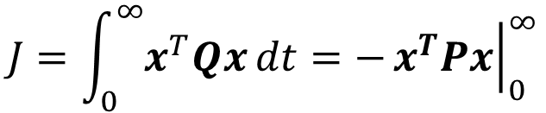
Optimization by Second Method of Liapunov
$$J=\int_{0}^{∞}{x^{T}Qx}dt$$
We know from Liapunov stability theorem (Lecture-39-40) that
The performance index J can be evaluated as
$$\dot{x}=Ax$$
$$x^{T}Qx=−\dot{V}\left(t\right)$$
$$x^{T}Qx=−\frac{d}{dt}x^{T}Px$$
$$x^{T}Qx=−{\dot{x}}^{T}Px−x^{T}P\dot{x}$$
$$x^{T}Qx=−x^{T}\left(A^{T}P+PA\right)x$$
$$Q=−\left(A^{T}P+PA\right)$$
$$J=\int_{0}^{∞}{x^{T}Qx}dt=−{\left.x^{T}Px\right|}_{0}^{∞}$$
$$J=−x^{T}\left(∞\right)Px\left(∞\right)+x^{T}\left(0\right)Px\left(0\right)$$

Slide 10

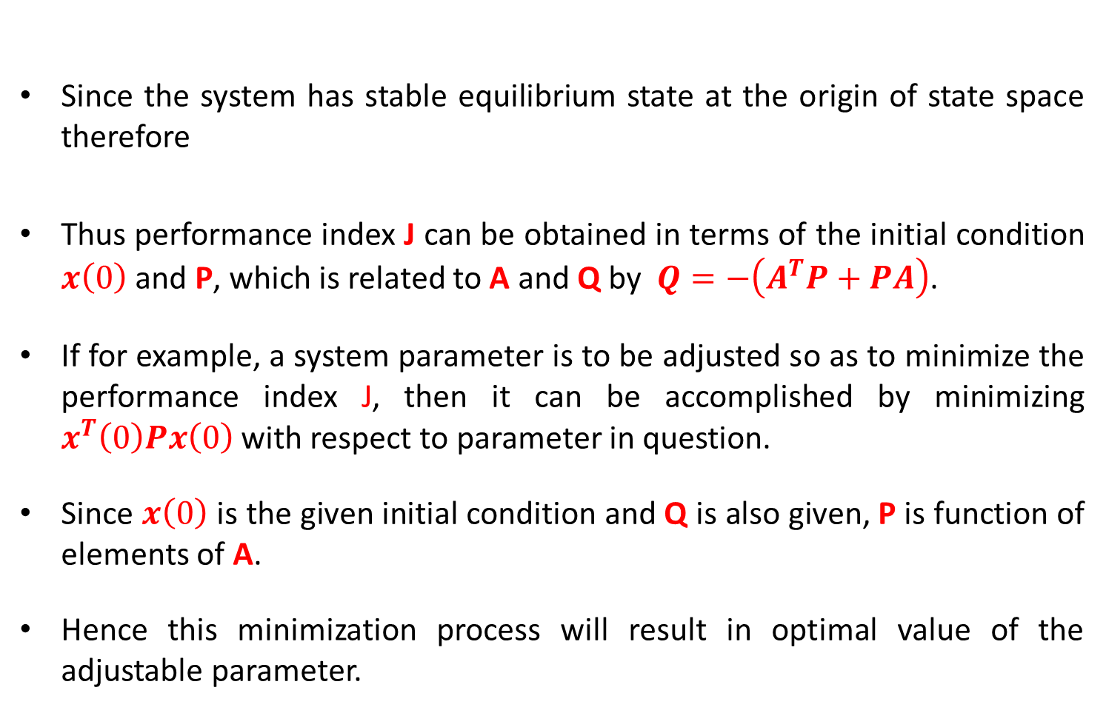

Optimization by Second Method of Liapunov
Since the system has stable equilibrium state at the origin of state space therefore
Thus performance index J can be obtained in terms of the initial condition $x\left(0\right)$ and P, which is related to A and Q by $Q=−\left(A^{T}P+PA\right)$.
If for example, a system parameter is to be adjusted so as to minimize the performance index J, then it can be accomplished by minimizing $x^{T}\left(0\right)Px\left(0\right)$ with respect to parameter in question.
Since $x\left(0\right)$ is the given initial condition and Q is also given, P is function of elements of A.
Hence this minimization process will result in optimal value of the adjustable parameter.
$$J=−x^{T}\left(∞\right)Px\left(∞\right)+x^{T}\left(0\right)Px\left(0\right)$$
$$J=x^{T}\left(0\right)Px\left(0\right)$$

Slide 11

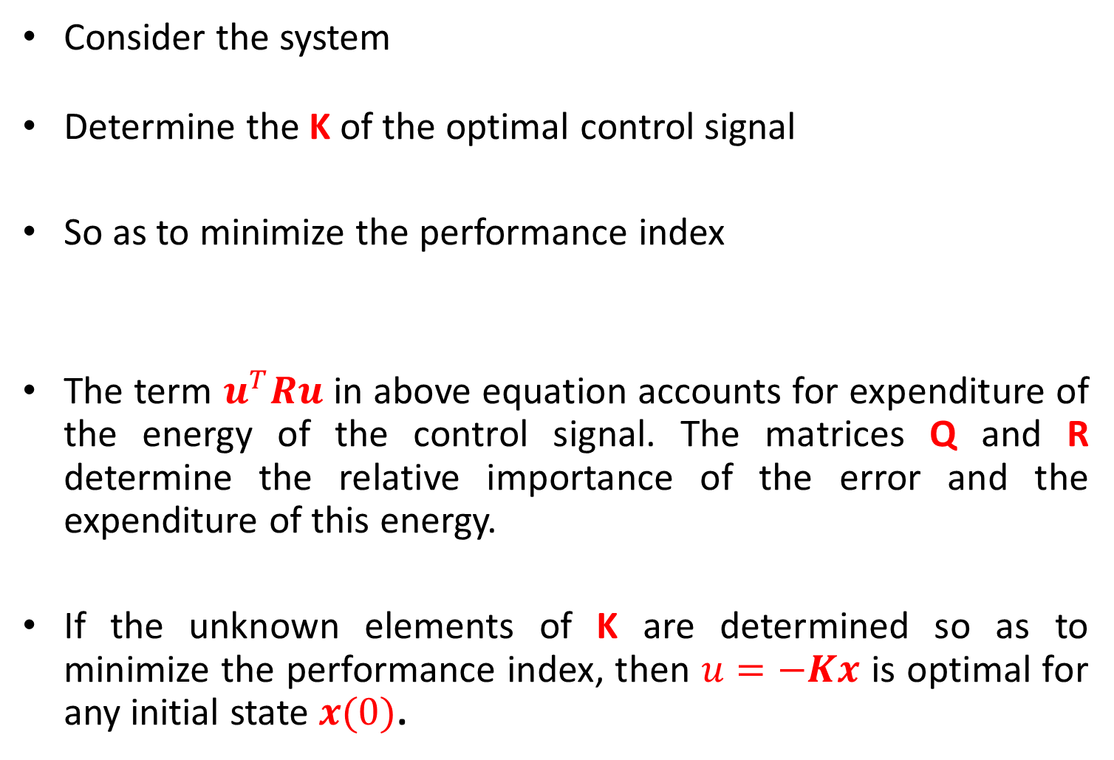
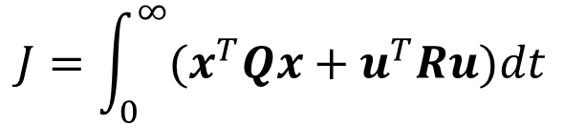

Quadratic Optimal Control
Consider the system
Determine the K of the optimal control signal
So as to minimize the performance index
The term $u^{T}Ru$ in above equation accounts for expenditure of the energy of the control signal. The matrices Q and R determine the relative importance of the error and the expenditure of this energy.
If the unknown elements of K are determined so as to minimize the performance index, then $u=−Kx$ is optimal for any initial state $x(0)$.
$$\dot{x}=Ax+Bu$$
$$u=−Kx$$
$$J=\int_{0}^{∞}{{(x}^{T}Qx}+u^{T}Ru)dt$$

Slide 12
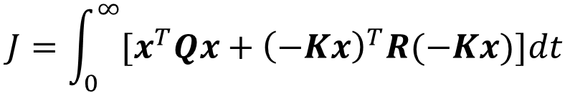





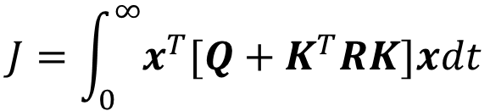

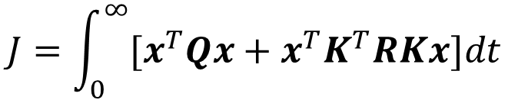
Quadratic Optimal Control
The block diagram showing the optimal configuration is shown below.
Since $u=−Kx$ performance index J can be written as
$$u$$
$$x$$
$$\dot{x}=Ax+Bu$$
$$\dot{x}=(A−BK)x$$
$$−K$$
$$J=\int_{0}^{∞}{{[x}^{T}Qx}+{\left(−Kx\right)}^{T}R(−Kx)]dt$$
$$J=\int_{0}^{∞}{{[x}^{T}Qx}+x^{T}K^{T}RKx]dt$$
$$J=\int_{0}^{∞}{x^{T}[Q}+K^{T}RK]xdt$$

Slide 13
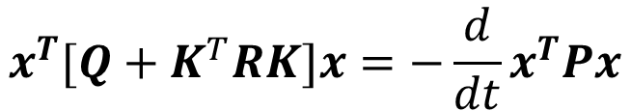
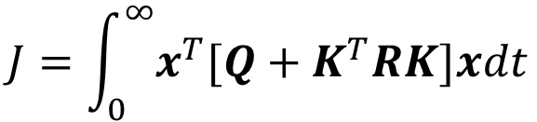

Quadratic Optimal Control
$$J=\int_{0}^{∞}{x^{T}[Q}+K^{T}RK]xdt$$
Following the discussion of parameter optimization by second method of Liapunov
Then we obtain
$$x^{T}[Q+K^{T}RK]x=−\frac{d}{dt}x^{T}Px$$
$$x^{T}[Q+K^{T}RK]x=−{\dot{x}}^{T}Px−x^{T}P\dot{x}$$
$$x^{T}[Q+K^{T}RK]x=−{[\left(A−BK\right)x]}^{T}Px−x^{T}P\left(A−BK\right)x$$
$$x^{T}[Q+K^{T}RK]x=−x^{T}{\left(A−BK\right)}^{T}Px−x^{T}P\left(A−BK\right)x$$
$$x^{T}\left[Q+K^{T}RK\right]x=−x^{T}{[\left(A−BK\right)}^{T}P+P\left(A−BK\right)x]$$
$$Q+K^{T}RK=−{\left(A−BK\right)}^{T}P+P\left(A−BK\right)$$

Slide 14

Quadratic Optimal Control
$$Q+K^{T}RK=−{\left(A−BK\right)}^{T}P+P\left(A−BK\right)$$
Since R is a positive definite symmetric square matrix, we can write (Cholesky decomposition)
Where T is nonsingular. Then above equation can be written as
$$R=T^{T}T$$
$$Q+K^{T}T^{T}TK=−{\left(A−BK\right)}^{T}P+P\left(A−BK\right)$$
$$\left(A^{T}−K^{T}B^{T}\right)P+P\left(A−BK\right)+Q+K^{T}T^{T}TK=0$$
$$A^{T}P−K^{T}B^{T}P+PA−PBK+Q+K^{T}T^{T}TK=0$$
$$A^{T}P+PA−K^{T}B^{T}P−PBK+K^{T}T^{T}TK+Q=0$$
$$A^{T}P+PA+{[TK−{\left(T^{T}\right)}^{−1}B^{T}P]}^{T}[TK−{\left(T^{T}\right)}^{−1}B^{T}P]−PBR^{−1}B^{T}P+Q=0$$

Slide 15







Quadratic Optimal Control
$$A^{T}P+PA+{[TK−{\left(T^{T}\right)}^{−1}B^{T}P]}^{T}[TK−{\left(T^{T}\right)}^{−1}B^{T}P]−PBR^{−1}B^{T}P+Q=0$$
Compare above equation to
Minimization of J with respect to K requires minimization of
Above expression is zero when
Hence
Thus the optimal control law to the quadratic optical control problem is given by
$$Q=−\left(A^{T}P+PA\right)$$
$${[TK−{\left(T^{T}\right)}^{−1}B^{T}P]}^{T}[TK−{\left(T^{T}\right)}^{−1}B^{T}P]$$
$$TK={\left(T^{T}\right)}^{−1}B^{T}P$$
$$K=T^{−1}{\left(T^{T}\right)}^{−1}B^{T}P$$
$$K={\left(T^{T}T\right)}^{−1}B^{T}P$$
$$K=R^{−1}B^{T}P$$
$$u=−R^{−1}B^{T}Px(t)$$

Slide 16

Quadratic Optimal Control
$$A^{T}P+PA−K^{T}B^{T}P−PBK+K^{T}T^{T}TK+Q=0$$
Above equation can be reduced to
Which is called reduced matrix Ricati equation.
$$A^{T}P+PA−PBR^{−1}B^{T}P+Q=0$$

Slide 17

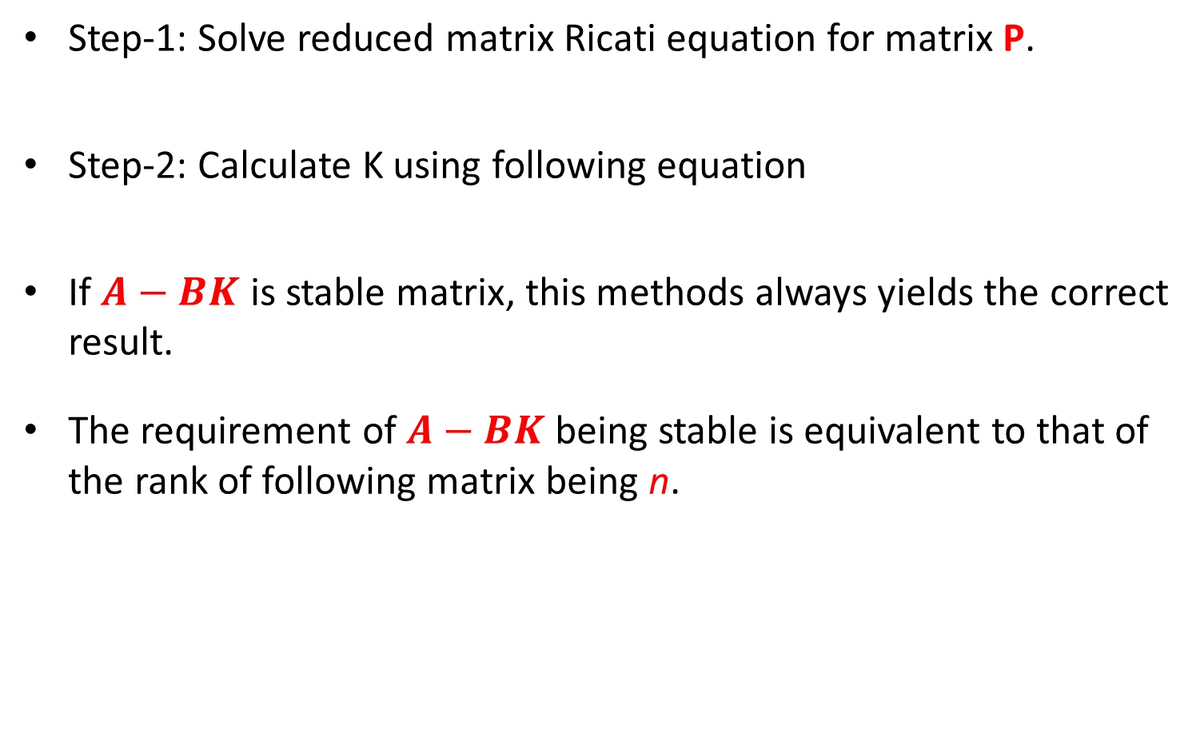


Quadratic Optimal Control (Design Steps)
Step-1: Solve reduced matrix Ricati equation for matrix P.
Step-2: Calculate K using following equation
If $A−BK$ is stable matrix, this methods always yields the correct result.
The requirement of $A−BK$ being stable is equivalent to that of the rank of following matrix being n.
$$A^{T}P+PA−PBR^{−1}B^{T}P+Q=0$$
$$K=R^{−1}B^{T}P$$
$$rank\left[\begin{matrix}Q^{\frac{1}{2}} \\ Q^{\frac{1}{2}}A \\ ⋮ \\ Q^{\frac{1}{2}}A^{n−1}\end{matrix}\right]=n$$

Slide 18

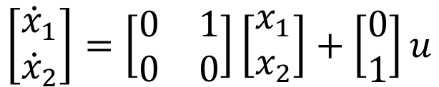
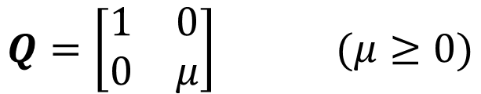
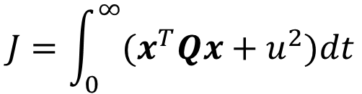
Example-1
Consider the system given below
Assume the control signal to be
Determine the optimal feedback gain K such that the following performance index is minimized.
Where
$$\left[\begin{matrix}{\dot{x}}_{1} \\ {\dot{x}}_{2}\end{matrix}\right]=\left[\begin{matrix}0 & 1 \\ 0 & 0\end{matrix}\right]\left[\begin{matrix}x_{1} \\ x_{2}\end{matrix}\right]+\left[\begin{matrix}0 \\ 1\end{matrix}\right]u$$
$$u=−Kx$$
$$J=\int_{0}^{∞}{{(x}^{T}Qx}+u^{2})dt$$
$$Q=\left[\begin{matrix}1 & 0 \\ 0 & μ\end{matrix}\right] (μ≥0)$$

Slide 19

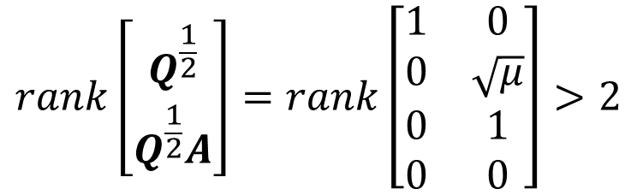
Example-1
We find that
Therefore A-BK is stable matrix and the Liapunov approach for optimization can be successfully applied.
Step-1: Solve the reduced matrix Riccati equation
$$rank\left[\begin{matrix}Q^{\frac{1}{2}} \\ Q^{\frac{1}{2}}A\end{matrix}\right]=rank\left[\begin{matrix}1 & 0 \\ 0 & \sqrt{μ} \\ 0 & 1 \\ 0 & 0\end{matrix}\right]>2$$
$$A^{T}P+PA−PBR^{−1}B^{T}P+Q=0$$
$${\left[\begin{matrix}0 & 1 \\ 0 & 0\end{matrix}\right]}^{T}\left[\begin{matrix}p_{11} & p_{12} \\ p_{12} & p_{22}\end{matrix}\right]+\left[\begin{matrix}p_{11} & p_{12} \\ p_{12} & p_{22}\end{matrix}\right]\left[\begin{matrix}0 & 1 \\ 0 & 0\end{matrix}\right]−\left[\begin{matrix}p_{11} & p_{12} \\ p_{12} & p_{22}\end{matrix}\right]\left[\begin{matrix}0 \\ 1\end{matrix}\right]{\left[1\right]}^{−1}{\left[\begin{matrix}0 \\ 1\end{matrix}\right]}^{−1}\left[\begin{matrix}p_{11} & p_{12} \\ p_{12} & p_{22}\end{matrix}\right]+\left[\begin{matrix}1 & 0 \\ 0 & μ\end{matrix}\right]=\left[\begin{matrix}0 & 0 \\ 0 & 0\end{matrix}\right]$$

Slide 20
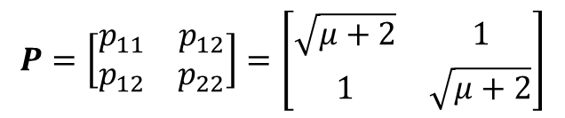




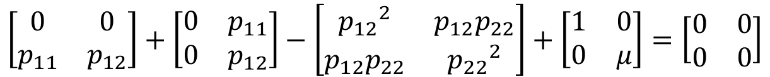
Example-1
$${\left[\begin{matrix}0 & 1 \\ 0 & 0\end{matrix}\right]}^{T}\left[\begin{matrix}p_{11} & p_{12} \\ p_{12} & p_{22}\end{matrix}\right]+\left[\begin{matrix}p_{11} & p_{12} \\ p_{12} & p_{22}\end{matrix}\right]\left[\begin{matrix}0 & 1 \\ 0 & 0\end{matrix}\right]−\left[\begin{matrix}p_{11} & p_{12} \\ p_{12} & p_{22}\end{matrix}\right]\left[\begin{matrix}0 \\ 1\end{matrix}\right]{\left[1\right]}^{−1}{\left[\begin{matrix}0 \\ 1\end{matrix}\right]}^{−1}\left[\begin{matrix}p_{11} & p_{12} \\ p_{12} & p_{22}\end{matrix}\right]+\left[\begin{matrix}1 & 0 \\ 0 & μ\end{matrix}\right]=\left[\begin{matrix}0 & 0 \\ 0 & 0\end{matrix}\right]$$
Which is further simplified as
From which we obtain the following equations
Solving these three equations for $p_{11}$, $p_{12}$ and $p_{22}$, requiring P to be positive definite, we obtain
$$\left[\begin{matrix}0 & 0 \\ p_{11} & p_{12}\end{matrix}\right]+\left[\begin{matrix}0 & p_{11} \\ 0 & p_{12}\end{matrix}\right]−\left[\begin{matrix}{p_{12}}^{2} & p_{12}p_{22} \\ p_{12}p_{22} & {p_{22}}^{2}\end{matrix}\right]+\left[\begin{matrix}1 & 0 \\ 0 & μ\end{matrix}\right]=\left[\begin{matrix}0 & 0 \\ 0 & 0\end{matrix}\right]$$
$${{1−p}_{12}}^{2}=0$$
$$p_{11}−p_{12}p_{22}=0$$
$${{{μ+2p}_{12}−p}_{22}}^{2}=0$$
$$P=\left[\begin{matrix}p_{11} & p_{12} \\ p_{12} & p_{22}\end{matrix}\right]=\left[\begin{matrix}\sqrt{μ+2} & 1 \\ 1 & \sqrt{μ+2}\end{matrix}\right]$$

Slide 21

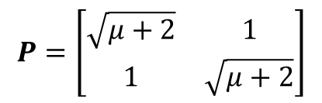

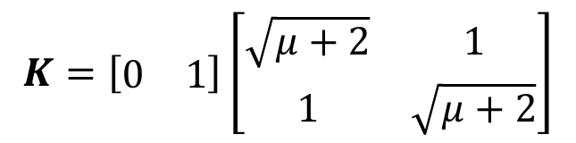
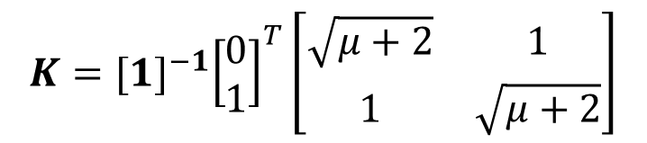
Example-1
$$P=\left[\begin{matrix}\sqrt{μ+2} & 1 \\ 1 & \sqrt{μ+2}\end{matrix}\right]$$
Step-2: Calculate K using following equation
$$K=R^{−1}B^{T}P$$
$$K={[1]}^{−1}{\left[\begin{matrix}0 \\ 1\end{matrix}\right]}^{T}\left[\begin{matrix}\sqrt{μ+2} & 1 \\ 1 & \sqrt{μ+2}\end{matrix}\right]$$
$$K=\left[\begin{matrix}0 & 1\end{matrix}\right]\left[\begin{matrix}\sqrt{μ+2} & 1 \\ 1 & \sqrt{μ+2}\end{matrix}\right]$$
$$K=\left[\begin{matrix}1 & \sqrt{μ+2}\end{matrix}\right]$$

Slide 22
End of Lectures-41-42
To download this lecture visit
http://imtiazhussainkalwar.weebly.com/

