Slide 1


Control Systems With Embedded Implementation (CSEI)
Lecture-3
Modeling of Digital Control Systems
Dr. Imtiaz Hussain
Assistant Professor
email: imtiaz.hussain@faculty.muet.edu.pk
URL :http://imtiazhussainkalwar.weebly.com/

Slide 2
Lecture Outline
Sampling Theorem
ADC Model
DAC Model
Combined Models

Slide 3
Sampling Theorem
Sampling is necessary for the processing of analog data using digital elements.
Successful digital data processing requires that the samples reflect the nature of the analog signal and that analog signals be recoverable from a sequence of samples.

Slide 4
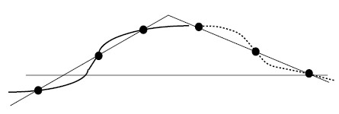
Sampling Theorem
Following figure shows two distinct waveforms with identical samples.
Obviously, faster sampling of the two waveforms would produce distinguishable sequences.

Slide 5
Sampling Theorem
Thus, it is obvious that sufficiently fast sampling is a prerequisite for successful digital data processing.
The sampling theorem gives a lower bound on the sampling rate necessary for a given band-limited signal (i.e., a signal with a known finite bandwidth)

Slide 6
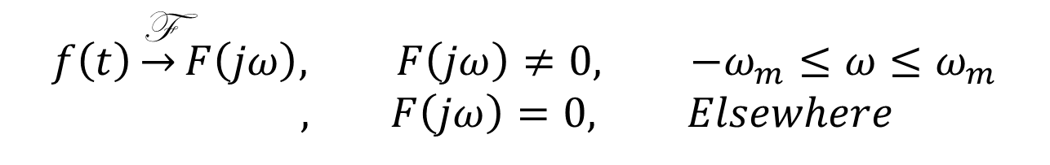
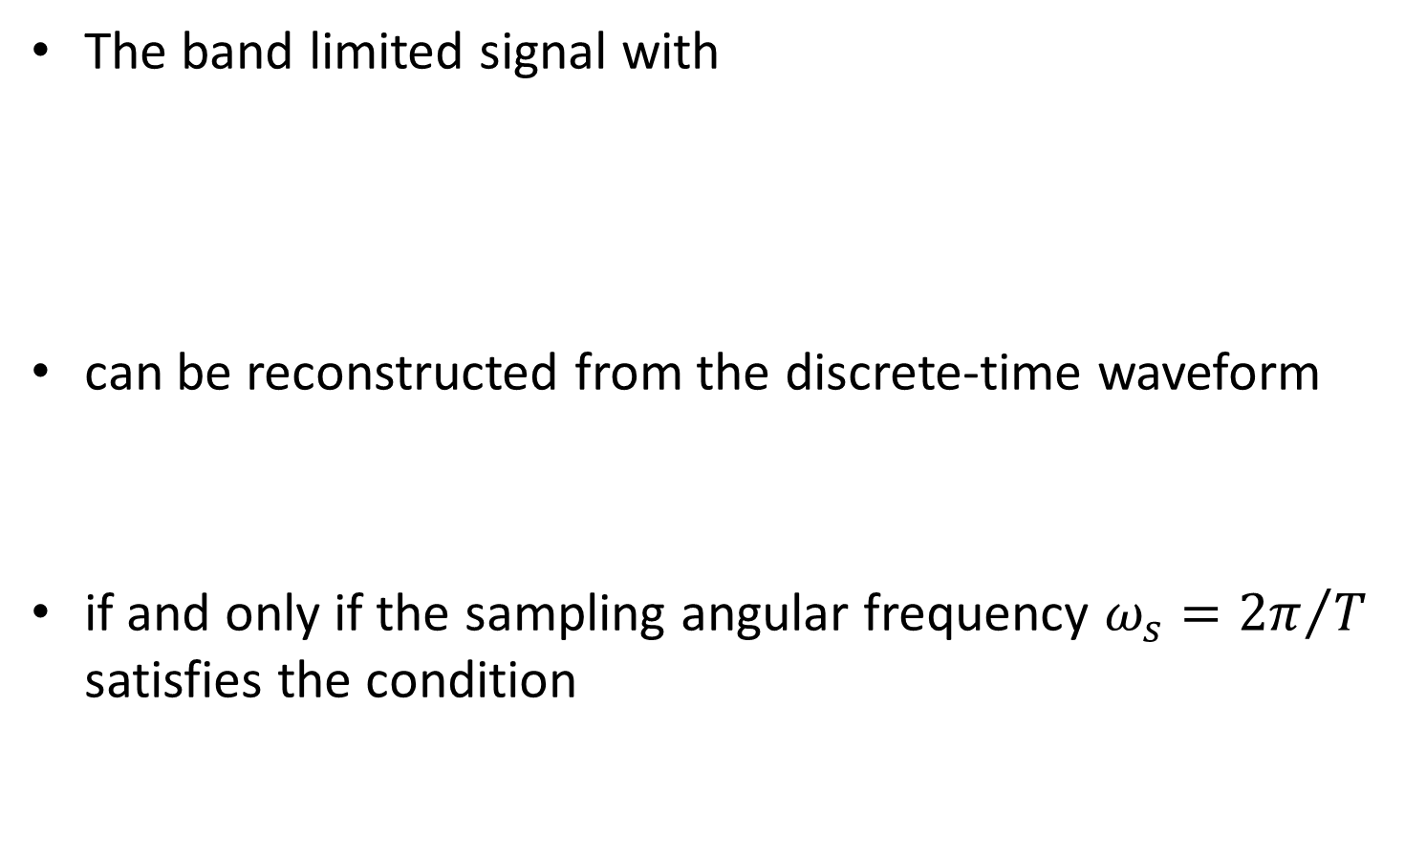
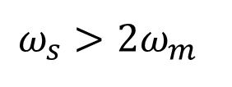
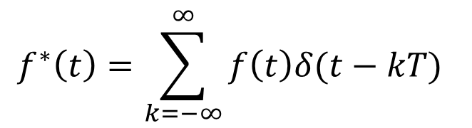
Sampling Theorem
The band limited signal with
can be reconstructed from the discrete-time waveform
if and only if the sampling angular frequency $ω_{s}={2π}/T$ satisfies the condition
$$f\left(t\right)\underset{→}{\text{F}}F\left(jω\right), F\left(jω\right)≠0, −ω_{m}≤ω≤ω_{m}$$
$, F\left(jω\right)=0, Elsewhere$
$$f^{∗}\left(t\right)=\sum_{k=−∞}^{∞}{f\left(t\right)δ(t−kT)}$$
$$ω_{s}>2ω_{m}$$

Slide 7
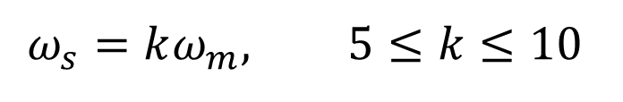
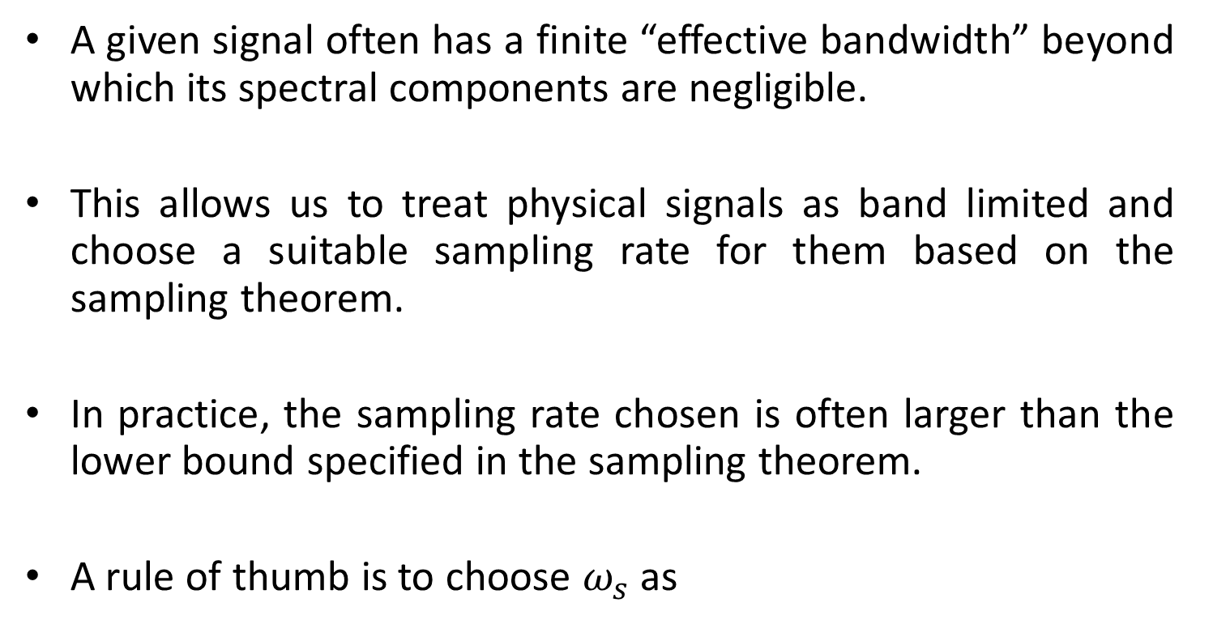
Selection of Sampling Frequency
A given signal often has a finite “effective bandwidth” beyond which its spectral components are negligible.
This allows us to treat physical signals as band limited and choose a suitable sampling rate for them based on the sampling theorem.
In practice, the sampling rate chosen is often larger than the lower bound specified in the sampling theorem.
A rule of thumb is to choose $ω_{s}$ as
$$ω_{s}=kω_{m}, 5≤k≤10$$

Slide 8
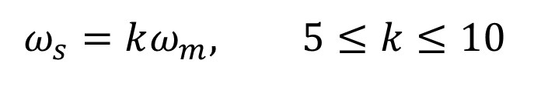
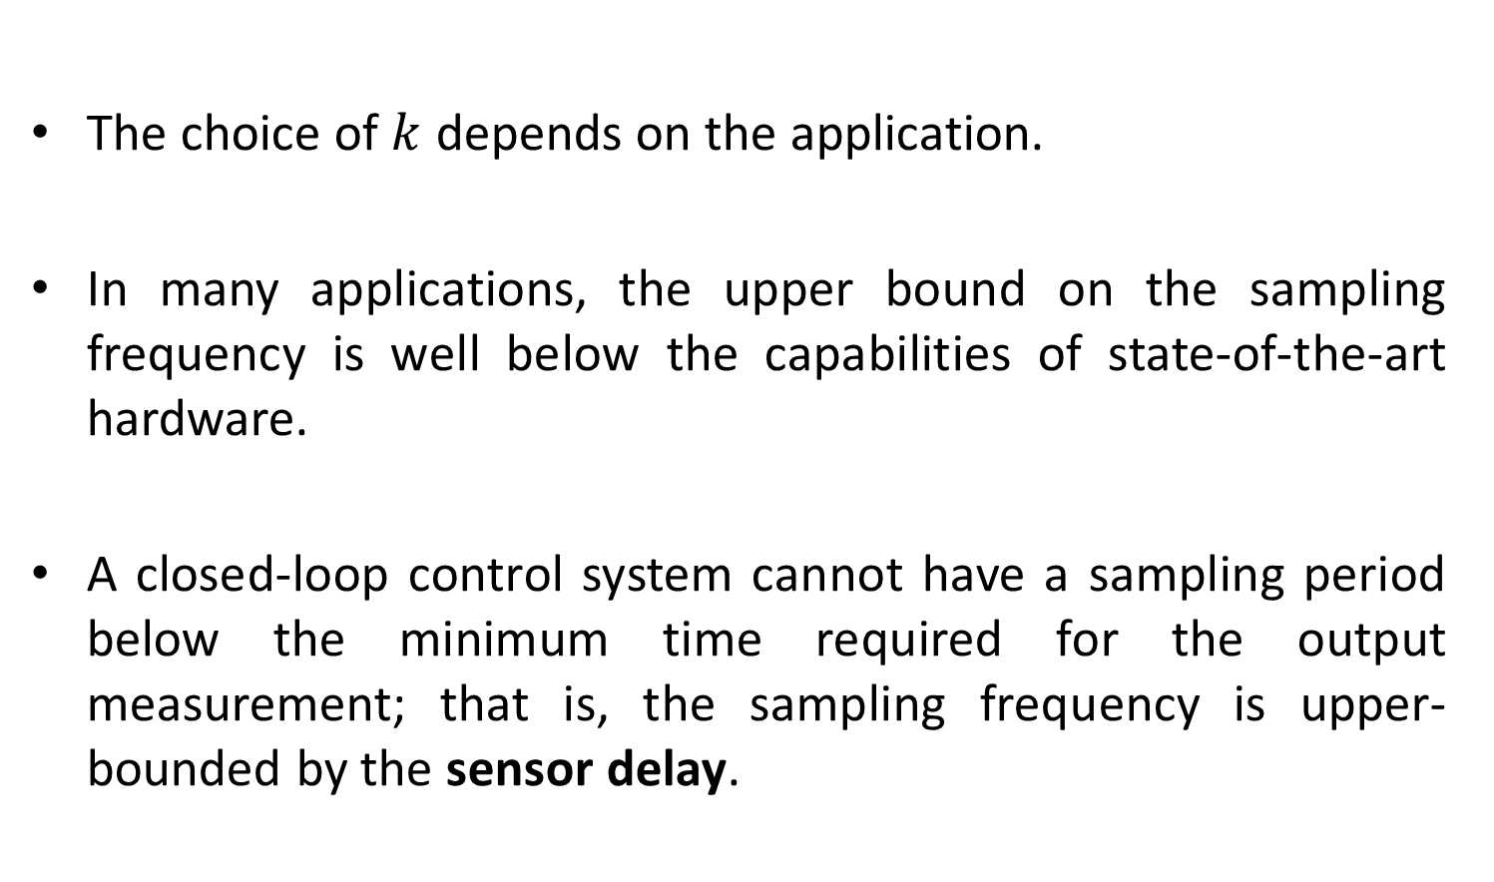
Selection of Sampling Frequency
$$ω_{s}=kω_{m}, 5≤k≤10$$
The choice of $k$ depends on the application.
In many applications, the upper bound on the sampling frequency is well below the capabilities of state-of-the-art hardware.
A closed-loop control system cannot have a sampling period below the minimum time required for the output measurement; that is, the sampling frequency is upper-bounded by the sensor delay.

Slide 9
Selection of Sampling Frequency
For example, oxygen sensors used in automotive air/fuel ratio control have a sensor delay of about 20 ms, which corresponds to a sampling frequency upper bound of 50 Hz.
Another limitation is the computational time needed to update the control.
This is becoming less restrictive with the availability of faster microprocessors but must be considered in sampling rate selection.

Slide 10
Selection of Sampling Frequency
For a linear system, the output of the system has a spectrum given by the product of the frequency response and input spectrum.
Because the input is not known a priori, we must base our choice of sampling frequency on the frequency response.

Slide 11
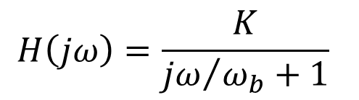

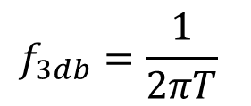
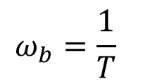
Selection of Sampling Frequency (1st Order Systems)
The frequency response of first order system is
where K is the DC gain and $ω_{b}$ is the system bandwidth.
Time constant and 3db bandwidth relationship
$$H\left(jω\right)=\frac{K}{{jω}/{ω_{b}+1}}$$
$$ω_{b}=\frac{1}{T}$$
$$f_{3db}=\frac{1}{2πT}$$

Slide 12
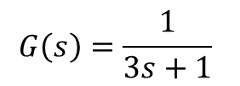
Selection of Sampling Frequency (1st Order Systems)
$$G\left(s\right)=\frac{1}{3s+1}$$

Slide 13
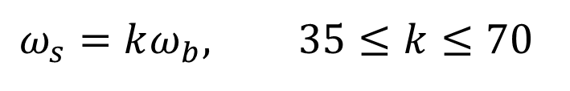

Selection of Sampling Frequency (1st Order Systems)
The frequency response amplitude drops below the DC level by a factor of about 10 at the frequency $7ω_{b}$.
If we consider $ω_{m}=7ω_{b}$, the sampling frequency is chosen as
$$ω_{s}=kω_{b}, 35≤k≤70$$

Slide 14
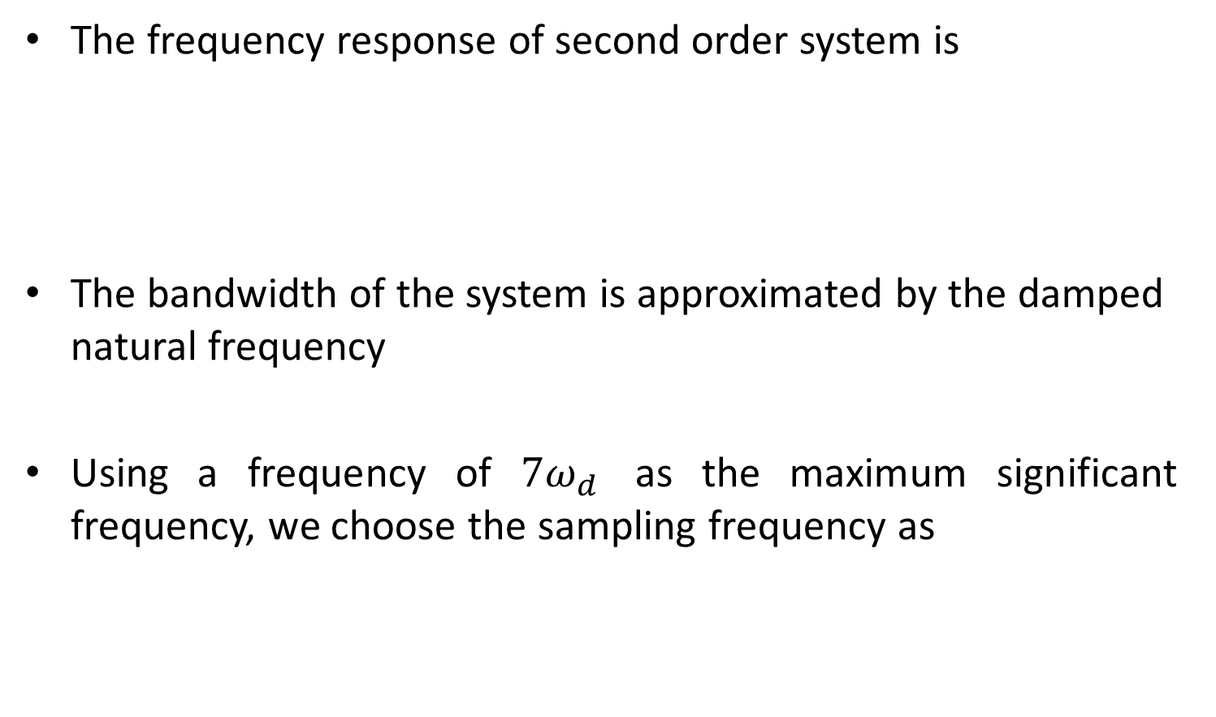
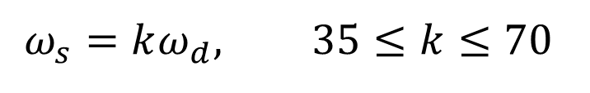
Selection of Sampling Frequency (2nd Order Systems)
The frequency response of second order system is
The bandwidth of the system is approximated by the damped natural frequency
Using a frequency of $7ω_{d}$ as the maximum significant frequency, we choose the sampling frequency as
$$ω_{s}=kω_{d}, 35≤k≤70$$

Slide 15
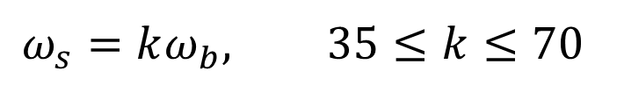
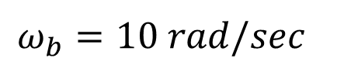
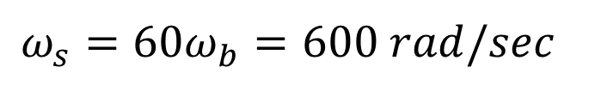
Example-1
Given a first-order system of bandwidth 10 rad/s, select a suitable sampling frequency and find the corresponding sampling period.
We know
Choosing k=60
Solution
$$ω_{b}=10 rad/sec$$
$$ω_{s}=kω_{b}, 35≤k≤70$$
$$ω_{s}=60ω_{b}=600 rad/sec$$

Slide 16
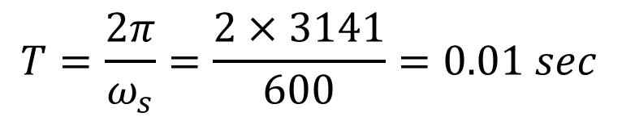
Example-1
Corresponding sapling period is calculated as
$$T=\frac{2π}{ω_{s}}=\frac{2×3141}{600}=0.01 sec$$

Slide 17
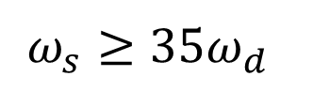
Example-2
A closed-loop control system must be designed for a steady-state error not to exceed 5 percent, a damping ratio of about 0.7, and an undamped natural frequency of 10 rad/s. Select a suitable sampling period for the system if the system has a sensor delay of 0.02 sec.
Let the sampling frequency be
Solution
$$ω_{s}≥35ω_{d}$$

Slide 18
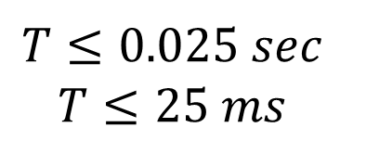
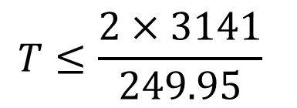
Example-2
The corresponding sampling period is
A suitable choice is T = 20 ms because this is equal to the sensor delay.
$$T≤\frac{2×3141}{249.95}$$
$$T≤0.025 sec$$
$$T≤25 ms$$

Slide 19
Home Work
A closed-loop control system must be designed for a steady-state error not to exceed 5 percent, a damping ratio of about 0.7, and an undamped natural frequency of 10 rad/s. Select a suitable sampling period for the system if the system has a sensor delay of 0.03 sec.

Slide 20
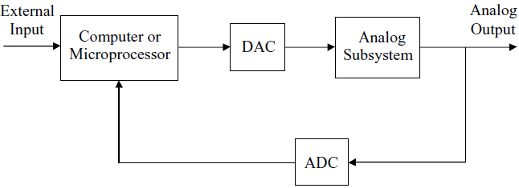
Digital Control Systems
A common configuration of digital control system is shown in following figure.

Slide 21
ADC Model
Assume that
  ADC outputs are exactly equal in magnitude to their inputs (i.e., quantization errors are negligible)
  The ADC yields a digital output instantaneously
  Sampling is perfectly uniform (i.e., occur at a fixed rate)
Then the ADC can be modeled as an ideal sampler with sampling period T.
T
u(t)
u*(t)
t
t
0
0

Slide 22
Sampling Process
T
u(t)
u*(t)
u(t)
u*(t)
δ_{T}(t)
×
＝
t
t
t
0
0
0
Modulation
signal
modulating
pulse(carrier)
modulated
wave

Slide 23
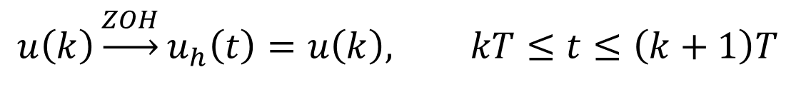
DAC Model
Assume that
  DAC outputs are exactly equal in magnitude to their inputs.
  The DAC yields an analog output instantaneously.
  DAC outputs are constant over each sampling period.
Then the input-output relationship of the DAC is given by
u(k)
u(t)
u_{h}(t)
$$u\left(k\right)\underset{→}{ZOH}u_{h}\left(t\right)=u\left(k\right), kT≤t≤\left(k+1\right)T$$

Slide 24
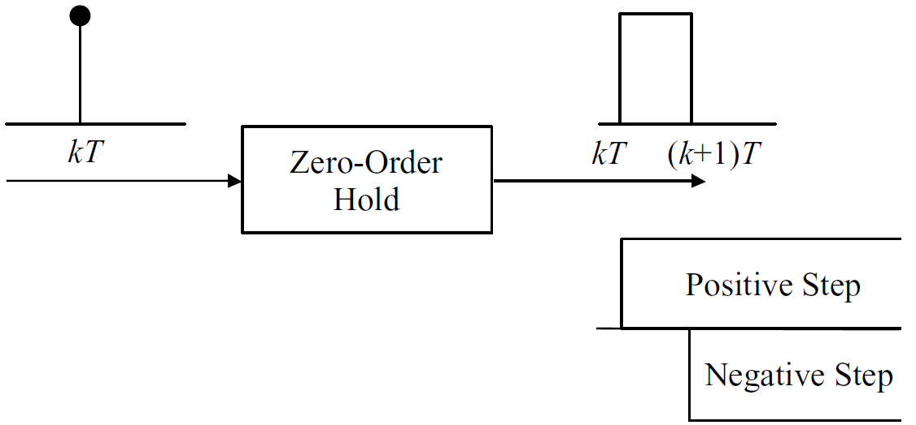
DAC Model
Unit impulse response of ZOH
The transfer function can then be obtained by Laplace transformation of the impulse response.

Slide 25

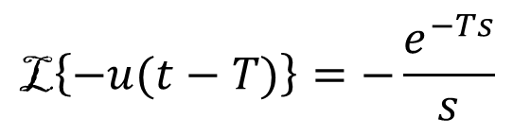
DAC Model
As shown in figure the impulse response is a unit pulse of width T.
A pulse can be represented as a positive step at time zero followed by a negative step at time T.
Using the Laplace transform of a unit step and the time delay theorem for Laplace transforms,
$$\text{L}\left\{u(t)\right\}=\frac{1}{s}$$
$$\text{L}\left\{−u(t−T)\right\}=−\frac{e^{−Ts}}{s}$$

Slide 26
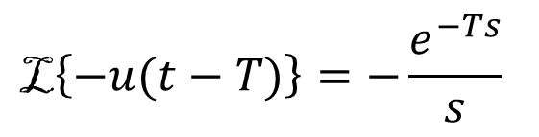

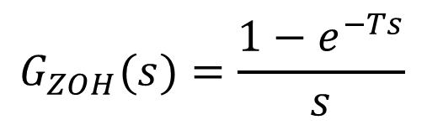
DAC Model
Thus, the transfer function of the ZOH is
$$\text{L}\left\{u(t)\right\}=\frac{1}{s}$$
$$\text{L}\left\{−u(t−T)\right\}=−\frac{e^{−Ts}}{s}$$
$$G_{ZOH}(s)=\frac{1−e^{−Ts}}{s}$$

Slide 27
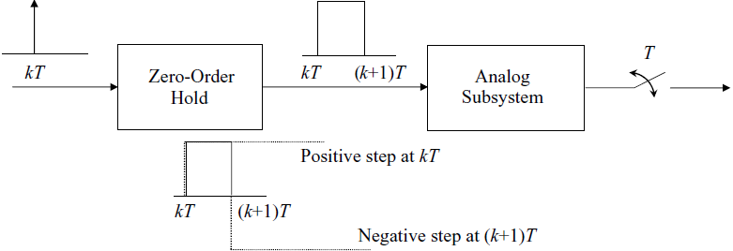
DAC, Analog Subsystem, and ADC Combination
Transfer Function
The cascade of a DAC, analog subsystem, and ADC is shown in following figure.
Because both the input and the output of the cascade are sampled, it is possible to obtain its z-domain transfer function in terms of the transfer functions of the individual subsystems.

Slide 28
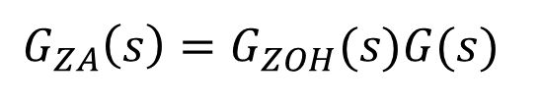
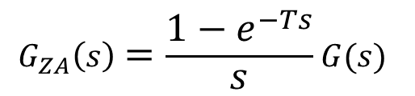
DAC, Analog Subsystem, and ADC Combination
Transfer Function
Using the DAC model, and assuming that the transfer function of the analog subsystem is G(s), the transfer function of the DAC and analog subsystem cascade is
$$G_{ZA}\left(s\right)=G_{ZOH}(s)G(s)$$
$$G_{ZA}\left(s\right)=\frac{1−e^{−Ts}}{s}G(s)$$

Slide 29
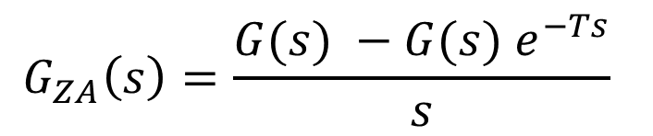
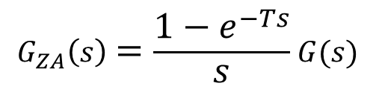
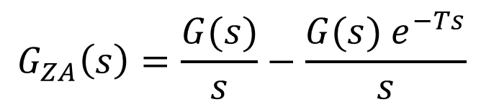
DAC, Analog Subsystem, and ADC Combination
Transfer Function
$$G_{ZA}\left(s\right)=\frac{1−e^{−Ts}}{s}G(s)$$
The corresponding impulse response is
The impulse response is the analog system step response minus a second step response delayed by one sampling period.
$$G_{ZA}\left(s\right)=\frac{G(s) −G(s) e^{−Ts}}{s}$$
$$G_{ZA}\left(s\right)=\frac{G(s)}{s}−\frac{G(s) e^{−Ts}}{s}$$

Slide 30
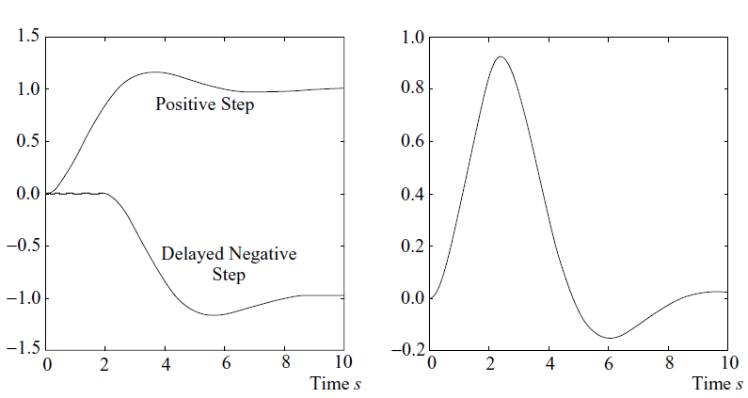
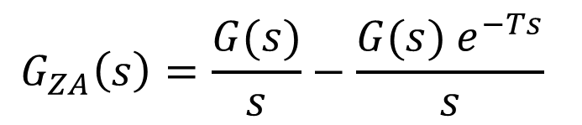
DAC, Analog Subsystem, and ADC Combination
Transfer Function
$$G_{ZA}\left(s\right)=\frac{G(s)}{s}−\frac{G(s) e^{−Ts}}{s}$$

Slide 31
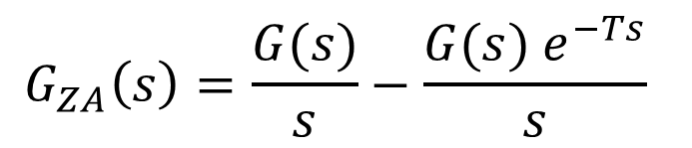

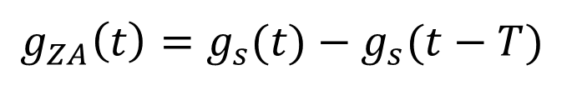
DAC, Analog Subsystem, and ADC Combination
Transfer Function
Inverse Laplace yields
Where $g_{s}\left(t\right)={\text{L}}^{−1}\left\{\frac{G(s)}{s}\right\}$
$$G_{ZA}\left(s\right)=\frac{G(s)}{s}−\frac{G(s) e^{−Ts}}{s}$$
$$g_{ZA}\left(t\right)=g_{s}(t)−g_{s}(t−T)$$

Slide 32
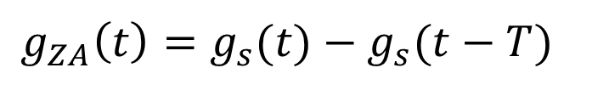
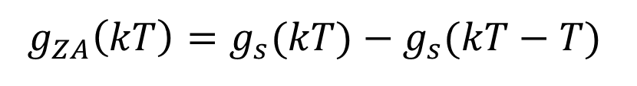
DAC, Analog Subsystem, and ADC Combination
Transfer Function
The analog response is sampled to give the sampled impulse response
By z-transforming, we can obtain the z-transfer function of the DAC (zero-order hold), analog subsystem, and ADC (ideal sampler) cascade.
$$g_{ZA}\left(t\right)=g_{s}(t)−g_{s}(t−T)$$
$$g_{ZA}\left(kT\right)=g_{s}(kT)−g_{s}(kT−T)$$

Slide 33
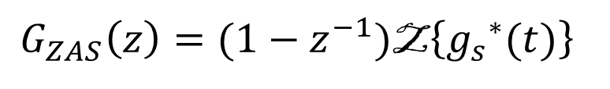
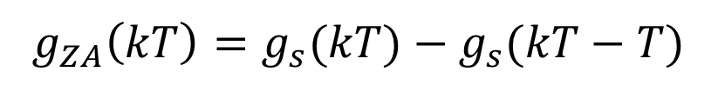
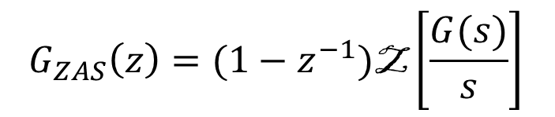
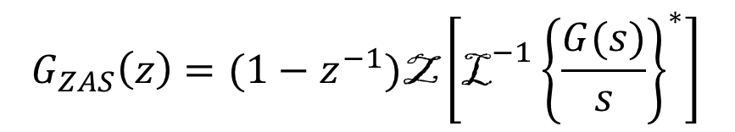
DAC, Analog Subsystem, and ADC Combination
Transfer Function
Z-Transform is given as
The * in above equation is to emphasize that sampling of a time function is necessary before z-transformation.
Having made this point, the equation can be rewritten more concisely as
$$g_{ZA}\left(kT\right)=g_{s}(kT)−g_{s}(kT−T)$$
$$G_{ZAS}\left(z\right)=(1−z^{−1})\text{Z}\left\{{g_{s}^{}}^{∗}(t)\right\}$$
$$G_{ZAS}\left(z\right)=(1−z^{−1})\text{Z}\left[{{\text{L}}^{−1}\left\{\frac{G(s)}{s}\right\}}^{∗}\right]$$
$$G_{ZAS}\left(z\right)=(1−z^{−1})\text{Z}\left[\frac{G(s)}{s}\right]$$

Slide 34




Example-3
Find G_{ZAS}(z) for the cruise control system for the vehicle shown in figure, where u is the input force, v is the velocity of the car, and b is the viscous friction coefficient.
The transfer function of system is given as
Re-writing transfer function in standard form
Solution
$$G\left(s\right)=\frac{V(s)}{U(s)}=\frac{1}{Ms+b}$$
$$G\left(s\right)=\frac{K}{τs+1}=\frac{K/τ}{s+1/τ}$$

Slide 35





Example-3
Where $K=1/b$ and $τ=M/b$
Now we know
Therefore,
The corresponding partial fraction expansion is
$$G\left(s\right)=\frac{K/τ}{s+1/τ}$$
$$G_{ZAS}\left(z\right)=(1−z^{−1})\text{Z}\left[\frac{G(s)}{s}\right]$$
$$\frac{G\left(s\right)}{s}=\frac{K/τ}{s(s+1/τ)}$$
$$\frac{G\left(s\right)}{s}=\left(\frac{K}{τ}\right)\left[\frac{τ}{s}−\frac{τ}{s+1/τ}\right]$$

Slide 36




Example-3
Using the z-transform table, the desired z-domain transfer function is
$$G_{ZAS}\left(z\right)=(1−z^{−1})\text{Z}\left[\left(\frac{K}{τ}\right)\left\{\frac{τ}{s}−\frac{τ}{s+1/τ}\right\}\right]$$
$$G_{ZAS}\left(z\right)=(1−z^{−1})\text{Z}\left[K\left\{\frac{1}{s}−\frac{1}{s+1/τ}\right\}\right]$$
$$G_{ZAS}\left(z\right)=\frac{z−1}{z}\left[K\left\{\frac{z}{z−1}−\frac{z}{z−e^{−T/τ}}\right\}\right]$$
$$G_{ZAS}\left(z\right)=\left[K\left\{1−\frac{z−1}{z−e^{−T/τ}}\right\}\right]$$

Slide 37



Example-3
$$G_{ZAS}\left(z\right)=\left[K\left\{1−\frac{z−1}{z−e^{−T/τ}}\right\}\right]$$
$$G_{ZAS}\left(z\right)=K \frac{z−e^{−\frac{T}{τ}}−z+1}{z−e^{−T/τ}}$$
$$G_{ZAS}\left(z\right)=K \frac{1−e^{−\frac{T}{τ}}}{z−e^{−T/τ}}$$

Slide 38




Example-4
Find G_{ZAS}(z) for the vehicle position control system, where u is the input force, y is the position of the car, and b is the viscous friction coefficient.
The transfer function of system is given as
Re-writing transfer function in standard form
$$b\dot{y}$$
$$y$$
Solution
$$G\left(s\right)=\frac{Y(s)}{U(s)}=\frac{1}{s(Ms+b)}$$
$$G\left(s\right)=\frac{K}{s(τs+1)}=\frac{K/τ}{s(s+\frac{1}{τ})}$$

Slide 39



Example-4
Where $K=1/b$ and $τ=M/b$
Now we know
Therefore,
The corresponding partial fraction expansion is
$$G\left(s\right)=\frac{K/τ}{s(s+\frac{1}{τ})}$$
$$G_{ZAS}\left(z\right)=(1−z^{−1})\text{Z}\left[\frac{G(s)}{s}\right]$$
$$\frac{G\left(s\right)}{s}=\frac{K/τ}{s^{2}(s+1/τ)}$$
$$\frac{G\left(s\right)}{s}=K\left[\frac{1}{s^{2}}−\frac{τ}{s}+\frac{τ}{s+1/τ}\right]$$

Slide 40




Example-4
The desired z-domain transfer function can be obtained as
$$G_{ZAS}\left(z\right)=(1−z^{−1})\text{Z}K\left[\frac{1}{s^{2}}−\frac{τ}{s}+\frac{τ}{s+1/τ}\right]$$
$$G_{ZAS}\left(z\right)=\frac{z−1}{z} K\left[\frac{z}{{(z−1)}^{2}}−\frac{τz}{z−1}+\frac{τz}{z−e^{−T/τ}}\right]$$
$$G_{ZAS}\left(z\right)=K\left[\frac{1}{z−1}−τ+\frac{τ(z−1)}{z−e^{−T/τ}}\right]$$
$$G_{ZAS}\left(z\right)=K\left[\frac{\left(1−τ+τe^{−\frac{T}{τ}}\right)z+\left[τ−e^{−\frac{T}{τ}}(τ+1)\right]}{(z−1)(z−e^{−T/τ})}\right]$$

Slide 41

Example-5
Find G_{ZAS}(z) for the series R-L circuit shown in Figure with the inductor voltage as output.

Slide 42
End of Lectures-3
To download this lecture visit
http://imtiazhussainkalwar.weebly.com/

