Slide 1
Modern Control Systems (MCS)
Lecture-37-38
Design of Control Systems in Sate Space
LIAPUNOV STABILITY ANALYSIS
Dr. Imtiaz Hussain
email: imtiaz.hussain@faculty.muet.edu.pk
URL :http://imtiazhussainkalwar.weebly.com/

Slide 2
Outline
Introduction
Equilibrium State of a Dynamic System
Phase Plane Analysis
Liapunov stability Analysis

Slide 3

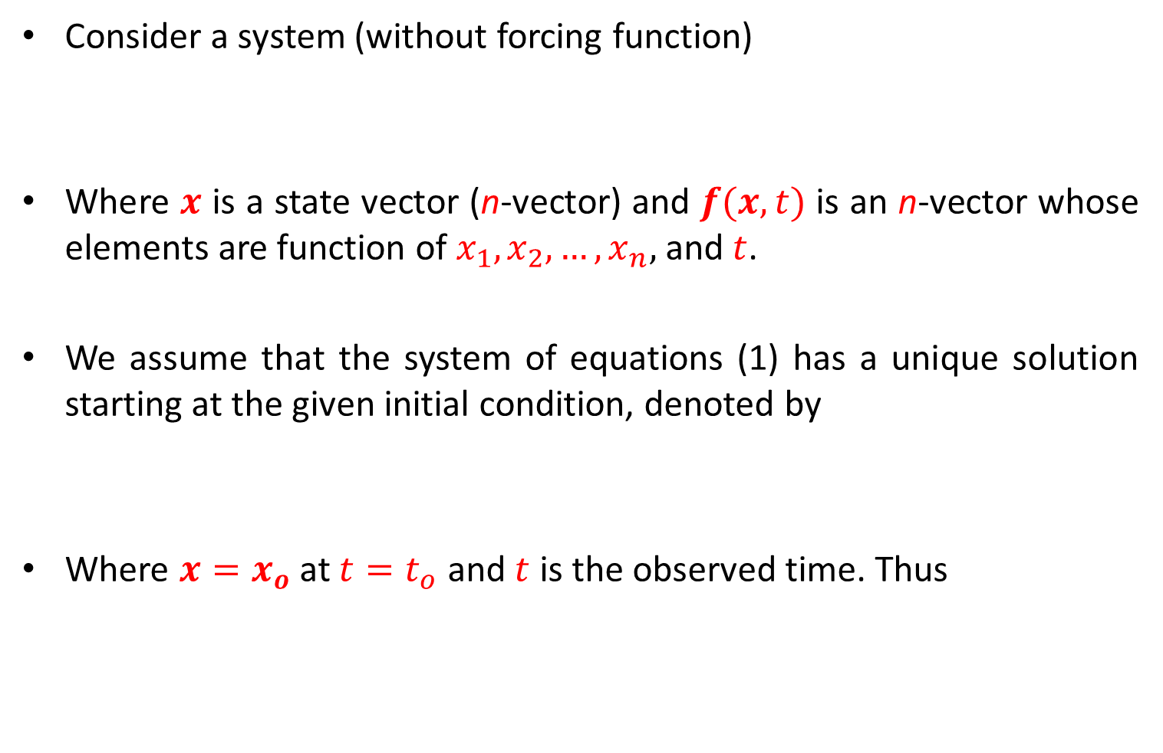
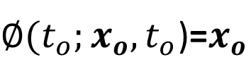
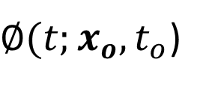
Introduction
Consider a system (without forcing function)
Where $x$ is a state vector (n-vector) and $f(x,t)$ is an n-vector whose elements are function of $x_{1},x_{2}, …,x_{n},$ and $t$.
We assume that the system of equations (1) has a unique solution starting at the given initial condition, denoted by
Where $x=x_{o}$ at $t=t_{o}$ and $t$ is the observed time. Thus
$$\dot{x}=f(x,t)$$
(1)
$∅(t;x_{o},t_{o}$)
$∅(t_{o};x_{o},t_{o}$)=$x_{o}$

Slide 4
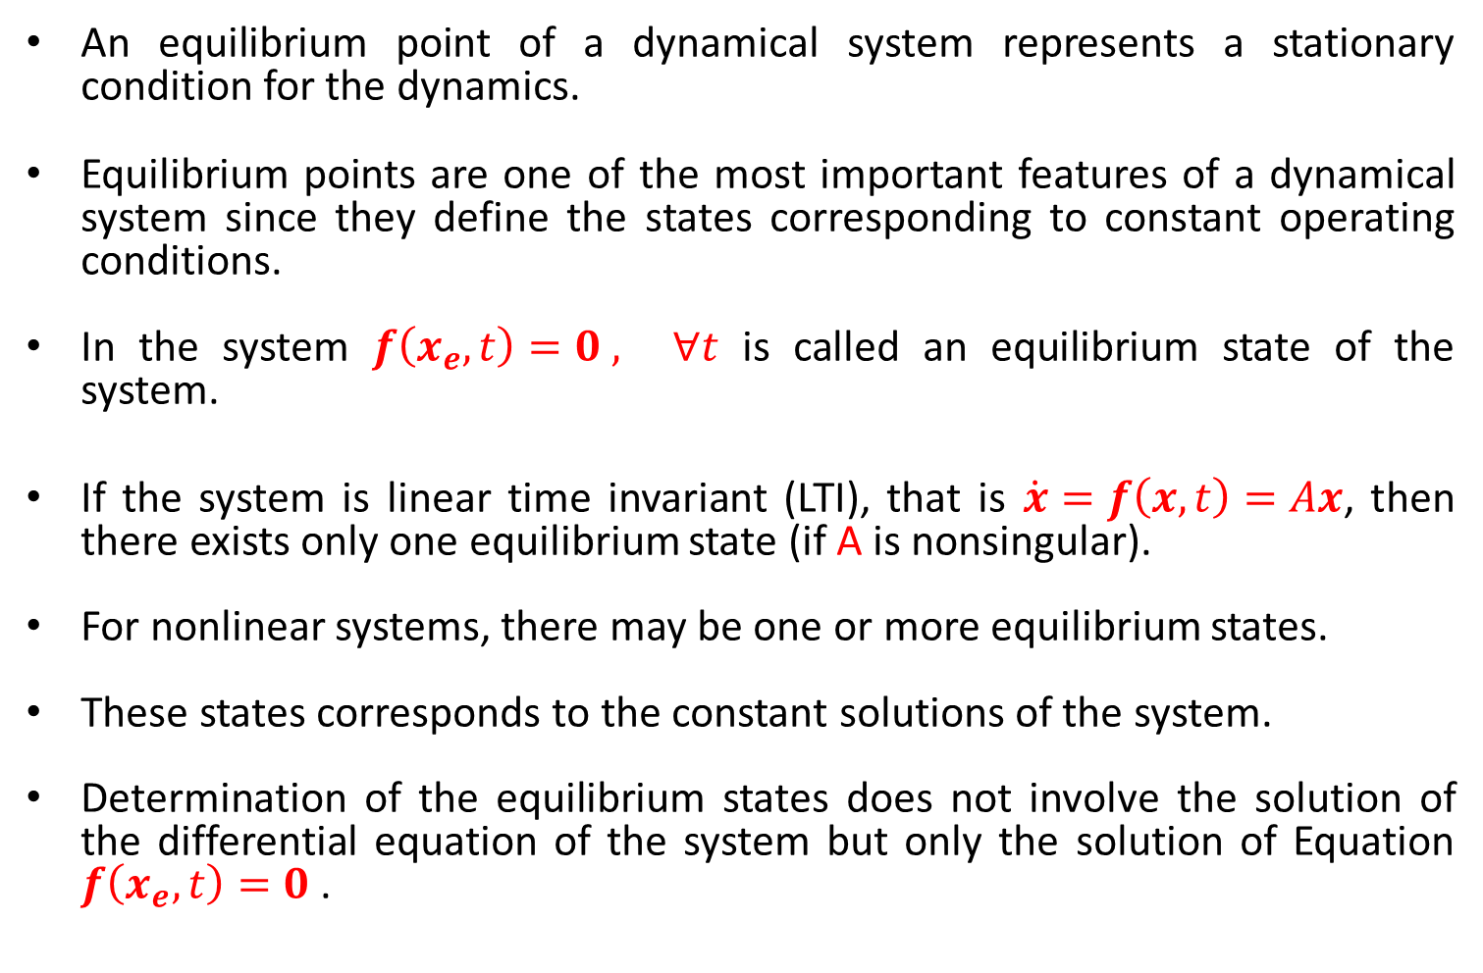
Equilibrium State
An equilibrium point of a dynamical system represents a stationary condition for the dynamics.
Equilibrium points are one of the most important features of a dynamical system since they define the states corresponding to constant operating conditions.
In the system $f\left(x_{e},t\right)=0 , ∀t$ is called an equilibrium state of the system.
If the system is linear time invariant (LTI), that is $\dot{x}=f\left(x,t\right)=Ax$, then there exists only one equilibrium state (if A is nonsingular).
For nonlinear systems, there may be one or more equilibrium states.
These states corresponds to the constant solutions of the system.
Determination of the equilibrium states does not involve the solution of the differential equation of the system but only the solution of Equation $f\left(x_{e},t\right)=0$.

Slide 5


Equilibrium States
Example-1: Consider the second-order system with state variables $v_{c}$ and $i_{L}$ whose dynamics are described via the equations
Only equilibrium point of the system is at origin of state space.
i_{L}
+
+
V_{c}
V_{o}
-
-

Slide 6

Equilibrium States
Example-1: Consider the second-order system with state variables $v_{c}$ and $i_{L}$ whose dynamics are described via the equations
Only equilibrium point of the system is at origin of state space.

Slide 7

Equilibrium States
Example-1: Consider the second-order system with state variables $v_{c}$ and $i_{L}$ whose dynamics are described via the equations
Only equilibrium point of the system is at origin of state space.

Slide 8



Equilibrium States
Example-2: Consider the second-order system with state variables $r$ and $θ$ whose dynamics are most easily described in polar coordinates via the equations
It is easy to see that there are precisely two equilibrium points: one at the origin, and the other at r = 1, $θ$= 0.
$$\dot{θ}=sin2{(\frac{θ}{2})}$$
$$\dot{r}=r(1−r)$$

Slide 9
Phase Portrait
When the state variables are represented in phase variable form the resulting state space is called phase plane.
The state space trajectories plotted in phase plane for number of different initial conditions is called phase portrait.
Phase portrait helps to graphically visualize stability of an equilibrium state.
Phase portraits can generally only be plotted for two dimensions dynamical systems, but they often give insight into the dynamics of much more complicated systems.
The stable system if system released from an initial condition converges to equilibrium point as time increased indefinitely.

Slide 10


Phase Portrait
Example-3: Consider a system with state equations given below (in phase variable form)
$${\dot{x}}_{1}=x_{2}$$
$${\dot{x}}_{2}=−x_{1}−x_{2}$$

Slide 11



Phase Portrait
Example-4: Consider the second-order system with state variables $r$ and $θ$ whose dynamics are most easily described in polar coordinates via the equations
There are two equilibrium points: one at the origin, and the other at r = 1, $θ$= 0.
$$\dot{θ}=sin2{(\frac{θ}{2})}$$
$$\dot{r}=r(1−r)$$

Slide 12
Liapunov Stability Analysis
For a given control system stability is usually most important thing to be determined.
If the system is linear and time invariant, many stability criteria are available (Nyquist stability, Routh Herwitz etc.).
If the system is nonlinear or linear but time varying such stability criteria do not apply.
Liapunov stability analysis is used to determine the stability of linear, nonlinear, time varying, time invariant systems.
There are two methods of Liapunov
  1st method
  2nd method (Direct method of Liapunov)

Slide 13
Liapunov Stability Analysis
Second method of Liapunov is the most general method for determination of stability of systems.
In addition this method is also useful for solving some optimization problems.

Slide 14
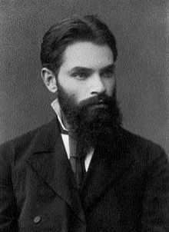
Second Method of Liapunov
In 1892 A. M Liapunov presented two methods (called first and second methods) for determining the stability of dynamic systems described by ordinary differential equations.
The first method consists of all procedures in which the explicit form of solution of differential equations are used for analysis.
The second method on the other hand does not require the solutions of the differential equations.

Slide 15



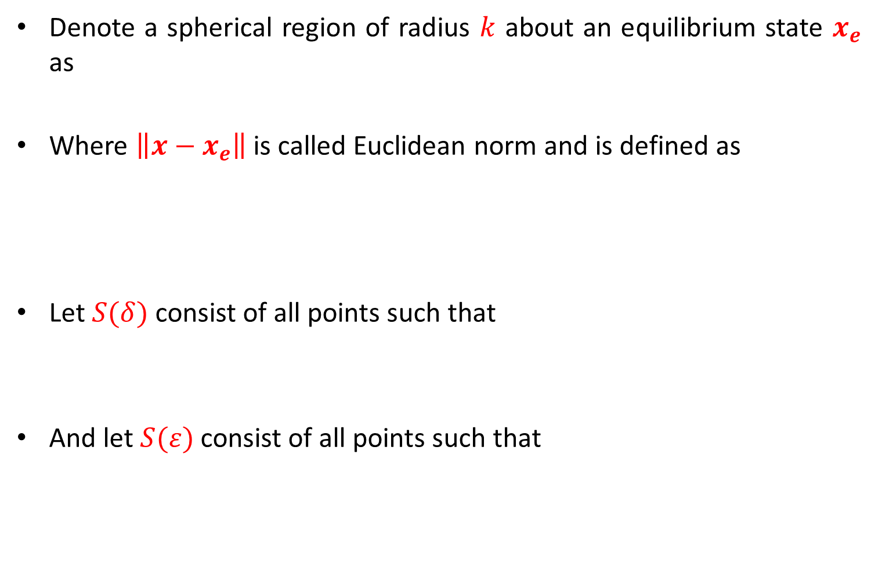




Stability in the Sense of Liapunov
Denote a spherical region of radius $k$ about an equilibrium state $x_{e}$ as
Where $\left\|{x−x}_{e}\right\|$ is called Euclidean norm and is defined as
Let $S(δ)$ consist of all points such that
And let $S(ε)$ consist of all points such that
$$\left\|{x−x}_{e}\right\|≤k$$
$$\left\|{x−x}_{e}\right\|=\sqrt{{\left(x_{1}−x_{1e}\right)}^{2}+{\left(x_{2}−x_{2e}\right)}^{2}+⋯+{\left(x_{n}−x_{ne}\right)}^{2}}$$
$S(δ)$
$$\left\|{x_{o}−x}_{e}\right\|≤δ$$
$$x_{o}$$
$$x_{e}$$
$$\left\|{{∅(t;x}_{o},t}_{o})−x_{e}\right\|≤ε$$
$S(ε)$

Slide 16



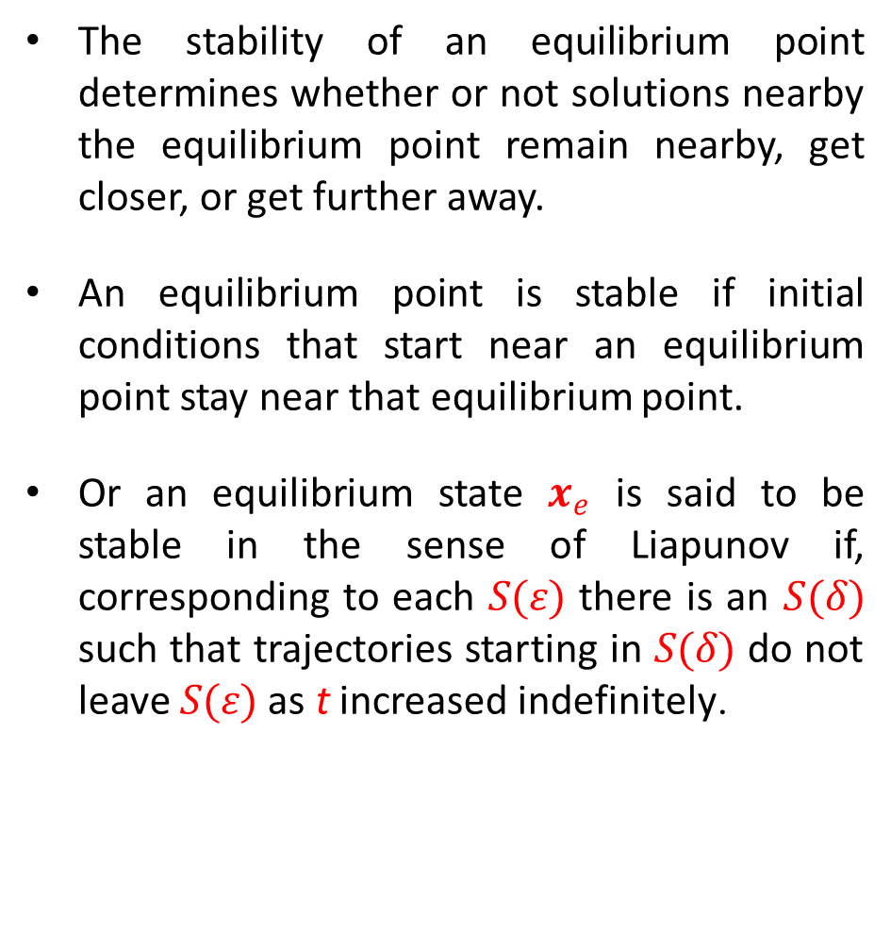



Stability in the Sense of Liapunov
The stability of an equilibrium point determines whether or not solutions nearby the equilibrium point remain nearby, get closer, or get further away.
An equilibrium point is stable if initial conditions that start near an equilibrium point stay near that equilibrium point.
Or an equilibrium state $x_{e}$ is said to be stable in the sense of Liapunov if, corresponding to each $S(ε)$ there is an $S(δ)$ such that trajectories starting in $S(δ)$ do not leave $S(ε)$ as t increased indefinitely.
$S(δ)$
$$x_{o}$$
$$x_{e}$$
$S(ε)$
$$\left\|{x_{o}−x}_{e}\right\|≤δ$$
$$\left\|{x(t)−x}_{e}\right\|≤ε$$
for all t > 0

Slide 17





Stability in the Sense of Liapunov
Asymptotic Stability
An equilibrium state $x_{e}$ of the system is said to be asymptotically stable if it is stable in the sense of Liapunov and if every solution starting within $S(δ)$ converges, without leaving $S(ε)$, to $x_{e}$ as t increases indefinitely.
This definition does not imply that x(t) gets closer to x_{e} as time increases, but just that it stays nearby.
$S(δ)$
$$x_{o}$$
$$x_{e}$$
$S(ε)$

Slide 18
Stability in the Sense of Liapunov
Asymptotic Stability
From the phase portrait, we see that if we start near the equilibrium then we stay near the equilibrium.

Slide 19





Stability in the Sense of Liapunov
Asymptotic Stability in large
If asymptotic stability holds for all sates from which trajectories originate the equilibrium state is said to be asymptotically stable in large.
That is, the equilibrium state $x_{e}$ is said to be asymptotically stable in large if it is stable and every solution converges to $x_{e}$ as t increased indefinitely.
$S(δ)$
$$x_{o}$$
$$x_{e}$$
$S(ε)$

Slide 20
Stability in the Sense of Liapunov
Asymptotic Stability in large
This corresponds to the case where all nearby trajectories converge to the equilibrium point for large time.
Note from the phase portraits that not only do all trajectories stay near the equilibrium point at the origin, but they all approach the origin as t gets large (the directions of the arrows on the phase plot show the direction in which the trajectories move).

Slide 21




Stability in the Sense of Liapunov
Instability
That is, the equilibrium state $x_{e}$ is said to be unstable if for some real number $ε>0$ and any real number $δ>0,$ no matter how small, there is always a state $x_{o}$in $S(δ)$ such the trajectory starting at this leaves $S(ε)$.
$S(δ)$
$$x_{o}$$
$$x_{e}$$
$S(ε)$

Slide 22
Stability in the Sense of Liapunov
Instability
Phase portrait for a system with a single unstable equilibrium point.

Slide 23
Example-4
Consider the spring mass system
Determine the equilibrium point and stability in the sense of Liapunov.

Slide 24
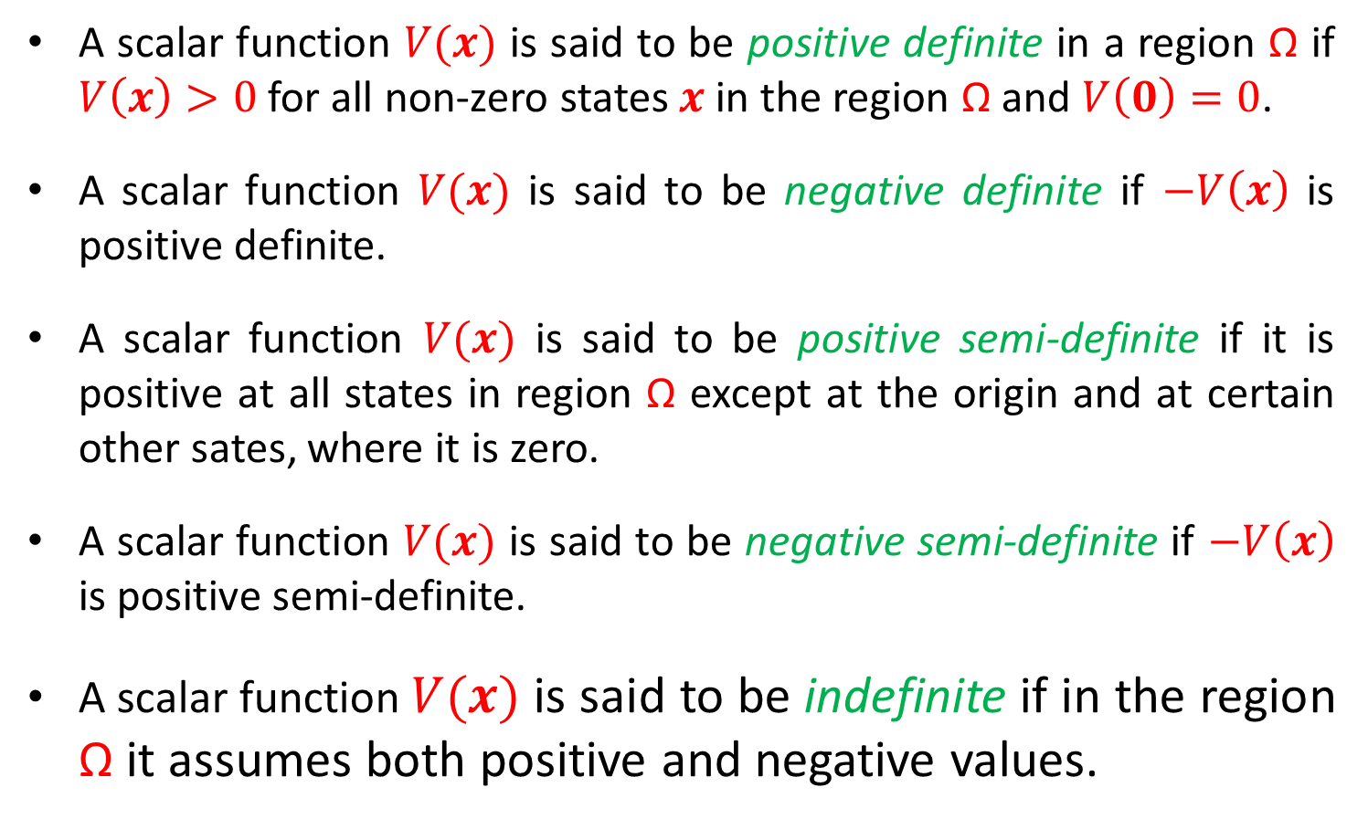
Positive Definiteness of a Scalar Function
A scalar function $V(x)$ is said to be positive definite in a region Ω if $V\left(x\right)>0$ for all non-zero states $x$in the region Ω and $V\left(0\right)=0$.
A scalar function $V(x)$ is said to be negative definite if $−V\left(x\right)$ is positive definite.
A scalar function $V(x)$ is said to be positive semi-definite if it is positive at all states in region Ω except at the origin and at certain other sates, where it is zero.
A scalar function $V(x)$ is said to be negative semi-definite if $−V\left(x\right)$ is positive semi-definite.
A scalar function $V(x)$ is said to be indefinite if in the region Ω it assumes both positive and negative values.

Slide 25
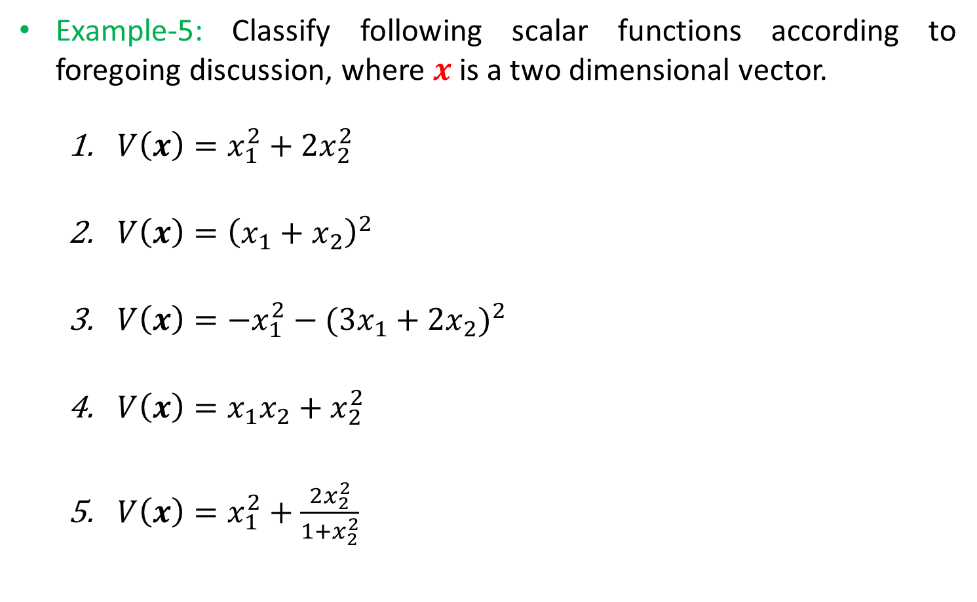
Positive Definiteness of a Scalar Function
Example-5: Classify following scalar functions according to foregoing discussion, where $x$ is a two dimensional vector.
  $V\left(x\right)=x_{1}^{2}+2x_{2}^{2}$
  $V\left(x\right)={\left(x_{1}+x_{2}\right)}^{2}$
  $V\left(x\right)={−x}_{1}^{2}−{(3x_{1}+2x_{2})}^{2}$
  $V\left(x\right)=x_{1}x_{2}+x_{2}^{2}$
  $V\left(x\right)=x_{1}^{2}+\frac{2x_{2}^{2}}{1+x_{2}^{2}}$
Positive Definite
Positive semi-definite
Negative Definite
Indefinite
Positive Definite

Slide 26
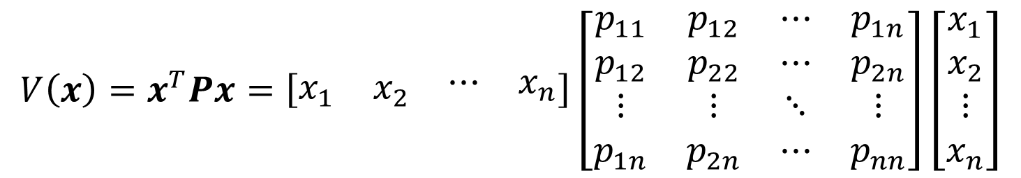
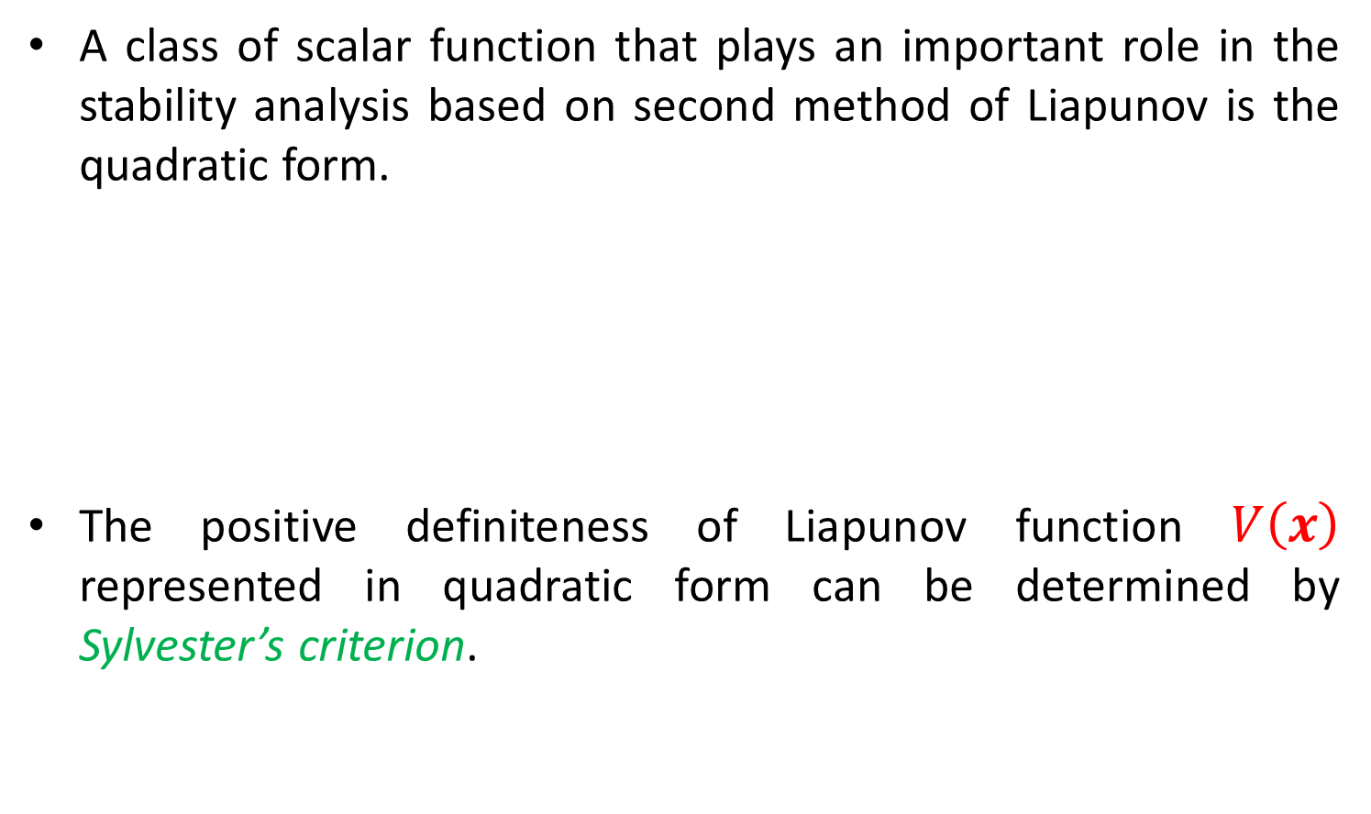
Quadratic Form
A class of scalar function that plays an important role in the stability analysis based on second method of Liapunov is the quadratic form.
The positive definiteness of Liapunov function $V\left(x\right)$ represented in quadratic form can be determined by Sylvester’s criterion.
$$V\left(x\right)=x^{T}Px=\left[\begin{matrix}x_{1} & x_{2} & \begin{matrix}⋯ & x_{n}\end{matrix}\end{matrix}\right]\left[\begin{matrix}p_{11} & p_{12} & ⋯ & p_{1n} \\ p_{12} & p_{22} & ⋯ & p_{2n} \\ ⋮ & ⋮ & ⋱ & ⋮ \\ p_{1n} & p_{2n} & ⋯ & p_{nn}\end{matrix}\right]\left[\begin{matrix}x_{1} \\ x_{2} \\ \begin{matrix}⋮ \\ x_{n}\end{matrix}\end{matrix}\right]$$

Slide 27

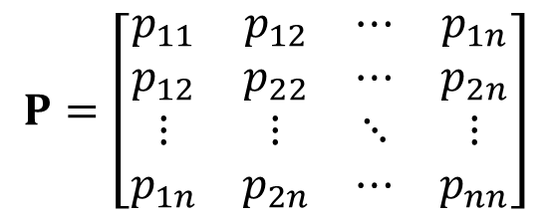

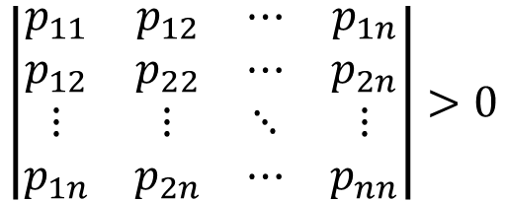


Sylvester’s Criterion
Sylvester’s criterion states that the necessary and sufficient conditions that the quadratic form $V(x)$ be positive definite are that all principle minors of P be positive.
That is
$$P=\left[\begin{matrix}p_{11} & p_{12} & ⋯ & p_{1n} \\ p_{12} & p_{22} & ⋯ & p_{2n} \\ ⋮ & ⋮ & ⋱ & ⋮ \\ p_{1n} & p_{2n} & ⋯ & p_{nn}\end{matrix}\right]$$
$$\left|\begin{matrix}p_{11} & p_{12} & ⋯ & p_{1n} \\ p_{12} & p_{22} & ⋯ & p_{2n} \\ ⋮ & ⋮ & ⋱ & ⋮ \\ p_{1n} & p_{2n} & ⋯ & p_{nn}\end{matrix}\right|>0$$
$$p_{11}>0$$
$$\left|\begin{matrix}p_{11} & p_{12} \\ p_{12} & p_{22}\end{matrix}\right|>0$$
$$…$$

Slide 28
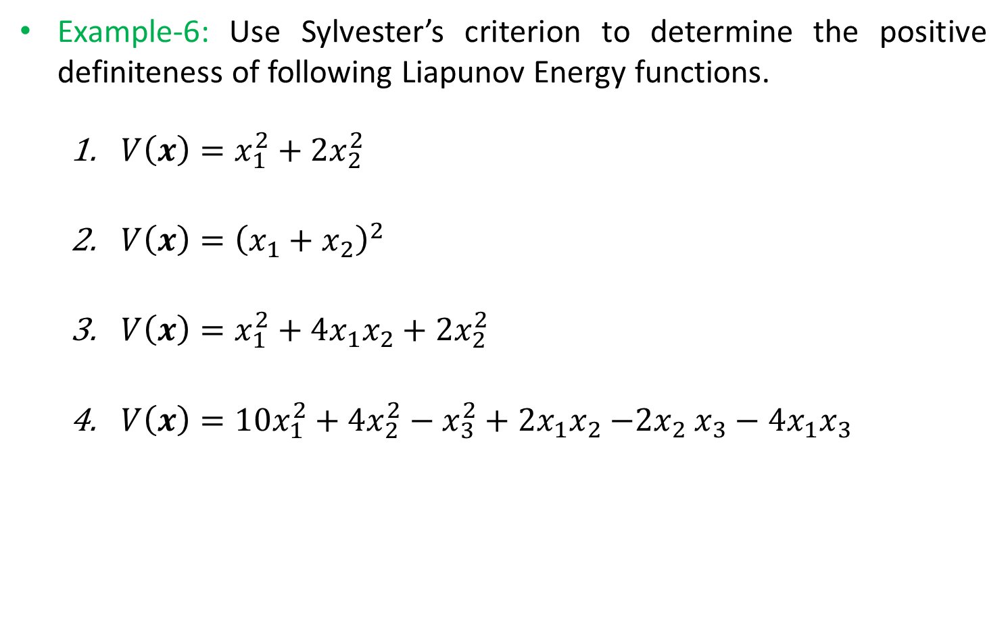
Positive Definiteness of a Scalar Function
Example-6: Use Sylvester’s criterion to determine the positive definiteness of following Liapunov Energy functions.
  $V\left(x\right)=x_{1}^{2}+2x_{2}^{2}$
  $V\left(x\right)={\left(x_{1}+x_{2}\right)}^{2}$
  $V\left(x\right)=x_{1}^{2}+4x_{1}x_{2}+2x_{2}^{2}$
  $V\left(x\right)=10x_{1}^{2}+4x_{2}^{2}−x_{3}^{2}+2x_{1}x_{2}{−2x}_{2}x_{3}−4x_{1}x_{3}$

Slide 29
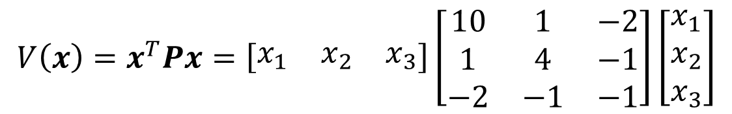




Positive Definiteness of a Scalar Function
Example-6.4: Use Sylvester’s criterion to determine the positive definiteness of following Liapunov Energy functions.
  $V\left(x\right)=10x_{1}^{2}+4x_{2}^{2}−x_{3}^{2}+2x_{1}x_{2}{−2x}_{2}x_{3}−4x_{1}x_{3}$
$$V\left(x\right)=x^{T}Px=\left[\begin{matrix}x_{1} & x_{2} & x_{3}\end{matrix}\right]\left[\begin{matrix}10 & 1 & −2 \\ 1 & 4 & −1 \\ −2 & −1 & −1\end{matrix}\right]\left[\begin{matrix}x_{1} \\ x_{2} \\ x_{3}\end{matrix}\right]$$
$$\left|\begin{matrix}10 & 1 \\ 1 & 4\end{matrix}\right|>0$$
$$\left|\begin{matrix}10 & 1 & −2 \\ 1 & 4 & −1 \\ −2 & −1 & −1\end{matrix}\right|>0$$
$$10>0$$

Slide 30
End of Lectures-37-38
To download this lecture visit
http://imtiazhussainkalwar.weebly.com/

