Slide 1
Feedback Control Systems (FCS)
Lecture-31
Nichol’s Chart
Dr. Imtiaz Hussain
email: imtiaz.hussain@faculty.muet.edu.pk
URL :http://imtiazhussainkalwar.weebly.com/

Slide 2
Nichol’s Chart (Log-magnitude vs Phase Plot)
Another approach to graphically portraying the frequency-response characteristics is to use the log-magnitude-versus-phase plot.
Which is a plot of the logarithmic magnitude in decibels versus the phase angle for a frequency range of interest.
In the manual approach the log-magnitude-versus-phase plot can easily be constructed by reading values of the log magnitude and phase angle from the Bode diagram.
Advantages of the log-magnitude-versus-phase plot are that the relative stability of the closed-loop system can be determined quickly and that compensation can be worked out easily.

Slide 3
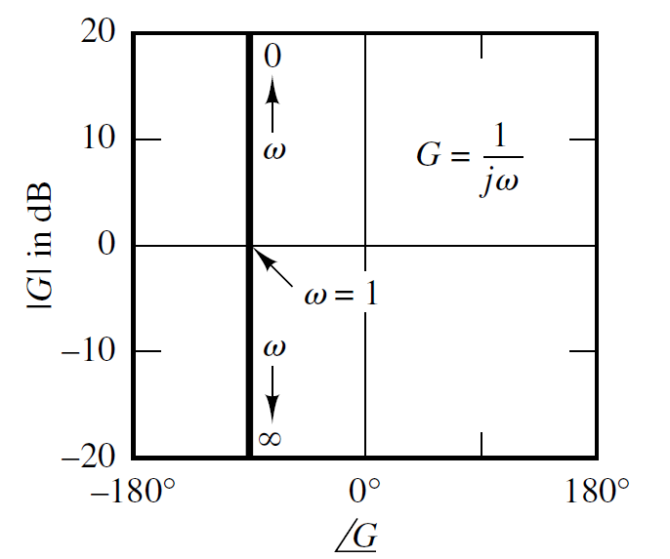
Nichol’s Chart of simple transfer functions
ω | db | φ
0 | ∞ | -90º
0.5 | 6 | -90º
1 | 0 | -90º
2 | -6 | -90º
∞ | -∞ | -90º

Slide 4
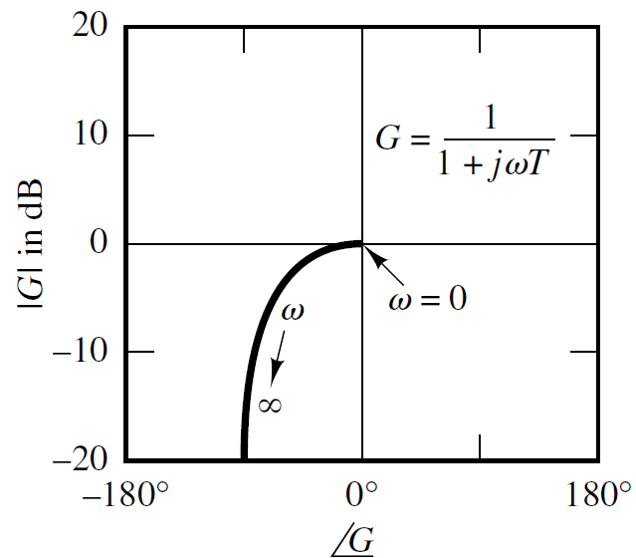
Nichol’s Chart of simple transfer functions

Slide 5
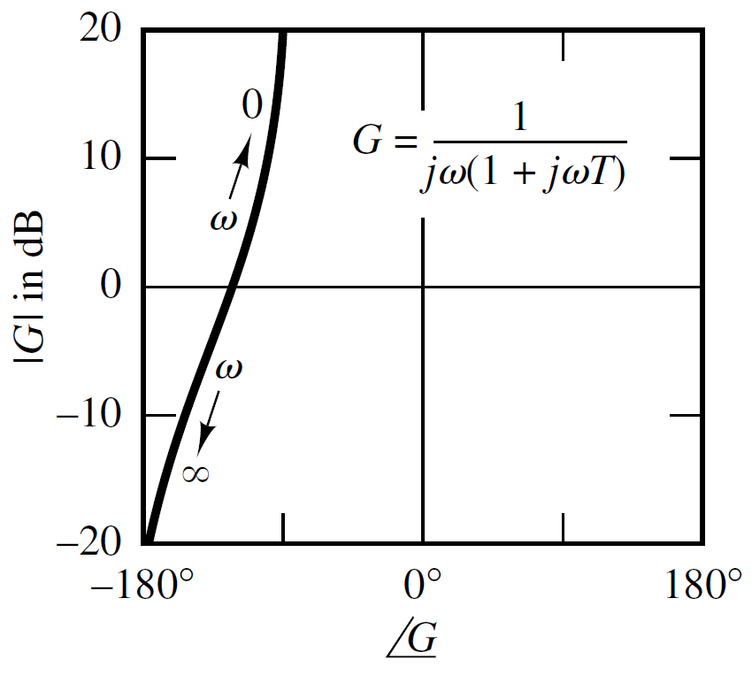
Nichol’s Chart of simple transfer functions

Slide 6
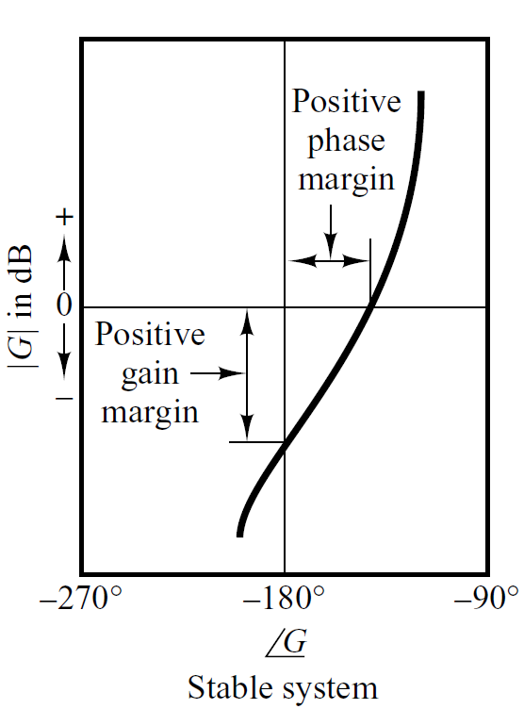
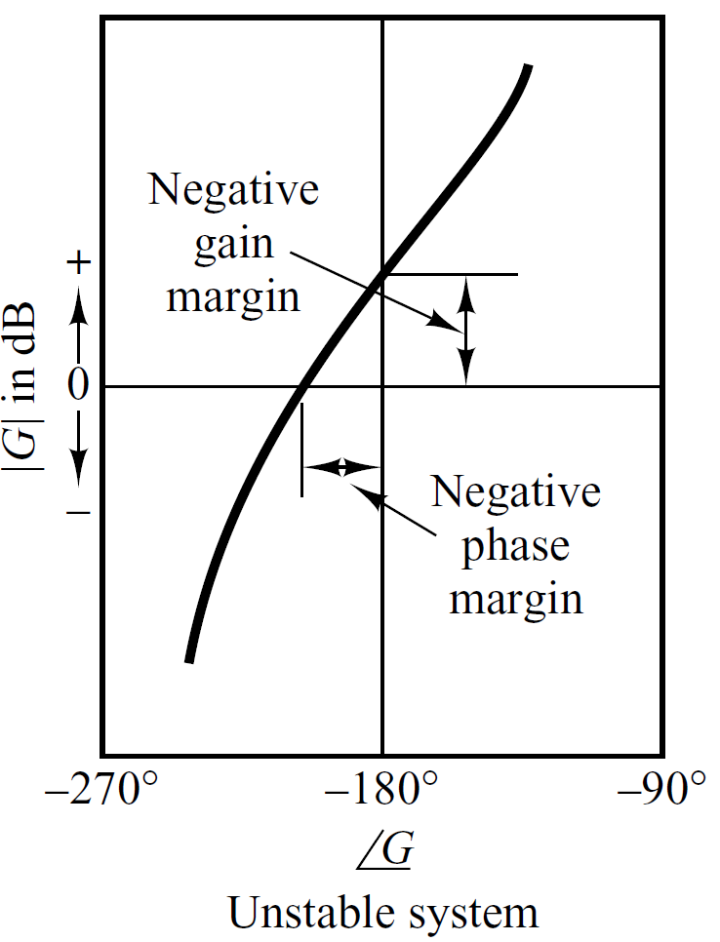
Relative Stability

Slide 7
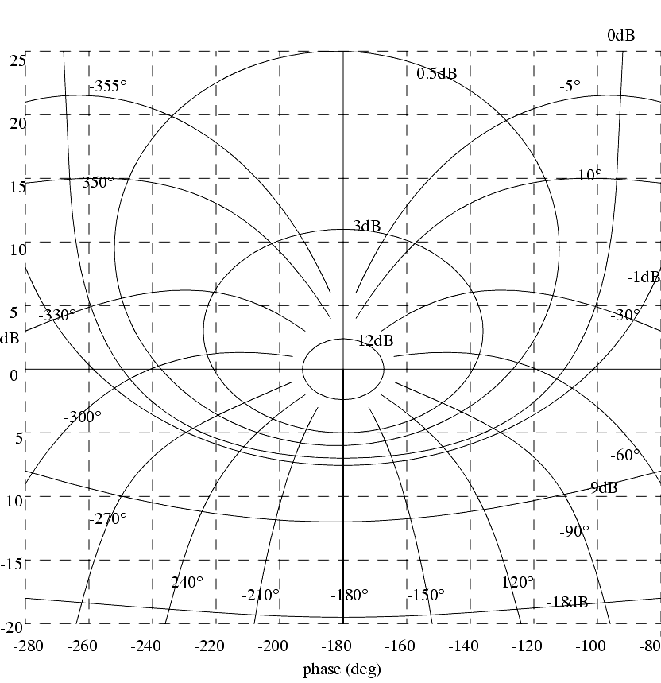

Slide 8
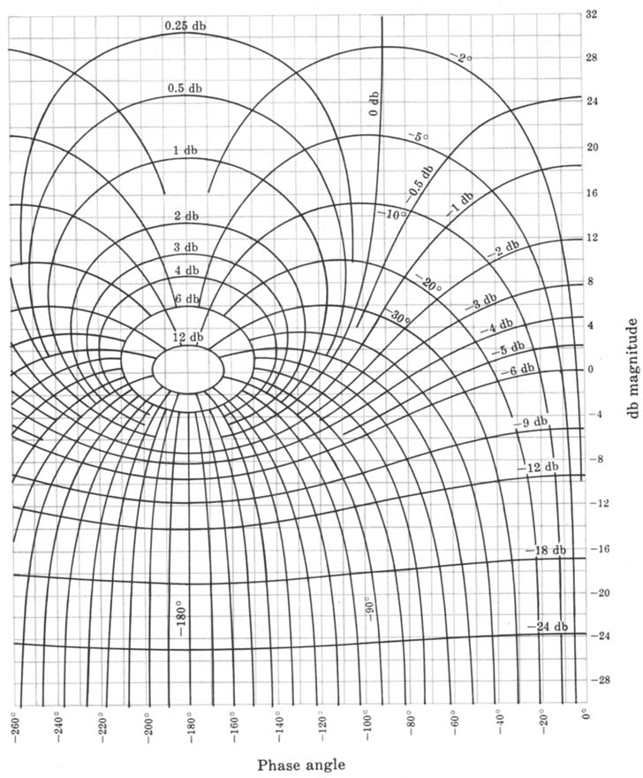

Slide 9
Example#1
Draw the Nichol’s Chart of following open loop transfer function and obtain the Gain Margin and Phase Margin.
Solution

Slide 10
Example#1

Slide 11
Example#1
ω
0.01 | 30 | -90º
0.1 | 10.3 | -97.5º
0.5 | -4.4 | -125º
1 | -14 | -153º
2 | -22 | -180º
10 | -26 | -189º

Slide 12
ω
0.01 | 30 | -90º
0.1 | 10.3 | -97.5º
0.5 | -4.4 | -125º
1 | -14 | -153º
2 | -22 | -180º
10 | -26 | -189º

Slide 13
Phase Margin=70⁰
Gain Margin=22 db
Gain Cross over point
Phase Cross over point

Slide 15
End of Lecture-31
To download this lecture visit
http://imtiazhussainkalwar.weebly.com/

