Slide 1
Communication Systems (EE-341)
Lecture-2
Introduction Part-2
Dr. Imtiaz Hussain
Associate Professor (Control Systems),
School of Electrical Engineering
DHA Suffa University, Karachi, Pakistan
email: imtiaz.hussain@dsu.edu.pk
URL :http://imtiazhussainkalwar.weebly.com/
5th Semester (Sec-5A)
Location GF-030
Monday-Wednesday-Friday 11:00 am
Note: I do not claim any originality in these lectures. The contents of this presentation are mostly taken from the book Communication Systems, by Simon Haykin and various other internet sources.

Slide 2
Outline
Elements of Electrical Communication System
Analog Communication System
Digital Communication System
Transmission Media
Guided Media
Unguided Media

Slide 3
Electrical Communication System
Electrical communication systems are designed to send messages or information from a source that generates the messages to one or more destinations.

Slide 4
Electrical Communication System
In general, a communication system can be represented by the functional block diagram shown in following Figure.
Information Source and Input Transducer
Transmitter
Noise
Channel
Output
Signal
Output Transducer
Receiver

Slide 5
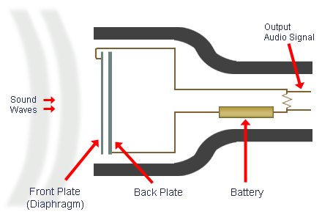
Electrical Communication System
A transducer is usually required to convert the output of a source into an electrical signal that is suitable for transmission.
For example, a microphone serves as the transducer that converts an acoustic speech signal into an electrical signal, and a video camera converts an image into an electrical signal.

Slide 6
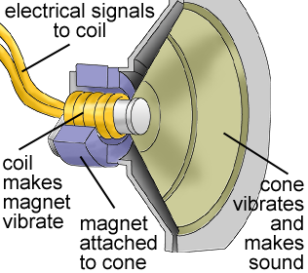
Electrical Communication System
At the destination, a similar transducer is required to convert the electrical signals that are received into a form that is suitable for the user; e.g., acoustic signals, images, etc.

Slide 7
Electrical Communication System
The heart of the communication system consists of three basic parts, namely, the transmitter, the channel, and the receiver.
Transmitter
Channel
Receiver

Slide 8
Transmitter
The transmitter converts the electrical signal into a form that is suitable for transmission through the physical channel or transmission medium.
For example, in radio and TV broadcast, the Federal Communications Commission (FCC in USA, PTA, FAB, in Pakistan) specifies the frequency range for each transmitting station.
Hence, the transmitter must translate the information signal to be transmitted into the appropriate frequency range that matches the frequency allocation assigned to the transmitter.
Thus, signals transmitted by multiple radio stations do not interfere with one another.

Slide 9
Transmitter
In general, the transmitter performs the matching of the message signal to the channel by a process called modulation.
Usually, modulation involves the use of the information signal to systematically vary either the amplitude, frequency, or phase of a sinusoidal carrier.

Slide 10
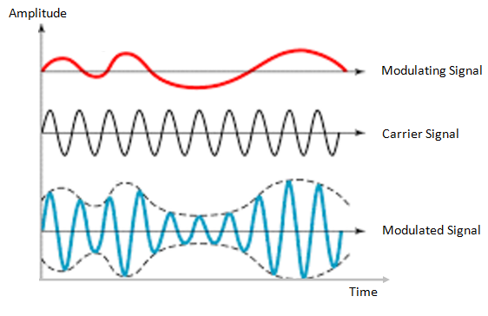
Transmitter
For example, in AM radio broadcast, the information signal that is transmitted is contained in the amplitude variations of the sinusoidal carrier, which is the center frequency in the frequency band allocated to the radio transmitting station.

Slide 11
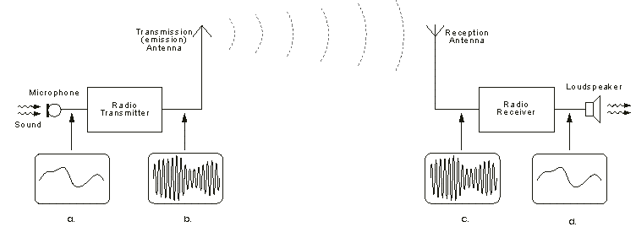
AM Transmission

Slide 12
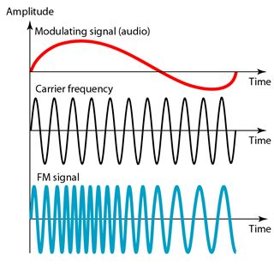
Transmitter
In FM radio broadcast, the information signal that is transmitted is contained in the frequency variations of the sinusoidal carrier.

Slide 13
Transmitter
Thus, through the process of modulation, the information signal is translated in frequency to match the allocation of the channel.
The choice of the type of modulation is based on several factors, such as:
amount of bandwidth allocated,
types of noise and interference that the signal encounters in transmission over the channel
electronic devices that are available for signal amplification prior to transmission.

Slide 14
Channel
The communications channel is the physical medium that is used to send the signal from the transmitter to the receiver.
In wireless transmission, the channel is usually the atmosphere (free space).
On the other hand, telephone channels usually employ a variety of physical media, including copper wires and optical fiber cables.

Slide 15
Channel
Whatever the physical medium for signal transmission, the essential feature is that the transmitted signal is corrupted in a random manner by a variety of possible mechanisms.
The most common form of signal degradation comes in the form of additive noise, which is generated at the front end of the receiver, where signal amplification is performed.
This noise is often called thermal noise.

Slide 16
Channel
In wireless transmission, additional additive disturbances are man-made noise, and atmospheric noise picked up by a receiving antenna.
Automobile ignition noise is an example of man-made noise.
Electrical lightning discharges from thunderstorms is an example of atmospheric noise.
Interference from other users of the channel is another form of additive noise that often arises in both wireless and wireline communication systems.

Slide 17
Channel
In the design of a communication system, the system designer works with mathematical models that statistically characterize the signal distortion encountered on physical channels.
Often, the statistical description that is used in a mathematical model is a result of actual empirical measurements obtained from experiments involving signal transmission over such channels.

Slide 18
Receiver
The function of the receiver is to recover the message signal contained in the received signal.
If the message signal is transmitted by carrier modulation, the receiver performs carrier demodulation in order to extract the message from the sinusoidal carrier.

Slide 19
Receiver
Besides performing the primary function of signal demodulation, the receiver also performs a number of peripheral functions, including signal filtering and noise suppression.

Slide 20
Receiver
Since the signal demodulation is performed in the presence of additive noise and possibly other signal distortion, the demodulated message signal is generally degraded to some extent by the presence of these distortions in the received signal.
The fidelity of the received message signal is a function of
Type of modulation,
Strength of the additive noise
Type of any non-additive interference.

Slide 21
Digital Communication System
Up to this point we have described an electrical communication system in rather broad terms based on the implicit assumption that the message signal is a continuous time varying waveform.
We refer to such continuous-time signal waveforms as analog signals and to the corresponding information sources that produce such signals as analog sources.
Analog signals can be transmitted directly via carrier modulation over the communication channel and demodulated accordingly at the receiver.
We call such a communication system an analog communication system.

Slide 22
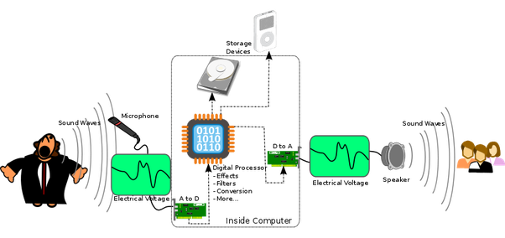
Digital Communication System
Alternatively, an analog source output may be converted into a digital form and the message can be transmitted via digital modulation and demodulated as a digital signal at the receiver.

Slide 23
Digital Communication System
There are Some potential advantages to transmitting an analog signal by means of digital modulation.
The most important reason is that signal fidelity is better controlled through digital transmission than analog transmission.

Slide 24
Digital Communication System
Following figure illustrates the functional diagram and the basic elements of a digital communication system.
Information Source and Input Transducer
Source Encoder
Channel Encoder
Digital Modulator
Channel
Output
Signal
Output Transducer
Source Decoder
Channel Decoder
Digital
demodulator

Slide 25
Digital Communication System
The process of efficiently converting the output of either an analog or a digital source into a sequence of binary digits is called source encoding.
The sequence of binary digits from the source encoder, which we call the information sequence is passed to the channel encoder.
The purpose of the channel encoder is to introduce, in a controlled manner, some redundancy in the binary information sequence which can be used at the receiver to overcome the effects of noise and interference encountered in the transmission of the signal through the channel.

Slide 26
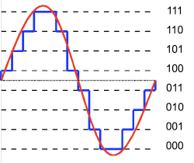
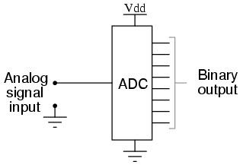
Source Encoding
The process of efficiently converting the output of either an analog or a digital source into a sequence of binary digits is called source encoding.

Slide 27
Channel Encoding
A major feature of digital data transmission is the myriad techniques used to protect data or speech through coding.
Coding adds additional bits to the original payload to provide a means of protecting the original information.

Slide 28
Digital Modulator
The binary sequence at the output of the channel encoder is passed to the digital modulator, which serves as the interface to the communications channel.

Slide 29
Digital Modulator
Since nearly all of the communication channels encountered in practice are capable of transmitting electrical signals (waveforms), the primary purpose of the digital modulator is to map the binary information sequence into signal waveforms.

Slide 30
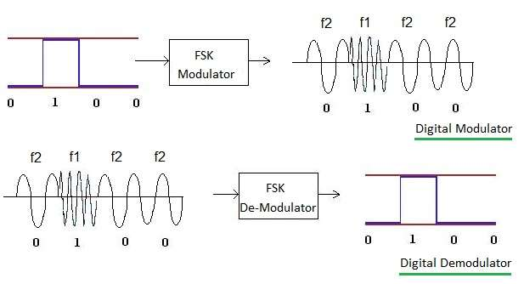
Digital Demodulator
At the receiving end of a digital communications system, the digital demodulator processes the channel-corrupted transmitted waveform and reduces each waveform to a single number that represents an estimate of the transmitted data symbol.

Slide 31
Channel Decoder
Recovery

Slide 32
Source Decoder
As- a final step, when an analog output is desired, the source decoder accepts the output sequence from the channel decoder and, from knowledge of the source encoding method used, attempts to reconstruct the original signal from the source.

Slide 33
Digital versus analog
Advantages of digital communications:
Regenerator receiver
Different kinds of digital signal are treated identically.
Original
pulse
Regenerated
pulse
Propagation distance
Voice
Data
A bit is a bit!
Media

Slide 34
End of Lecture-2
To download this lecture visit
http://imtiazhussainkalwar.weebly.com/

