Slide 1
Feedback Control Systems (FCS)
Lecture-26
Routh-Herwitz Stability Criterion
Dr. Imtiaz Hussain
email: imtiaz.hussain@faculty.muet.edu.pk
URL :http://imtiazhussainkalwar.weebly.com/

Slide 2
Stability of Higher Order Systems
Un-Stable
Stable

Slide 3
Routh-Hurwitz Stability Criterion
It is a method for determining continuous system stability.
The Routh-Hurwitz criterion states that “the number of roots of the characteristic equation with positive real parts is equal to the number of changes in sign of the first column of the Routh array”.

Slide 4
Routh-Hurwitz Stability Criterion
This method yields stability information without the need to solve for the closed-loop system poles.
Using this method, we can tell how many closed-loop system poles are in the left half-plane, in the right half-plane, and on the jw-axis. (Notice that we say how many, not where.)
The method requires two steps:
Generate a data table called a Routh table.
interpret the Routh table to tell how many closed-loop system poles are in the LHP, the RHP, and on the jw-axis.

Slide 5
Routh’s Stability Condition
If the closed-loop transfer function has all poles in the left half of the s-plane, the system is stable. Thus, a system is stable if there are no sign changes in the first column of the Routh table.
The Routh-Hurwitz criterion declares that the number of roots of the polynomial that are lies in the right half-plane is equal to the number of sign changes in the first column. Hence the system is unstable if the poles lies on the right hand side of the s-plane.

Slide 6
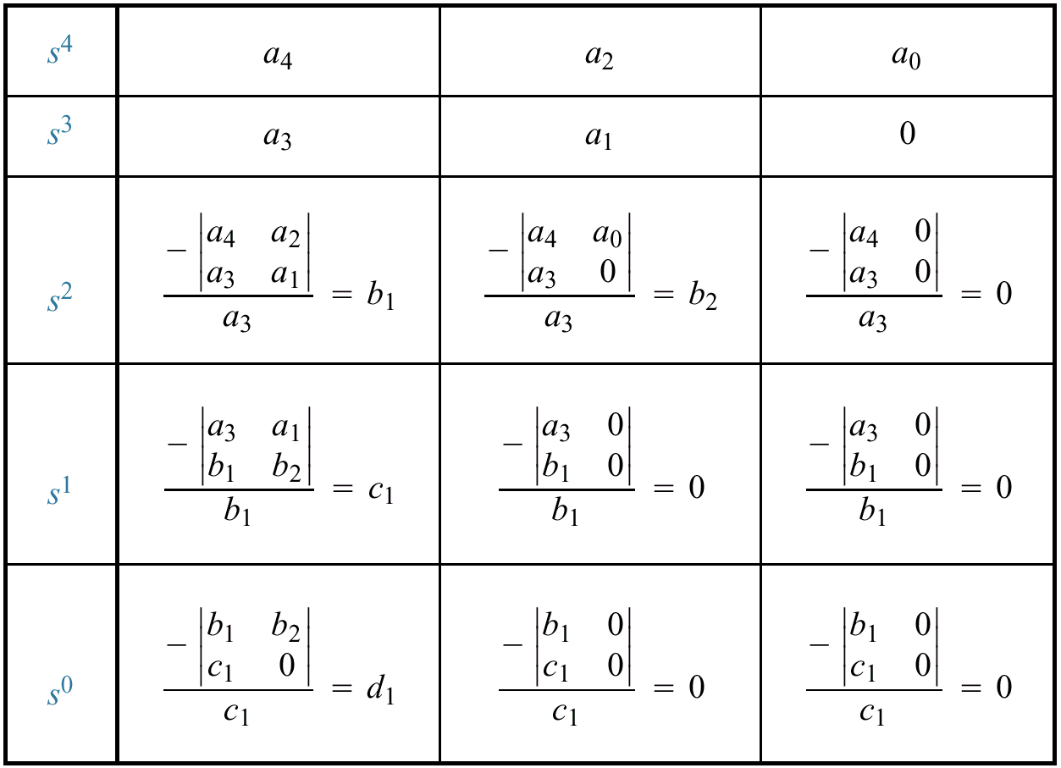
Generating a basic Routh Table
Only the first 2 rows of the array are obtained from the characteristic eq. the remaining are calculated as follows;

Slide 7
Example#1
Consider the following characteristics equation:
Develop Routh array and determine the stability of the system.

Slide 8
Example#2
Consider the following system:
Develop Routh array and determine the stability of the system.

Slide 9
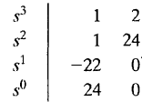
Example#3
Find the stability of the continues system having the characteristic polynomial of a third order system is given below
The Routh array is
Because TWO changes in sign appear in the first column, we find that two roots of the characteristic equation lie in the right hand side of the s-plane. Hence the system is unstable.

Slide 10
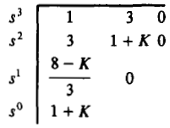
Example#4
Determine a rang of values of a system parameter K for which the system is stable.
The Routh table of the given system is computed and shown is the table below;
For system stability, it is necessary that the conditions 8 – k >0, and 1 + k > 0, must be satisfied. Hence the rang of values of a system parameter k must lie between -1 and 8 (i.e., -1 < k < 8).

Slide 11
Special Cases
Case-1: Zero in the first column
If first element of a row is zero, division by zero would be required to form the next row.
To avoid this phenomenon, zero is replaced by a very small number (say є).

Slide 12
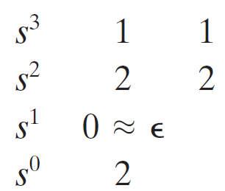
Example#5

Slide 13
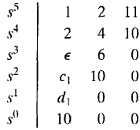
Example#5
Determine the stability of the system having a characteristic equation given below;
The Routh array is shown in the table;
Where
There are TWO sign changes due to the large negative number in the first column,
Therefore the system is unstable, and two roots of the equation lie in the right half of the s-plane.

Slide 14
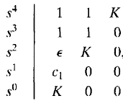
Determine the range of parameter K for which the system is unstable.
Example#6
The Routh array of the above characteristic equation is shown below;
Where
Therefore, for any value of K greater than zero, the system is unstable.
Also, because the last term in the first column is equal to K, a negative value of K will result in an unstable system.
Consequently, the system is unstable for all values of gain K.

Slide 15
Case-II: Entire Row is Zero.
Sometimes while making a Routh table, we find that an entire row consists of zeros.
This happen because there is an even polynomial that is a factor of the original polynomial.
This case must be handled differently from the case of a zero in only the first column of a row.

Slide 16
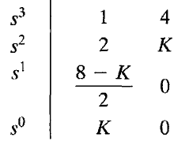
Example-7: Determine the stability of the system.
The characteristic equation q(s) of the system is
Where K is an adjustable loop gain.
The Routh array is then;
For a stable system, the value of K must be;

Slide 17
Example-7: Determine the stability of the system.
Also, when K = 8, we obtain a row of zeros (Case-II).
The auxiliary polynomial, U(s), is the equation of the row preceding the row of Zeros.
The U(s) in this case, obtained from the s² row.
The order of the auxiliary polynomial is always even and indicates the number of symmetrical root pairs.

Slide 18
Example-7: Determine the stability of the system.
The auxiliary polynomial, U(s), can be obtain as;

Slide 19
Example#8
Consider the following characteristic equation. Determine the range of K for stability.

Slide 20
End of Lectures-26
To download this lecture visit
http://imtiazhussainkalwar.weebly.com/

