Slide 1
Digital Control Systems (DCS)
Lecture-20-21
Time Response and Steady State Errors of Discrete Time Control Systems
Dr. Imtiaz Hussain
Assistant Professor
email: imtiaz.hussain@faculty.muet.edu.pk
URL :http://imtiazhussainkalwar.weebly.com/

Slide 2
Lecture Outline
Introduction
Time Response of DT System
Examples
Final Value Theorem
Examples
Steady State Errors

Slide 3
Introduction
The time response of a discrete-time linear system is the solution of the difference equation governing the system.
For the linear time-invariant (LTI) case, the response due to the initial conditions and the response due to the input can be obtained separately and then added to obtain the overall response of the system.
The response due to the input, or the forced response, is the convolution summation of its input and its response to a unit impulse.

Slide 4
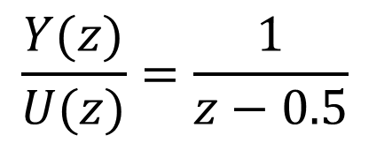
Example-1
Given the discrete-time system
Find the impulse response of the system.
Taking z-transform
$$y\left(k+1\right)−0.5y\left(k\right)=u\left(k\right)$$
Solution
$$zY\left(z\right)−0.5Y\left(z\right)=U\left(z\right)$$
$$\frac{Y(z)}{U(z)}=\frac{1}{z−0.5}$$

Slide 5
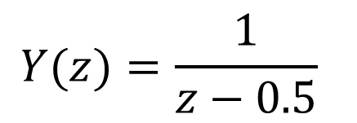
Example-1
Since U(z)=1
Taking Inverse z-Transform
$$Y(z)=\frac{1}{z−0.5}$$
$$y\left(k\right)={(0.5)}^{k−1}, k≥0$$

Slide 6
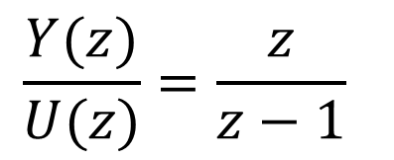
Example-2
Given the discrete time system
find the system transfer function and its response to a sampled unit step.
The transfer function corresponding to the difference equation is
$$y\left(k+1\right)−y\left(k\right)=u\left(k+1\right)$$
Solution
$$zY\left(z\right)−Y\left(z\right)=zU\left(z\right)$$
$$\frac{Y(z)}{U(z)}=\frac{z}{z−1}$$

Slide 7
Example-2
Since $U\left(z\right)=\frac{z}{z−1}$
Taking Inverse z-Transform (time advance Property)
$$Y(z)=\frac{z}{z−1}U(z)$$
$$Y(z)=\frac{z}{z−1}×\frac{z}{z−1}$$
$$Y(z)=z\frac{z}{{(z−1)}^{2}}$$
$$y\left(k\right)=k+1, k≥0$$

Slide 8
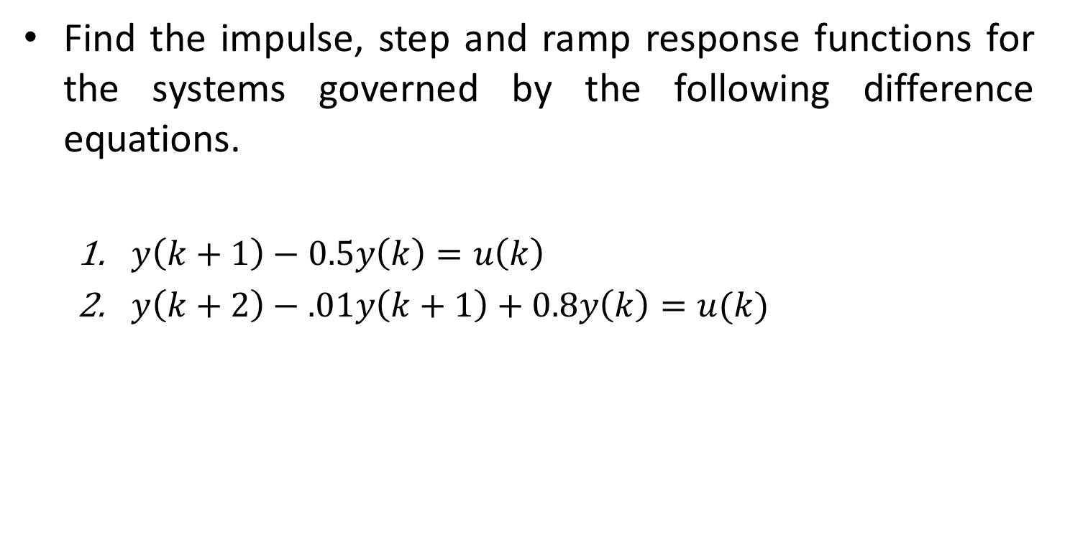
Home Work
Find the impulse, step and ramp response functions for the systems governed by the following difference equations.
$y\left(k+1\right)−0.5y\left(k\right)=u\left(k\right)$
$y\left(k+2\right)−.01y\left(k+1\right)+0.8y\left(k\right)=u(k)$

Slide 9
Final Value Theorem
The final value theorem allows us to calculate the limit of a sequence as k tends to infinity, if one exists, from the z-transform of the sequence.
If one is only interested in the final value of the sequence, this constitutes a significant short cut.
The main pitfall of the theorem is that there are important cases where the limit does not exist.
The two main case are
An unbounded sequence
An oscillatory sequence

Slide 10
Final Value Theorem
If a sequence approaches a constant limit as k tends to infinity, then the limit is given by
$$f\left(∞\right)=\lim_{k→∞}{f\left(k\right)}$$
$$f\left(∞\right)=\lim_{z→1}{\frac{z−1}{z}F\left(z\right)}$$
$$f\left(∞\right)=\lim_{z→1}{(z−1)F\left(z\right)}$$

Slide 11
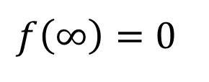
Example-3
Verify the final value theorem using the z-transform of a decaying exponential sequence and its limit as k tends to infinity.
The z-transform of an exponential sequence is
Applying final value theorem
Solution
$$F\left(z\right)=\frac{z}{z−e^{−aT}}$$
$$f\left(∞\right)=\lim_{z→1}{\frac{z−1}{z}F\left(z\right)=}\lim_{z→1}{\frac{z−1}{z}\frac{z}{z−e^{−aT}}}$$
$$f\left(∞\right)=0$$

Slide 12
Example-4
Obtain the final value for the sequence whose z-transform is
Applying final value theorem
$$F\left(z\right)=\frac{z^{2}(z−a)}{(z−1)(z−b)(z−c)}$$
Solution
$$f\left(∞\right)=\lim_{z→1}{\frac{z−1}{z}\frac{z^{2}(z−a)}{(z−1)(z−b)(z−c)}}$$
$$f\left(∞\right)=\frac{1−a}{(1−b)(1−c)}$$

Slide 13
Home work
Find the final value of following z-transform functions if it exists.
$F(z)=\frac{z}{z^{2}−1.2z+0.2}$
$F(z)=\frac{z}{z^{2}−0.3z+2}$

Slide 14
Steady State Error
Consider the unity feedback block diagram shown in following figure.
The error ratio can be calculated as
Applying the final value theorem yields the steady-state error.
$$\frac{E(z)}{R(z)}=\frac{1}{1+G_{ZAS}\left(z\right)C(z)}$$
$$e\left(∞\right)=\lim_{z→1}{\frac{z−1}{z}E\left(z\right)}$$

Slide 15
Steady state Error
As with analog systems, an error constant is associated with each input (e.g., Position Error constant and Velocity Error Constant)
Type number can be defined for any system from which the nature of the error constant can be inferred.
The type number of the system is the number of unity poles in the system z-transfer function.

Slide 16
Position Error Constant $K_{p}$
Error of the system is given as
Where
Therefore, the steady state error due to step input is given as
$$E(z)=\frac{R(z)}{1+G_{ZAS}\left(z\right)C(z)}$$
$$R\left(z\right)=\frac{z}{z−1}$$
$e\left(∞\right)=\lim_{z→1}{\frac{z−1}{z}\frac{1}{1+G_{ZAS}\left(z\right)C(z)}}$ $\frac{z}{z−1}$
$$e\left(∞\right)=\lim_{z→1}{\frac{1}{1+G_{ZAS}\left(z\right)C(z)}}$$

Slide 17
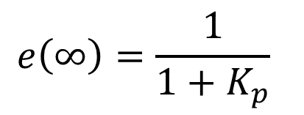
Position Error Constant $K_{p}$
$$e\left(∞\right)=\lim_{z→1}{\frac{1}{1+G_{ZAS}\left(z\right)C(z)}}$$
Position error constant $K_{p}$ is given as
Steady state error can be calculated as
$$K_{p}=\lim_{z→1}{G_{ZAS}\left(z\right)C(z)}$$
$$e\left(∞\right)=\frac{1}{1+K_{p}}$$

Slide 18
Velocity Error Constant $K_{v}$
Error of the system is given as
Where
Therefore, the steady state error due to step input is given as
$$E(z)=\frac{R(z)}{1+G_{ZAS}\left(z\right)C(z)}$$
$$R\left(z\right)=\frac{τz}{{\left(z−1\right)}^{2}}$$
$$e\left(∞\right)=\lim_{z→1}{\frac{z−1}{z}\frac{1}{1+G_{ZAS}\left(z\right)C(z)}}\frac{τz}{{\left(z−1\right)}^{2}}$$
$$e\left(∞\right)=\lim_{z→1}{\frac{τ}{\left(z−1\right)[1+G_{ZAS}\left(z\right)C\left(z\right)]}}$$

Slide 19
Velocity Error Constant $K_{v}$
$K_{v}$ is given as
Steady state error due to sampled ramp input is given as
$$e\left(∞\right)=\lim_{z→1}{\frac{τ}{\left(z−1\right)[1+G_{ZAS}\left(z\right)C\left(z\right)]}}$$
$$K_{v}=\frac{1}{τ}\lim_{z→1}\left(z−1\right)G_{ZAS}\left(z\right)C\left(z\right)$$
$$e\left(∞\right)=\frac{1}{K_{v}}$$

Slide 20
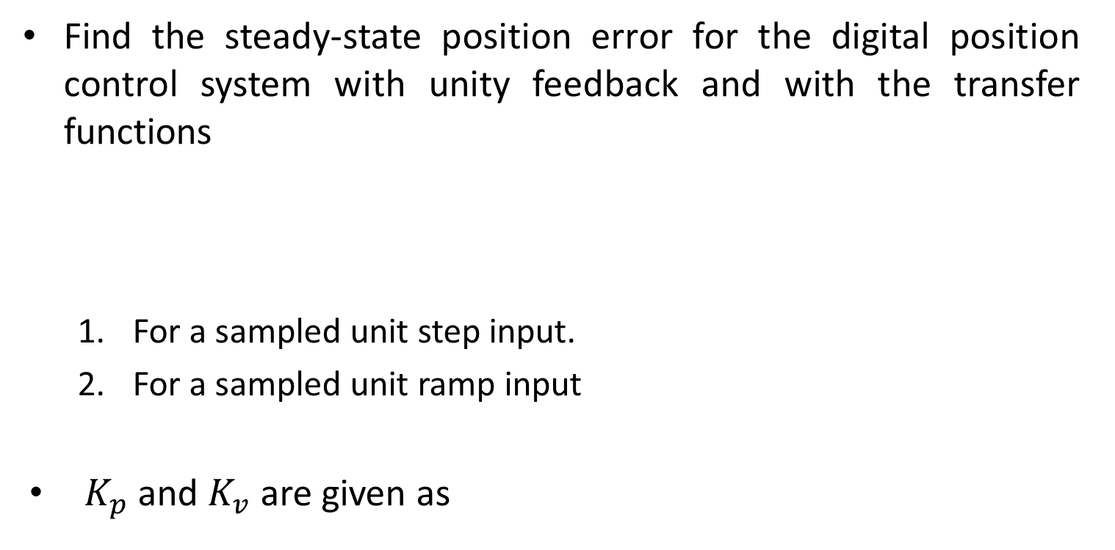
Example-5
Find the steady-state position error for the digital position control system with unity feedback and with the transfer functions
For a sampled unit step input.
For a sampled unit ramp input
$K_{p}$ and $K_{v}$ are given as
$$G_{ZAS}\left(z\right)=\frac{K(z+a)}{(z−1)(z−b)}$$
$$C\left(z\right)=\frac{K_{c}(z−b)}{z−c}$$
$$,0<a,b,c<1$$
Solution
$$K_{v}=\frac{1}{τ}\lim_{z→1}\left(z−1\right)G_{ZAS}\left(z\right)C\left(z\right)$$
$$K_{p}=\lim_{z→1}{G_{ZAS}\left(z\right)C(z)}$$

Slide 21

Example-5
$$K_{v}=\frac{1}{τ}\lim_{z→1}\left(z−1\right)G_{ZAS}\left(z\right)C\left(z\right)$$
$K_{p}$ can be further evaluated as
Corresponding steady state error is
$$K_{p}=\lim_{z→1}{G_{ZAS}\left(z\right)C(z)}$$
$$K_{p}=\lim_{z→1}{\frac{K(z+a)}{(z−1)(z−b)}\frac{K_{c}(z−b)}{z−c}}$$
$$K_{p}=\frac{K(1+a)}{(1−1)(1−b)}\frac{K_{c}(1−b)}{1−c}=∞$$
$$e\left(∞\right)=\frac{1}{1+K_{p}}=0$$

Slide 22
Example-5
$$K_{v}=\frac{1}{τ}\lim_{z→1}\left(z−1\right)G_{ZAS}\left(z\right)C\left(z\right)$$
$K_{v}$ is evaluated as
Corresponding steady state error is
$$K_{p}=\lim_{z→1}{G_{ZAS}\left(z\right)C(z)}$$
$$K_{v}=\frac{1}{τ}\lim_{z→1}\left(z−1\right)\frac{K(z+a)}{(z−1)(z−b)}\frac{K_{c}(z−b)}{z−c}$$
$$K_{v}=\frac{1}{τ}\frac{K(1+a)}{(1−b)}\frac{K_{c}(1−b)}{1−c}=\frac{KK_{c}(1+a)}{τ(1−c)}$$
$$e\left(∞\right)=\frac{1}{K_{v}}=\frac{τ(1−c)}{KK_{c}(1+a)}$$

Slide 23
End of Lectures-20-21
To download this lecture visit
http://imtiazhussainkalwar.weebly.com/

