Slide 1
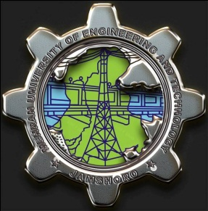

Power Electronics
Lecture-1
Introduction
Dr. Imtiaz Hussain
Assistant Professor
email: imtiaz.hussain@faculty.muet.edu.pk
URL :http://imtiazhussainkalwar.weebly.com/

Slide 2
Lecture Outline
Introduction to subject
Application Areas
Power Electronic Devices
Power Converters

Slide 3
Course Outline
Power Electronic Devices
Power Converters
Diodes
Power Transistors
IGBTs
etc.
Uncontrolled Rectifiers
Controlled rectifiers
Inverters
Converters

Slide 4
What is power electronics?
1) Definition
Power Electronics: is the electronics applied to conversion and control of electric power.

Slide 5
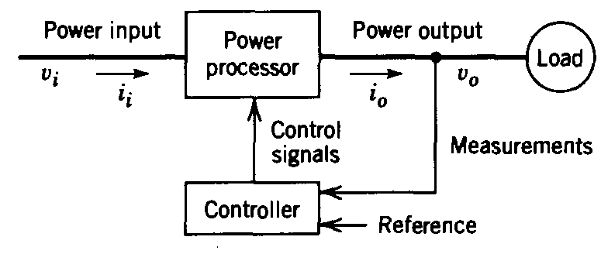
What is power electronics?
A more exact explanation:
The primary task of power electronics is to process and control the flow of electric energy by supplying voltages and currents in a form that is optimally suited for user loads.

Slide 6
Prerequisites
Power electronics incorporates concepts from the fields of
  Analog circuits
  Electronic devices
  Control systems
  Power systems
  Magnetics
  Electric machines
  Numerical simulation

Slide 7
Scope
It is not possible to build practical computers, cell phones, personal data devices, cars, airplanes, industrial processes, and other everyday products without power electronics.
Alternative energy systems such as wind generators, solar power, fuel cells, and others require power electronics to function.
Technology advances such as electric and hybrid vehicles, laptop computers, microwave ovens, flat-panel displays, LED lighting, and hundreds of other innovations were not possible until advances in power electronics enabled their implementation.
Although no one can predict the future, it is certain that power electronics will be at the heart of fundamental energy innovations.

Slide 8
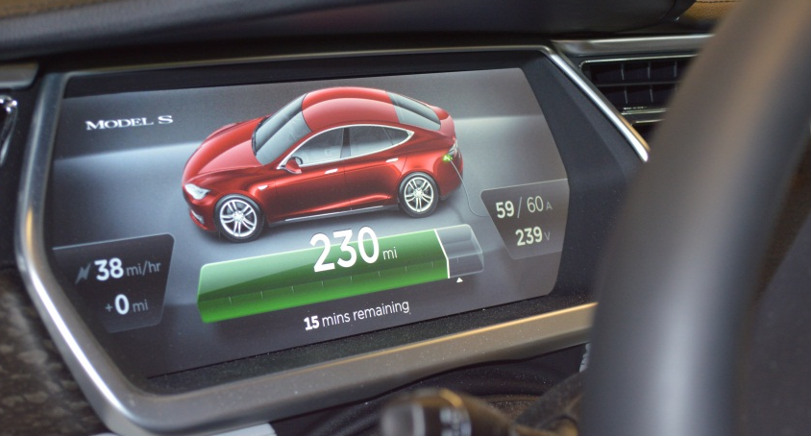
Applications: Electric Vehicle
Tesla Model S
Functions of the power electronics:
1. Convert the DC battery voltage to the variable AC required to drive the AC motor
  240 V battery
  Variable-frequency, variable-voltage AC drives the motor
  AC motor propels the rear axle
  Up to 330 kW (acceleration)
  Up to 60 kW regenerative braking
2. Control charging of the battery
  Interface to 240 V 60 Hz 1φ 100 A circuit in garage.
  Control AC current waveform to be sinusoidal, unity power factor.
  Control charging of battery to maximize life.

Slide 9
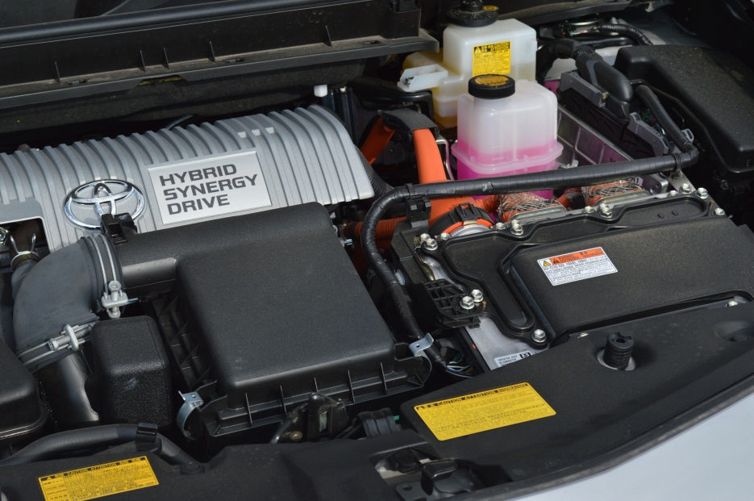
Applications: Hybrid Vehicles
Prius
Power Electronics Module:
Convert the DC battery voltage to the variable AC required to drive the AC motor.
Includes dc-dc boost converter and dc-3φ ac inverter
Control system can operate in all-electric mode or in hybrid gas+electric mode
Partial-power electronics
Under the hood:
Gas engine
Power electronics module

Slide 10

Applications: Variable-Speed Wind Turbine Systems
AC generator produces “wild ac”: frequency and amplitude change with wind speed.
Utility operates with constant frequency (60 Hz) constant voltage ac.
Power electronics changes the frequency and voltage, and also implements control functions
  Cycloconverter, or
  DC link system: rectifier, boost dc-dc, inverter

Slide 11
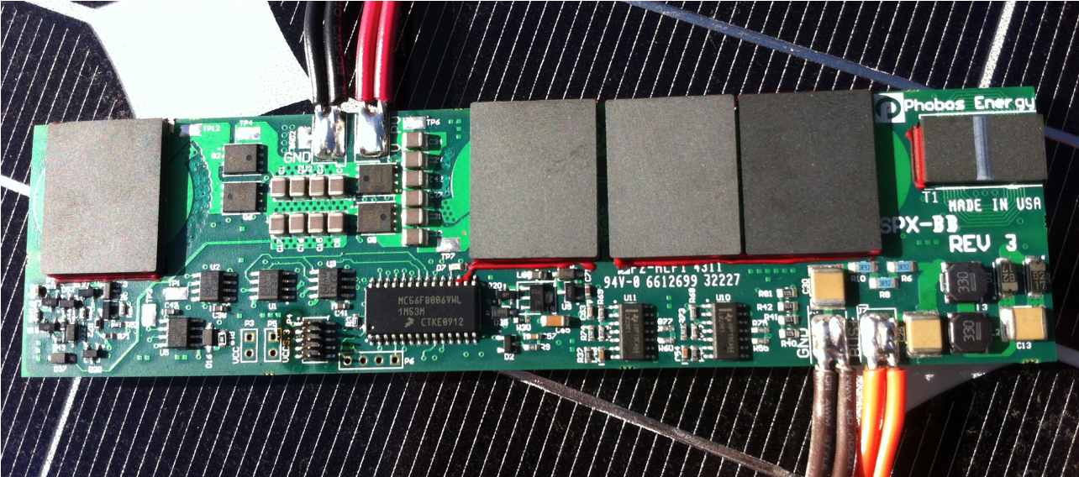
Applications: Photovoltaic Solar Power Systems
Grid-tied solar: inverter converts dc of solar panels to ac for grid.
Stand-alone solar: dc-dc converter interfaces solar panels to batteries

Slide 12
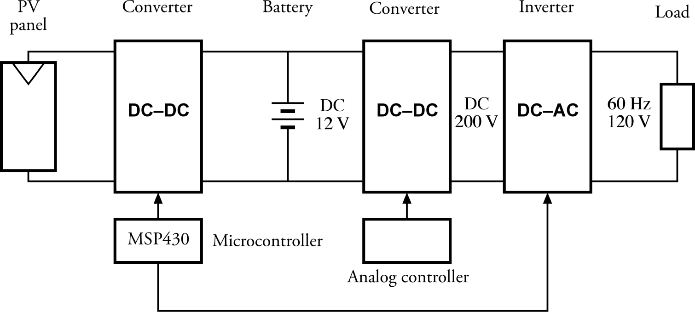
A standalone photovoltaic power system
The system constructed in ECEN 4517/5517 Power Electronics and Photovoltaic Systems Laboratory

Slide 13
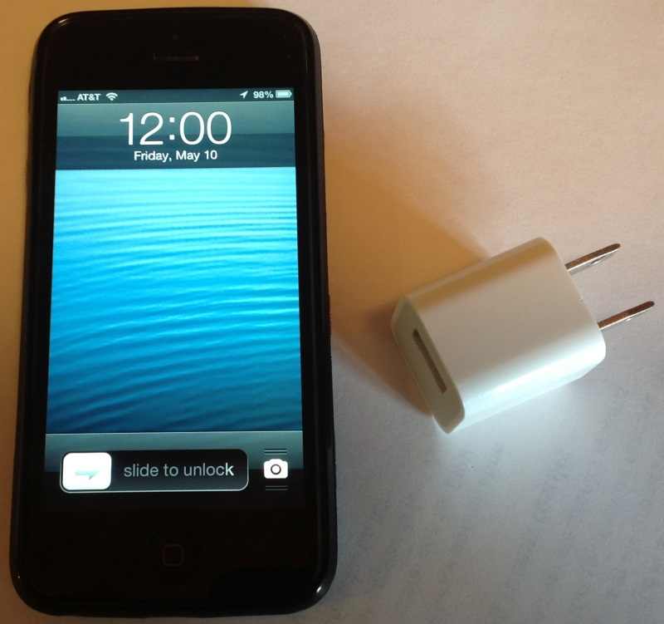
Applications: Computer power supply systems
Laptop power system
iPhone power system and charger

Slide 14
Trends in Power Supplies
Two distinct trends drive electronic power supplies, one of the major classes of power electronic circuits.
  At one end, microprocessors, memory chips, and other advanced digital circuits require increasing power levels and increasing performance at very low voltage.
  At the other end, the explosive growth of portable devices with rechargeable batteries. The power supplies for these devices and for other consumer products must be cheap and efficient.

Slide 15
Trends in Power Supplies
In the past, bulky “linear” power supplies were designed with transformers and rectifiers from the ac line frequency to provide dc voltages for electronic circuits.
In a well-designed power electronics arrangement today, called a switch-mode power supply, an ac source from a wall outlet is rectified without direct transformation.
The resulting high dc voltage is converted through a dc–dc converter to the 1, 3, 5, and 12V, or other levels required.

Slide 16
Trends in Power Supplies
A personal computer commonly requires multiple 3.3- and 5-V supplies, 12-V supplies, additional levels, and a separate converter for 1-V delivery to the microprocessor.
Only a switch-mode supply can support such complex requirements with acceptable costs.

Slide 17
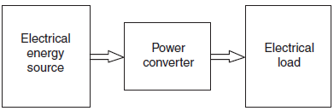
Key Characteristics of Power Converter
All power electronic circuits manage the flow of electrical energy between an electrical source and a load.
The parts in a circuit must direct electrical flows, not impede them.
The function of the power converter in the middle is to control the energy flow between a source and a load.
A crucial point emerges: to build a power converter, we should consider only lossless components.
A realistic converter design must approach 100% efficiency.

Slide 18
Devices Available to the circuit designer

Slide 19
Devices available to the circuit designer
Signal processing: avoid magnetics

Slide 20
Devices available to the circuit designer
Power processing: avoid lossy elements

Slide 21
Power loss in an ideal switch
Switch closed: v(t) = 0
Switch open: i(t) = 0
In either event: p(t) = v(t) i(t) = 0
Ideal switch consumes zero power

Slide 22
Power Electronic Devices
The power Electronic devices provides the utility of switching.
The flow of power through these devices can be controlled via small currents.
Power electronics devices differ from ordinary electronics devices in terms of their characteristics.

Slide 23
Power Electronic Devices
Power Semiconductor Devices can be classified into three groups according to their degree of controllability.
  Diodes (on and off controlled by power circuit)
  Thyristors (latched on by control signal but must be turned off by power circuit)
  Controllable Switches (turned on and off by control signal)

Slide 24
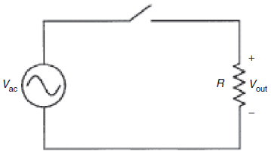
Conversion Examples
Single-Switch Circuits
  Consider the circuit shown in figure.
  It contains an ac source, a switch, and a resistive load.
  It is a simple but complete power electronic system.
What if the switch is turned on whenever Vac >0, and turned off otherwise?

Slide 25
End of Lecture-1
To download this lecture visit
http://imtiazhussainkalwar.weebly.com/

