Slide 1
Advanced Control Systems (ACS)
Lecture-1
Introduction to Subject
&
Review of Basic Concepts of Classical control
Dr. Imtiaz Hussain
email: imtiaz.hussain@faculty.muet.edu.pk
URL :http://imtiazhussainkalwar.weebly.com/

Slide 2
Course Outline
Review of basic concepts of classical control
State Space representation
Design of Compensators
Design of Proportional
Proportional plus Integral
Proportional Integral and Derivative (PID) controllers
Pole Placement Design
Design of Estimators
Linear Quadratic Gaussian (LQG) controllers
Linearization of non-linear systems
Design of non-linear systems
Analysis and Design of multivariable systems
Analysis and Design of Adaptive Control Systems

Slide 3
Recommended Books
Burns R. “Advanced Control Engineering, Butterworth Heinemann”, Latest edition.
Mutanmbara A.G.O.; Design and analysis of Control Systems, Taylor and Francis, Latest Edition
Modern Control Engineering, (5th Edition)
By: Katsuhiko Ogata.
4. Control Systems Engineering, (6th Edition)
By: Norman S. Nise

Slide 4
What is Control System?
A system Controlling the operation of another system.
A system that can regulate itself and another system.
A control System is a device, or set of devices to manage, command, direct or regulate the behaviour of other device(s) or system(s).

Slide 5
Types of Control System
Natural Control System
  Universe
  Human Body
Manmade Control System
  Vehicles
  Aeroplanes

Slide 6
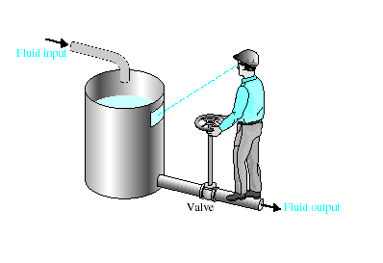
Types of Control System
Manual Control Systems
  Room Temperature regulation Via Electric Fan
  Water Level Control
Automatic Control System
  Room Temperature regulation Via A.C
  Human Body Temperature Control

Slide 7

Types of Control System
Open-Loop Control Systems
Open-Loop Control Systems utilize a controller or control actuator to obtain the desired response.
Output has no effect on the control action.
In other words output is neither measured nor fed back.
Input
Controller
Process
Output
Examples:- Washing Machine, Toaster, Electric Fan

Slide 8
Types of Control System
Open-Loop Control Systems
Since in open loop control systems reference input is not compared with measured output, for each reference input there is fixed operating condition.
Therefore, the accuracy of the system depends on calibration.
The performance of open loop system is severely affected by the presence of disturbances, or variation in operating/ environmental conditions.

Slide 9

Types of Control System
Closed-Loop Control Systems
Closed-Loop Control Systems utilizes feedback to compare the actual output to the desired output response.
Input
Controller
Process
Output
Comparator
Measurement
Examples:- Refrigerator, Iron

Slide 10
Types of Control System
Multivariable Control System
Controller
Process
Temp
Outputs
Humidity
Comparator
Pressure
Measurements

Slide 11
Types of Control System
Feedback Control System
A system that maintains a prescribed relationship between the output and some reference input by comparing them and using the difference (i.e. error) as a means of control is called a feedback control system.
Feedback can be positive or negative.
Controller
Process
Input
+
error
Output
-
Feedback

Slide 12
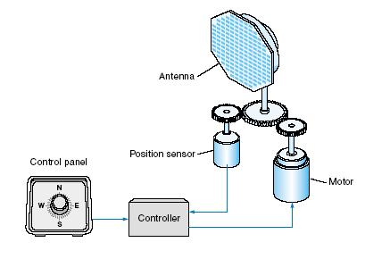
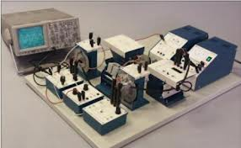
Types of Control System
Servo System
A Servo System (or servomechanism) is a feedback control system in which the output is some mechanical position, velocity or acceleration.
Antenna Positioning System
Modular Servo System (MS150)

Slide 13
Types of Control System
Linear Vs Nonlinear Control System
A Control System in which output varies linearly with the input is called a linear control system.
Process
u(t)
y(t)

Slide 14
Types of Control System
Linear Vs Nonlinear Control System
When the input and output has nonlinear relationship the system is said to be nonlinear.

Slide 15
Types of Control System
Linear Vs Nonlinear Control System
Linear control System Does not exist in practice.
Linear control systems are idealized models fabricated by the analyst purely for the simplicity of analysis and design.
When the magnitude of signals in a control system are limited to range in which system components exhibit linear characteristics the system is essentially linear.

Slide 16
Types of Control System
Linear Vs Nonlinear Control System
Temperature control of petroleum product in a distillation column.
°C
Temperature
500°C
Valve Position
0%
25%
100%
% Open

Slide 17
Types of Control System
Time invariant vs Time variant
When the characteristics of the system do not depend upon time itself then the system is said to time invariant control system.
Time varying control system is a system in which one or more parameters vary with time.

Slide 18
Types of Control System
Lumped parameter vs Distributed Parameter
Control system that can be described by ordinary differential equations are lumped-parameter control systems.
Whereas the distributed parameter control systems are described by partial differential equations.

Slide 19
Types of Control System
Continuous Data Vs Discrete Data System
In continuous data control system all system variables are function of a continuous time t.
A discrete time control system involves one or more variables that are known only at discrete time intervals.
x(t)
t
X[n]
n

Slide 20
Types of Control System
Deterministic vs Stochastic Control System
A control System is deterministic if the response to input is predictable and repeatable.
If not, the control system is a stochastic control system
x(t)
y(t)
t
t
z(t)
t

Slide 21
Types of Control System
Adaptive Control System
The dynamic characteristics of most control systems are not constant for several reasons.
The effect of small changes on the system parameters is attenuated in a feedback control system.
An adaptive control system is required when the changes in the system parameters are significant.

Slide 22
Types of Control System
Learning Control System
A control system that can learn from the environment it is operating is called a learning control system.

Slide 23
Classification of Control Systems
Control Systems
Natural
Man-made
Manual
Automatic
Open-loop
Closed-loop
Non-linear
linear
Non-linear
linear
Time variant
Time invariant
Time variant
Time invariant

Slide 24
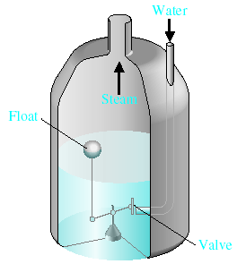
Examples of Control Systems
Water-level float regulator

Slide 25

Examples of Control Systems

Slide 26
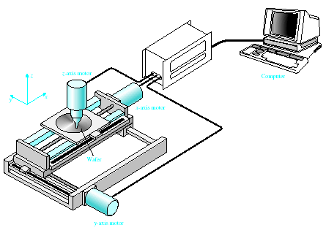

Examples of Modern Control Systems

Slide 27
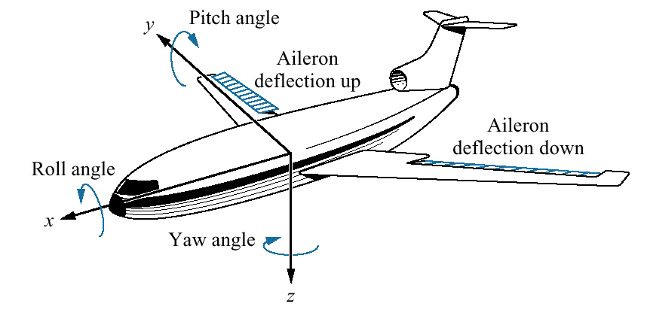
Examples of Modern Control Systems

Slide 28
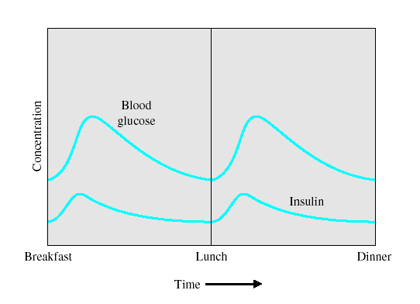

Examples of Modern Control Systems

Slide 29
Transfer Function
Transfer Function is the ratio of Laplace transform of the output to the Laplace transform of the input. Assuming all initial conditions are zero.
Where is the Laplace operator.
Plant
u(t)
y(t)

Slide 30
Transfer Function
Then the transfer function G(S) of the plant is given as
G(S)
U(S)
Y(S)

Slide 31
Why Laplace Transform?
By use of Laplace transform we can convert many common functions into algebraic function of complex variable s.
For example
Or
Where s is a complex variable (complex frequency) and is given as

Slide 32
Laplace Transform of Derivatives
Not only common function can be converted into simple algebraic expressions but calculus operations can also be converted into algebraic expressions.
For example

Slide 33
Laplace Transform of Derivatives
In general
Where is the initial condition of the system.

Slide 34
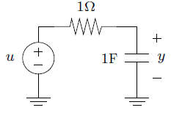
Example: RC Circuit
If the capacitor is not already charged then y(0)=0.
u is the input voltage applied at t=0
y is the capacitor voltage

Slide 35
Laplace Transform of Integrals
The time domain integral becomes division by s in frequency domain.

Slide 36
Calculation of the Transfer Function
Consider the following ODE where y(t) is input of the system and x(t) is the output.
or
Taking the Laplace transform on either sides

Slide 37
Calculation of the Transfer Function
Considering Initial conditions to zero in order to find the transfer function of the system
Rearranging the above equation

Slide 38

Example
Find out the transfer function of the RC network shown in figure-1. Assume that the capacitor is not initially charged.
Figure-1
2. u(t) and y(t) are the input and output respectively of a system defined by following ODE. Determine the Transfer Function. Assume there is no any energy stored in the system.

Slide 39
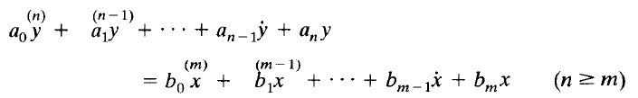
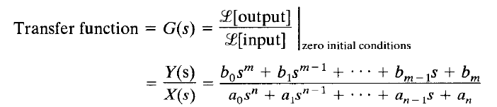
Transfer Function
In general
Where x is the input of the system and y is the output of the system.

Slide 40
Transfer Function
When order of the denominator polynomial is greater than the numerator polynomial the transfer function is said to be ‘proper’.
Otherwise ‘improper’

Slide 41
Transfer Function
Transfer function helps us to check
  The stability of the system
  Time domain and frequency domain characteristics of the system
  Response of the system for any given input

Slide 42
Stability of Control System
There are several meanings of stability, in general there are two kinds of stability definitions in control system study.
  Absolute Stability
  Relative Stability

Slide 43
Stability of Control System
Roots of denominator polynomial of a transfer function are called ‘poles’.
And the roots of numerator polynomials of a transfer function are called ‘zeros’.

Slide 44
Stability of Control System
Poles of the system are represented by ‘x’ and zeros of the system are represented by ‘o’.
System order is always equal to number of poles of the transfer function.
Following transfer function represents n^{th} order plant.

Slide 45
Stability of Control System
Poles is also defined as “it is the frequency at which system becomes infinite”. Hence the name pole where field is infinite.
And zero is the frequency at which system becomes 0.

Slide 46
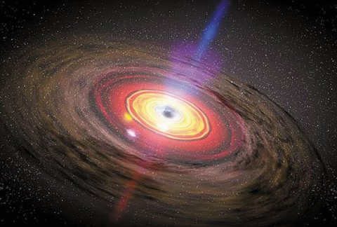
Stability of Control System
Poles is also defined as “it is the frequency at which system becomes infinite”.
Like a magnetic pole or black hole.

Slide 47
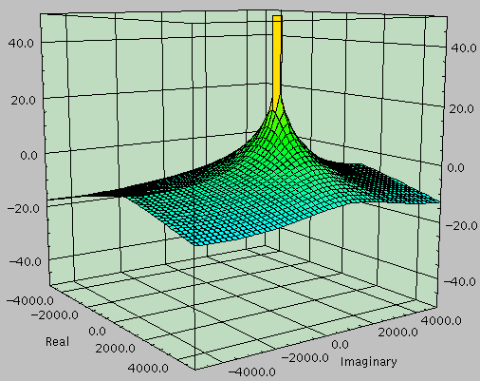
Relation b/w poles and zeros and frequency response of the system
The relationship between poles and zeros and the frequency response of a system comes alive with this 3D pole-zero plot.
Single pole system

Slide 48
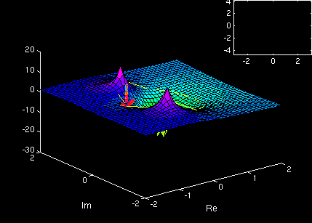
Relation b/w poles and zeros and frequency response of the system
3D pole-zero plot
  System has 1 ‘zero’ and 2 ‘poles’.

Slide 49
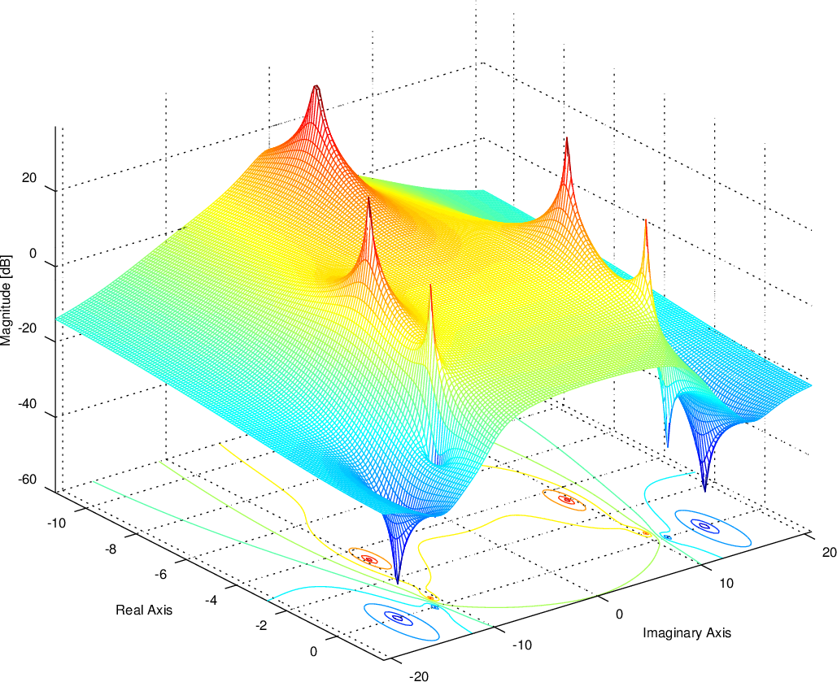
Relation b/w poles and zeros and frequency response of the system

Slide 50
Example
Consider the Transfer function calculated in previous slides.
The only pole of the system is

Slide 51
Examples
Consider the following transfer functions.
  Determine
    Whether the transfer function is proper or improper
    Poles of the system
    zeros of the system
    Order of the system
i)
ii)
iii)
iv)

Slide 52
Stability of Control Systems
The poles and zeros of the system are plotted in s-plane to check the stability of the system.
LHP
RHP
s-plane

Slide 53
Stability of Control Systems
If all the poles of the system lie in left half plane the system is said to be Stable.
If any of the poles lie in right half plane the system is said to be unstable.
If pole(s) lie on imaginary axis the system is said to be marginally stable.
Absolute stability does not depend on location of zeros of the transfer function
LHP
RHP
s-plane

Slide 54
Examples
stable

Slide 55
Examples
stable

Slide 56
Examples
unstable

Slide 57
Examples
stable

Slide 58
Examples
Marginally stable

Slide 59
Examples
stable

Slide 60
Examples
Marginally stable

Slide 61
Examples
Relative Stability
stable
stable

Slide 62
Stability of Control Systems
For example
Then the only pole of the system lie at
LHP
RHP
X
-3
s-plane

Slide 63
Examples
Consider the following transfer functions.
    Determine whether the transfer function is proper or improper
    Calculate the Poles and zeros of the system
    Determine the order of the system
    Draw the pole-zero map
    Determine the Stability of the system
i)
ii)
iii)
iv)

Slide 64
Another definition of Stability
The system is said to be stable if for any bounded input the output of the system is also bounded (BIBO).
Thus the for any bounded input the output either remain constant or decrease with time.
u(t)
overshoot
y(t)
1
Plant
1
t
t
Unit Step Input
Output

Slide 65
Another definition of Stability
If for any bounded input the output is not bounded the system is said to be unstable.
u(t)
y(t)
1
Plant
t
t
Unit Step Input
Output

Slide 66
BIBO vs Transfer Function
For example
unstable
stable

Slide 67
BIBO vs Transfer Function
For example

Slide 68
BIBO vs Transfer Function
For example

Slide 69
BIBO vs Transfer Function
Whenever one or more than one poles are in RHP the solution of dynamic equations contains increasing exponential terms.
Such as .
That makes the response of the system unbounded and hence the overall response of the system is unstable.

Slide 70
Types of Systems
Static System: If a system does not change with time, it is called a static system.
Dynamic System: If a system changes with time, it is called a dynamic system.

Slide 71
Dynamic Systems
A system is said to be dynamic if its current output may depend on the past history as well as the present values of the input variables.
Mathematically,
Example: A moving mass
y
u
Model: Force=Mass x Acceleration
M

Slide 72
Ways to Study a System
System
Experiment with actual System
Experiment with a model of the System
Physical Model
Mathematical Model
Analytical Solution
Simulation
Frequency Domain
Time Domain
Hybrid Domain

Slide 73
Model
A model is a simplified representation or abstraction of reality.
Reality is generally too complex to copy exactly.
Much of the complexity is actually irrelevant in problem solving.

Slide 74
Types of Models
Model
Physical
Mathematical
Computer
Static
Dynamic
Static
Dynamic
Static
Dynamic
Notes:
74

Slide 75
What is Mathematical Model?
A set of mathematical equations (e.g., differential eqs.) that describes the input-output behavior of a system.
What is a model used for?
Simulation
Prediction/Forecasting
Prognostics/Diagnostics
Design/Performance Evaluation
Control System Design

Slide 76
Classification of Mathematical Models
Linear vs. Non-linear
Deterministic vs. Probabilistic (Stochastic)
Static vs. Dynamic
Discrete vs. Continuous
White box, black box and gray box

Slide 77
Black Box Model
When only input and output are known.
Internal dynamics are either too complex or unknown.
Easy to Model
Input
Output

Slide 78
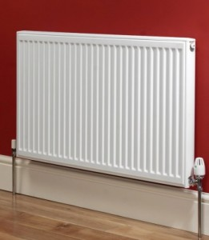
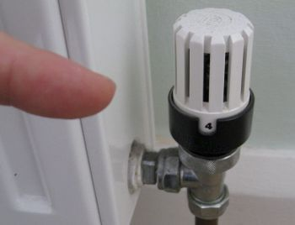
Black Box Model
Consider the example of a heat radiating system.

Slide 79
Black Box Model
Consider the example of a heat radiating system.
Valve Position | Room Temperature (ºC)
0 | 0
2 | 3
4 | 6
6 | 12
8 | 20
10 | 33

Slide 80
Grey Box Model
When input and output and some information about the internal dynamics of the system is known.
Easier than white box Modelling.
u(t)
y(t)
y[u(t), t]

Slide 81
White Box Model
When input and output and internal dynamics of the system is known.
One should know have complete knowledge of the system to derive a white box model.
u(t)
y(t)

Slide 82
Mathematical Modelling Basics
Mathematical model of a real world system is derived using a combination of physical laws and/or experimental means
Physical laws are used to determine the model structure (linear or nonlinear) and order.
The parameters of the model are often estimated and/or validated experimentally.
Mathematical model of a dynamic system can often be expressed as a system of differential (difference in the case of discrete-time systems) equations

Slide 83
Different Types of Lumped-Parameter Models
System Type
Model Type
Nonlinear
Input-output differential equation
Linear
State equations
Linear Time Invariant
Transfer function

Slide 84
Approach to dynamic systems
    Define the system and its components.
    Formulate the mathematical model and list the necessary assumptions.
    Write the differential equations describing the model.
    Solve the equations for the desired output variables.
    Examine the solutions and the assumptions.
    If necessary, reanalyze or redesign the system.
Notes:
84

Slide 85
Simulation
Computer simulation is the discipline of designing a model of an actual or theoretical physical system, executing the model on a digital computer, and analyzing the execution output.
Simulation embodies the principle of ``learning by doing'' --- to learn about the system we must first build a model of some sort and then operate the model.

Slide 86
Advantages to Simulation
Can be used to study existing systems without disrupting the ongoing operations.
Proposed systems can be “tested” before committing resources.
Allows us to control time.
Allows us to gain insight into which variables are most important to system performance.
Notes:
86

Slide 87
Disadvantages to Simulation
Model building is an art as well as a science. The quality of the analysis depends on the quality of the model and the skill of the modeler.
Simulation results are sometimes hard to interpret.
Simulation analysis can be time consuming and expensive.
Should not be used when an analytical method would provide for quicker results.
Notes:
87

Slide 88
End of Lecture-1
To download this lecture visit
http://imtiazhussainkalwar.weebly.com/

