Slide 1
Control Systems (CS)
Lecture-17
Routh-Herwitz Stability Criterion
Dr. Imtiaz Hussain
Associate Professor
Mehran University of Engineering & Technology Jamshoro, Pakistan
email: imtiaz.hussain@faculty.muet.edu.pk
URL :http://imtiazhussainkalwar.weebly.com/

Slide 2
Routh-Hurwitz Stability Criterion
It is a method for determining continuous system stability.
The Routh-Hurwitz criterion states that “the number of roots of the characteristic equation with positive real parts is equal to the number of changes in sign of the first column of the Routh array”.

Slide 3
Routh-Hurwitz Stability Criterion
This method yields stability information without the need to solve for the closed-loop system poles.
Using this method, we can tell how many closed-loop system poles are in the left half-plane, in the right half-plane, and on the jw-axis. (Notice that we say how many, not where.)
The method requires two steps:
Generate a data table called a Routh table.
interpret the Routh table to tell how many closed-loop system poles are in the LHP, the RHP, and on the jw-axis.

Slide 4
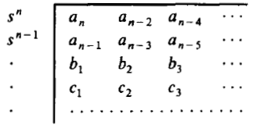
Routh-Hurwitz Stability Criterion
The characteristic equation of the n^{th} order continuous system can be written as:
The stability criterion is applied using a Routh table which is defined as;
Where a re coefficients of the characteristic equation.

Slide 5
Generating a Basic Routh Table
First label the rows with powers of s from highest power of s down to lowest power of s in a vertical column.
Next form the first row of the Routh table, using the coefficients of the denominator of the closed-loop transfer function (characteristic equation).
Start with the coefficient of the highest power and skip every other power of s.
Now form the second row with the coefficients of the denominator skipped in the previous step.
The table is continued horizontally and vertically until zeros are obtained.
For convenience, any row can be multiplied or divide by a positive constant before the next row is computed without changing the values of the rows below and disturbing the properties of the Routh table.

Slide 6
Routh’s Stability Condition
If the closed-loop transfer function has all poles in the left half of the s-plane, the system is stable. Thus, a system is stable if there are no sign changes in the first column of the Routh table.
The Routh-Hurwitz criterion declares that the number of roots of the polynomial that are lies in the right half-plane is equal to the number of sign changes in the first column. Hence the system is unstable if the poles lies on the right hand side of the s-plane.

Slide 7
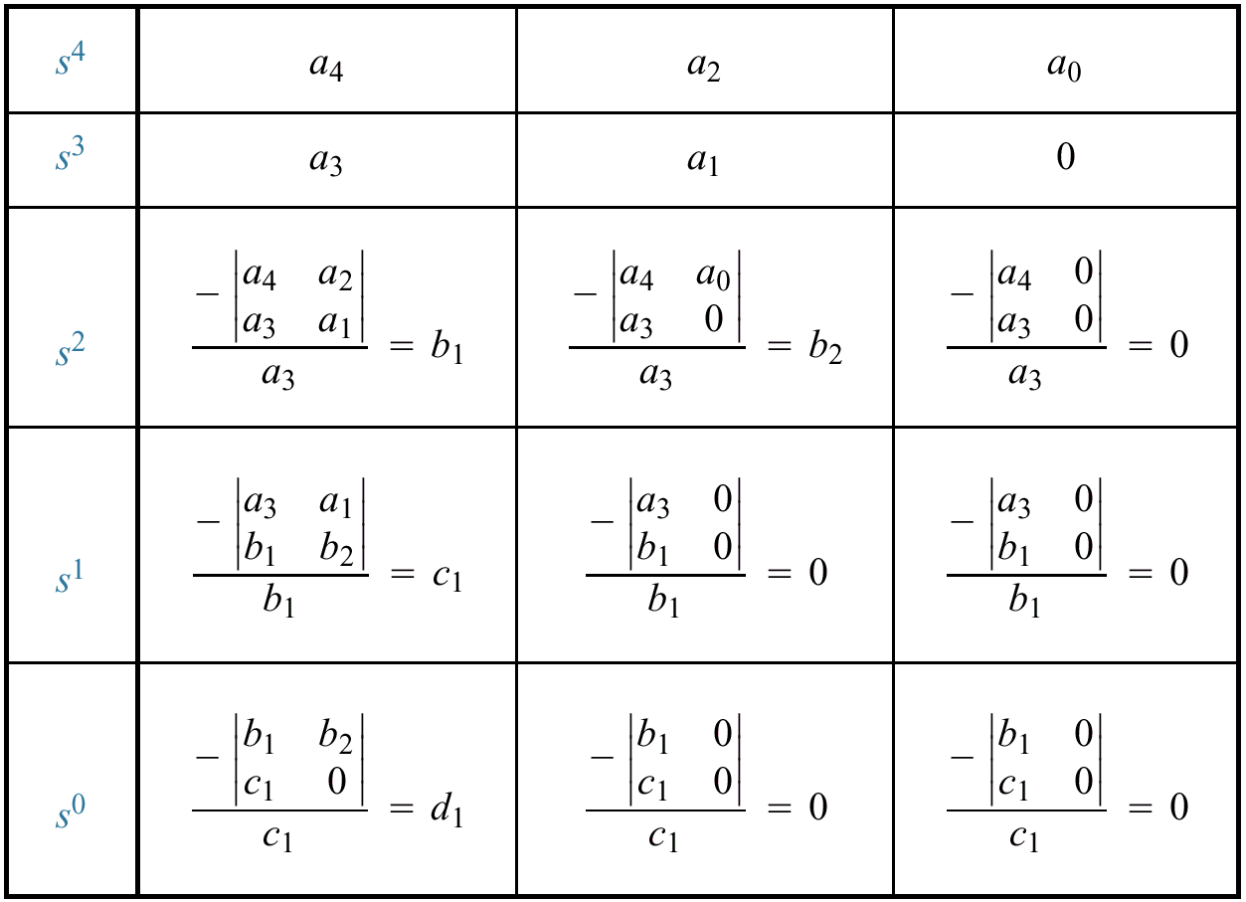
Example: Generating a basic Routh Table.
Only the first 2 rows of the array are obtained from the characteristic eq. the remaining are calculated as follows;

Slide 8
Four Special Cases or Configurations in the First Column Array of the Routh’s Table:
Case-I: No element in the first column is zero.
Case-II: A zero in the first column but some other elements of the row containing the zero in the first column are nonzero.
Case-III: A zero in the first column and the other elements of the row containing the zero are also zero.
Case-IV: As in the third case but with repeated roots on the jw -axis.

Slide 9
Case-I: No element in the first column is zero.
Second-Order System.
The characteristic polynomial of a second order system is given below
The Routh array is written as
Where
The requirement for a stable second order system is simply that all the coefficient be positive or all the coefficient s be negative.

Slide 10
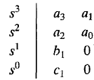
Third-Order System.
The characteristic polynomial of a third order system is given below
The Routh array is
Where
The requirement for a stable third order system is that the coefficients be positive and
The condition when results in a marginally stability case (recognized as Case-3 because there is a zero in the first column) and one pair of roots lies on the imaginary axis in the s-plane.

Slide 11
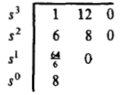
Example-1: Find the stability of the continues system having the characteristic equation of
The Routh table of the given system is computed and shown is the table below;
Since there is no changes of the sign in the first column of the Routh table, it means that all the roots of the characteristic equation have negative real parts and hence this system is stable.

Slide 12
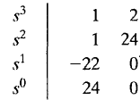
Example-2: Find the stability of the continues system having the characteristic polynomial of a third order system is given below
The Routh array is
Because TWO changes in sign appear in the first column, we find that two roots of the characteristic equation lie in the right hand side of the s-plane. Hence the system is unstable.

Slide 13
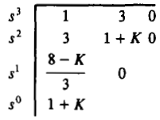
Example-3: Determine a rang of values of a system parameter K for which the system is stable.
The Routh table of the given system is computed and shown is the table below;
For system stability, it is necessary that the conditions 8 – k >0, and 1 + k > 0, must be satisfied. Hence the rang of values of a system parameter k must be lies between -1 and 8 (i.e., -1 < k < 8).

Slide 14
Example-4: Find the stability of the system shown below using Routh criterion.
The close loop transfer function is shown in the figure
The Routh table of the system is shown in the table
Because TWO changes in sign appear in the first column, we find that two roots of the characteristic equation lie in the right hand side of the s-plane. Hence the system is unstable.

Slide 15
Example-5: Find the stability of the system shown below using Routh criterion.
The Routh table of the system is
System is unstable because there are two sign changes in the first column of the Routh’s table. Hence the equation has two roots on the right half of the s-plane.

Slide 16
Case-II: A Zero Only in the First Column
There are TWO methods in case-II.
Stability via Epsilon Method.
Stability via Reverse Coefficients (Phillips, 1991).

Slide 17
Case-II: Stability via Epsilon Method
If the first element of a row is zero, division by zero would be required to form the next row.
To avoid this phenomenon, an epsilon, ε, (a small positive number) is assigned to replace the zero in the first column.
The value ε is then allowed to approach zero from either the positive or the negative side, after which the signs of the entries in the first column can be determined.

Slide 18
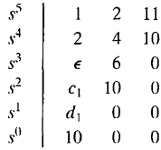
Case-II: Stability via Epsilon Method
Example-6: Determine the stability of the system having a characteristic equation given below;
The Routh array is shown in the table;
Where
There are TWO sign changes due to the large negative number in the first column,
Therefore the system is unstable, and two roots of the equation lie in the right half of the s-plane.

Slide 19
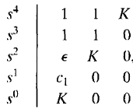
Example-7: Determine the range of parameter K for which the system is unstable.
The Routh array of the above characteristic equation is shown below;
Where
Therefore, for any value of K greater than zero, the system is unstable.
Also, because the last term in the first column is equal to K, a negative value of K will result in an unstable system.
Consequently, the system is unstable for all values of gain K.

Slide 20
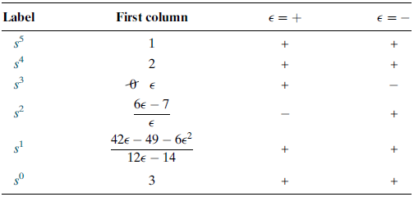
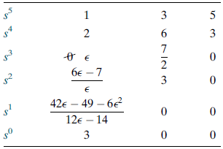
Example-8: Determine the stability of the of the closed-loop transfer function;
Table-1: The complete Routh table is formed by using the denominator of the characteristic equation T(s).
Table-2: shows the first column of Table-1 along with the resulting signs for choices of ε positive and ε negative.
A zero appears only in the first column (the s3 row).
Next replace the zero by a small number, ε, and complete the table.
Assume a sign, positive or negative, for the quantity ε.
When quantity ε is either positive or negative, in both cases the sign in the first column of Routh table is changes twice.
Hence, the system is unstable and has two poles in the right half-plane.

Slide 21
Case-II: Stability via Reverse Coefficients (Phillips, 1991).
A polynomial that has the reciprocal roots of the original polynomial has its roots distributed the same—right half-plane, left half plane, or imaginary axis—because taking the reciprocal of the root value does not move it to another region.
If we can find the polynomial that has the reciprocal roots of the original, it is possible that the Routh table for the new polynomial will not have a zero in the first column.
The polynomial with reciprocal roots is a polynomial with the coefficients written in reverse order.
This method is usually computationally easier than the epsilon method.

Slide 22
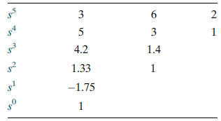
Example-9: Repeated example-8: Determine the stability of the closed-loop transfer function;
First write a polynomial that has the reciprocal roots of the denominator of T(s).
This polynomial is formed by writing the denominator of T(s) in reverse order. Hence,
The Routh table is
Since there are TWO sign changes, the system is unstable and has TWO right-half-plane poles.
This is the same as the result obtained in the previous Example.
Notice that Table does not have a zero in the first column.

Slide 23
Case-III: Entire Row is Zero.
Sometimes while making a Routh table, we find that an entire row consists of zeros.
This happen because there is an even polynomial that is a factor of the original polynomial.
This case must be handled differently from the case of a zero in only the first column of a row.

Slide 24
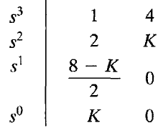
Example-10: Determine the stability of the system.
The characteristic equation q(s) of the system is
Where K is an adjustable loop gain. The Routh array is then;
For a stable system, the value of K must be;
When K = 8, the two roots exist on the jω axis and the system will be marginally stable.
Also, when K = 8, we obtain a row of zeros (case-III).
The auxiliary polynomial, U(s), is the equation of the row preceding the row of Zeros.
The U(s) in this case, obtained from the s² row.
The order of the auxiliary polynomial is always even and indicates the number of symmetrical root pairs.

Slide 25
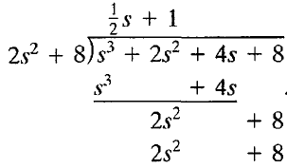
Example-10: continue.
The auxiliary polynomial, U(s), can be obtain as;
To show that the auxiliary polynomial, U(s), is indeed a factor of the characteristic polynomial, q(s), we divide q(s) by U(s) to obtain
When K = 8, the factors of the characteristic polynomial, q(s), are

Slide 26
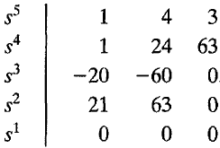
Case-IV: Repeated roots of the characteristic equation on the jω-axis.
If the jω-axis roots are repeated, the system response will be unstable with a form tsin(ωt + Ф). The Routh-Hurwitz criteria will not reveal this form of instability.
Example-11: Determine the stability of the system with the characteristic equation of
The Routh array is;

Slide 27
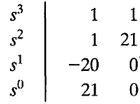
Example-11:Continue.
Therefore, the Auxiliary polynomial, U(s), is;
Which indicates that TWO roots are on the imaginary jω-axis.
To examine the remaining roots, we divide the characteristic equation, q(s), by the auxiliary polynomial, U(s), to obtain;
Establishing a Routh table for this equation, we have;
The TWO changes in sign in the first column indicate the presence of TWO roots in the right-hand plane, and the system is unstable.
There are THREE roots of eq. (a). The ONE root in left-hand side is s = - 3.
The TWO roots in the right-hand plane are
(a)

Slide 28
Skill Assessment # 3:
Problem: Make a Routh table and tell how many roots of the following polynomial are in the right half-plane and in the left half-plane.

Slide 29
Answer of the Skill Assessment # 3:
Four roots of the characteristic equation lie in the right half-plane (rhp), and three roots lie of the characteristic equation in the left half-plane (lhp). Therefore the system is unstable.

Slide 30
End of Lecture-17
To download this lecture visit
http://imtiazhussainkalwar.weebly.com/

