Slide 1
Digital Control Systems (DCS)
Lecture-17-18-19
Introduction to Digital Control Systems
Dr. Imtiaz Hussain
Associate Professor
Mehran University of Engineering & Technology Jamshoro, Pakistan
email: imtiaz.hussain@faculty.muet.edu.pk
URL :http://imtiazhussainkalwar.weebly.com/

Slide 2
Lecture Outline
Introduction
Difference Equations
Review of Z-Transform
Inverse Z-transform
Relations between s-plane and z-plane
Solution of difference Equations

Slide 3
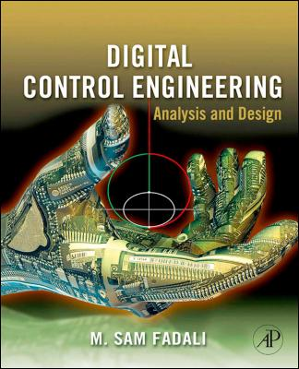
Recommended Book
M.S. Fadali, “Digital Control Engineering – Analysis and Design”, Elsevier, 2009. ISBN: 13: 978-0-12-374498-2
Professor of Electrical Engineering
Area of Specialization: Control Systems

Slide 4
Introduction
Digital control offers distinct advantages over analog control that explain its popularity.
Accuracy: Digital signals are more accurate than their analogue counterparts.
Implementation Errors: Implementation errors are negligible.
Flexibility: Modification of a digital controller is possible without complete replacement.
Speed: Digital computers may yield superior performance at very fast speeds
Cost: Digital controllers are more economical than analogue controllers.

Slide 5
Structure of a Digital Control System

Slide 6
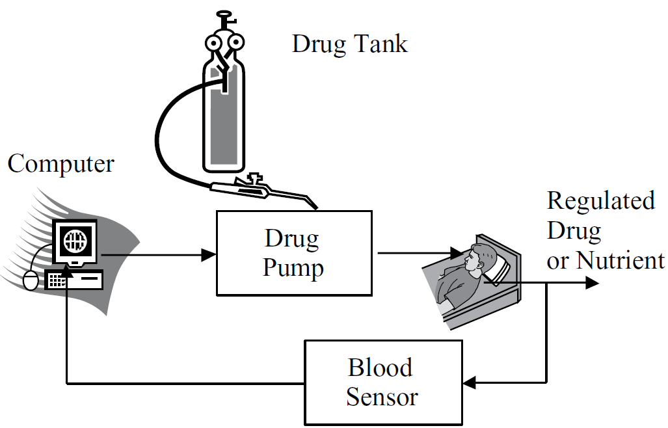
Examples of Digital control Systems
Closed-Loop Drug Delivery System

Slide 7
Examples of Digital control Systems
Aircraft Turbojet Engine

Slide 8
Difference Equation vs Differential Equation
A difference equation expresses the change in some variable as a result of a finite change in another variable.
A differential equation expresses the change in some variable as a result of an infinitesimal change in another variable.

Slide 9
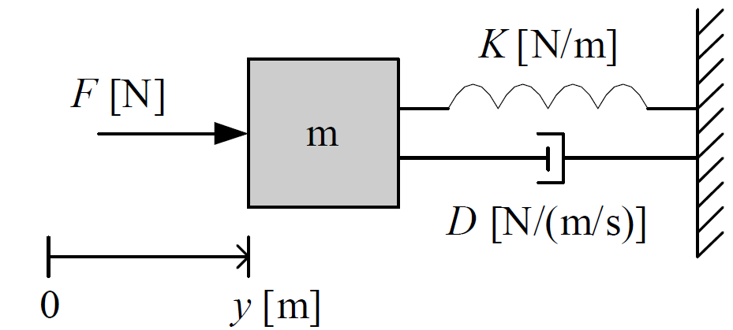
Differential Equation
Following figure shows a mass-spring-damper-system. Where y is position, F is applied force D is damping constant and K is spring constant.
Rearranging above equation in following form
$$F\left(t\right)=m\ddot{y}\left(t\right)+D\dot{y}\left(t\right)+Ky(t)$$
$$\ddot{y}\left(t\right)=\frac{1}{m}F\left(t\right)−\frac{D}{m}\dot{y}\left(t\right)\frac{K}{m}y(t)$$

Slide 10
Differential Equation
Rearranging above equation in following form
$$\ddot{y}\left(t\right)=\frac{1}{m}F\left(t\right)−\frac{D}{m}\dot{y}\left(t\right)\frac{K}{m}y(t)$$
$$F(t)$$
$$\frac{1}{m}$$
$$\ddot{y}$$
$$\int{dt}$$
$$\dot{y}$$
$$\int{dt}$$
$$y$$
$$−\frac{D}{m}$$
$$−\frac{K}{m}$$

Slide 11
Difference Equation
$$y(k+2)=\frac{1}{m}F(k)−\frac{D}{m}y(k+1) \frac{K}{m}y(k)$$
$$F(k)$$
$$\frac{1}{m}$$
$$y(k+2)$$
$$\frac{1}{z}$$
$y(k+1$)
$$\frac{1}{z}$$
$$y(k)$$
$$−\frac{D}{m}$$
$$−\frac{K}{m}$$

Slide 12
Difference Equations
Difference equations arise in problems where the independent variable, usually time, is assumed to have a discrete set of possible values.
Where coefficients $a_{n−1}$, $a_{n−2}$,… and $b_{n}$, $b_{n−1}$,… are constant.
$u(k)$ is forcing function
$$y\left(k+n\right)+a_{n−1}y\left(k+n−1\right)+…+a_{1}y\left(k+1\right)+a_{0}y\left(k\right)=b_{n}u\left(k+n\right)+b_{n−1}u\left(k+n−1\right)+…+b_{1}u\left(k+1\right)+b_{0}u\left(k\right)$$

Slide 13
Difference Equations
Example-1: For each of the following difference equations, determine the (a) order of the equation. Is the equation (b) linear, (c) time invariant, or (d) homogeneous?
$y\left(k+2\right)+0.8y\left(k+1\right)+0.07y\left(k\right)=u\left(k\right)$
$y\left(k+4\right)+sin⁡(0.4k)y\left(k+1\right)+0.3y\left(k\right)=0$
$y\left(k+1\right)=−0.1y^{2}\left(k\right)$

Slide 14
Difference Equations
Example-1: For each of the following difference equations, determine the (a) order of the equation. Is the equation (b) linear, (c) time invariant, or (d) homogeneous?
$y\left(k+2\right)+0.8y\left(k+1\right)+0.07y\left(k\right)=u\left(k\right)$
Solution:
The equation is second order.
All terms enter the equation linearly
All the terms if the equation have constant coefficients. Therefore the equation is therefore LTI.
A forcing function appears in the equation, so it is nonhomogeneous.

Slide 15
Difference Equations
Example-1: For each of the following difference equations, determine the (a) order of the equation. Is the equation (b) linear, (c) time invariant, or (d) homogeneous?
$y\left(k+4\right)+sin⁡(0.4k)y\left(k+1\right)+0.3y\left(k\right)=0$
Solution:
The equation is 4th order.
All terms are linear
The second coefficient is time dependent
There is no forcing function therefore the equation is homogeneous.

Slide 16
Difference Equations
Example-1: For each of the following difference equations, determine the (a) order of the equation. Is the equation (b) linear, (c) time invariant, or (d) homogeneous?
$y\left(k+1\right)=−0.1y^{2}\left(k\right)$
Solution:
The equation is 1st order.
Nonlinear
Time invariant
Homogeneous

Slide 17
Z-Transform
Difference equations can be solved using classical methods analogous to those available for differential equations.
Alternatively, z-transforms provide a convenient approach for solving LTI equations.
The z-transform is an important tool in the analysis and design of discrete-time systems.
It simplifies the solution of discrete-time problems by converting LTI difference equations to algebraic equations and convolution to multiplication.
Thus, it plays a role similar to that served by Laplace transforms in continuous-time problems.

Slide 18
Z-Transform
Given the causal sequence {u₀, u₁, u₂, …, u_{k}}, its z-transform is defined as
The variable z ⁻¹ in the above equation can be regarded as a time delay operator.
$$U\left(z\right)=u_{o}+u_{1}z^{−1}+u_{2}z^{−2}+u_{k}z^{−k}$$
$$U\left(z\right)=\sum_{k=0}^{∞}{u_{k}z^{−k}}$$

Slide 19
Z-Transform
Example-2: Obtain the z-transform of the sequence

Slide 20
Relation between Laplace Transform and Z-Transform
Given the impulse train representation of a discrete-time signal
$$u(t)$$
$$u^{∗}(t)$$
$$u(t)$$
$$u^{∗}(t)$$
$$U(s)$$
$$U^{∗}(s)$$
$$u^{∗}\left(t\right)=u_{o}δ\left(t\right)+u_{1}δ\left(t−T\right)+u_{2}δ\left(t−2T\right)+…+u_{k}δ\left(t−kT\right)$$
$$u^{∗}\left(t\right)=\sum_{k=0}^{∞}{u_{k}δ\left(t−kT\right)}$$

Slide 21
Relation between Laplace Transform and Z-Transform
The Laplace Transform of above equation is
And the Z-transform of $u^{∗}\left(t\right)$ is given as
Comparing (A) and (B) yields
$$u^{∗}\left(t\right)=u_{o}δ\left(t\right)+u_{1}δ\left(t−T\right)+u_{2}δ\left(t−2T\right)+…+u_{k}δ\left(t−kT\right)$$
$$U^{∗}\left(s\right)=u_{o}+u_{1}e^{−sT}+u_{2}e^{−2sT}+…+u_{k}e^{−ksT}$$
$$U^{∗}\left(s\right)=\sum_{k=0}^{∞}{u_{k}e^{−ksT}} (A)$$
$$U\left(z\right)=\sum_{k=0}^{∞}{u_{k}z^{−k}} (B)$$
$$z=e^{sT}$$

Slide 22
Conformal Mapping between s-plane to z-plane
Where $s=σ+jω$.
Then $z$ in polar coordinates is given by
$$z=e^{sT}$$
$$z=e^{(σ+jω)T}$$
$$z=e^{σT}e^{jωT}$$
$$\left|z\right|=e^{σT}$$
$$∠z=ωT$$

Slide 23
Conformal Mapping between s-plane to z-plane
We will discuss following cases to map given points on s-plane to z-plane.
Case-1: Real pole in s-plane $(s=σ)$
Case-2: Imaginary Pole in s-plane $(s=jω)$
Case-3: Complex Poles $(s=σ+jω)$
$$s−plane$$
$$z−plane$$

Slide 24
Conformal Mapping between s-plane to z-plane
Case-1: Real pole in s-plane $(s=σ)$
We know
Therefore
$$\left|z\right|=e^{σT}$$
$$∠z=ωT$$
$$\left|z\right|=e^{σT}$$
$$∠z=0$$

Slide 25
Conformal Mapping between s-plane to z-plane
Case-1: Real pole in s-plane $(s=σ)$
$$\left|z\right|=e^{σT}$$
$$∠z=ωT$$
When $s=0$
$$\left|z\right|=e^{0T}=1$$
$$∠z=0T=0$$
$$s=0$$
$$1$$
$$s−plane$$
$$z−plane$$

Slide 26
Conformal Mapping between s-plane to z-plane
Case-1: Real pole in s-plane $(s=σ)$
$$\left|z\right|=e^{σT}$$
$$∠z=ωT$$
When $s=−∞$
$$\left|z\right|=e^{−∞T}=0$$
$$∠z=0$$
$$0$$
$$−∞$$
$$s−plane$$
$$z−plane$$

Slide 27
Conformal Mapping between s-plane to z-plane
Case-1: Real pole in s-plane $(s=σ)$
$$\left|z\right|=e^{σT}$$
$$∠z=ωT$$
Consider $s=−a$
$$\left|z\right|=e^{−aT}$$
$$∠z=0$$
$$0$$
$$1$$
$$−a$$
$$s−plane$$
$$z−plane$$

Slide 28
Conformal Mapping between s-plane to z-plane
Case-2: Imaginary pole in s-plane $(s=±jω)$
We know
Therefore
$$\left|z\right|=e^{σT}$$
$$∠z=ωT$$
$$\left|z\right|=1$$
$$∠z=±ωT$$

Slide 29
Conformal Mapping between s-plane to z-plane
Case-2: Imaginary pole in s-plane $(s=±jω)$
$$\left|z\right|=e^{σT}$$
$$∠z=ωT$$
Consider $s=jω$
$$\left|z\right|=e^{0T}=1$$
$$∠z=ωT$$
$$1$$
$$s=jω$$
$$ωT$$
$$−1$$
$$1$$
$$−1$$
$$s−plane$$
$$z−plane$$

Slide 30
Conformal Mapping between s-plane to z-plane
Case-2: Imaginary pole in s-plane $(s=±jω)$
$$\left|z\right|=e^{σT}$$
$$∠z=ωT$$
When $s=−jω$
$$\left|z\right|=e^{0T}=1$$
$$∠z=−ωT$$
$$1$$
$$−1$$
$$−ωT$$
$$1$$
$$s=−jω$$
$$−1$$
$$s−plane$$
$$z−plane$$

Slide 31
Conformal Mapping between s-plane to z-plane
Case-2: Imaginary pole in s-plane $(s=±jω)$
$$\left|z\right|=e^{σT}$$
$$∠z=ωT$$
When $s=±j\frac{ω}{T}$
$$\left|z\right|=e^{0T}=1$$
$$∠z=±π$$
$$ωT=π$$
$$j\frac{ω}{T}$$
$$1$$
$$π$$
$$−1$$
$$1$$
$$−j\frac{ω}{T}$$
$$−1$$
$$s−plane$$
$$z−plane$$

Slide 32
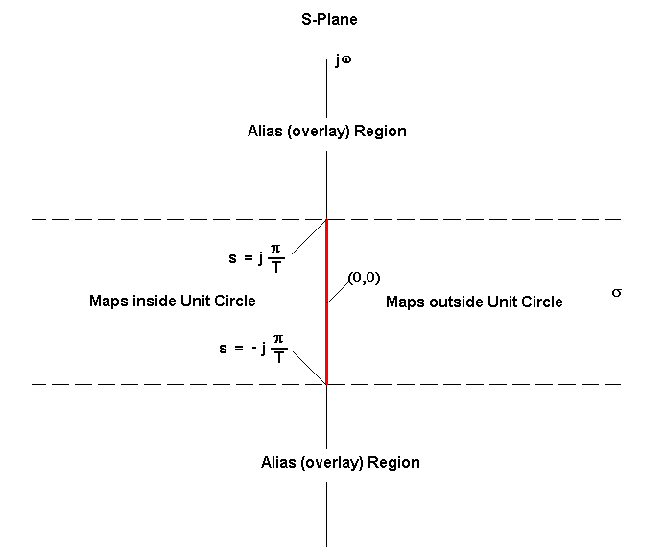
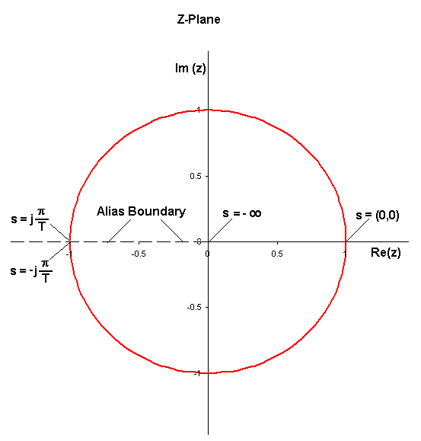
Conformal Mapping between s-plane to z-plane
Anything in the Alias/Overlay region in the S-Plane will be overlaid on the Z-Plane along with the contents of the strip between $±j\frac{π}{T}$.

Slide 33
Conformal Mapping between s-plane to z-plane
In order to avoid aliasing, there must be nothing in this region, i.e. there must be no signals present with radian frequencies higher than ω = π/T, or cyclic frequencies higher than f = 1/2T.
Stated another way, the sampling frequency must be at least twice the highest frequency present (Nyquist rate).

Slide 34
Conformal Mapping between s-plane to z-plane
Case-3: Complex pole in s-plane $(s=σ±jω)$
$$\left|z\right|=e^{σT}$$
$$∠z=ωT$$
$$\left|z\right|=e^{σT}$$
$$∠z=±ωT$$
$$1$$
$$−1$$
$$1$$
$$−1$$
$$s−plane$$
$$z−plane$$

Slide 35
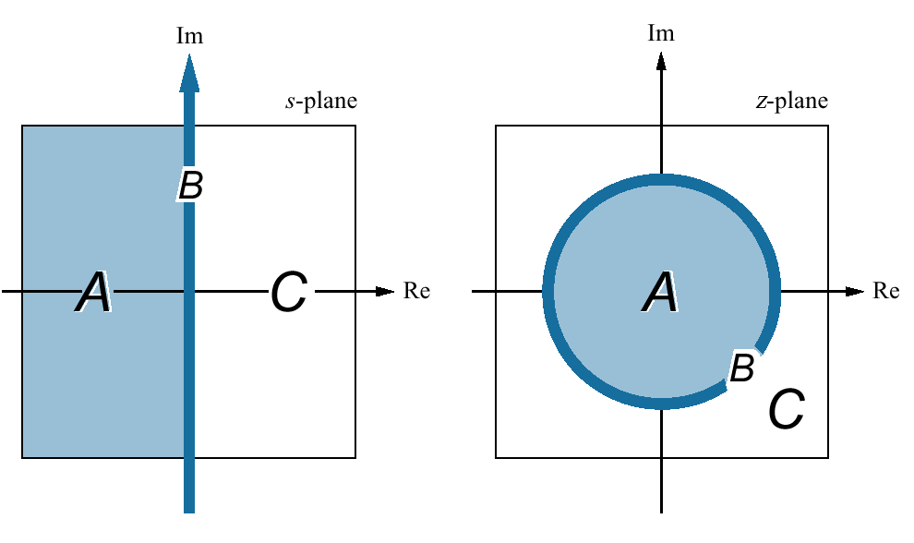
Mapping regions of the s-plane onto the z-plane

Slide 36
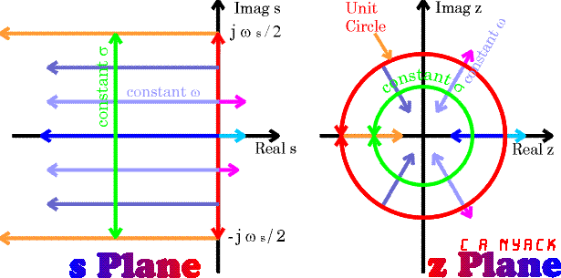
Mapping regions of the s-plane onto the z-plane

Slide 37
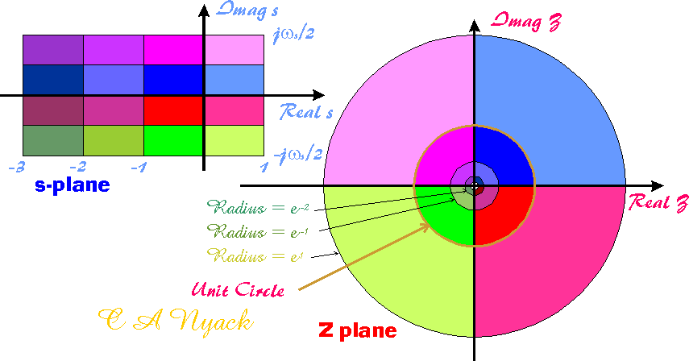
Mapping regions of the s-plane onto the z-plane

Slide 38
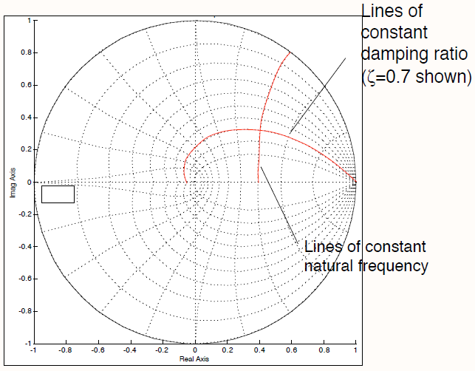

Slide 39
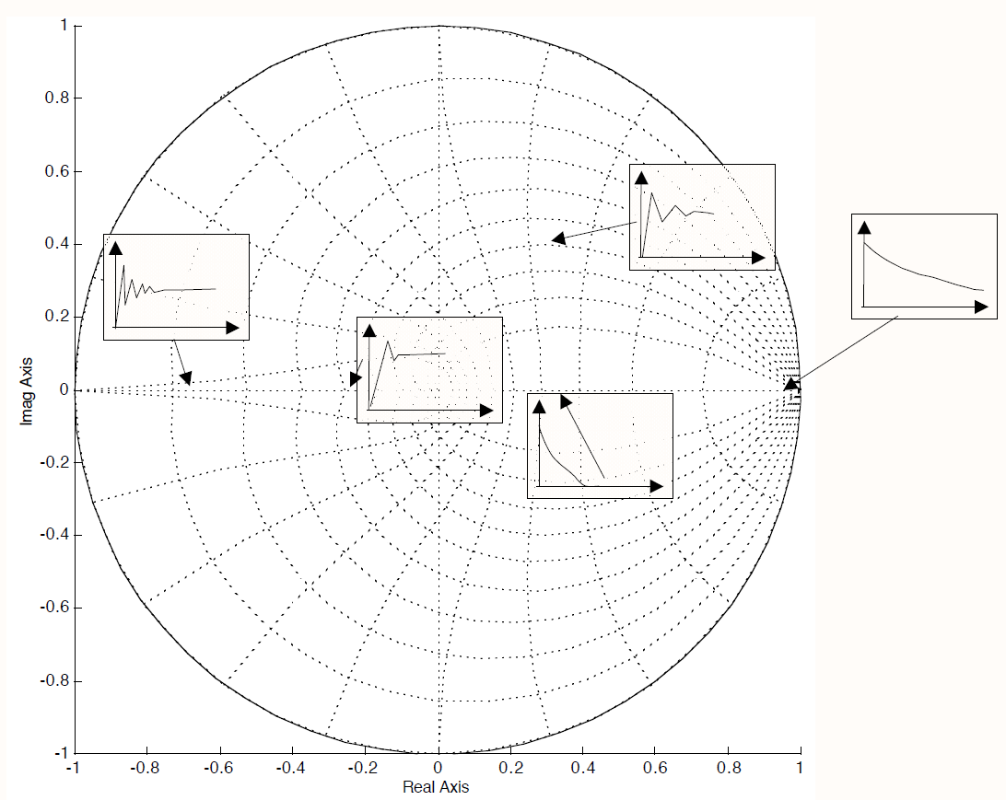

Slide 40
Example-3
Map following s-plane poles onto z-plane assume (T=1). Also comment on the nature of step response in each case.
$s=−3$
$s=±4j$
$s=±πj$
$s=±2πj$
$s=−10±5j$

Slide 41
z-Transforms of Standard Discrete-Time Signals
The following identities are used repeatedly to derive several important results.
$$\sum_{k=0}^{n}{a^{k}}=\frac{1−a^{n+1}}{1−a}, a≠1$$
$$\sum_{k=0}^{∞}{a^{k}}=\frac{1}{1−a}, \left|a\right|≠1$$

Slide 42
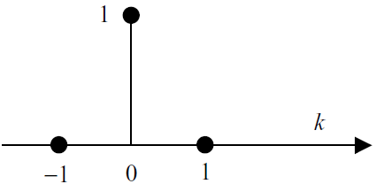
z-Transforms of Standard Discrete-Time Signals
Unit Impulse
Z-transform of the signal
$$δ\left(k\right)=\left\{\begin{aligned}1, \\ 0,\end{aligned}\right. {k=0 \atop k≠0}$$
$$δ\left(z\right)=1$$

Slide 43
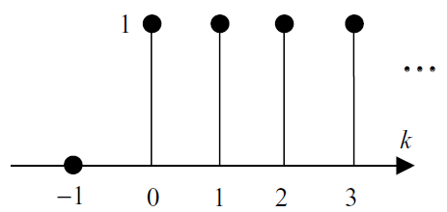
z-Transforms of Standard Discrete-Time Signals
Sampled Step
or
Z-transform of the signal
$$u\left(k\right)=\left\{\begin{aligned}1, \\ 0,\end{aligned}\right. {k≥0 \atop k<0}$$
$u\left(k\right)=\left\{1, 1, 1,1, …\right\}$ $k≥0$
$$U\left(z\right)=1+z^{−1}+z^{−2}+z^{−3}+…+z^{−k}=\sum_{k=0}^{n}{z^{−k}}$$
$U\left(z\right)=\frac{1}{1−z^{−1}}=\frac{z}{z−1}$ $\left|z\right|<1$

Slide 44
z-Transforms of Standard Discrete-Time Signals
Sampled Ramp
Z-transform of the signal
$$r\left(k\right)=\left\{\begin{aligned}k, \\ 0,\end{aligned}\right. {k≥0 \atop k<0}$$
$$r\left(k\right)$$
$$……$$
$$k$$
$$0$$
$$1$$
$$2$$
$$3$$
$$U\left(z\right)=\frac{z}{{\left(z−1\right)}^{2}}$$

Slide 45
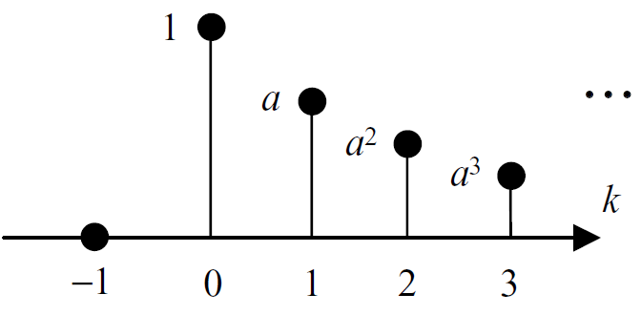
z-Transforms of Standard Discrete-Time Signals
Sampled Parabolic Signal
Then
$$u\left(k\right)=\left\{\begin{aligned}a^{k}, \\ 0,\end{aligned}\right. {k≥0 \atop k<0}$$
$$U\left(z\right)=1+{az}^{−1}+{a^{2}z}^{−2}+{a^{3}z}^{−3}+…+{a^{k}z}^{−k}=\sum_{k=0}^{n}{{(az)}^{−k}}$$
$U\left(z\right)=\frac{1}{1−{az}^{−1}}=\frac{z}{z−a}$ $\left|z\right|<1$

Slide 46
Exercise
Find the z-transform of following causal sequences.
$f\left(k\right)=2×1\left(k\right)+4×δ\left(k\right), k=0,1,2,…$
$f\left(k\right)=\left\{\begin{matrix}4, k=2,3,… \\ 0, otherwise\end{matrix}\right.$

Slide 47
Exercise
Find the z-transform of following causal sequences.
$$f\left(k\right)=2×1\left(k\right)+4×δ\left(k\right), k=0,1,2,…$$
Solution: Using Linearity Property
$$F\left(z\right)=𝒵\{2×1\left(k\right)+4×δ\left(k\right)\}$$
$$F\left(z\right)=2×𝒵\left\{1\left(k\right)\right\}+4×𝒵\{δ\left(k\right)\}$$
$$F\left(z\right)=2×\frac{z}{z−1}+4$$
$$F\left(z\right)=\frac{6z−4}{z−1}$$

Slide 48
Exercise
Find the z-transform of following causal sequences.
$$f\left(k\right)=\left\{\begin{matrix}4, k=2,3,… \\ 0, otherwise\end{matrix}\right.$$
Solution: The given sequence is a sampled step starting at k-2 rather than k=0 (i.e. it is delayed by two sampling periods). Using the delay property, we have
$$F\left(z\right)=𝒵\{4×1\left(k−2\right)\}$$
$$F\left(z\right)=4z^{−2} 𝒵\{1\left(k−2\right)\}$$
$$F\left(z\right)=4z^{−2}\frac{z}{z−1}=\frac{4}{z(z−1)}$$

Slide 49
Inverse Z-transform
Long Division: We first use long division to obtain as many terms as desired of the z-transform expansion.
Partial Fraction: This method is almost identical to that used in inverting Laplace transforms. However, because most z-functions have the term z in their numerator, it is often convenient to expand F(z)/z rather than F(z).

Slide 50
Inverse Z-transform
Example-4: Obtain the inverse z-transform of the function
Solution
1. Long Division
$$F\left(z\right)=\frac{z+1}{z^{2}+0.2z+0.1}$$

Slide 51
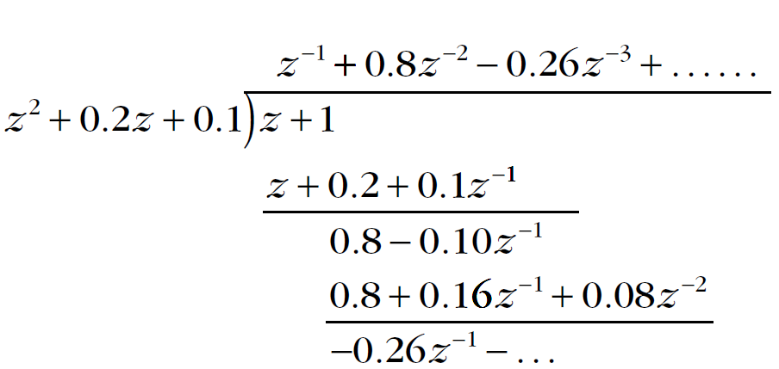
Inverse Z-transform
$$F\left(z\right)=\frac{z+1}{z^{2}+0.2z+0.1}$$
1. Long Division
Thus
Inverse z-transform
$$F\left(z\right)=0+z^{−1}+0.8z^{−2}−0.26z^{−3}+…$$
$$f\left(k\right)=\left\{0, 1, 0.8, −0.26, … \right\}$$

Slide 52
Inverse Z-transform
Example-5: Obtain the inverse z-transform of the function
Solution
2. Partial Fractions
$$F\left(z\right)=\frac{z+1}{z^{2}+0.3z+0.02}$$
$$\frac{F\left(z\right)}{z}=\frac{z+1}{z(z^{2}+0.3z+0.02)}$$
$$\frac{F\left(z\right)}{z}=\frac{z+1}{z(z^{2}+0.1z+0.2z+0.02)}$$

Slide 53
Inverse Z-transform
$$\frac{F\left(z\right)}{z}=\frac{z+1}{z(z+0.1)(z+0.2)}$$
$$\frac{F\left(z\right)}{z}=\frac{A}{z}+\frac{B}{z+0.1}+\frac{C}{z+0.2}$$

Slide 54
Inverse Z-transform
$$\frac{F\left(z\right)}{z}=\frac{50}{z}−\frac{90}{z+0.1}+\frac{40}{z+0.2}$$
$$F\left(z\right)=50−\frac{90z}{z+0.1}+\frac{40z}{z+0.2}$$
Taking inverse z-transform (using z-transform table)
$$f\left(k\right)=50δ\left(k\right)−90{\left(−0.1\right)}^{k}+40{\left(−0.2\right)}^{k}$$

Slide 55
Inverse Z-transform
Example-6: Obtain the inverse z-transform of the function
Solution
2. Partial Fractions
$$F\left(z\right)=\frac{z}{(z+0.1)(z+0.2)(z+0.3)}$$

Slide 56
Z-transform solution of Difference Equations
By a process analogous to Laplace transform solution of differential equations, one can easily solve linear difference equations.
The equations are first transformed to the z-domain (i.e., both the right- and left-hand side of the equation are z-transformed) .
Then the variable of interest is solved.
Finally inverse z-transformed is computed.

Slide 57
Z-transform solution of Difference Equations
Example-7: Solve the linear difference equation
With initial conditions $x\left(0\right)=1, x\left(1\right)=\frac{5}{2}$
1. Taking z-transform of given equation
2. Solve for X(z)
$$x\left(k+2\right)−\frac{3}{2}x\left(k+1\right)+\frac{1}{2}x\left(k\right)=1(k)$$
Solution
$$\left[z^{2}X\left(z\right)−z^{2}x\left(0\right)−zx\left(1\right)\right]−\frac{3}{2}zX\left(z\right)+\frac{1}{2}X\left(z\right)=\frac{z}{z−1}$$
$${[z}^{2}−\frac{3}{2}z+\frac{1}{2}]X\left(z\right)=\frac{z}{z−1}+z^{2}+(\frac{5}{2}−\frac{3}{2})z$$

Slide 58
Z-transform solution of Difference Equations
$${[z}^{2}−\frac{3}{2}z+\frac{1}{2}]X\left(z\right)=\frac{z}{z−1}+z^{2}+(\frac{5}{2}−\frac{3}{2})z$$
Then
3. Inverse z-transform
$$X\left(z\right)=\frac{z[1+(z+1)(z−1)]}{(z−1)(z−1)(z−0.5)}=\frac{z^{3}}{{\left(z−1\right)}^{2}(z−0.5)}$$
$$\frac{X\left(z\right)}{z}=\frac{z^{2}}{{\left(z−1\right)}^{2}(z−0.5)}=\frac{A}{{\left(z−1\right)}^{2}}+\frac{B}{z−1}+\frac{C}{z−0.5}$$
$$X(z)=\frac{2z}{{\left(z−1\right)}^{2}}+\frac{z}{z−0.5}$$
$$x(k)=2k+{(0.5)}^{k}$$

Slide 59
End of Lectures-17-18-19
To download this lecture visit
http://imtiazhussainkalwar.weebly.com/

