Slide 1
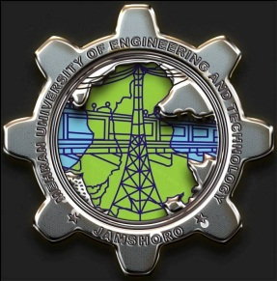
Power Electronics
Lecture-11
Inverters
Dr. Imtiaz Hussain
Associate Professor
email: imtiaz.hussain@faculty.muet.edu.pk
URL :http://imtiazhussainkalwar.weebly.com/

Slide 2
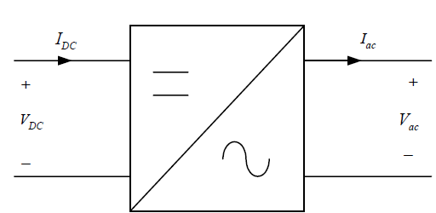
Introduction
Converts DC to AC power by switching the DC input voltage (or current) in a pre-determined sequence so as to generate AC voltage (or current) output.

Slide 3
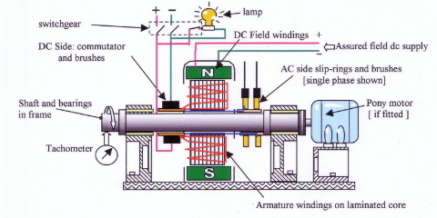
Methods of Inversion
Rotary inverters use a DC motor to turn an AC Power generator, the provide a true sine wave output, but are inefficient, and have a low surge capacity rating
Electrical inverters use a combination of ‘chopping’ circuits and transformers to change DC power into AC.
They are much more widely used and are far more efficient and practical.

Slide 4
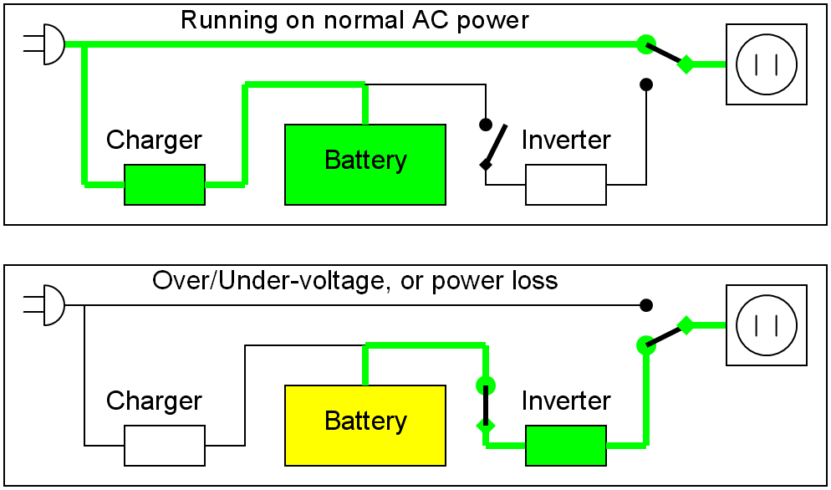
TYPICAL APPLICATIONS
Un-interruptible power supply (UPS)

Slide 5
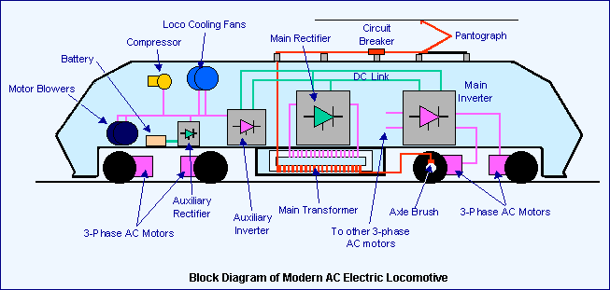
TYPICAL APPLICATIONS
Traction

Slide 6
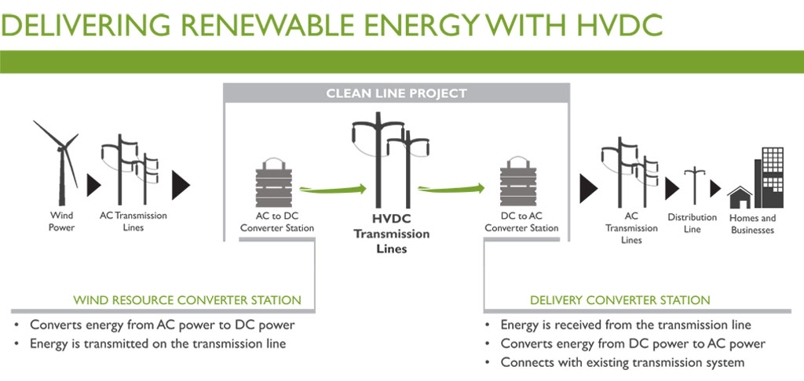
TYPICAL APPLICATIONS
HVDC (High Voltage Direct Current)

Slide 7
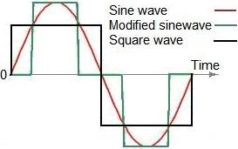
Types of Inverters
There are three basic types of dc-ac converters depending on their AC output waveform:
Square wave Inverters
Modified sine wave Inverters
Pure sine wave Inverters

Slide 8
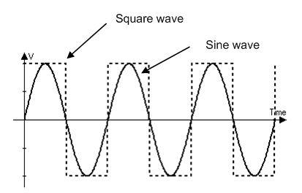
Square Wave Inverters
The square wave is the simplest and cheapest type, but nowadays it is practically not used commercially because of low power quality (THD≈45%).

Slide 9
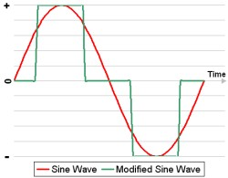
Modified Sine wave Inverters
The modified sine wave topologies provide rectangular pulses with some dead spots between positive and negative half-cycles.
They are suitable for most electronic loads, although their THD is almost 24%.
They are the most popular low-cost inverters on the consumer market today,

Slide 10
Pure Sine Wave Inverters
A true sine wave inverter produces output with the lowest total harmonic distortion (normally below 3%).
It is the most expensive type of AC source, which is used when there is a need for a sinusoidal output for certain devices, such as medical equipment, laser printers, stereos, etc.
This type is also used in grid-connected applications.

Slide 11
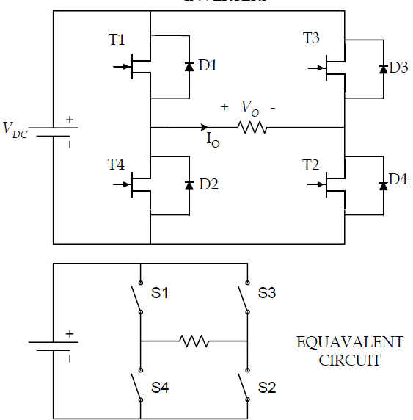
Simple square-wave inverter
To illustrate the concept of AC waveform generation

Slide 12
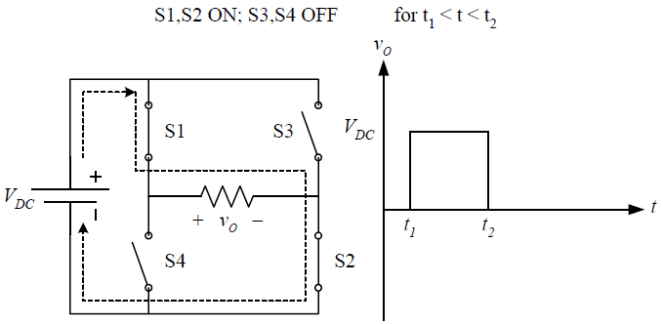
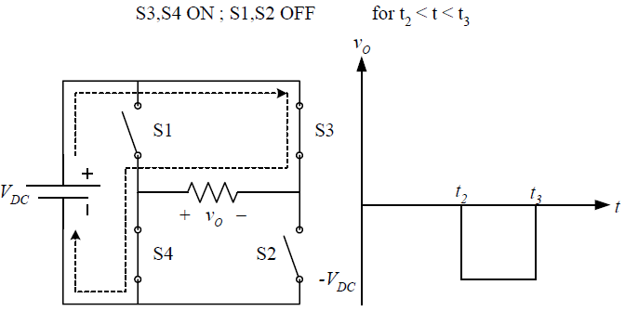
AC Waveform Generation

Slide 13
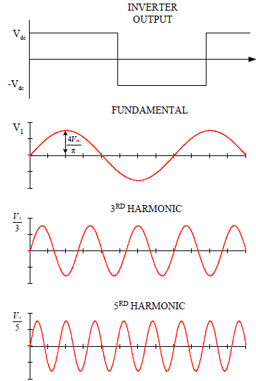
AC Waveforms

Slide 14
Output voltage harmonics
Harmonics may cause degradation of equipment (Equipment need to be “de-rated”).
Total Harmonic Distortion (THD) is a measure to determine the “quality” of a given waveform.
$${THD}_{v}=\frac{\sqrt{\sum_{n=2}^{∞}{{\left(V_{n, RMS}\right)}^{2}}}}{V_{1, RMS}}$$
$${THD}_{i}=\frac{\sqrt{\sum_{n=2}^{∞}{{\left(I_{n, RMS}\right)}^{2}}}}{I_{1, RMS}}$$

Slide 15
Fourier Series
Study of harmonics requires understanding of wave shapes.
Fourier Series is a tool to analyse wave shapes.
Where,
$$v\left(t\right)=a_{o}+\sum_{n=1}^{∞}{\left[a_{n}\cos\left(nθ\right)+b_{n}\sin\left(nθ\right)\right]}$$
$$a_{o}=\frac{1}{π}\int_{0}^{2π}{v\left(t\right)dθ}$$
$$a_{n}=\frac{1}{π}\int_{0}^{2π}{v\left(t\right)\cos\left(nθ\right)dθ}$$
$$b_{n}=\frac{1}{π}\int_{0}^{2π}{v\left(t\right)\sin\left(nθ\right)dθ}$$

Slide 16
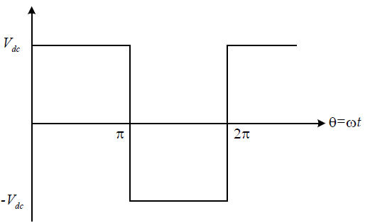
Harmonics of square-wave
$$a_{o}=\frac{1}{π}\int_{0}^{2π}{v\left(t\right)dθ}$$
$$a_{o}=\frac{1}{π}\left[\int_{0}^{π}{V_{dc} dθ}+\int_{π}^{2π}{{−V}_{dc} dθ}\right]$$
$$a_{o}=0$$

Slide 17
Harmonics of square-wave
$$a_{n}=\frac{1}{π}\int_{0}^{2π}{v\left(t\right)\cos\left(nθ\right)dθ}$$
$$a_{n}=\frac{1}{π}\left[\int_{0}^{π}{V_{dc}\cos\left(nθ\right)dθ}+\int_{π}^{2π}{−V_{dc}\cos\left(nθ\right)dθ}\right]$$
$$a_{n}=\frac{V_{dc}}{π}\left[\int_{0}^{π}{\cos\left(nθ\right)dθ}−\int_{π}^{2π}{\cos\left(nθ\right)dθ}\right]=0$$

Slide 18
Harmonics of square-wave
$$b_{n}=\frac{1}{π}\int_{0}^{2π}{v\left(t\right)\sin\left(nθ\right)dθ}$$
$$b_{n}=\frac{1}{π}\left[\int_{0}^{π}{V_{dc}\sin\left(nθ\right)dθ}+\int_{π}^{2π}{−V_{dc}\sin\left(nθ\right)dθ}\right]$$
$$b_{n}=\frac{V_{dc}}{π}\left[\int_{0}^{π}{\sin\left(nθ\right)dθ}−\int_{π}^{2π}{\sin\left(nθ\right)dθ}\right]=\frac{2V_{dc}}{nπ}\left[1−cos⁡(nπ)\right]$$
When n is even
$$b_{n}=0$$
When n is odd
$$b_{n}=\frac{4V_{dc}}{nπ}$$

Slide 19
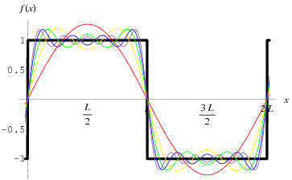
Harmonics of square-wave
$$v\left(t\right)=a_{o}+\sum_{n=1}^{∞}{\left[a_{n}\cos\left(nθ\right)+b_{n}\sin\left(nθ\right)\right]}$$
$$v\left(t\right)=\sum_{n=1}^{∞}{\left[b_{n}\sin\left(nθ\right)\right]}$$
Where, $b_{n}=\frac{4V_{dc}}{nπ}\left\{\begin{aligned}0 n even \\ 1 n odd\end{aligned}\right.$
$$v\left(t\right)=\frac{4V_{dc}}{π}\sum_{n=1,3,5…}^{∞}{\frac{1}{n}\sin\left(nθ\right)}$$

Slide 20
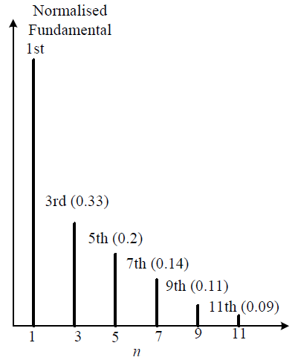
Harmonics of square-wave
Spectra characteristics
Harmonic decreases as n increases.
It decreases with a factor of (1/n).
Even harmonics are absent.
Nearest harmonics is the 3rd.
If fundamental is 50Hz, then nearest harmonic is 150Hz.

Slide 21
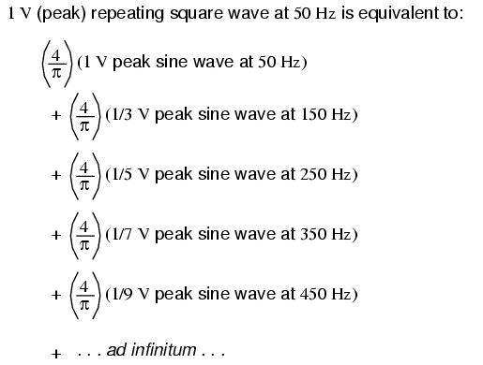
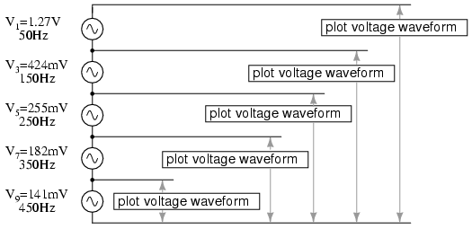
Harmonics of square-wave

Slide 22
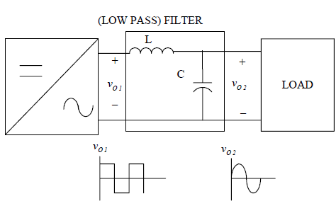
Filtering
Low-pass filter is normally fitted at the inverter output to reduce the high frequency harmonics.

Slide 23
Topologies of Inverters
Voltage Source Inverter (VSI)
Where the independently controlled ac output is a voltage waveform.
In industrial markets, the VSI design has proven to be more efficient, have higher reliability and faster dynamic response, and be capable of running motors without de-rating.
Current Source Inverter (CSI)
Where the independently controlled ac output is a current waveform.
These structures are still widely used in medium-voltage industrial applications, where high-quality voltage waveforms are required.

Slide 24
1-$∅$ Voltage source Inverters
Single phase voltage source inverters are of two types.
Single Phase Half Bridge voltage source inverters
Single Phase full Bridge voltage source inverters

Slide 25
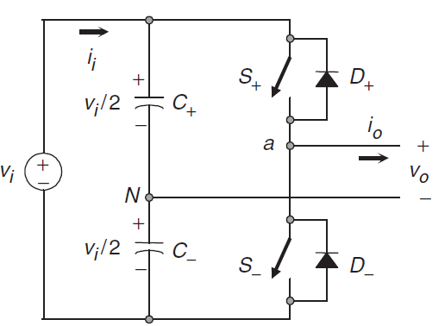
1-$∅$ Half Bridge VSI
Figure shows the power topology of a half-bridge VSI, where two large capacitors are required to provide a neutral point N, such that each capacitor maintains a constant voltage v_{i} /2.
It is clear that both switches S+ and S− cannot be on simultaneously because a short circuit across the dc link voltage source v_{i} would be produced.

Slide 26
1-$∅$ Half Bridge VSI
Figure shows the ideal waveforms associated with the half-bridge inverter.

Slide 27
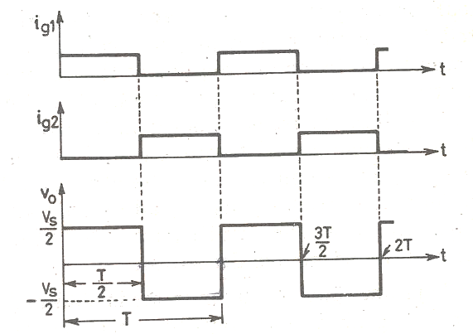
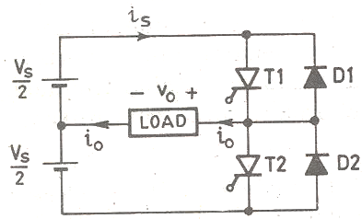
1-$∅$ Half Bridge VSI
The gating signals for thyristors and resulting output voltage waveforms are shown below.
$$v_{o}=\left\{ \begin{aligned}\frac{V_{s}}{2} 0<t<T/2 \\ −\frac{V_{s}}{2} T/2<t<T\end{aligned}\right.$$
Note: Turn off circuitry for thyristor is not shown for simplicity

Slide 28
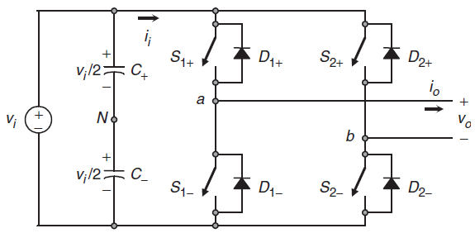
1-$∅$ Full Bridge VSI
This inverter is similar to the half-bridge inverter; however, a second leg provides the neutral point to the load.
It can be observed that the ac output voltage can take values up to the dc link value v_{i}, which is twice that obtained with half-bridge VSI topologies.

Slide 29
1-$∅$ Full Bridge VSI
Figure shows the ideal waveforms associated with the half-bridge inverter.
$$v_{i}$$
$$v_{i}$$

Slide 30
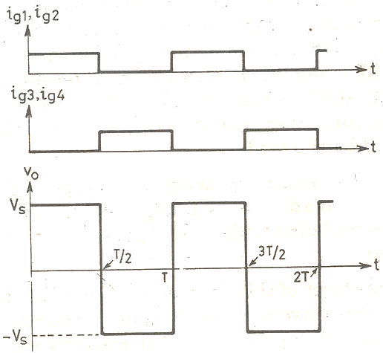
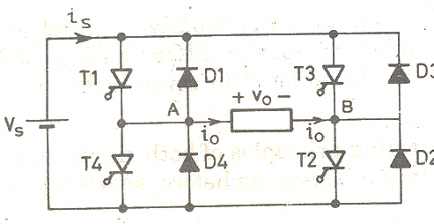
1-$∅$ Full Bridge VSI
The gating signals for thyristors and resulting output voltage waveforms are shown below.
$$v_{o}=\left\{ \begin{aligned}V_{s} 0<t<T/2 \\ −V_{s} T/2<t<T\end{aligned}\right.$$

Slide 31
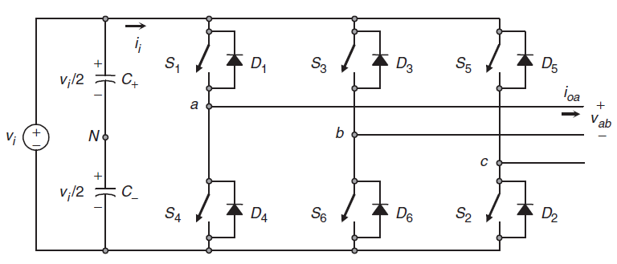
3-$∅$ Full Bridge VSI
Single-phase VSIs cover low-range power applications and three-phase VSIs cover medium- to high-power applications.
The main purpose of these topologies is to provide a three phase voltage source, where the amplitude, phase, and frequency of the voltages should always be controllable.

Slide 32
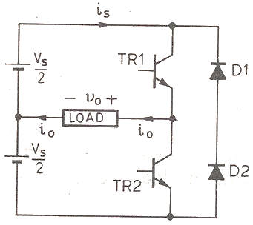
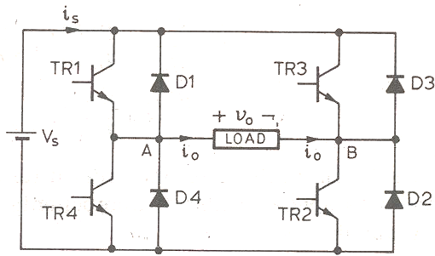
1-$∅$ VSI using transistors
Single-phase half bridge and full bridge voltage source inverters using transistors are shown below.

Slide 33
Example-1
A full bridge single phase voltage source inverter is feeding a square wave signals of 50 Hz as shown in figure below. The DC link signal is 100V. The load is 10 ohm.
Calculate
THD_{v}
THD_{v} by first three nonzero harmonics
100V
-100V

Slide 34
Example-1
To calculate the harmonic contents we need to expand the output waveform into Fourier series expansion.
Since output of the inverter is an odd function with zero offset, therefore $a_{o}$ and $a_{n}$ will be zero.
$$v_{o}=a_{o}+\sum_{n=1}^{∞}{\left[a_{n}\cos\left(nθ\right)+b_{n}\sin\left(nθ\right)\right]}$$
100V
-100V

Slide 35
Example-1
$$v_{o}=\sum_{n=1}^{∞}{b_{n}\sin\left(nθ\right)}$$
Where,
$$b_{n}=\frac{1}{π}\int_{0}^{2π}{v_{o}\left(t\right)\sin\left(nθ\right)dθ}$$
$$b_{n}=\frac{4V_{o}}{nπ}\left\{\begin{aligned}0 n even \\ 1 n odd\end{aligned}\right.$$
100V
$$v\left(t\right)=\frac{4V_{o}}{π}\sum_{n=1,3,5…}^{∞}{\frac{1}{n}\sin\left(nθ\right)}$$
-100V

Slide 36
Example-1
THD_{v} can be calculated as
Fourier series can be further expanded as
$${THD}_{v}=\frac{\sqrt{\sum_{n=2}^{∞}{{\left(V_{n, RMS}\right)}^{2}}}}{V_{1, RMS}}$$
$$v\left(t\right)=\frac{4V_{o}}{π}\sum_{n=1,3,5…}^{∞}{\frac{1}{n}\sin\left(nθ\right)}$$
$$v\left(t\right)=\frac{400}{π}\sin{θ}+\frac{400}{3π}\sin{(3θ)}+\frac{400}{5π}\sin{(5θ)}+\frac{400}{7π}\sin\left(7θ\right)+\frac{400}{9π}\sin\left(9θ\right)+…$$

Slide 37
Example-1
$$v\left(t\right)=\frac{400}{π}\sin{θ}+\frac{400}{3π}\sin{(3θ)}+\frac{400}{5π}\sin{(5θ)}+\frac{400}{7π}\sin\left(7θ\right)+\frac{400}{9π}\sin\left(9θ\right)+…$$
$${THD}_{v}=\frac{\sqrt{{\left(V_{3, RMS}\right)}^{2}+{\left(V_{5, RMS}\right)}^{2}+{\left(V_{7, RMS}\right)}^{2}{+\left(V_{9, RMS}\right)}^{2}+…}}{V_{1, RMS}}$$
$${THD}_{v}=\frac{\sqrt{{\left(\frac{0.707×400}{3π}\right)}^{2}+{\left(\frac{0.707×400}{5π}\right)}^{2}+{\left(\frac{0.707×400}{7π}\right)}^{2}{+\left(\frac{0.707×400}{9π}\right)}^{2}+…}}{\frac{0.707×400}{π}}$$
$${THD}_{v}=\sqrt{{\left(\frac{1}{3}\right)}^{2}+{\left(\frac{1}{5}\right)}^{2}+{\left(\frac{1}{7}\right)}^{2}+{\left(\frac{1}{9}\right)}^{2}+{\left(\frac{1}{11}\right)}^{2}+{\left(\frac{1}{13}\right)}^{2}+…}$$
$${THD}_{v}=0.45$$
$${THD}_{v}=45\%$$

Slide 38
Example-1
THD_{v} by first three nonzero harmonics
$${THD}_{v}=\frac{\sqrt{{\left(V_{3, RMS}\right)}^{2}+{\left(V_{5, RMS}\right)}^{2}+{\left(V_{7, RMS}\right)}^{2}}}{V_{1, RMS}}$$
$${THD}_{v}=\frac{\sqrt{{\left(\frac{0.707×400}{3π}\right)}^{2}+{\left(\frac{0.707×400}{5π}\right)}^{2}+{\left(\frac{0.707×400}{7π}\right)}^{2}}}{\frac{0.707×400}{π}}$$
$${THD}_{v}=\sqrt{{\left(\frac{1}{3}\right)}^{2}+{\left(\frac{1}{5}\right)}^{2}+{\left(\frac{1}{7}\right)}^{2}}$$
$${THD}_{v}=0.41$$
$${THD}_{v}=41\%$$

Slide 39
End of Lecture-11
To download this lecture visit
http://imtiazhussainkalwar.weebly.com/

