Slide 1


Modern Control Systems (MCS)
Lecture-10
Nonlinearities in Control Systems
Dr. Imtiaz Hussain
Assistant Professor
email: imtiaz.hussain@faculty.muet.edu.pk
URL :http://imtiazhussainkalwar.weebly.com/

Slide 2
Lecture Outline
Introduction
Properties of nonlinear systems
Describing Function Method
Phase Plane Analysis
Liapunov Stability Analysis (2nd Method)

Slide 3
Introduction
It is a well known fact that many relationships among quantities are not quite linear, although they are often approximated by linear equations mainly for mathematical simplicity.
The simplifications may be satisfactory as long as the resulting solutions are in agreement with experimental results.
One of the most important characteristics of nonlinear system is the dependence of the system response on the magnitude and type of the input.

Slide 4
Introduction
One of the most important characteristics of nonlinear system is the dependence of the system response on the magnitude and type of the input.

Slide 5
Introduction
For example, a nonlinear system may behave completely differently in response to step inputs of different magnitudes.
Nonlinear systems exhibit many phenomena that cannot be seen in linear systems
  Frequency Amplitude Dependency
  Multivalued Responses
  Jump resonance
  Sub-harmonic Oscillations
  Self excited oscillations or limit cycles
  Frequency entrainment
  Asynchronous Quenching
In investigating nonlinear systems we must be familiar with these phenomena.

Slide 6
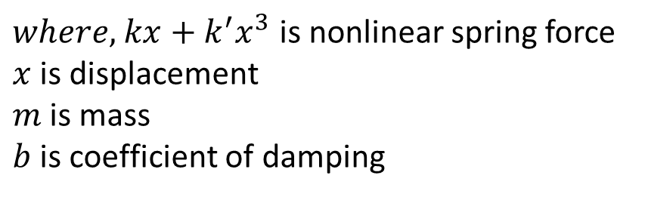
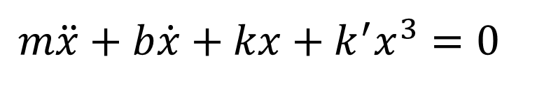
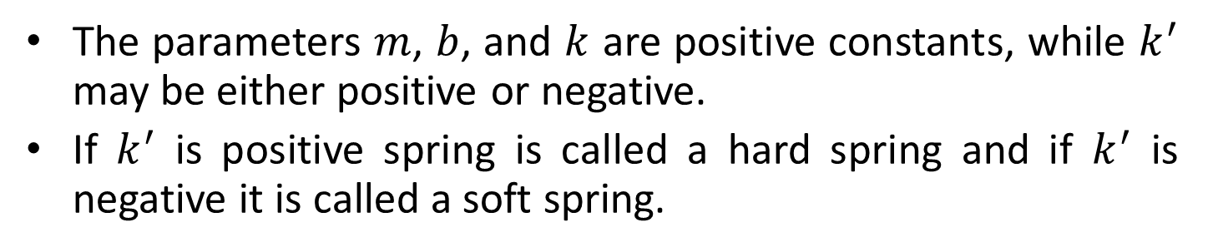
Frequency Amplitude Dependence
Consider the free oscillation of the mechanical systems shown in figure.
The differential equation of the system is
Nonlinear
Spring
$$m\ddot{x}+b\dot{x}+kx+k^{′}x^{3}=0$$
M
$where,$ $kx+k^{′}x^{3}$ is nonlinear spring force
$x$ is displacement
$m$ is mass
$b$ is coefficient of damping
The parameters $m$, $b$, and $k$ are positive constants, while $k^{′}$ may be either positive or negative.
If $k^{′}$ is positive spring is called a hard spring and if $k^{′}$ is negative it is called a soft spring.

Slide 7
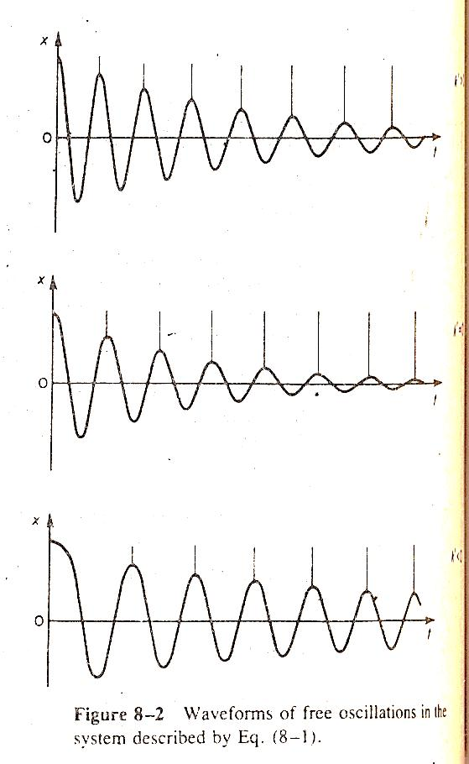

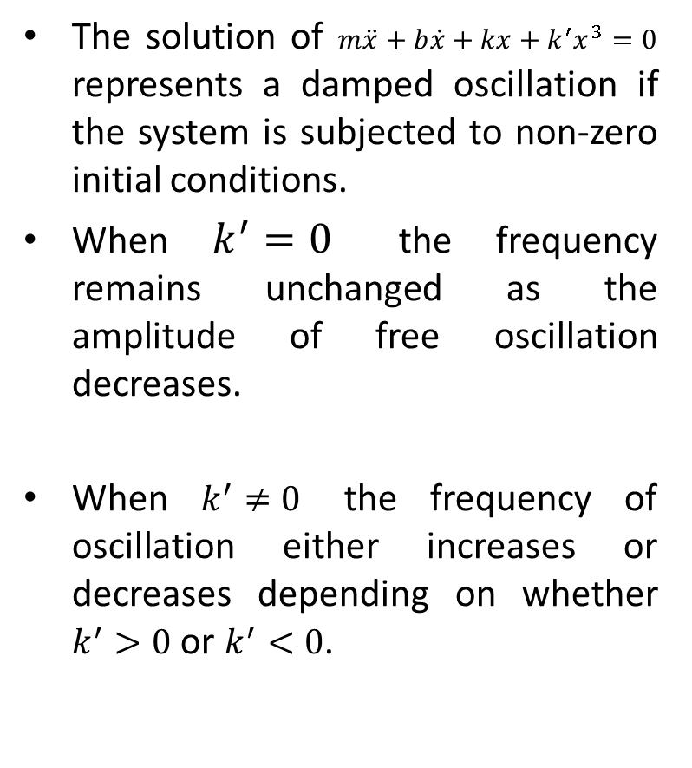


Frequency Amplitude Dependence
The solution of $m\ddot{x}+b\dot{x}+kx+k^{′}x^{3}=0$ represents a damped oscillation if the system is subjected to non-zero initial conditions.
When $k^{′}=0$ the frequency remains unchanged as the amplitude of free oscillation decreases.
When $k^{′}≠0$ the frequency of oscillation either increases or decreases depending on whether $k^{′}>0$ or $k^{′}<0$.
$k^{′}>0$
$k^{′}=0$
$k^{′}<0$

Slide 8
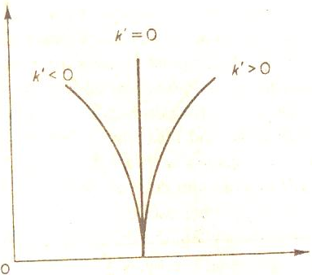
Frequency Amplitude Dependence
Frequency amplitude dependence is one of the most fundamental characteristics of the nonlinear systems.
Amplitude
Frequency

Slide 9
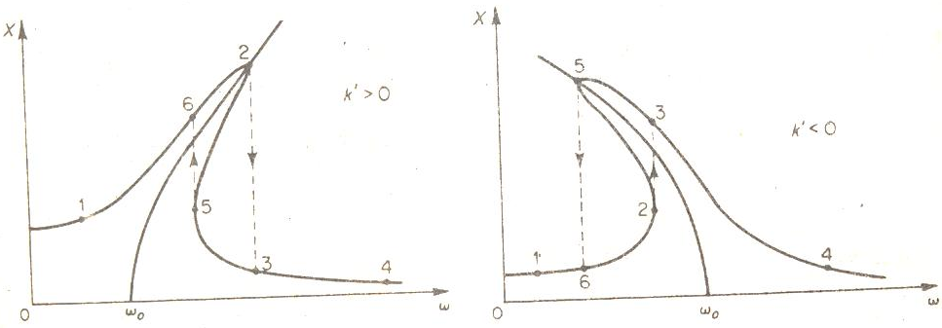

Multivalued Responses and Jump Resonances
The differential equation of spring mass damper system with sinusoidal forcing function exhibits multivalued response and jump resonance.
$$m\ddot{x}+b\dot{x}+kx+k^{′}x^{3}=P cos⁡(ωt)$$

Slide 10
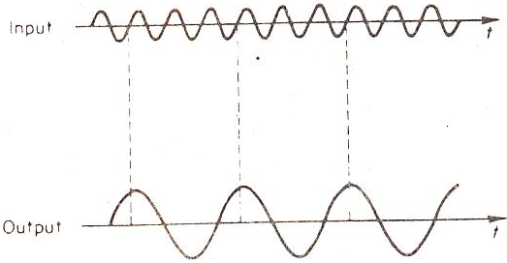

Sub-Harmonic & Super-Harmonic Oscillations
The differential equation of spring mass damper system also exhibits periodic motions such as sub-harmonic and super-harmonic oscillations.
$$m\ddot{x}+b\dot{x}+kx+k^{′}x^{3}=P cos⁡(ωt)$$

Slide 11

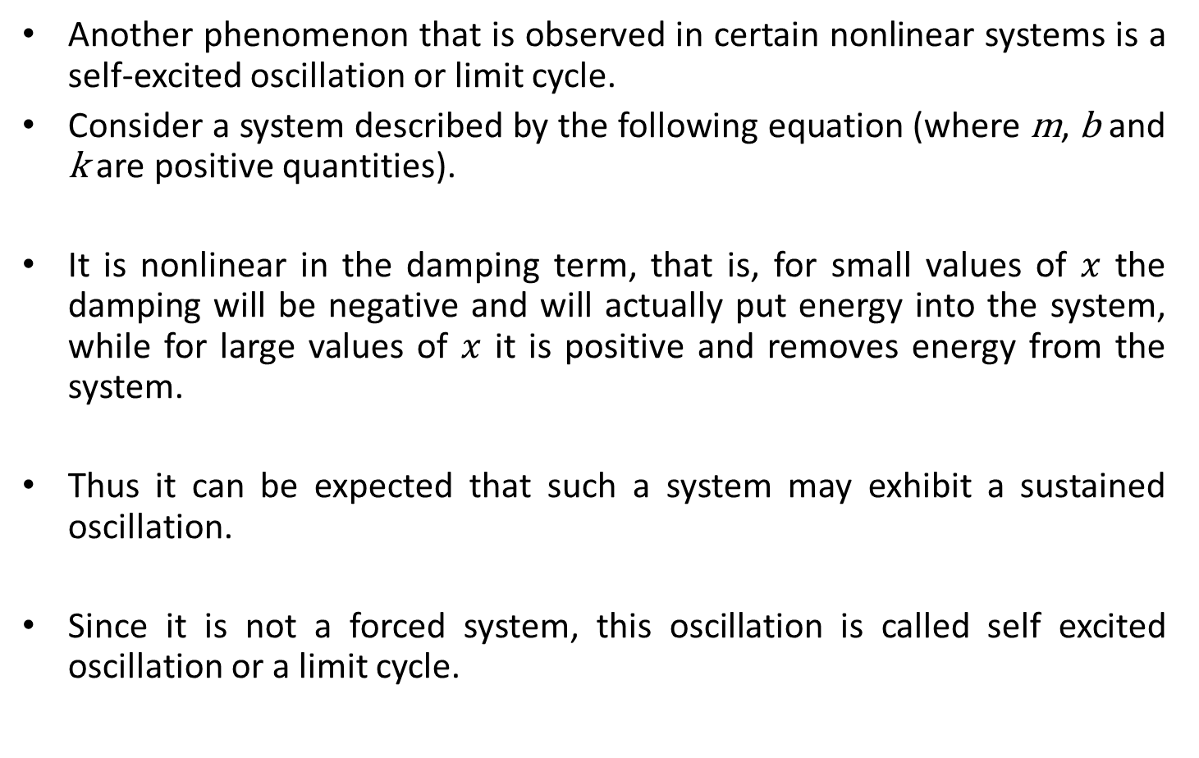
Self-excited Oscillations or limit cycles
Another phenomenon that is observed in certain nonlinear systems is a self-excited oscillation or limit cycle.
Consider a system described by the following equation (where m, b and k are positive quantities).
It is nonlinear in the damping term, that is, for small values of $x$ the damping will be negative and will actually put energy into the system, while for large values of $x$ it is positive and removes energy from the system.
Thus it can be expected that such a system may exhibit a sustained oscillation.
Since it is not a forced system, this oscillation is called self excited oscillation or a limit cycle.
$$m\ddot{x}−b(1−x^{2})\dot{x}+kx=0$$

Slide 12
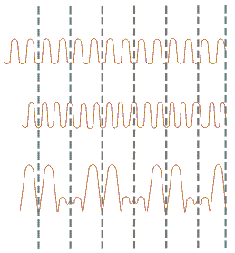




Frequency Entrainment
If a periodic force of frequency $ω$ is applied to a system capable of exhibiting a limit cycle of frequency $ω_{o}$, the well known phenomenon of beat is observed.
Suppose two tuning forks having frequencies 256 and 257 per second respectively, are sounded together. If at the beginning of a given second, they vibrate in the same phase so that the compressions (or rarefactions) of the corresponding waves reach the ear together, the sound will be reinforced (strengthened). Half a second later, when one makes 128 and the other 128/2 vibrations, they are in opposite phase, i.e., the compression of one wave combines with the rarefaction of the other and tends to produce silence. At the end of one second, they are again be in the same phase and the sound is reinforced. By this time, one fork is ahead of the other by one vibration.
Thus, in the resultant sound, the observer hears maximum sound at the interval of one second. Similarly, a minimum loudness is heard at an interval of one second. As we may consider a single beat to occupy the interval between two consecutive maxima or minima, the beat produced in one second in this case, is one in each second. If the two tuning forks had frequencies 256 and 258, a similar analysis would show that the number of beats will be two per second. Thus, in general, the number of beats heard per second will be equal to the difference in the frequencies of the two sound waves.
$$ω$$
$$ω_{o}$$
$$\left|{ω−ω}_{o}\right|$$

Slide 13





Frequency Entrainment
In a self excited nonlinear system the frequency $ω_{o}$ of the limit cycles falls in synchronistic ally with, or entrained by, the forcing frequency $ω$, within a certain band of frequencies.
The phenomenon is called frequency entrainment and band of frequency in which entrainment occurs is called zone of frequency entrainment .
$$\left|ω−ω_{o}\right|$$
$$∆ω$$
$$o$$
$$ω$$

Slide 14
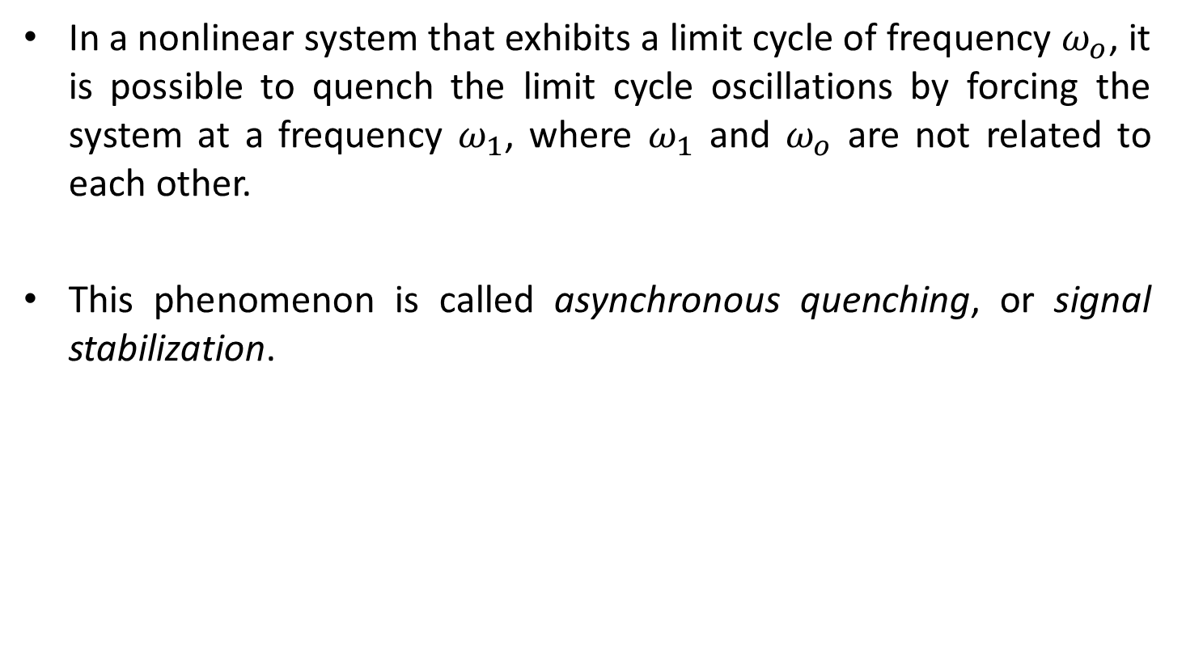
Asynchronous Quenching
In a nonlinear system that exhibits a limit cycle of frequency $ω_{o}$, it is possible to quench the limit cycle oscillations by forcing the system at a frequency $ω_{1}$, where $ω_{1}$ and $ω_{o}$ are not related to each other.
This phenomenon is called asynchronous quenching, or signal stabilization.

Slide 15
COMMON NONLINEARITIES IN CONTROL SYSTEMS
Consider the typical block diagram shown in Figure. It is composed of four parts: a plant to be controlled, sensors for measurement, actuators for control action, and a control law, usually implemented on a computer.
Nonlinearities may occur in any part of the system, thus make it a nonlinear control system.
Many different types of nonlinearities may be found in practical control systems, and they may be divided into
  Inherent Nonlinearities: The non-linear behavior that is already present in the system. eg. Saturation
  Intentional Nonlinearities: he non-linear elements that are added into a system. eg. Relay
r(t)
+
y(t)
Controller
Actuators
Plant
-
Sensors

Slide 16
Inherent Nonlinearities
Inherent nonlinearities are unavoidable in control systems.
Example of such nonlinearities are
  Saturation
  Dead Zone
  Hysteresis
  Backlash
  Friction (Static, Coulomb, etc.)
  Nonlinear Spring
  Compressibility of Fluid

Slide 17
Intentional Nonlinearities
Some nonlinear elements are intentionally introduced into a system to improve system performance.
Example of such nonlinearities are
  Relay
  On off control
  Solid state Switches

Slide 18
Approaches to the analysis and Design of nonlinear Control Systems
There is no general method for dealing with all nonlinear systems.
Analysis and design methods for nonlinear control systems include
  Describing function method
  Liapunov Method
  Phase Plane Analysis
  Several others

Slide 19
Describing Function Method
One way to analyze and design a particular nonlinear control system, in which the degree of nonlinearity is small, is to use equivalent linearization techniques.
The describing function method is one of the equivalent linearization methods.

Slide 20
Describing Function (DF)
The describing function (DF) method is an approximate procedure for analyzing certain nonlinear control problems.
It is based on quasi-linearization, which is the approximation of the non-linear system under investigation by a linear time-invariant (LTI) transfer function that depends on the amplitude of the input waveform.
Transfer function of a true LTI system cannot depend on the amplitude of the input function.
Thus, this dependence on amplitude generates a family of linear systems that are combined in an attempt to capture salient features of the non-linear system behavior.
The describing function is one of the few widely-applicable methods for designing nonlinear systems, and is very widely used as a standard mathematical tool for analyzing limit cycles in closed-loop controllers, such as industrial process controls, servomechanisms, and electronic oscillators.

Slide 21
Describing Function Method
Suppose that the input to a nonlinear system is sinusoidal.
The output of the nonlinear system is, in general, no sinusoidal.
The output contains higher harmonics in addition to the fundamental harmonic components.
Suppose that the output is periodic with the same period as the input.

Slide 22
Describing Function Method
In describing function analysis we assume that only fundamental harmonic component of the output is significant.
Such an assumption is often valid since the higher harmonic components of the output are often of smaller amplitude than the amplitude of fundamental harmonic component.
Most control systems are low-pass filters which results in attenuation of higher harmonic components of the output.

Slide 23
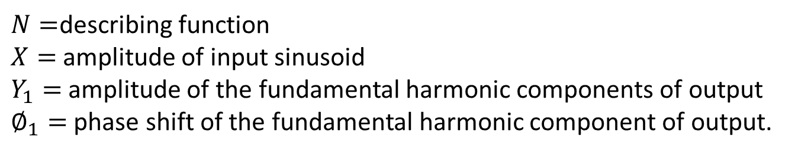
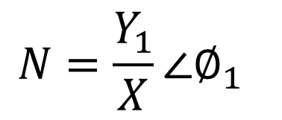
Describing Function Method
The describing function or sinusoidal describing function of a nonlinear systems is defined as the “complex ratio of the fundamental harmonic component of the output to the input”.
That is
Where,
$$N=\frac{Y_{1}}{X}∠∅_{1}$$
$N=$describing function
$X=$ amplitude of input sinusoid
$Y_{1}=$ amplitude of the fundamental harmonic components of output
$∅_{1}=$ phase shift of the fundamental harmonic component of output.

Slide 24
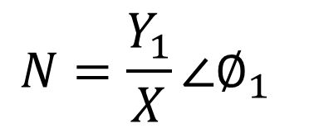
Describing Function Method
If no energy-storage element is included in the nonlinear system, then N is a function of only of the amplitude of the input.
On the other hand, if an energy-storage element is included then N is a function of both amplitude and frequency of the input.
$$N=\frac{Y_{1}}{X}∠∅_{1}$$

Slide 25
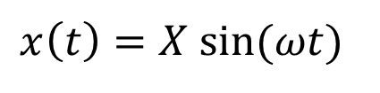
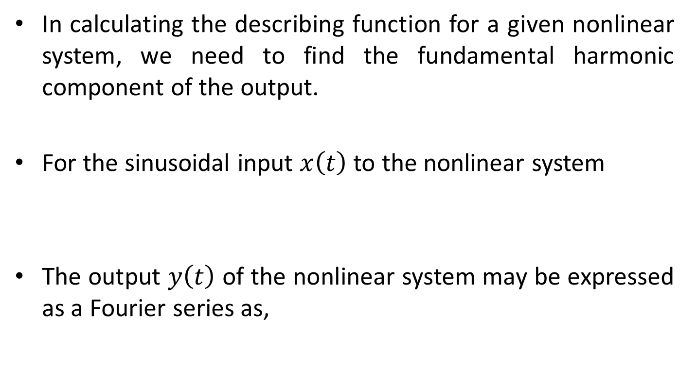
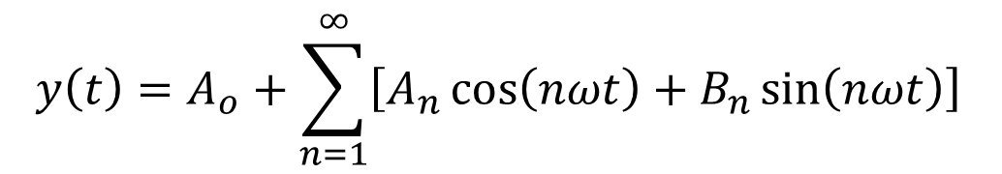
Describing Function Method
In calculating the describing function for a given nonlinear system, we need to find the fundamental harmonic component of the output.
For the sinusoidal input $x\left(t\right)$ to the nonlinear system
The output $y\left(t\right)$ of the nonlinear system may be expressed as a Fourier series as,
$$x\left(t\right)=X sin⁡(ωt)$$
$$y\left(t\right)=A_{o}+\sum_{n=1}^{∞}{\left[A_{n}\cos\left(nωt\right)+B_{n}\sin\left(nωt\right)\right]}$$

Slide 26
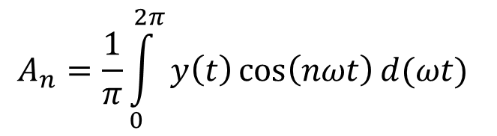
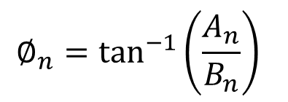
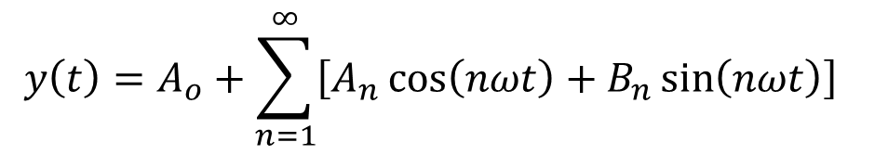
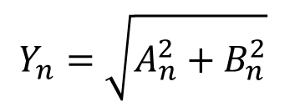
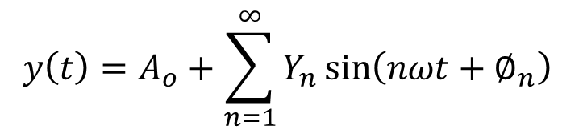
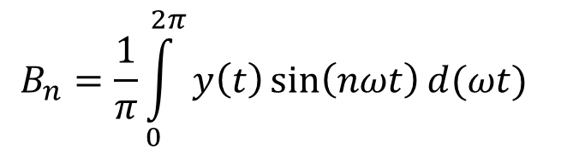
Describing Function Method
$$y\left(t\right)=A_{o}+\sum_{n=1}^{∞}{\left[A_{n}\cos\left(nωt\right)+B_{n}\sin\left(nωt\right)\right]}$$
Where,
Fourier series can also be represented as
$$A_{n}=\frac{1}{π}\int_{0}^{2π}{y\left(t\right)\cos\left(nωt\right)d(ωt)}$$
$$B_{n}=\frac{1}{π}\int_{0}^{2π}{y\left(t\right)\sin\left(nωt\right)d(ωt)}$$
$$y\left(t\right)=A_{o}+\sum_{n=1}^{∞}{Y_{n}\sin\left(nωt+∅_{n}\right)}$$
$$Y_{n}=\sqrt{A_{n}^{2}+B_{n}^{2}}$$
$$∅_{n}=\tan^{−1}\left(\frac{A_{n}}{B_{n}}\right)$$

Slide 27
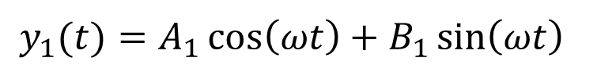
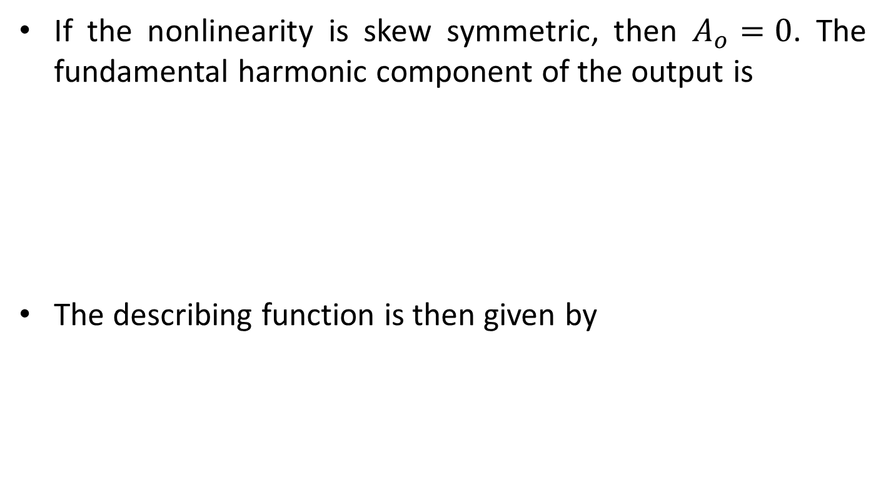
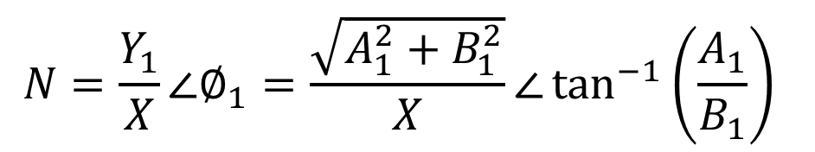
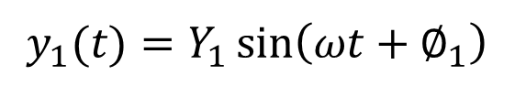
Describing Function Method
If the nonlinearity is skew symmetric, then $A_{o}=0$. The fundamental harmonic component of the output is
The describing function is then given by
$$y_{1}(t)=A_{1}\cos\left(ωt\right)+B_{1}\sin\left(ωt\right)$$
$$y_{1}(t)=Y_{1}\sin\left(ωt+∅_{1}\right)$$
$$N=\frac{Y_{1}}{X}∠∅_{1}=\frac{\sqrt{A_{1}^{2}+B_{1}^{2}}}{X}∠\tan^{−1}\left(\frac{A_{1}}{B_{1}}\right)$$

Slide 28
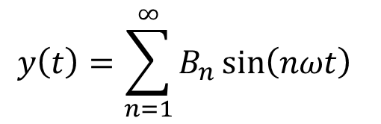
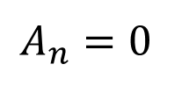
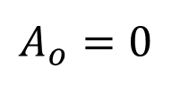
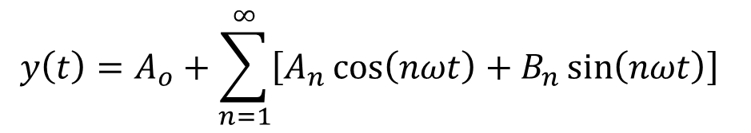
Relay Nonlinearity (On-Off Nonlinearity)
The relay-type (on-off) nonlinearity is shown in following figure.
y(t)
on
M
0
t
-M
off
Since output is an odd function and skew symmetric
The reduced Fourier series expansion is then written as
$$y\left(t\right)=A_{o}+\sum_{n=1}^{∞}{\left[A_{n}\cos\left(nωt\right)+B_{n}\sin\left(nωt\right)\right]}$$
$$A_{o}=0$$
$$A_{n}=0$$
$$y\left(t\right)=\sum_{n=1}^{∞}{B_{n}\sin\left(nωt\right)}$$

Slide 29
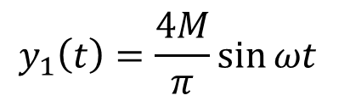

Relay Nonlinearity (On-Off Nonlinearity)
We are only interested in fundamental harmonic component.
Where,
Therefore,
$$y_{1}\left(t\right)=B_{1}\sin{ωt}$$
$$y_{1}\left(t\right)=\frac{4M}{π}\sin{ωt}$$

Slide 30
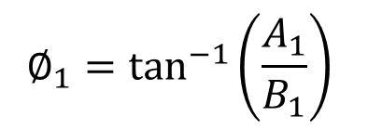
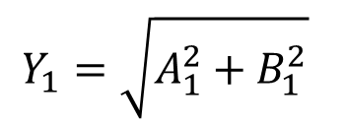
Relay Nonlinearity (On-Off Nonlinearity)
Therefore, the describing function of the relay nonlinearity is
Where,
$$Y_{1}=\sqrt{A_{1}^{2}+B_{1}^{2}}$$
$$∅_{1}=\tan^{−1}\left(\frac{A_{1}}{B_{1}}\right)$$

Slide 31
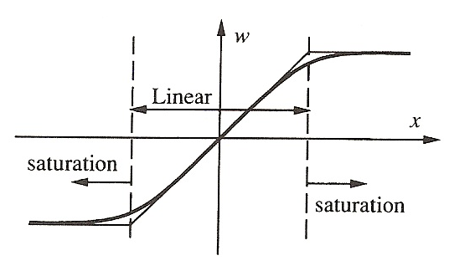
Saturation:
When one increases the input to a physical device, the following phenomenon is often observed: when the input is small, its increase leads to a corresponding (often proportional) increase of output: but when the input reaches a certain level, its further increase does produce little or no increase of the output. The output simply stays around its maximum value. The device is said to be saturation when this happen. A typical saturation nonlinearity is represented in following figure, where the thick line is the real nonlinearity and the thin line is an idealized saturation nonlinearity.
Most actuators display saturation characteristics. For example, the output torque of a tservo motor cannot increase infinitely and tends to saturate, due to the properties of magnetic material.

Slide 32
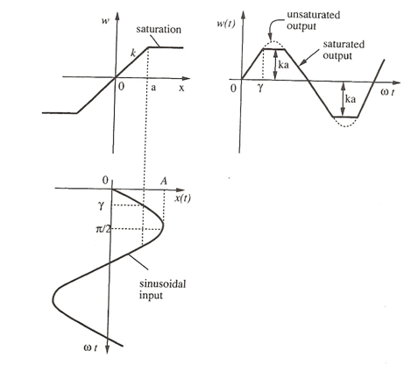
The input-output relationship for a saturation nonlinearity is plotted in following figure, with a and k denoting the range and slope of the linearity. Since this nonlinearity is single-valued, we expect the describing function to be a real function of the input amplitude.

Slide 33
Consider the input x(t)=Asin(ωt). If A≤a, then the input remains in the linear range, and therefore, the output is w(t)=kAsin(ωt). Hence, the describing function is simply a constant k.
Consider the case A>a. The output is seen to be symmetric over the four quarters of a period. In the first quarter, it can be expressed as
where γ=sin⁻¹(a/A). The odd nature of w(t) implies that a₁=0 and the symmetry over the four quarters of a period implies that
Therefore, the describing function is

Slide 34
Dead-Zone:
Consider the dead-zone characteristics shown in Figure 6, with the dead-zone with being 2δ and its slope k
w
-δ
δ
x
dead-zone
Figure 6. A dead-zone nonlinearity.
Dead-zones can have a number of possible effects on control systems. Their most common effect is to decrease static output accuracy. They may also lead to limit cycles or system instability because of the lack of response in the dead-zone. The response corresponding to a sinusoidal input x(t)=Asin(ωt) into a dead-zone of width 2δ and slope k, with A≥δ, is plotted in Figure 7. Since the characteristics is an odd function, a₁=0. The response is also seen to be symmetric over the four quarters of a period. In one quarter of a period, i.e., when 0≤ωt≤π/2, one has

Slide 35
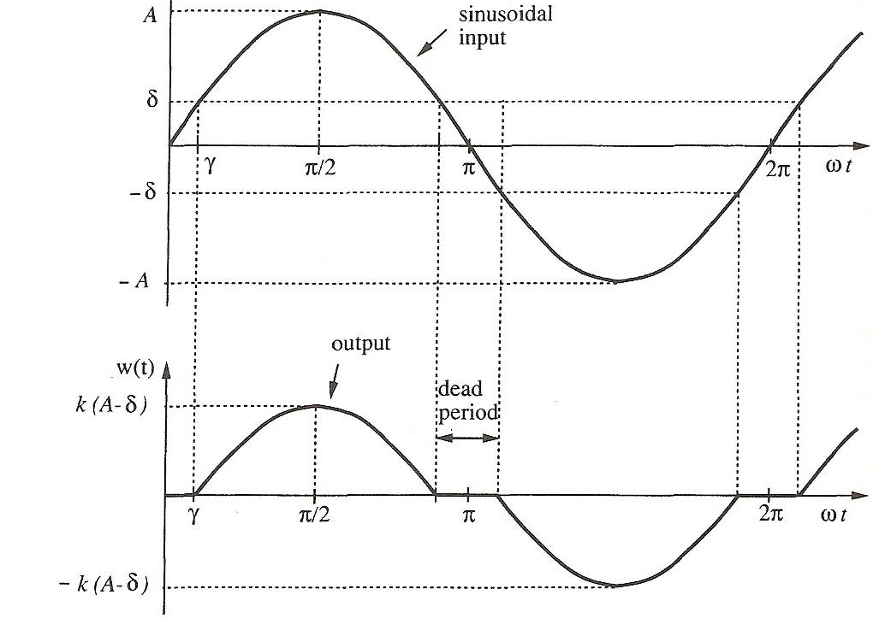
x(t)
Figure 7. Input and output functions for a dead-zone nonlinearity.

Slide 36
where
The coefficient b₁ can be computed as follows

Slide 37
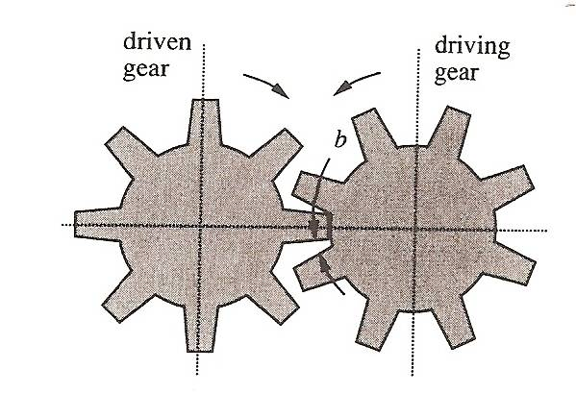
Backlash:
Backlash often occurs in transmission systems. It is caused by the small gaps which exist in transmission mechanism. In gear trains, there always exists small gaps between a pair of mating gears as shown in Figure 9.
output angle
C
B
A
slope 1
O
-b
b
input angle
D
E
Figure 9. A backlash nonlinearity.
The backlash occurs as result of the unavoidable errors in manufacturing and assembly. As a results of the gaps, when the driving gear rotates a smaller angle than the gap b, the driven gear does not move at all, which corresponds to the dead zone (OA segment); after contact has been established between the two gears, the driven gear follows the rotation of the driving gear in a liner fashion (AB segment). When the driving gear rotates in the reverse direction by a distance of 2b, the driven gear again does not move, corresponding the BC segment.

Slide 38
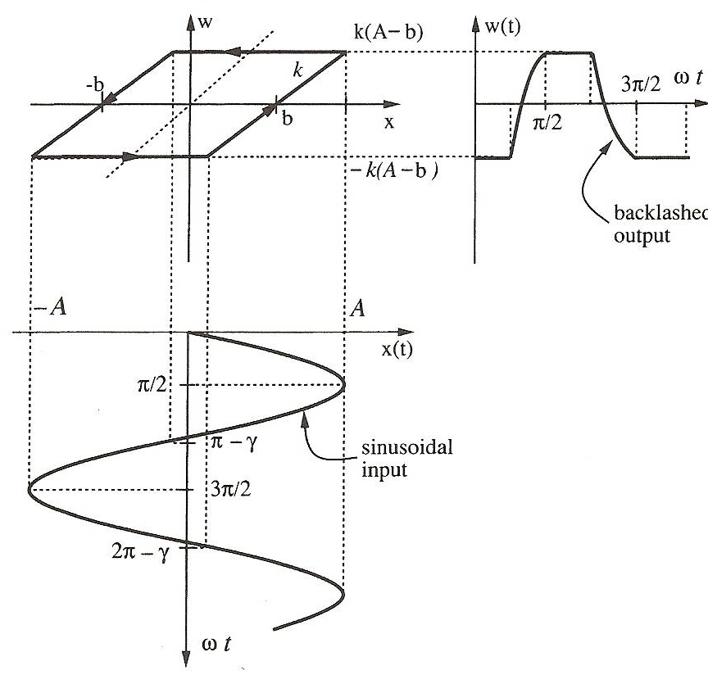
After the contact between the two gears is re-established, the driven gear follows the rotation of the driving gear in the reverse direction (CD segment). Therefore, if the driving gear is in periodic motion, the driven gear will move in the fashion represented by the closed loop EBCD. Note that the height of B, C, D, E in the figure depends on the amplitude of the input sinusoidal.
Figure 10 shows a backlash nonlinearity, with slope k and width 2b. If the input amplitude is smaller then b, there is no output. Consider the input being x(t)=Asin(ωt), A≥b. The output w(t) of the nonlinearity is as shown in the figure. In one cycle, the function w(t) can be represented as
where
Figure 10. Backlash nonlinearity.

Slide 39
Unlike the other nonlinearities, the function w(t) here is neither odd nor even. Therefore, a₁ and b₁ are both nonzero.
Therefore, the describing function of the backlash is given by
The amplitude of the describing function for backlash is plotted in Figure 11.

Slide 40
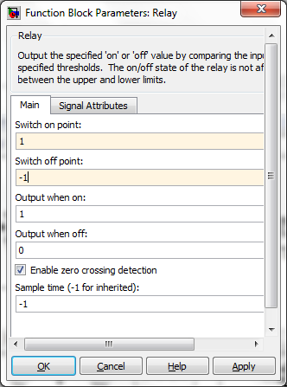
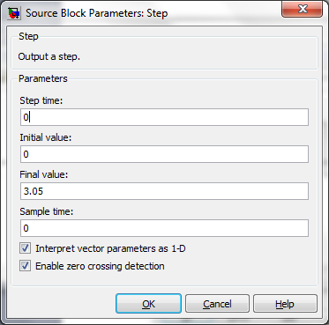
w
Example:
on
1
Consider the plant
with relay nonlinearity
x
0
-1
off
T₁=3, T₂=2, K=2, M=1, r(t)=3.05u(t)

Slide 41
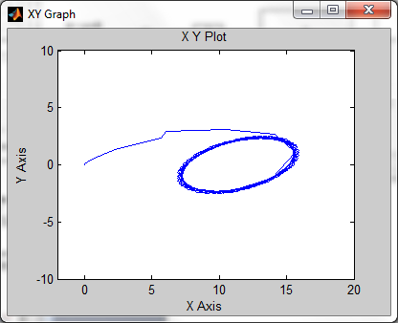
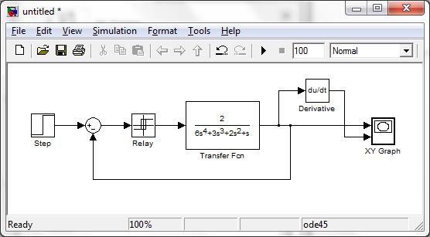
Construct the Simulink model including relay nonlinearity and observe the response.
Limit cycle occurs

Slide 42
End of Lecture-10
To download this lecture visit
http://imtiazhussainkalwar.weebly.com/

