Slide 1
Feedback Control Systems (FCS)
Lecture-9
Mathematical Modelling of Electrical & Electronic Systems
Dr. Imtiaz Hussain
email: imtiaz.hussain@faculty.muet.edu.pk
URL :http://imtiazhussainkalwar.weebly.com/

Slide 2
Outline of this Lecture
Part-I: Electrical System
Basic Elements of Electrical Systems
Equations for Basic Elements
Examples
Part-II: Electronic System
Operational Amplifiers
Inverting vs Non-inverting
Examples

Slide 3
Electrical Systems
Part-I

Slide 4
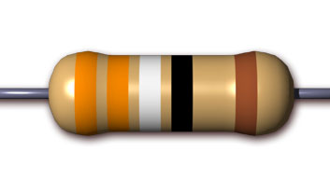
Basic Elements of Electrical Systems
The time domain expression relating voltage and current for the resistor is given by Ohm’s law i-e
The Laplace transform of the above equation is

Slide 5
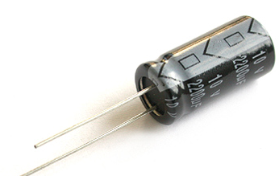
Basic Elements of Electrical Systems
The time domain expression relating voltage and current for the Capacitor is given as:
The Laplace transform of the above equation (assuming there is no charge stored in the capacitor) is

Slide 6
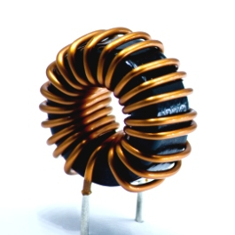
Basic Elements of Electrical Systems
The time domain expression relating voltage and current for the inductor is given as:
The Laplace transform of the above equation (assuming there is no energy stored in inductor) is

Slide 7
V-I and I-V relations
Component | Symbol | V-I Relation | I-V Relation
Resistor
Capacitor
Inductor

Slide 8
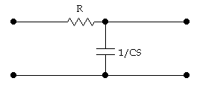
Example#1
The two-port network shown in the following figure has v_{i}(t) as the input voltage and v_{o}(t) as the output voltage. Find the transfer function V_{o}(s)/V_{i}(s) of the network.
v_{i}( t)
i(t)
C
v₂(t)

Slide 9
Example#1
Taking Laplace transform of both equations, considering initial conditions to zero.
Re-arrange both equations as:

Slide 10
Example#1
Substitute I(s) in equation on left

Slide 11
Example#1
The system has one pole at

Slide 12
Example#2
Design an Electrical system that would place a pole at -3 if added to another system.
System has one pole at
Therefore,
v_{i}( t)
i(t)
C
v₂(t)

Slide 13
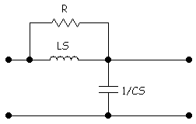
Example#3
Find the transfer function G(S) of the following two port network.
L
v_{i}(t)
i(t)
C
v_{o}(t)

Slide 14
Example#3
Simplify network by replacing multiple components with their equivalent transform impedance.
L
Z
V_{i}(s)
I(s)
C
V_{o}(s)

Slide 15
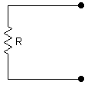
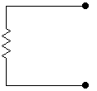
Transform Impedance (Resistor)
i_{R}(t)
I_{R}(S)
+
+
Transformation
v_{R}(t)
Z_{R} = R
V_{R}(S)
-
-

Slide 16
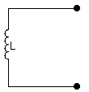
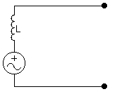
Transform Impedance (Inductor)
i_{L}(t)
I_{L}(S)
+
+
v_{L}(t)
Z_{L}=LS
V_{L}(S)
Li_{L}(0)
-
-

Slide 17
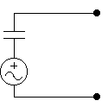
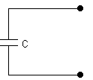
Transform Impedance (Capacitor)
i_{c}(t)
I_{c}(S)
+
+
v_{c}(t)
Z_{C}(S)=1/CS
V_{c}(S)
-
-

Slide 18
Equivalent Transform Impedance (Series)
Consider following arrangement, find out equivalent transform impedance.
L
C
R

Slide 19
Equivalent Transform Impedance (Parallel)
L
C
R

Slide 20
Equivalent Transform Impedance
Find out equivalent transform impedance of following arrangement.
L₂
L₂
R₁
R₂

Slide 21
Back to Example#3
L
Z
V_{i}(s)
I(s)
C
V_{o}(s)

Slide 22
Example#3
L
Z
V_{i}(s)
I(s)
C
V_{o}(s)

Slide 23
Example#4
Find transfer function V_{out}(s)/V_{in}(s) of the following electrical network
R
V_{in}
C
V_{out}
L

Slide 24
Example#5
Find transfer function V_{out}(s)/V_{in}(s) of the following electrical network
C₁
R
V_{in}
C₃
V_{out}
L
C₂

Slide 25
Electronic Systems
Part-II

Slide 26
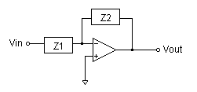
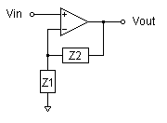
Operational Amplifiers

Slide 27
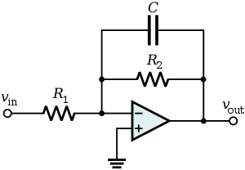
Example#6
Find out the transfer function of the following circuit.

Slide 28
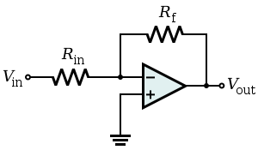
Example#7
Find out the transfer function of the following circuit.
v₁

Slide 29
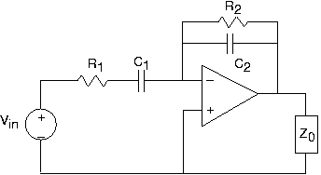
Example#8
Find out the transfer function of the following circuit.
v₁

Slide 30
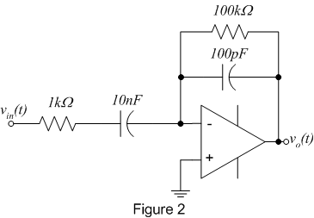
Example#9
Find out the transfer function of the following circuit and draw the pole zero map.
100kΩ
10kΩ

Slide 31
End of Lectures-9
To download this lecture visit
http://imtiazhussainkalwar.weebly.com/

