Slide 1


Sensors & Actuators for Automatic Systems (S&AAS)
Lecture-4
Mechanical Sensors
Dr. Imtiaz Hussain
Associate Professor
email: imtiaz.hussain@faculty.muet.edu.pk
URL :http://imtiazhussainkalwar.weebly.com/

Slide 2
Lecture Outline
Introduction
Potentiometric Sensors
Capacitive Sensors
Inductive Sensors
Applications

Slide 3
Introduction
The class of sensors used for the measurement of mechanical phenomena is of special significance because of extensive use of these devices in process industry.
To learn to use the mechanical sensors it is essential to understand the mechanical phenomena themselves and the operating principle and application detail of sensor.

Slide 4
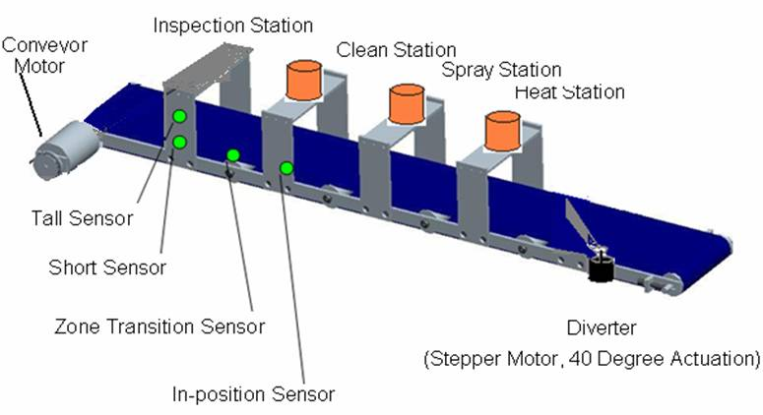
Displacement, Location or Position Sensors
The measurement of Displacement, Location or Position is of prime importance in industries.
For example:
  Location and position of an object on conveyor system

Slide 5
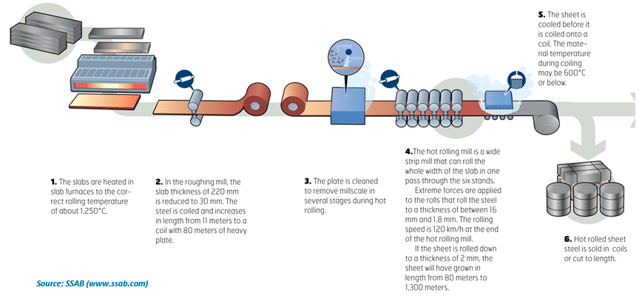
Displacement, Location or Position Sensors
The measurement of Displacement, Location or Position is of prime importance in industries.
For example:
  Orientation of steel plates in a rolling mill

Slide 6
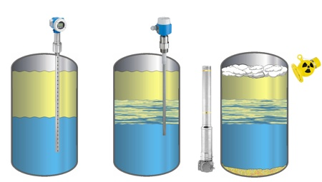
Displacement, Location or Position Sensors
The measurement of Displacement, Location or Position is of prime importance in industries.
For example:
  Liquid/ Solid level measurement

Slide 7
Displacement, Location or Position Sensors
There are several types of sensors available:
  Potentiometric
  Capacitive
  Inductive
  Variable Reluctance

Slide 8
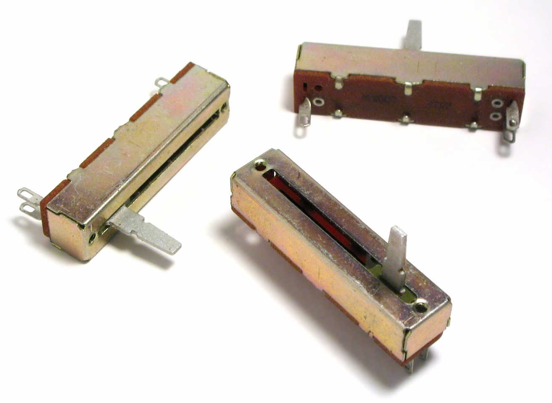
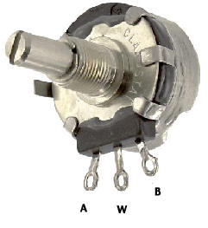
Potentiometric Sensors
The simplest type of displacement sensor involves the action of displacement in moving the wiper of a potentiometer.

Slide 9

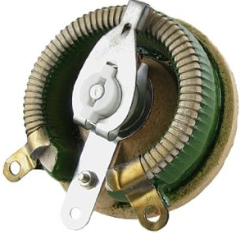
Potentiometric Sensors
This device then converts linear or angular motion into a changing resistance that may be converted directly to voltage or current signal.
Such potentiometric devices often suffer from the obvious problem of mechanical wear, friction in the wiper action, limited resolution in wire-wound units, and high electronic noise.

Slide 10
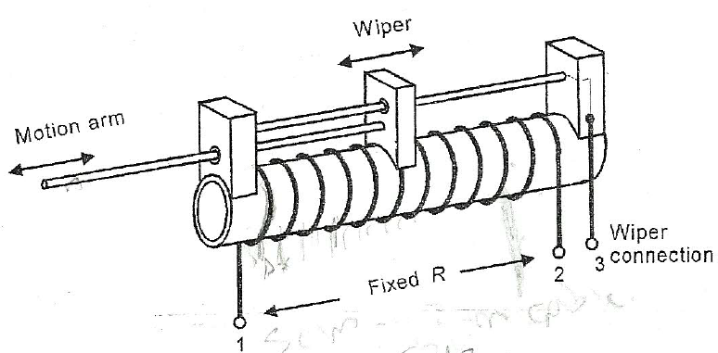

Potentiometric Sensors
Figure shows a simple potentiometric displacement sensor.
The resolution of this sensor is limited to the distance, $Δx$, between the individual turns of wire, with the resulting resistance change of the single turn, $ΔR$.

Slide 11
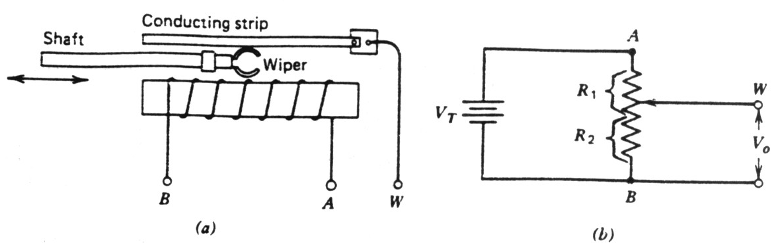
Potentiometric Sensors
Typical commercial units provide a choice of maximum shaft strokes from an inch or less to 5 feet or more.
Deviation from linearity of the resistance versus-distance specification can be as low as 0.1% to 1.0%.
Consider Fig. (b). If the circuit is unloaded, the output voltage V₀ is a certain fraction of V_{T,} depending on the position of the wiper:

Slide 12
Example-1
A displacement transducer with a shaft stroke of 3.0 inch is applied in the circuit of Fig (b). The total resistance of the potentiometer is 5 k , and the applied voltage V_{T}=5.0V. When the wiper is 0.9 inch from B, what is the value of the output voltage V₀?

Slide 13
Example-1
Solution:

Slide 14
Example-2
A displacement transducer with a shaft stroke of 5.0 inch is applied in the circuit of Fig (b). The total resistance of the potentiometer is 10 k , and the applied voltage V_{T}=5.0V. When the wiper is 1 inch from A, what is the value of the output voltage V₀?

Slide 15
Example-2
Solution:

Slide 16
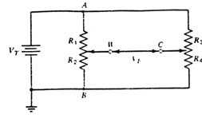



Potentiometric Sensors
To measure of the distance and direction that the object has traveled following arrangement is used.
$$w$$
$$c$$
$$V_{E}$$

Slide 17



Example-3
A resistive position transducer with a resistance of 5000 and a shaft stroke of 5.0 inch is used in the arrangement of following Fig. Potentiometer R₃ R₄ is also 5000 , and V_{T} = 5.0 V. The initial position to be used as a reference point is such that R₁=R₂ (i.e.. the shaft is at midstroke). At the start of the test, potentiometer R₃R₄ is adjusted so that the bridge is balanced (V_{E}=0). Assuming that the object being monitored will move a maximum distance of 0.5 in. toward A, what will be the new value of V_{E}?
$$w$$
$$c$$
$$V_{E}$$

Slide 18



Example-3
At initial position
Voltage drop across R₂ is
The value of R₄ to balance the bridge (V_{E}=0)
$$w$$
$$c$$
$$V_{E}$$

Slide 19



Example-3
If the wiper moves 0.5 in toward A from midstroke, it will be 3.0 inch from B.
V_{E} can now be calculated as:
$$w$$
$$c$$
$$V_{E}$$

Slide 20
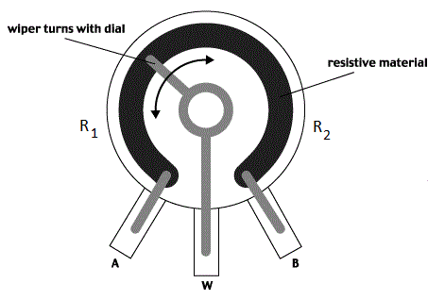
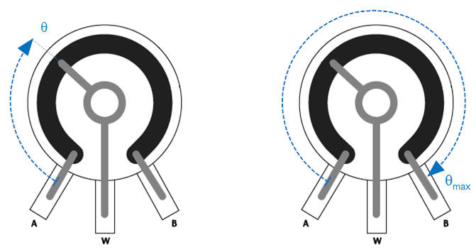
Rotary Potentiometer
The resistance between the wiper (slider) and "A" is labeled R₁, the resistance between the wiper and "B" is labeled R₂.
The total resistance between "A" and "B" is constant, R₁+R₂=R_{tot}.
If the potentiometer is turned to the extreme counterclockwise position such that the wiper is touching "A" we will call this θ=0; in this position R₁=0 and R₂=R_{tot}.
If the wiper is in the extreme clockwise position such that it is touching "B" we will call this θ=θ_{max}; in this position R₁=R_{tot} and R₂=0.

Slide 21
Rotary Potentiometer
R₁ and R₂ vary linearly with θ between the two extremes:

Slide 22
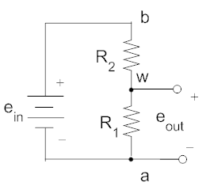
Rotary Potentiometer
Figure-1
Potentiometer can be used to sense angular position, consider the circuit of figure-1.
Using the voltage divider principle we can write:

Slide 23
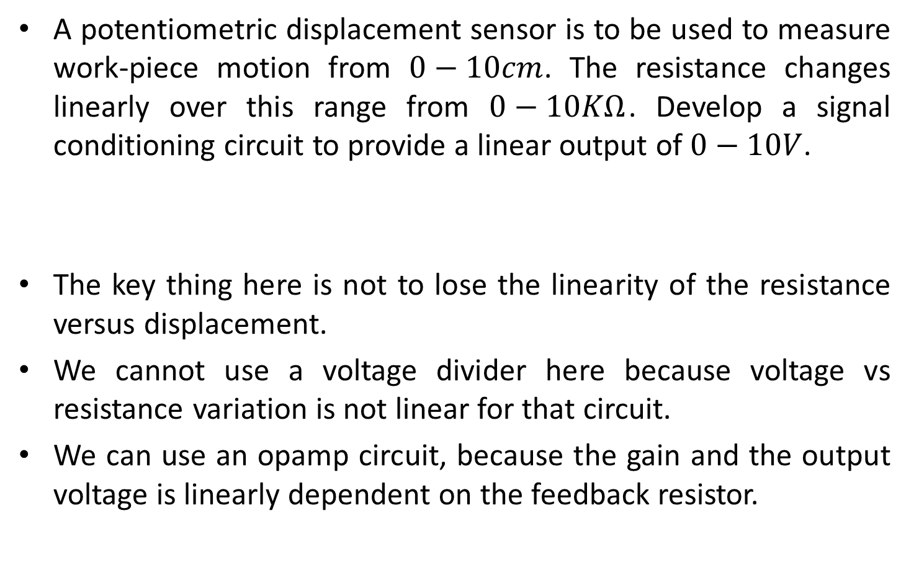
Example-4
A potentiometric displacement sensor is to be used to measure work-piece motion from $0−10cm$. The resistance changes linearly over this range from $0−10KΩ$. Develop a signal conditioning circuit to provide a linear output of $0−10V$.
The key thing here is not to lose the linearity of the resistance versus displacement.
We cannot use a voltage divider here because voltage vs resistance variation is not linear for that circuit.
We can use an opamp circuit, because the gain and the output voltage is linearly dependent on the feedback resistor.
Solution:

Slide 24
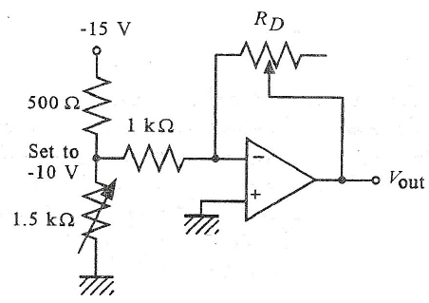
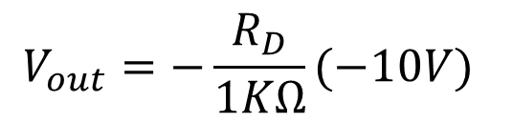
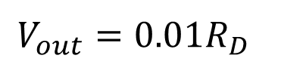
Example-4
We can use an opamp circuit, because the gain and the output voltage is linearly dependent on the feedback resistor.
$$V_{out}=−\frac{R_{D}}{1KΩ}(−10V)$$
$$V_{out}={0.01R}_{D}$$

Slide 25

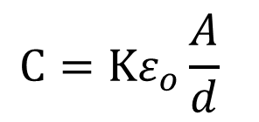



Capacitive Sensors
A second class of sensors for displacement measurement involves changes in the capacitance.
Basic operation of capacitive sensor can be seen from the familiar equation for a parallel-plate capacitor.
Where,
$$C=Kε_{o}\frac{A}{d}$$
$$K=Dielectric constamt$$
$$ε_{o}=Permitivity=8.85 pF/m$$
$$A=Shared Area of plates$$
$$d=Plate seperation$$

Slide 26
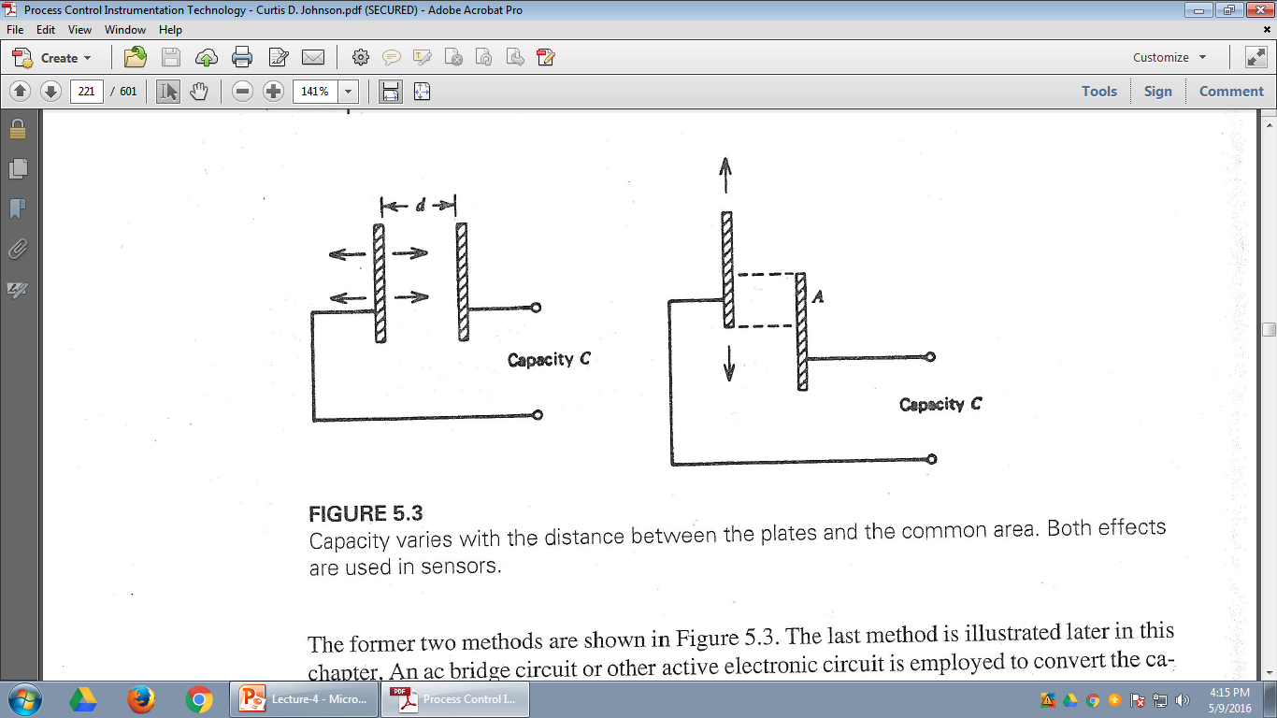
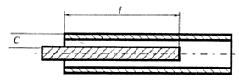
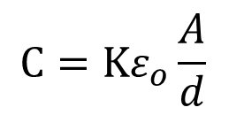
Capacitive Sensors
From the equation it is clear that there are three ways to change the capacity.
  Variation of distance between plates (d)
  Variation of shared area of plates (A)
  Variation of dielectric constant (K)
$$C=Kε_{o}\frac{A}{d}$$

Slide 27
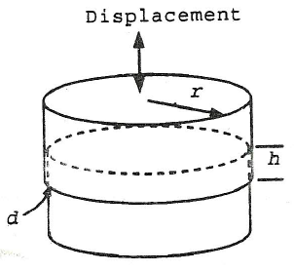
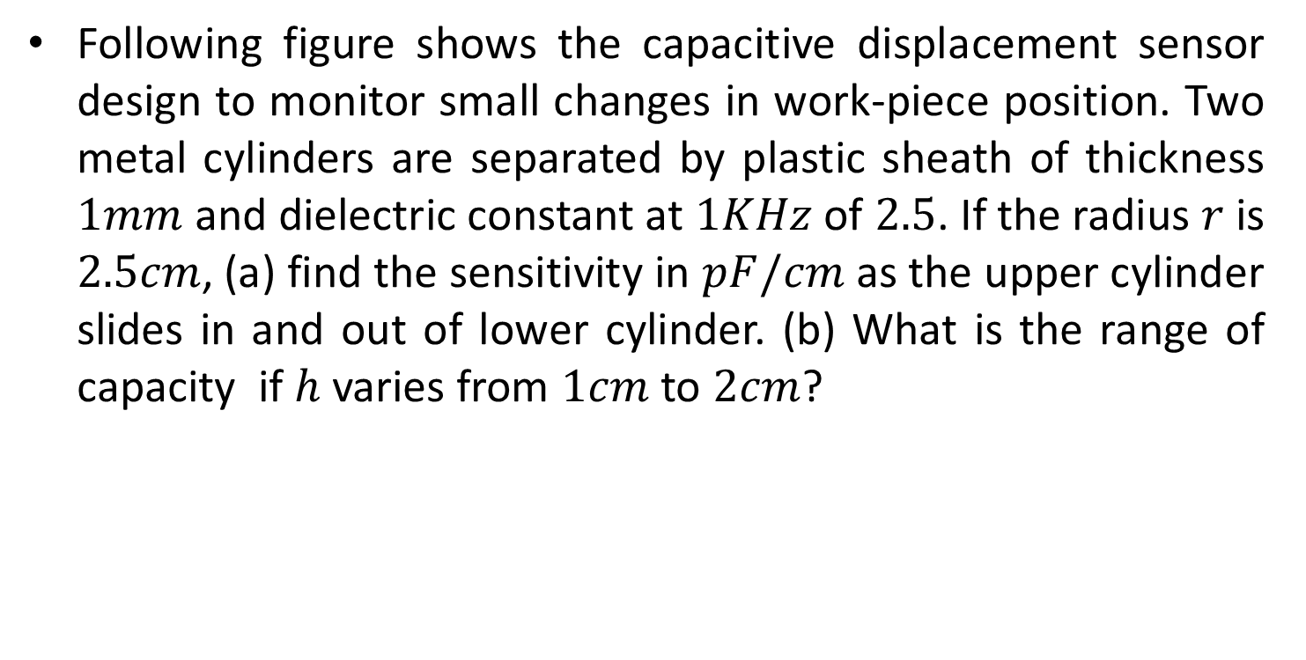
Example-5
Following figure shows the capacitive displacement sensor design to monitor small changes in work-piece position. Two metal cylinders are separated by plastic sheath of thickness $1mm$ and dielectric constant at $1KHz$ of $2.5$. If the radius $r$ is $2.5cm$, (a) find the sensitivity in $pF/cm$ as the upper cylinder slides in and out of lower cylinder. (b) What is the range of capacity if $h$ varies from $1cm$ to $2cm$?

Slide 28

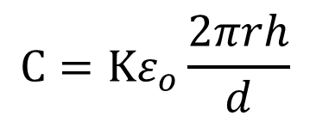
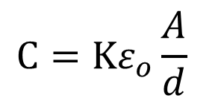
Example-5
Capacity is calculated using following equation.
The net area is the area of the shared cylindrical area, which has a radius $r$ and height $h$.
Thus $A=2πrh$, so the capacity can expressed as:
$$C=Kε_{o}\frac{A}{d}$$
$$C=Kε_{o}\frac{2πrh}{d}$$

Slide 29
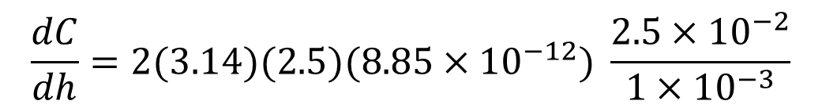

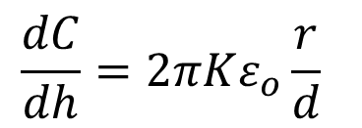
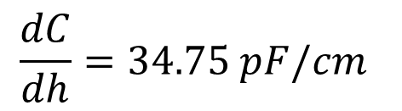
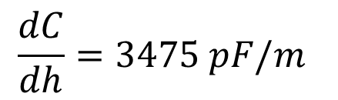
Example-5
(a) The sensitivity with respect o the height, $h$, is defined by how $C$ changes with $h$; that is $\frac{dC}{dh}$.
Substituting the values, we get ($ε_{o}=8.85×{10}^{−12} F/m$)
$$\frac{dC}{dh}=2πKε_{o}\frac{r}{d}$$
$$\frac{dC}{dh}=2(3.14)(2.5)(8.85×{10}^{−12}) \frac{2.5×{10}^{−2}}{1×{10}^{−3}}$$
$$\frac{dC}{dh}=3475 pF/m$$
$$\frac{dC}{dh}=34.75 pF/cm$$

Slide 30
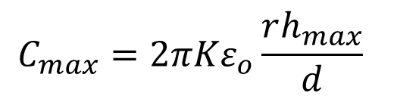
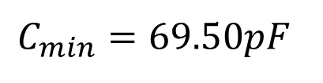
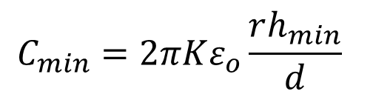
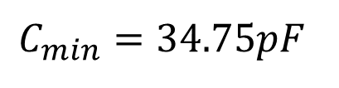
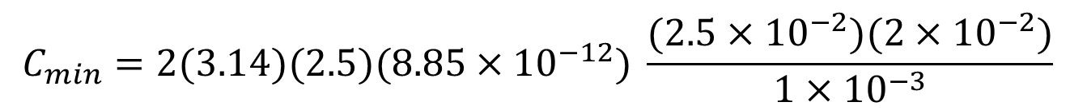
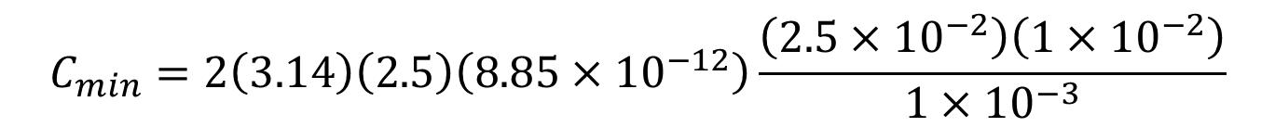
Example-5
(b) The minimum value of C can be calculated as.
Similarly Maximum value of C can be calculated as
$$C_{min}=2πKε_{o}\frac{rh_{min}}{d}$$
$$C_{min}=2\left(3.14\right)\left(2.5\right)\left(8.85×{10}^{−12}\right)\frac{\left(2.5×{10}^{−2}\right)\left(1×{10}^{−2}\right)}{1×{10}^{−3}}$$
$$C_{min}=34.75pF$$
$$C_{max}=2πKε_{o}\frac{rh_{max}}{d}$$
$$C_{min}=2(3.14)(2.5)(8.85×{10}^{−12}) \frac{(2.5×{10}^{−2})(2×{10}^{−2})}{1×{10}^{−3}}$$
$$C_{min}=69.50pF$$

Slide 31
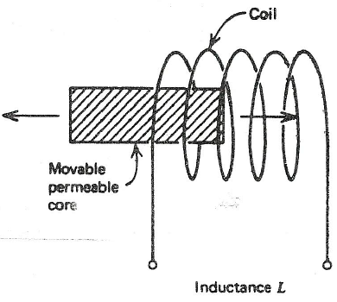
Inductive Sensors
If permeable core is inserted into an inductor, as shown in following figure, the net inductance is increased.
Every new position of the core produces a different inductance.
An ac bridge or other active electronic circuit sensitive to inductance may be employed for signal conditioning.

Slide 32
Variable Reluctance Sensors
The variable reluctance displacement sensors differ from the inductive in that a moving core is used to vary the magnetic flux coupling between two or more coils, rather than changing an individual inductance.
Such device find applications in many circumstances for the measurement of both translational and rotational displacements.
Many configurations of this device exit, but the most common and extensively used is called Linear Variable Differential Transformer (LVDT).

Slide 33
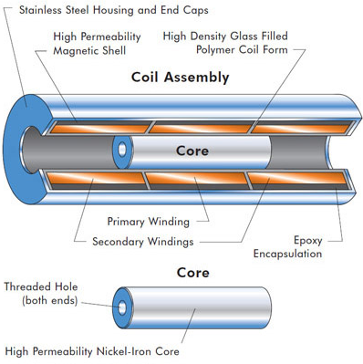
Linear variable differential transducer (LVDT)
LVDT linear position sensors are readily available that can measure movements as small as 0.001 mm up to 75 mm.

Slide 34
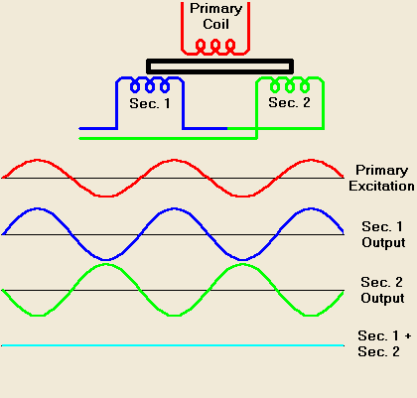
Working principle of LVDT

Slide 35
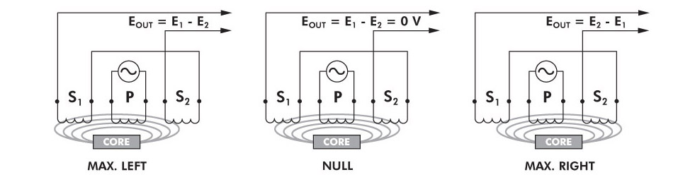
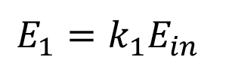
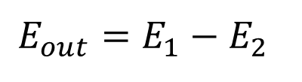
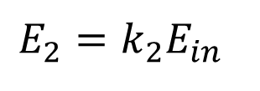
Working Principle of LVDT
$$E_{1}=k_{1}E_{in}$$
$$E_{2}=k_{2}E_{in}$$
$$E_{out}=E_{1}−E_{2}$$
k₁ and k₂ depend on the amount of coupling between the primary and the secondary coils, which is proportional to the position of the coil

Slide 36
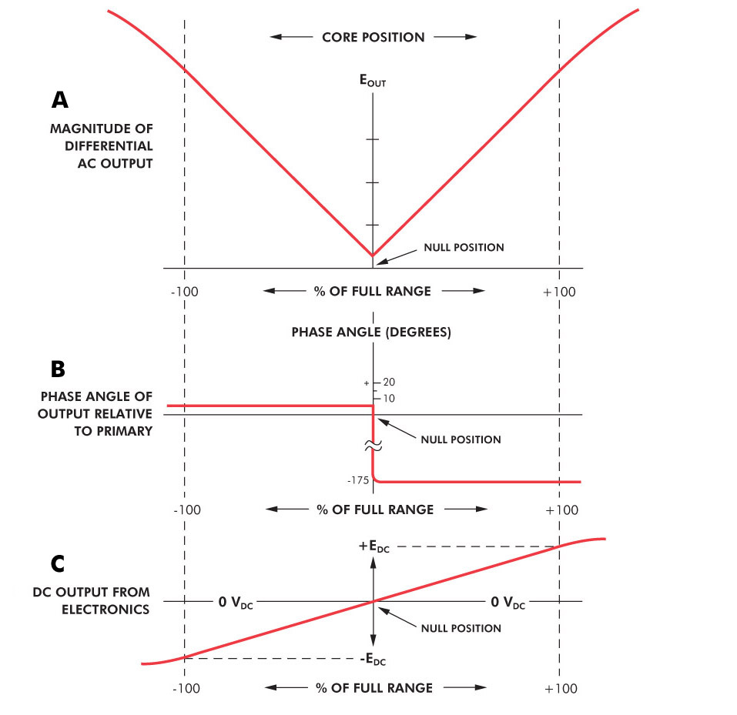
LVDT

Slide 37
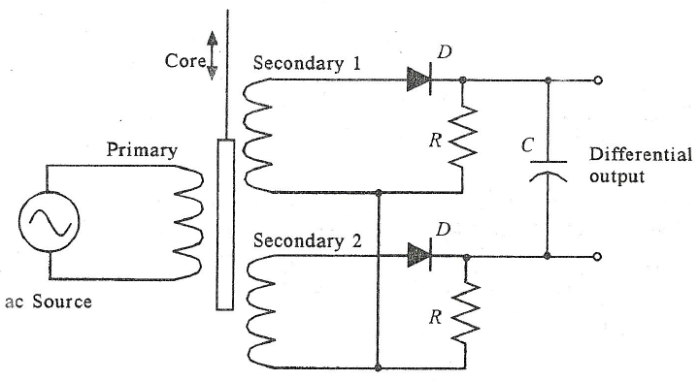
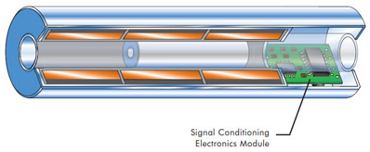
DC LVDT

Slide 38
LVDT
As the core moves, these mutual inductances change, causing the voltages induced in the secondaries to change.
The coils are connected in reverse series, so that the output voltage is the difference (hence "differential") between the two secondary voltages.
When the core is in its central position, equidistant between the two secondaries, equal but opposite voltages are induced in these two coils, so the output voltage is zero.

Slide 39
LVDT
When the core is displaced in one direction, the voltage in one coil increases as the other decreases, causing the output voltage to increase from zero to a maximum.
This voltage is in phase with the primary voltage. When the core moves in the other direction, the output voltage also increases from zero to a maximum, but its phase is opposite to that of the primary.
The magnitude of the output voltage is proportional to the distance moved by the core (up to its limit of travel), which is why the device is described as "linear". The phase of the voltage indicates the direction of the displacement.

Slide 40

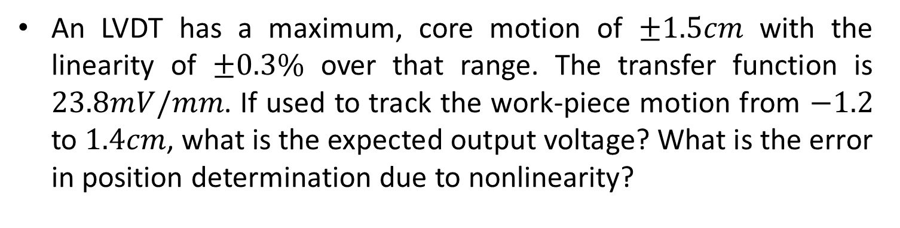


Example-4
An LVDT has a maximum, core motion of $±1.5cm$ with the linearity of $±0.3\%$ over that range. The transfer function is $23.8mV/mm$. If used to track the work-piece motion from $−1.2$ to $1.4cm$, what is the expected output voltage? What is the error in position determination due to nonlinearity?
Solution
Using the known transfer function, the output voltage can easily be calculated as:
$$V\left(@−1.2cm\right)=(23.8mV/mm)×(−1.2cm)$$
$$V\left(@−1.2cm\right)=(23.8mV/mm)×(−12mm)$$
$$V\left(@−1.2cm\right)=−285.6mV$$

Slide 41

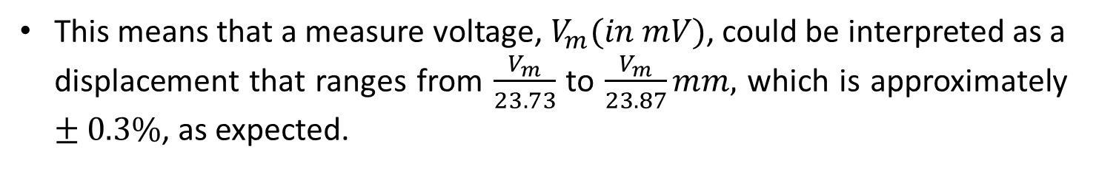



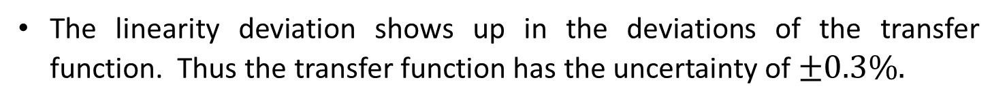
Example-4
Now
$$V\left(@1.4cm\right)=(23.8mV/mm)×(14mm)$$
$$V\left(@1.4cm\right)=333.2mV$$
The linearity deviation shows up in the deviations of the transfer function. Thus the transfer function has the uncertainty of $±0.3\%.$
$$T.F=\left(±0.003\right)(23.8mV/mm)$$
$$T.F=±0.0714 mV/mm$$
This means that a measure voltage, $V_{m}(in mV)$, could be interpreted as a displacement that ranges from $\frac{V_{m}}{23.73}$ to $\frac{V_{m}}{23.87}mm,$ which is approximately $±0.3\%$, as expected.

Slide 42
Level Sensors
The Measurement of solid or liquid Level calls for a special class of displacement sensors.
The level measurement is most commonly associated with material in tank or hopper.
A great variety of measurement techniques exist, which are discussed here.

Slide 43

Mechanical Level Sensor
One of the most common technique for level measurement, particularly for liquid, is a float that is allowed to ride up and down with level changes.
This float is connected by linkages to a secondary displacement measurement system such as potentiometer or LVDT.

Slide 44

Electrical Level Sensor
There are several purely electrical methods for measuring level.
For example, one may used inherent conductivity of a liquid or solid to vary resistance seen by probes inserted into material.
Another common technique is shown here

Slide 45

Example-5
The level of ethyl alcohol is to be measured from 0 to 5m using a capacitive system. Following specifications define the system.
  For ethyl Alcohol K=26 (for air K=1)
  Cylinder separation: d=0.5cm
  Plate area: $A=πRL$
  Where R=5.75cm (average radius)
  L=distance along cylinder axis
Find the capacity variation as the alcohol level varies from 0 to 5m.

Slide 46







Example-5
Solution
We all need to do is find the capacity for entire cylinder with no alcohol and then multiply it with 26.
Thu for air,
With the ethyl alcohol,
$$C=Kε_{o}\frac{A}{d}$$
$$A=2πRL=2(3.141)(5.75cm)(5m)$$
$$A=1.806m^{2}$$
$$C=(1)(8.85pF/M) \frac{1.806m^{2}}{0.005m}$$
$$C=0.0032μF$$
$$C=26×0.0032μF$$
$$C=0.0832μF$$

Slide 47




Technologies
LEVEL Measurement Through Radar and Ultrasonic
Through Air
Radar
Guided Wave
Radar
Ultrasonic

Slide 48



How it works
  The time it takes for the instrument’s signal to leave the antenna, travel to the product, and return to the antenna is calculated into distance.
  The instrument is spanned according to the distance the 100% and 0% points within the vessel are from its reference point.
  The measured distance can then be converted into the end user’s desired engineering unit and viewed on the head of the instrument or remote display.
100%
0%

Slide 49
Through Air Radar

Slide 50
Radar Technology – How it works
Radar is a time of flight measurement.
  Microwave energy is transmitted by the radar.
  The microwave energy is reflected off the product surface
  The radar sensor receives the microwave energy.
  The time from transmitting to receiving the microwave energy is measured.
  The time is converted to a distance measurement and then eventually a level.

Slide 51

Radar Technology – Why use it?
Radar level measurement
Top mounted
Solids and liquids applications
Non-contact
RADAR is virtually unaffected by the following process conditions:
  Temperature
  Pressure and Vacuum
  Conductivity
  Dielectric Constant (dK)
  Specific Gravity
  Vapor, Steam, Dust or Air Movement

Slide 52
Guided Wave
Radar
(TDR)

Slide 53


Principle of Operation
A microwave pulse (2 GHz) is guided along a cable or rod in a 20” diameter or inside a coaxial system.
The pulse is then reflected from the solid or liquid, back to the head of the unit.
The travel time of the pulse is measured and then converted to distance.

Slide 54


Guided Wave Radar Measurement
Guided Wave Radar level measurement
Time of Flight
Top mounted
Solids and liquids applications
Contact Measurement
GUIDED WAVE RADAR is virtually unaffected by the following process conditions:
  Temperature
  Pressure and Vacuum
  Conductivity
  Dielectric Constant (dK)
  Specific Gravity
  Vapor, Steam, or Dust Air Movement
  Build up (depends on type of build up)
  Foam

Slide 55


Ultrasonic

Slide 56

Ultrasonic Level Measurement – How it works
Time of Flight Technology
Short ultrasonic impulses emitted from transducer
Bursts are created from electrical energy applied to piezeo electric crystal inside the transducer
The transducer creates sound waves (mechanical energy)
With longer measuring ranges a lower frequency and higher amplitude are needed to produce sound waves that can travel farther
The longer the measuring range the larger the transducer must be

Slide 57
Ultrasonic Level Measurement
Ultrasonic level measurement
Time of Flight
Top mounted
Solids and liquids applications
Non-contact
ULTRASONIC is virtually unaffected by the following process conditions:
  Change is product density (spg)
  Change in dielectric constant (dk)

Slide 58

Ultrasonic Level Technology – Advantages
Can be mounted in plastic stilling wells
Narrow beam angles minimize effect of obstructions
Swivel flange available for applications with angles of repose
Familiar technology throughout the industry, therefore, often a trusted technology throughout the industry
Cost-effective

Slide 59
End of Lecture-4
To download this lecture visit
http://imtiazhussainkalwar.weebly.com/

