Slide 1
Sensors & Actuators for Automatic Systems (S&AAS)
Lecture-3
Hall Effect Sensor
Dr. Imtiaz Hussain
Associate Professor
email: imtiaz.hussain@faculty.muet.edu.pk
URL :http://imtiazhussainkalwar.weebly.com/

Slide 2
Lecture Outline
Introduction
Lorenz force
Hall Effect
Principle
Hall Effect sensor
Analog
Digital
Applications

Slide 3
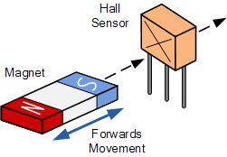
Introduction
Hall Effect Sensors are devices which are activated by an external magnetic field.

Slide 4
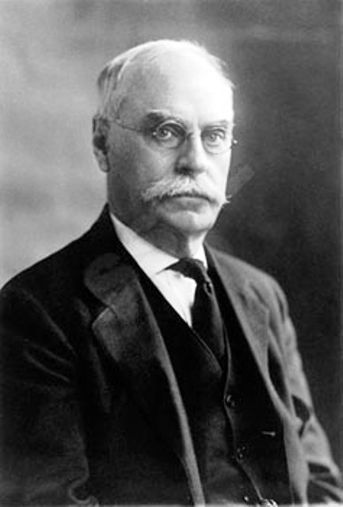
Discovery
Observed in 1879
Edwin Herbert Hall
Discovered 18 years before the electron
Via Wikimedia Commons (public domain)

Slide 5
Introduction
We know that a magnetic field has two important characteristics flux density, (B) and polarity (North and South Poles).
The output signal from a Hall effect sensor is the function of magnetic field density around the device.
When the magnetic flux density around the sensor exceeds a certain pre-set threshold, the sensor detects it and generates an output voltage called the Hall Voltage, V_{H}.

Slide 6
Lorentz Force
The force which is exerted by a magnetic field on a moving electric charge.
The Lorentz force is the combination of electric and magnetic force on a point charge due to electromagnetic fields.
If a particle of charge q moves with velocity $v$ in the presence of an electric field E and a magnetic field B, then it will experience a force
$$F=q\left[E+(v×B)\right]$$

Slide 7
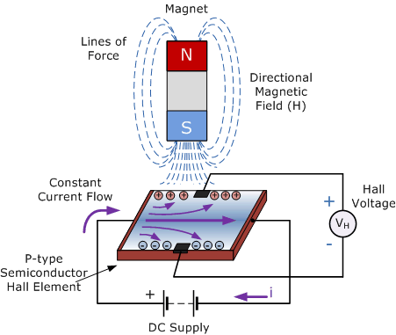
Hall Effect
Hall Effect Sensors consist basically of a thin piece of rectangular p-type semiconductor material such as gallium arsenide (GaAs), indium antimonide (InSb) or indium arsenide (InAs) passing a continuous current through itself.
When the device is placed within a magnetic field, the magnetic flux lines exert a force on the semiconductor material which deflects the charge carriers, electrons and holes, to either side of the semiconductor slab.

Slide 8
Hall Effect
As these electrons and holes move side wards a potential difference is produced between the two sides of the semiconductor material by the build-up of these charge carriers.
Then the movement of electrons through the semiconductor material is affected by the presence of an external magnetic field which is at right angles to it and this effect is greater in a flat rectangular shaped material.

Slide 9
Hall Effect
The effect of generating a measurable voltage by using a magnetic field is called the Hall Effect.
To generate a potential difference across the device the magnetic flux lines must be perpendicular, (90º) to the flow of current and be of the correct polarity, generally a south pole.

Slide 10
Hall Effect Magnetic Sensor
The output voltage, called the Hall voltage, (V_{H}) of the basic Hall Element is directly proportional to the strength of the magnetic field passing through the semiconductor material (output ∝ H).
This output voltage can be quite small, only a few microvolts even when subjected to strong magnetic fields.
Most commercially available Hall effect devices are manufactured with built-in DC amplifiers, logic switching circuits and voltage regulators to improve the sensors sensitivity, hysteresis and output voltage.

Slide 11
Principles
Mobile charges pressed to one side from Lorentz force, immobile charges unaltered.
Creates internal electric potential, known as Hall voltage.
Where $I$ is the current, $B$is magnetic filed, t is thickness and $R_{H}$ is Hall coefficient.
$$V_{H}=R_{H}\left(\frac{I}{t}×B\right)$$

Slide 12
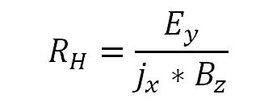
Hall Coefficient
In metals:
Where $j_{x}$ is the current density, $E_{y}$ is the induced electric field and $B_{z}$ is the induced magnetic filed.
In semiconductors:
Where $p$ is the hole concentration, $μ_{p}$ is the hole mobility, n is electron concentration, $μ_{n}$ is electron mobility and e is the elementary charge.

Slide 13
Example-1
A Hall effect element used for measuring a magnetic field strength gives on output voltage of 10.5 mV. The element is made of silicon and is 2.5 mm thick and carries a current of 4 A. The Hall coefficient for Si is 4.1 x 10⁻⁶ Vm/A-Wb/m².

Slide 14
Example-1
$$V_{H}=R_{H}\left(\frac{I}{t}×B\right)$$
Solution: Hall effect element thickness, t = 2.5mm = 2.5 x 10⁻³m
Output voltage, V_{H} = 10.5 mV= 10.5 x 10⁻³ V
Current, I = 4 A
Hall coefficient, R_{H} = 4.1 x 10⁻⁶ Vm/A-wb/m2

Slide 15
Example-1
Magnetic field strength, B
$$B=\frac{V_{H}×t}{R_{H}×I}$$
$$B=\frac{10.5×{10}^{−3}×2.5×{10}^{−3}}{4.1×{10}^{−4}×4}$$
$$B=1.6 Wb/m^{2}$$

Slide 16
Hall Effect Magnetic Sensor
The Hall voltage is a low-level signal on the order of 30 microvolts in the presence of a one gauss magnetic field.
This low-level output requires an amplifier with low noise, high input impedance and moderate gain.
Hall Effect Sensors are of two types
Linear (Analog) Hall Effect Sensor
Digital Hall Effect Sensor

Slide 17
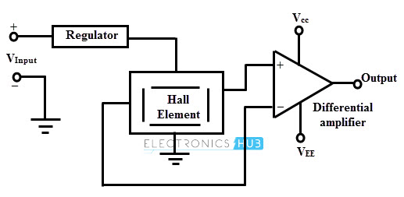
Analog Hall Effect Sensor
The output signal for linear (analog) sensors is taken directly from the output of the operational amplifier with the output voltage being directly proportional to the magnetic field passing through the Hall sensor.
$$V_{H}=R_{H}\left(\frac{I}{t}×B\right)$$

Slide 18
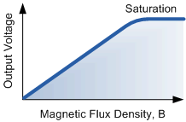
Analog Hall Effect Sensor
$$V_{H}=R_{H}\left(\frac{I}{t}×B\right)$$
Where:
$V_{H}$ is the Hall Voltage in volts
$R_{H}$ is the Hall Effect co-efficient
$I$ is the current flow through the sensor in amps
$t$ is the thickness of the sensor in mm
$B$ is the Magnetic Flux density in Teslas

Slide 19
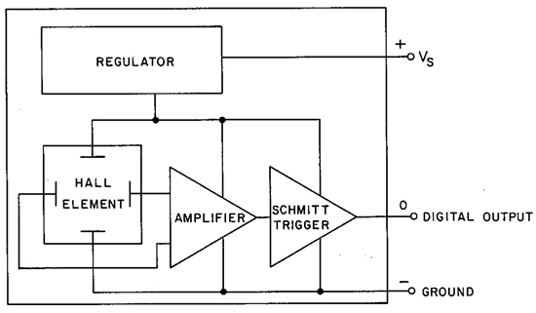
Digital Hall Effect Sensor (Hall Effect Switch)
Digital output sensors have a Schmitt-trigger connected to the op-amp.
When the magnetic flux passing through the Hall sensor exceeds a pre-set value the output from the device switches quickly between its “OFF” condition to an “ON” condition without any type of contact bounce.

Slide 20
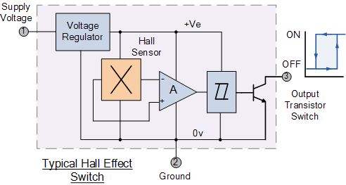
Digital Hall Effect Sensor (Hall Effect Switch)
Digital Hall effect sensors usually have built in hysteresis connected to the output of Schmitt trigger.
This built-in hysteresis eliminates any oscillation of the output signal as the sensor moves in and out of the magnetic field. Then digital output sensors have just two states, “ON” and “OFF”.

Slide 21
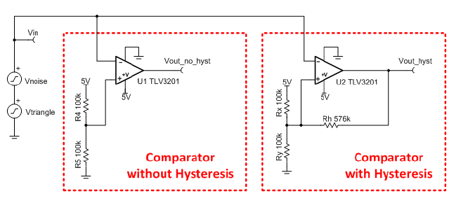
Digital Hall Effect Sensor (Hall Effect Switch)

Slide 22
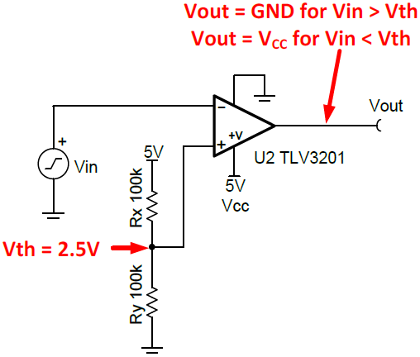
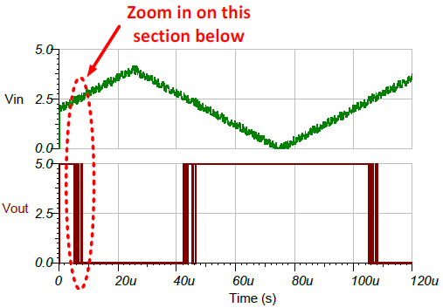
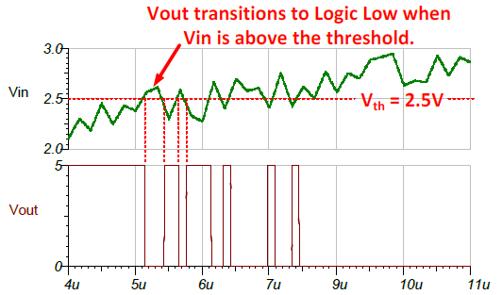
Digital Hall Effect Sensor (Hall Effect Switch)

Slide 23
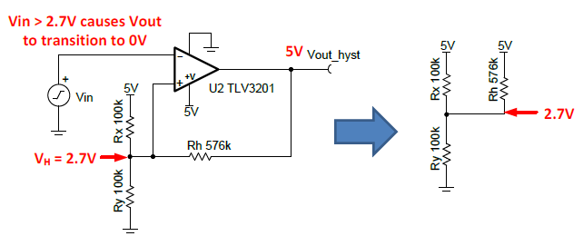
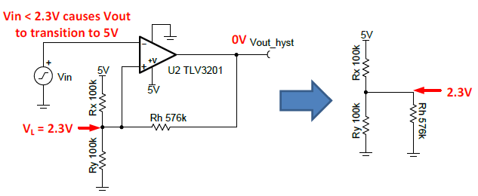
Digital Hall Effect Sensor (Hall Effect Switch)

Slide 24
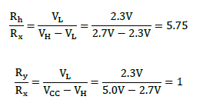
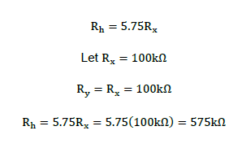
Digital Hall Effect Sensor (Hall Effect Switch)
Eq(1)
Eq(2)

Slide 25
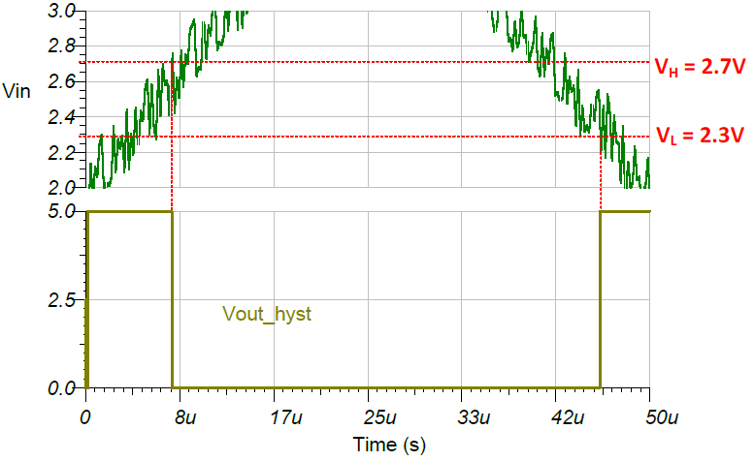
Digital Hall Effect Sensor (Hall Effect Switch)

Slide 26
Example-2
Design a Schmitt Trigger with hysteresis for the following Hall Effect Switch such that the circuit provides a hysteresis of 0.6v around threshold value (i.e 5V). The supply voltage is 10v.

Slide 27
Example-2
5.3
5.3
5.3
4.7
Using eq(1) and eq(2)
$$\frac{R_{h}}{R_{x}}=\frac{V_{L}}{V_{H}−V_{L}}$$
$$\frac{R_{h}}{R_{x}}=\frac{4.7}{5.3−4.7}=7.8$$
$$\frac{R_{y}}{R_{x}}=\frac{V_{L}}{V_{cc}−V_{H}}$$
$$\frac{R_{y}}{R_{x}}=\frac{4.7}{10−5.3}=1$$

Slide 28
Example-2
$$R_{h}=7.8R_{x}$$
$$R_{y}=R_{x}$$
Choosing $R_{y}=100KΩ$, therefore
Then
$$R_{y}=100KΩ$$
$$R_{h}=780KΩ$$

Slide 29
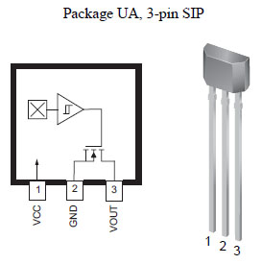
Hall Effect Sensor Package

Slide 30
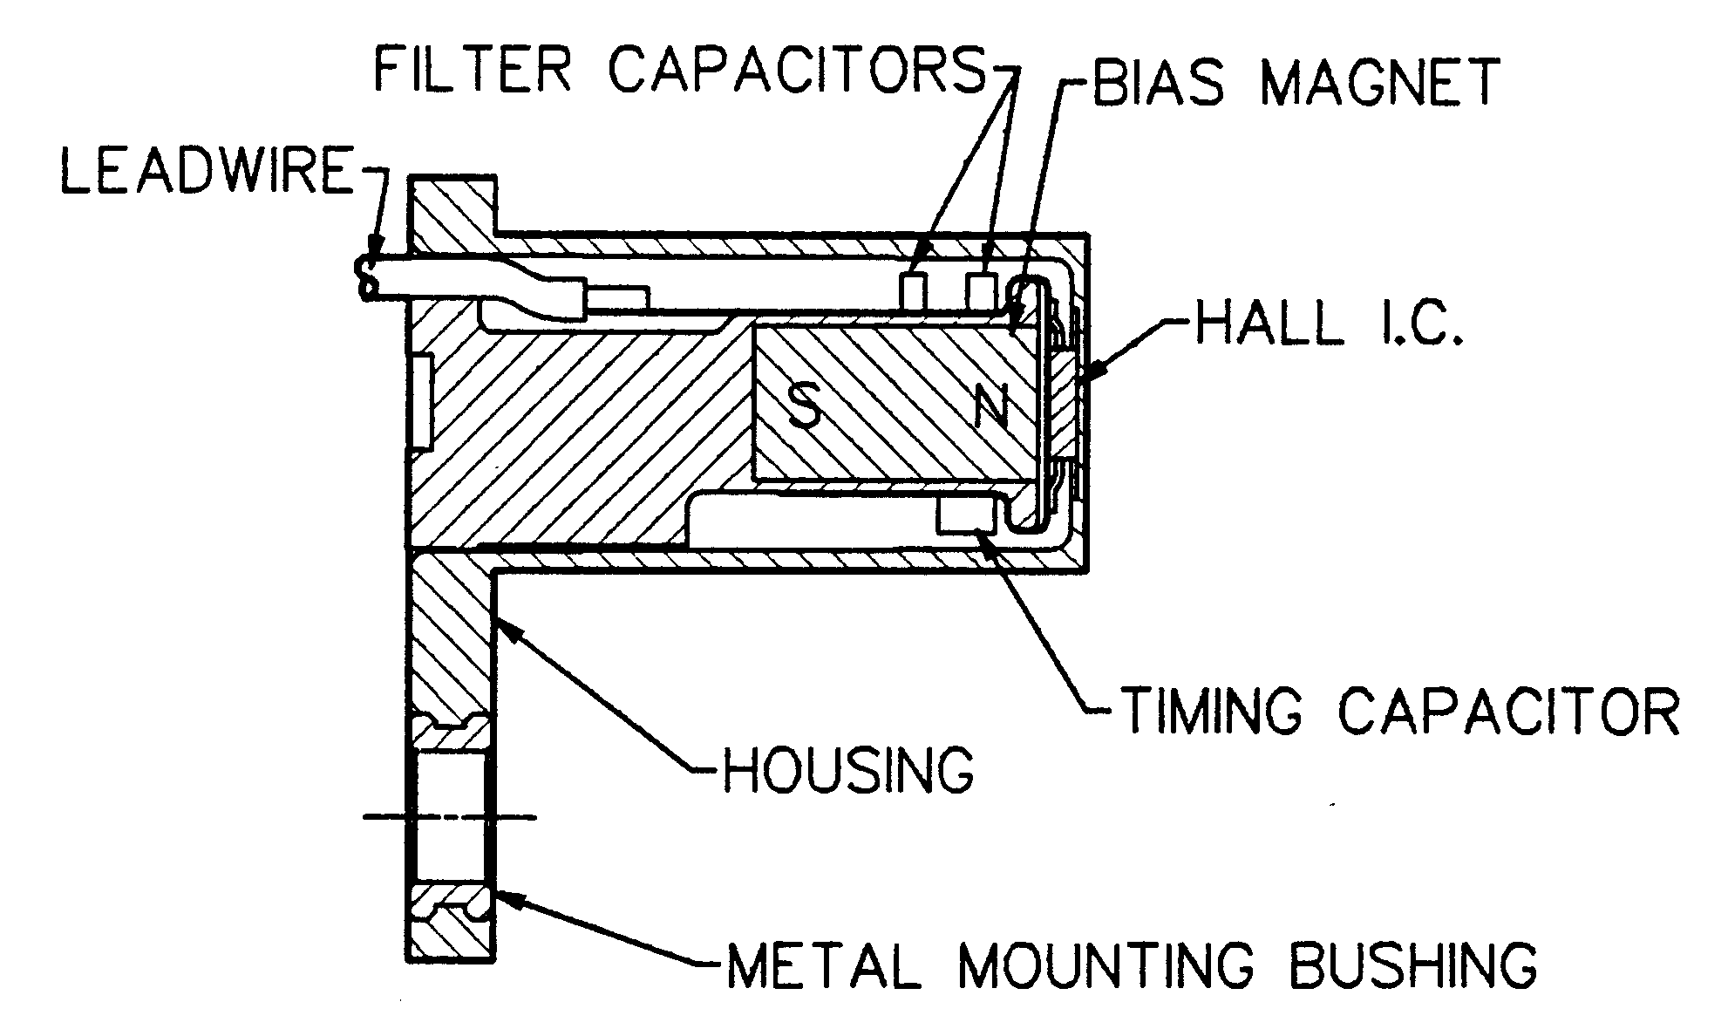
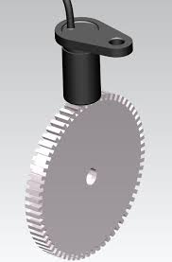
Applications
Gear Tooth Sensor
A gear tooth sensor is a magnetically biased Hall effect integrated circuit to accurately sense movement of ferrous metal targets.

Slide 31
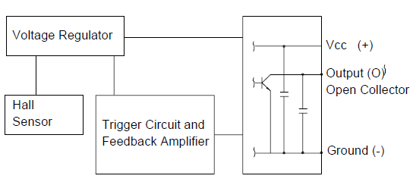
Applications
Gear Tooth Sensor

Slide 32
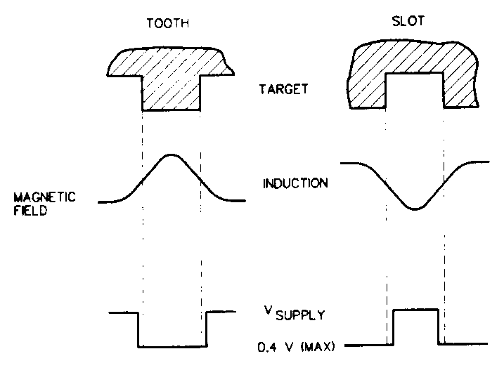
Applications
Gear Tooth Sensor
As a gear tooth passes by the sensor face, it concentrates the magnetic flux from the bias magnet.
The sensor detects the change in flux level and translates it into a change in the sensor output.
The current sinking (normally high) digital output switches between the supply voltage and saturation voltage of the output transistor.

Slide 33
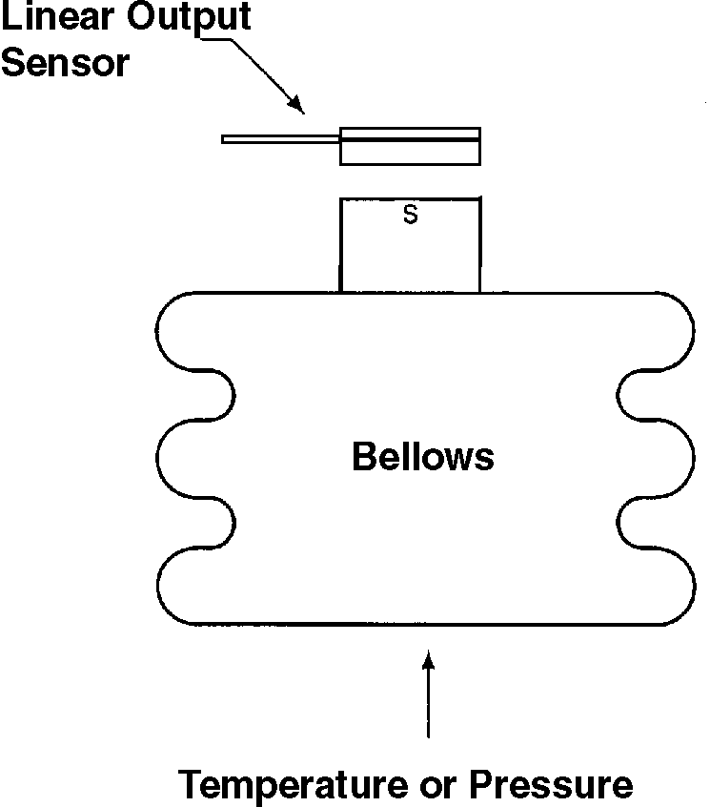
Hall Effect Based Temperature and Pressure Senor
In this example, an increase and/or decrease in temperature causes the bellows to expand or contract, moving the attached magnet.
The corresponding change in magnetic field is sensed by the Hall effect sensing device.
The end result is conversion of the temperature input to a measurable electrical field.

Slide 34
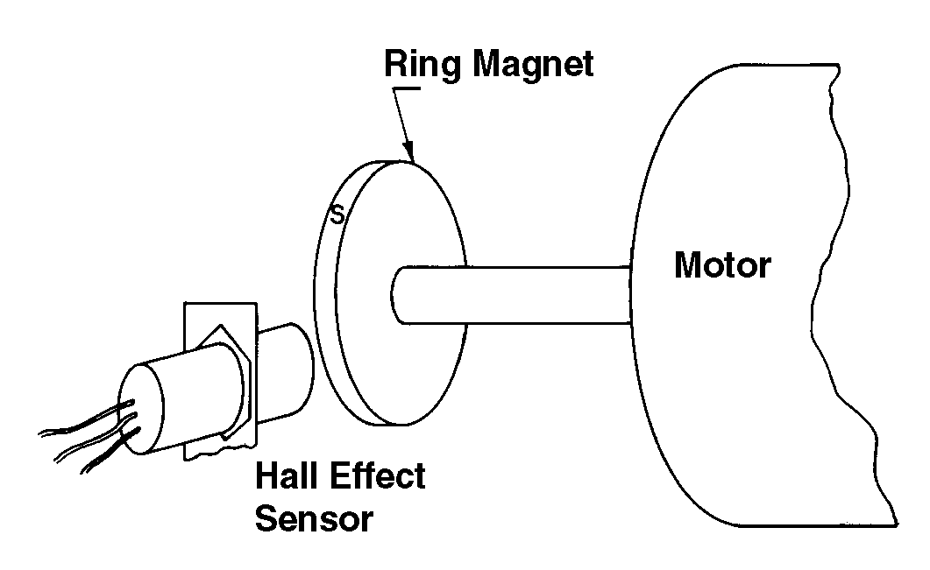
Hall Effect Based RPM Counter
The sensor consists of a ring magnet on the motor shaft and a radially-mounted digital output Hall effect sensor.
As the ring magnet rotates with the motor, its south pole passes the sensing face of the Hall sensor with each revolution.
The sensor is actuated when the south pole approaches the sensor and de-actuated when the south pole moves away.
Thus, a single digital pulse will be produced for each revolution.

Slide 35
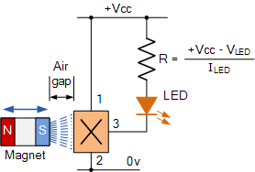
Hall Effect Based Position Detector

Slide 36
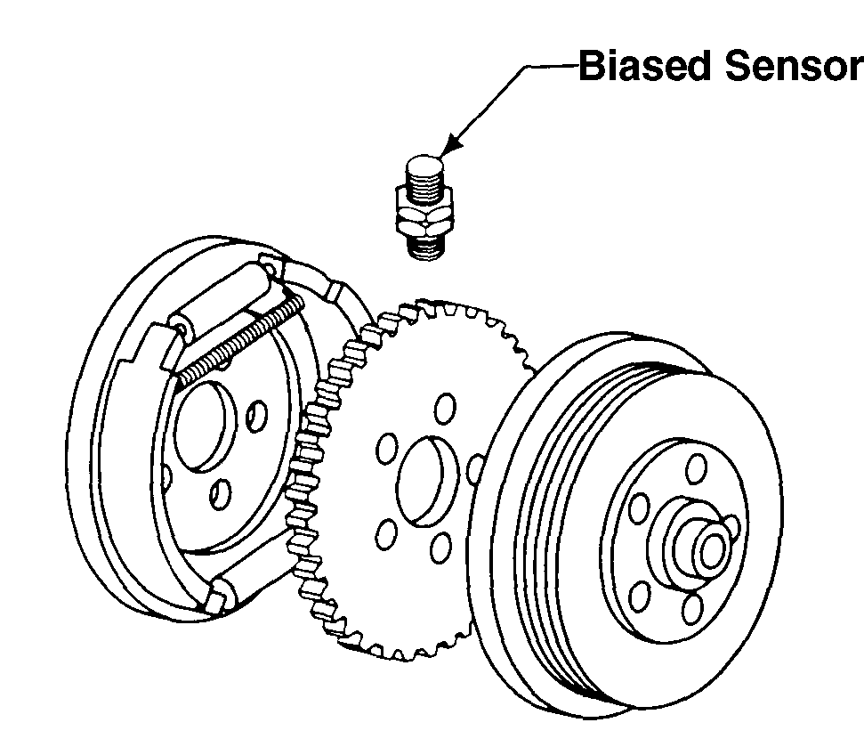
Antiskid Sensor
Figure shows a possible solution for controlling the braking force of a wheel so that it doesn’t lock-up.
A biased Hall effect sensor is used.
The sensor is positioned to sense an internal tooth gear.
The gear could be the disk brake hub.

Slide 37
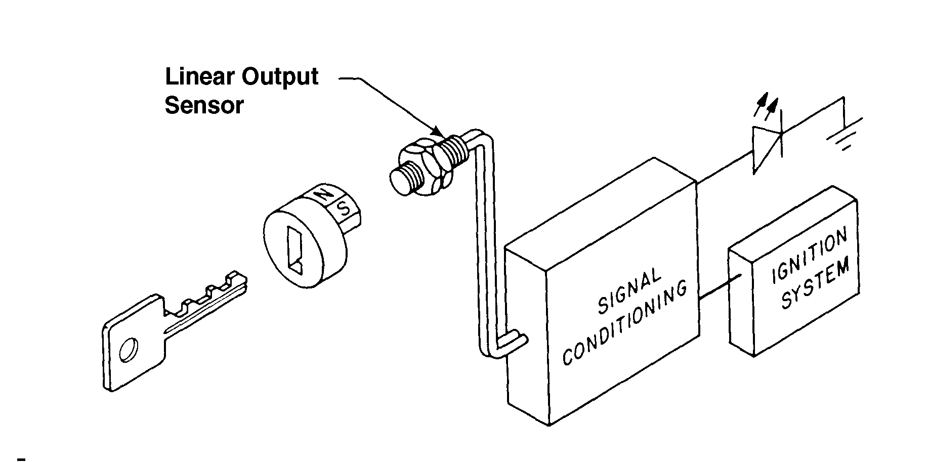
Door interlock and ignition sensor
A sensor is positioned so that a magnet rotates by it when the key is turned in the door lock.

Slide 38
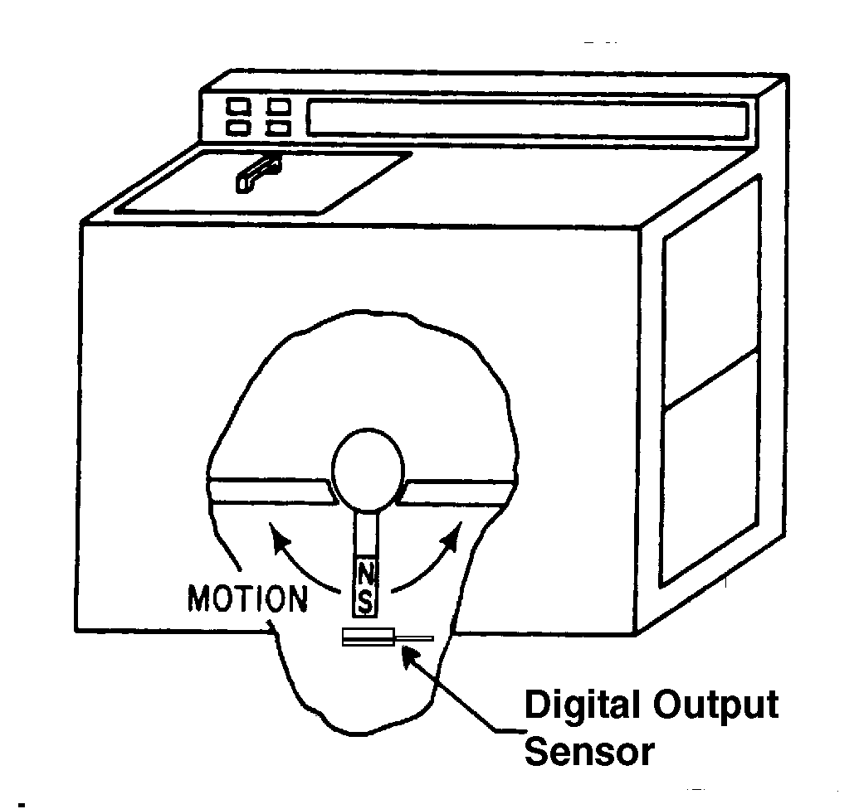
Level/tilt measurement sensor
Digital output unipolar sensor can be installed in the base of a machine with a magnet mounted in a pendulum fashion as illustrated in Figure.
As long as the magnet remains directly over the sensor, the machine is level.
A change in state of the output as the magnet swings away from the sensor is indication that the machine is not level.

Slide 39
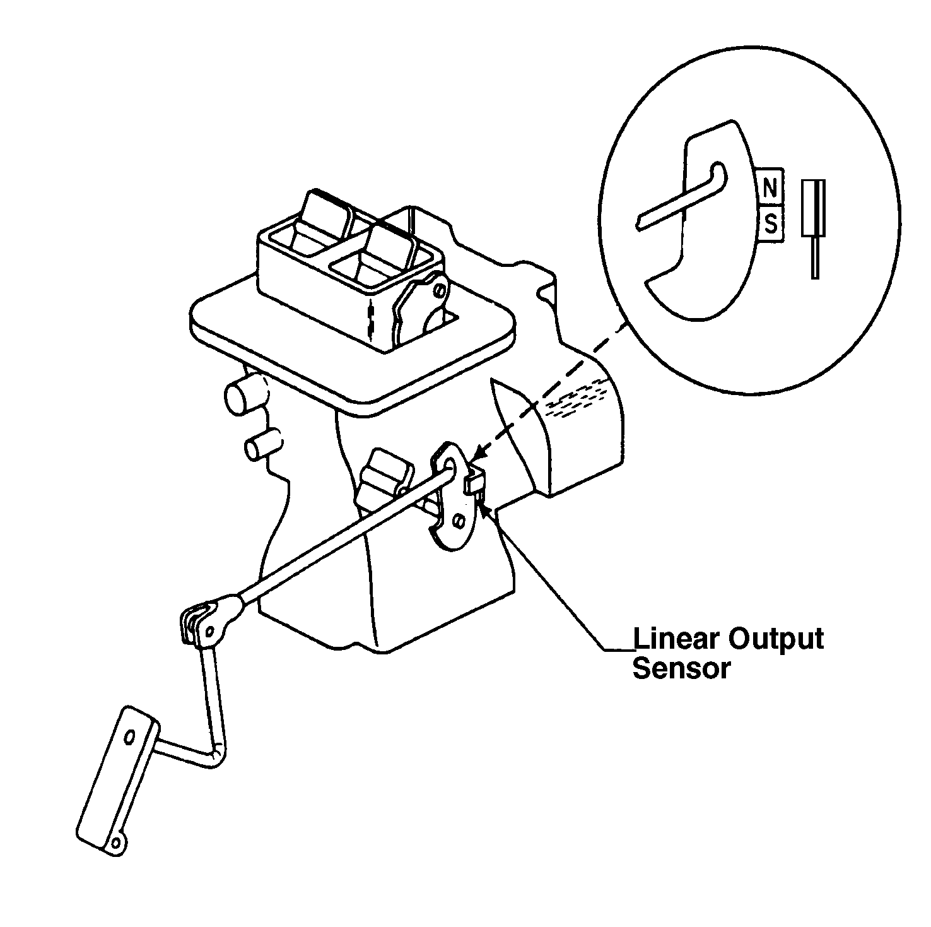
Throttle angle sensor
The arm of the throttle is contoured to provide the desired non-linear characteristics.
The magnet is mounted on the choke lever.

Slide 40
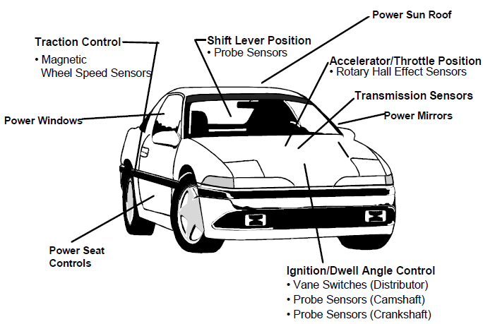
Automotive sensors

Slide 41
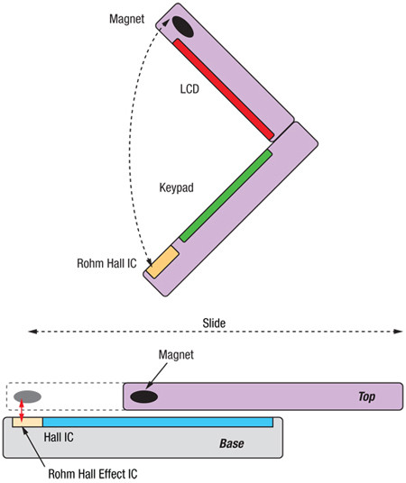
Applications for Hall Effect IC Switches in Portable Electronics

Slide 42
End of Lecture-3
To download this lecture visit
http://imtiazhussainkalwar.weebly.com/

