Slide 1


Signals & Systems (EE-2043)
Lecture-2
Mathematical Description of Continuous-Time Signals
Dr. Imtiaz Hussain
Associate Professor (Control Systems),
Department of Electrical Engineering
DHA Suffa University, Karachi, Pakistan
email: imtiaz.hussain@dsu.edu.pk
URL :http://imtiazhussainkalwar.weebly.com/
Spring 2020
4th Semester (BE-EE-4A)

Slide 2
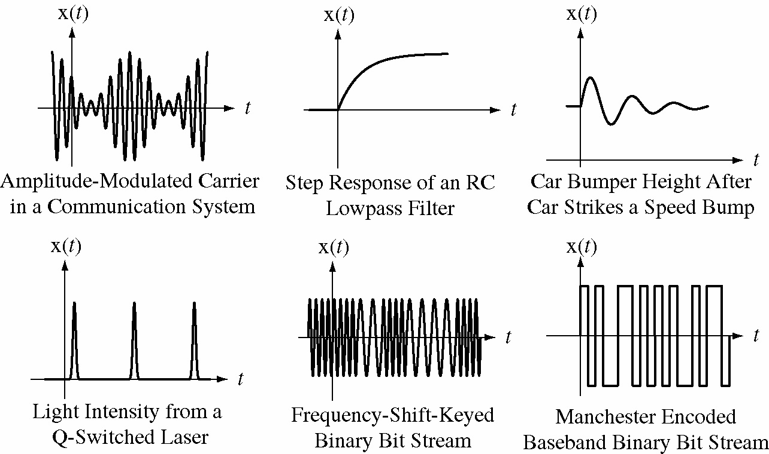
Typical Continuous-Time Signals

Slide 3
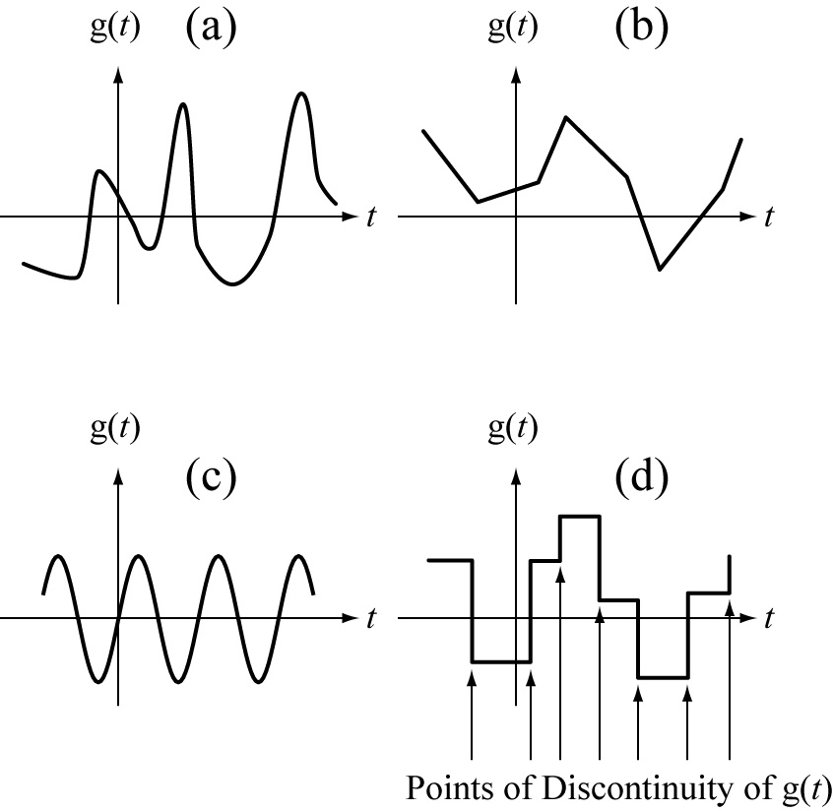
Continuous vs Continuous-Time Signals
All continuous signals that are functions of time are continuous-time but not all continuous-time signals are continuous

Slide 4
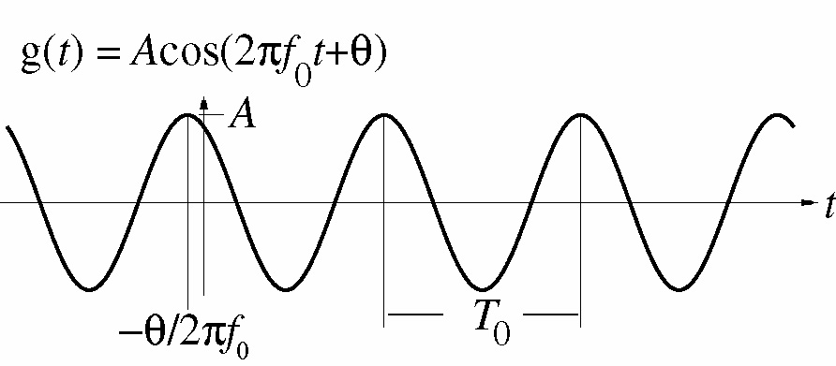
Continuous-Time Sinusoids

Slide 5
Continuous-Time Sinusoids

Slide 6
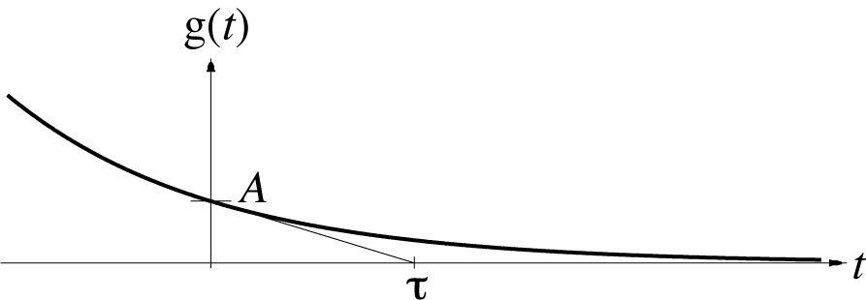
Continuous-Time Exponentials

Slide 7


Continuous-Time Exponentials
$$g\left(t\right)=3e^{−\frac{t}{0.5}}$$
$$g\left(t\right)=3e^{\frac{t}{0.5}}$$
Decaying Exponential
Increasing exponential

Slide 8


Continuous-Time Exponentials
$$g\left(t\right)=3e^{−\frac{t}{0.5}\sin{(2π3t)}}$$
$$g\left(t\right)=3e^{\frac{t}{0.5}\sin{(2π3t)}}$$

Slide 9
Continuous-Time Exponentials

Slide 10
Sinusoids and Exponentials
Sinusoids and exponentials are very common in signal and system analysis because most continuous-time systems can be described by linear, constant-coefficient, ordinary differential equations whose eigen-functions are complex exponentials.

Slide 11

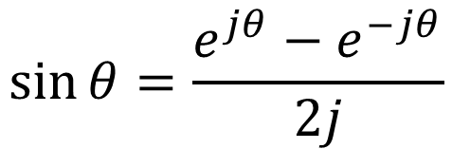
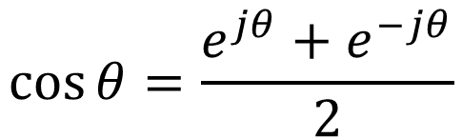
Complex Sinusoids
Any function of the form $Ae^{j(ωt+∅)}$ are called a complex sinusoid.
Using Euler's identity
$$Ae^{j(ωt+∅)}=A\cos\left(ωt+∅\right)+jA\sin{(ωt+∅)}$$
$$\cos{θ=\frac{e^{jθ}+e^{−jθ}}{2}}$$
$$\sin{θ=\frac{e^{jθ}−e^{−jθ}}{2j}}$$

Slide 12
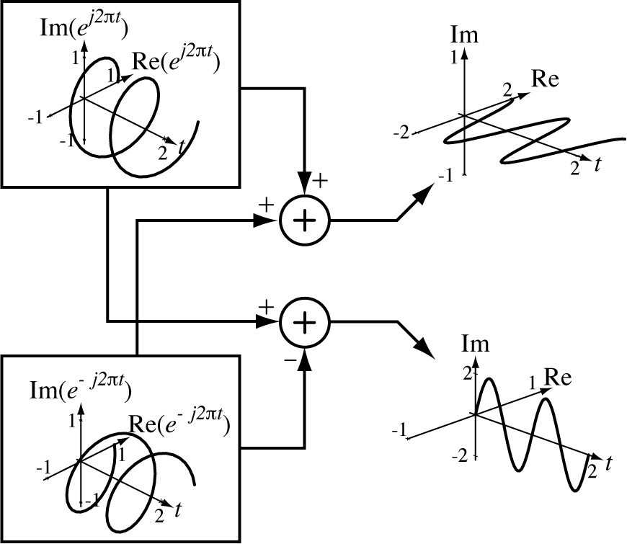
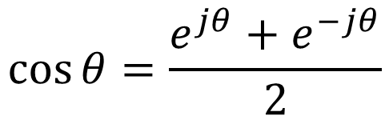
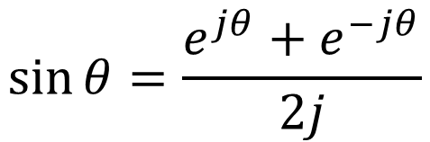
Complex Sinusoids
$$\cos{θ=\frac{e^{jθ}+e^{−jθ}}{2}}$$
$$\sin{θ=\frac{e^{jθ}+e^{−jθ}}{2j}}$$

Slide 13
Complex Sinusoids

Slide 14
FUNCTIONS WITH DISCONTINUITIES
Continuous-time sines, cosines and exponentials are all continuous and differentiable at every point in time.
But many other types of important signals that occur in practical systems are not continuous or differentiable everywhere.
A common operation in systems is to switch a signal on or off at some time

Slide 15
FUNCTIONS WITH DISCONTINUITIES

Slide 16
FUNCTIONS WITH DISCONTINUITIES

Slide 17
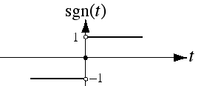
The Signum Function
For nonzero arguments, the value of the signum function has a magnitude of one and a sign that is the same as the sign of its argument:
The signum function, in a sense, returns an indication of the sign of its argument.

Slide 18
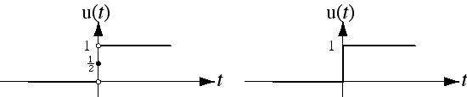
The Unit Step Function
The unit-step function is defined by

Slide 19
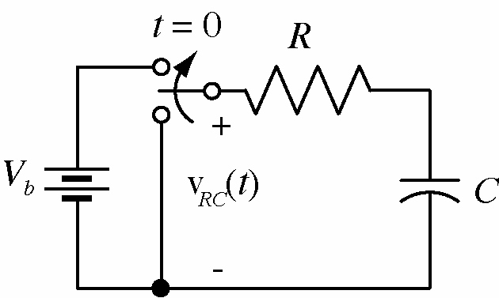
The Unit Step Function
The unit step function can mathematically describe a signal that is zero up to some point in time and non-zero after that.
The unit step can mathematically represent a common action in real physical systems, fast switching from one state to another (e.g. following circuit).

Slide 20
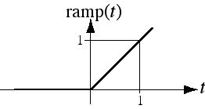
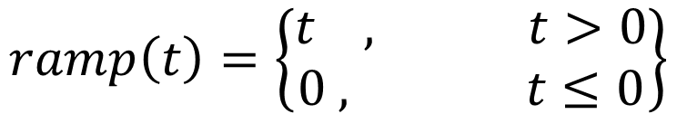
The Unit Ramp Function
$$ramp\left(t\right)=\left\{\begin{matrix}t , t>0 \\ 0 , t≤0\end{matrix}\right\}$$

Slide 21
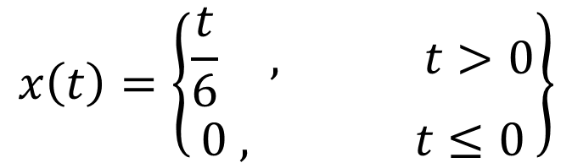
The Unit Ramp Function
$$x\left(t\right)=\left\{\begin{matrix}\frac{t}{6} , t>0 \\ 0 , t≤0\end{matrix}\right\}$$

Slide 22
The Unit Ramp Function

Slide 23
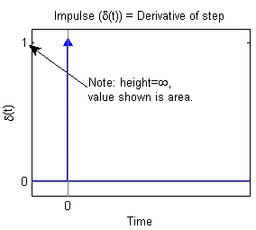
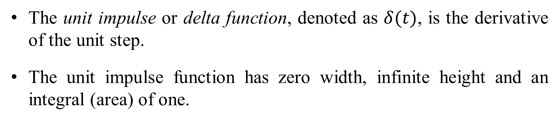
Introduction to the Impulse
The unit impulse or delta function, denoted as $δ(t)$, is the derivative of the unit step.
The unit impulse function has zero width, infinite height and an integral (area) of one.
We plot it as an arrow with the height of the arrow showing the area of the impulse.

Slide 24
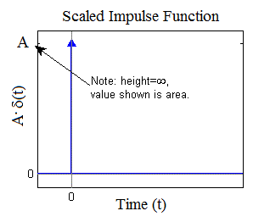
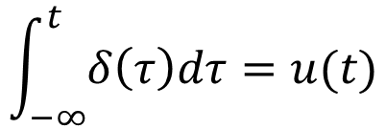

Introduction to the Impulse
In the diagram below the area of the impulse function is "A." For a scaled impulse (i.e., A·δ(t)), the multiplier in front of the impulse is the area.
It is also defined as
$$\int_{−∞}^{t}{δ\left(τ\right)dτ=u(t)}$$
or
$$δ\left(t\right)=0 for all t≠0$$

Slide 25

Introduction to the Impulse
To better understand the delta function δ(t), let us represent the unit step as shown in Figure (a)
The function of Figure (a) becomes the unit step as $ε→0$.
Figure (b) shows the derivative of the function in figure (a).

Slide 26

Introduction to the Impulse
As $ε→0$, $\frac{1}{2ε}$ becomes unbounded but the area of rectangle remains 1.
Therefore, in the limit, we can think of δ(t) as approaching a very large spike or impulse at the origin, with unbounded amplitude, zero width, and area equal to 1.

Slide 27
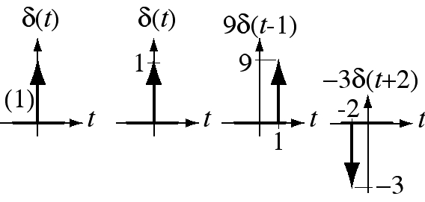
Graphical Representation of the Impulse
It is represented graphically by a vertical arrow.
Its strength is either written beside it or is represented by its length.

Slide 28

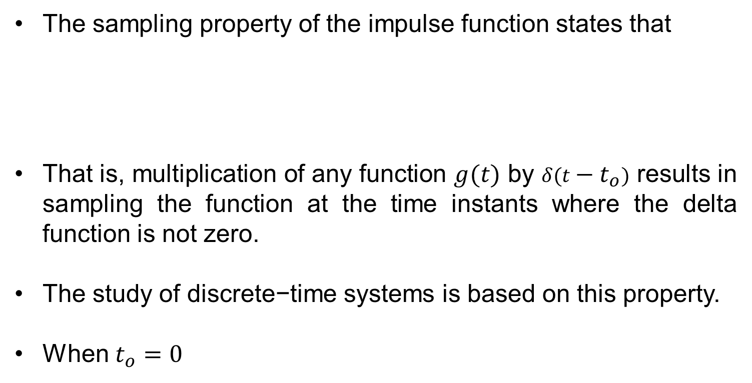

Properties of the Impulse (Sampling Property)
The sampling property of the impulse function states that
That is, multiplication of any function $g(t)$ by $δ(t−t_{o})$ results in sampling the function at the time instants where the delta function is not zero.
The study of discrete−time systems is based on this property.
When $t_{o}=0$
$$g\left(t\right)δ\left(t−t_{o}\right)=g\left(t_{o}\right)δ\left(t\right)$$
$$g\left(t\right)δ\left(t\right)=g\left(0\right)δ\left(t\right)$$

Slide 29
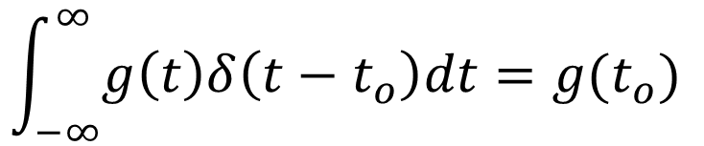

Properties of the Impulse (Sifting Property)
The sifting property of the impulse
That is, if we multiply any function $g(t)$ by $δ(t−t_{o})$, and integrate from $−∞ to ∞$, we will obtain the value of $g(t)$ evaluated at $t_{o}$.
$$\int_{−∞}^{∞}{g\left(t\right)δ\left(t−t_{o}\right)dt=g(t_{o}) }$$

Slide 30
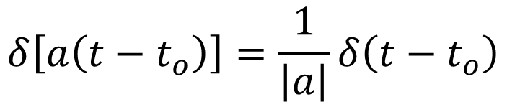
Properties of the Impulse (Scaling Property)
The scaling property of the impulse states that
$$δ\left[a\left(t−t_{o}\right)\right]=\frac{1}{\left|a\right|}δ\left(t−t_{o}\right)$$

Slide 31
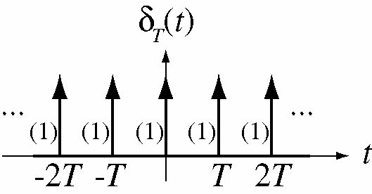
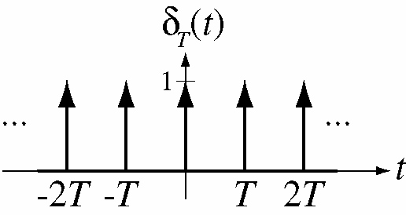
The Unit Periodic Impulse

Slide 32



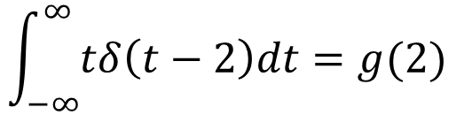
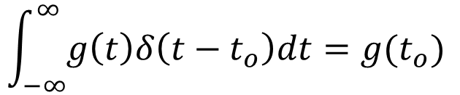
Example Problem
Evaluate the following expression
The sifting property states that
For this example $g\left(t\right)=t and α=2$.
Then
$$\int_{−∞}^{∞}{tδ\left(t−2\right)dt }$$
Solution
$$\int_{−∞}^{∞}{g\left(t\right)δ\left(t−t_{o}\right)dt=g(t_{o}) }$$
$$\int_{−∞}^{∞}{tδ\left(t−2\right)dt=g(2) }$$
$$g\left(2\right)={\left.t\right|}_{t=2}=2$$

Slide 33
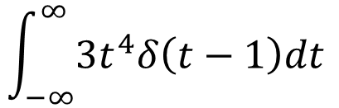

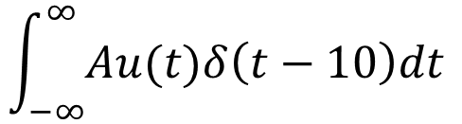
Exercise Problems
Evaluate the following expressions
$$\int_{−∞}^{∞}{t^{2}δ\left(t−3\right)dt }$$
(a)
$$\int_{−∞}^{∞}{{3t}^{4}δ\left(t−1\right)dt }$$
(b)
(c)
$$\int_{−∞}^{∞}{Au(t)δ\left(t−10\right)dt }$$

Slide 34
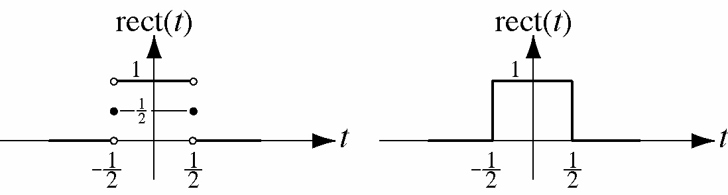
The Unit Rectangle Function

Slide 35
Exercise Problem
(a) Express the voltage waveform v(t) as a sum of basic waveforms (e.g. step, ramp etc.) for the time interval -1<t<7s

Slide 36
Exercise Problem
(b) Express the voltage waveform v(t) as a sum of unit step function for the time interval -1<t<7s

Slide 37
Exercise Problem
(c) Using the result of part (b), compute the derivative of and sketch its waveform.

Slide 38
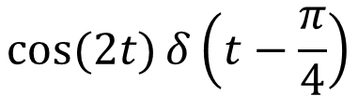
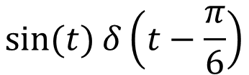
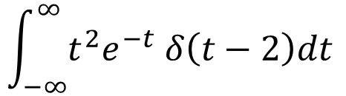
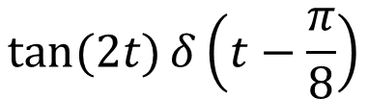
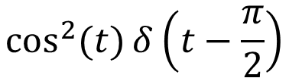
Exercise Problems
Evaluate following functions.
$$\sin{(t)}δ\left(t−\frac{π}{6}\right)$$
(a)
$$\cos{(2t)}δ\left(t−\frac{π}{4}\right)$$
(b)
$$\cos^{2}{(t)}δ\left(t−\frac{π}{2}\right)$$
(c)
$$\tan{(2t)}δ\left(t−\frac{π}{8}\right)$$
(d)
$$\int_{−∞}^{∞}{t^{2}e^{−t} δ\left(t−2\right)dt }$$
(e)

Slide 39
End of Lecture-2
To download this lecture visit
http://imtiazhussainkalwar.weebly.com/

