Slide 1
Modeling & Simulation of Dynamic Systems
Lecture-2
Mathematical Modeling of Mechanical Systems
Dr. Imtiaz Hussain
email: imtiaz.hussain@faculty.muet.edu.pk
URL :http://imtiazhussainkalwar.weebly.com/

Slide 2
Outline of this Lecture
Part-I: Translational Mechanical System
Part-II: Rotational Mechanical System
Part-III: Mechanical Linkages

Slide 3
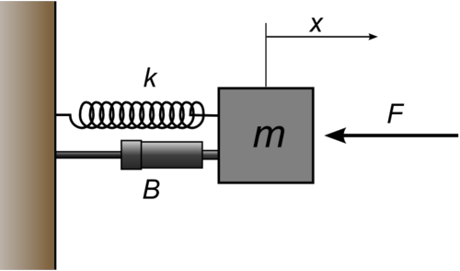
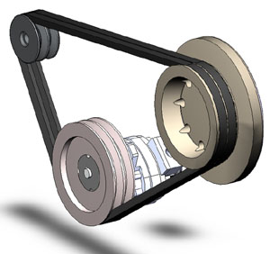
Basic Types of Mechanical Systems
Translational
  Linear Motion
Rotational
  Rotational Motion

Slide 4
Translational Mechanical Systems
Part-I

Slide 5


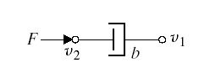
Basic Elements of Translational Mechanical Systems
Translational Spring
i)
Translational Mass
ii)
Translational Damper
iii)

Slide 6
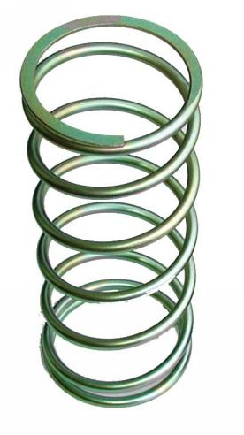

Translational Spring
A translational spring is a mechanical element that can be deformed by an external force such that the deformation is directly proportional to the force applied to it.
Translational Spring
i)
Circuit Symbols
Translational Spring

Slide 7
Translational Spring
If F is the applied force
Then is the deformation if
Or is the deformation.
The equation of motion is given as
Where is stiffness of spring expressed in N/m

Slide 8
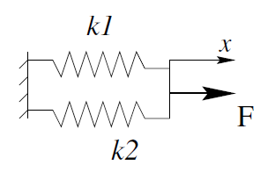
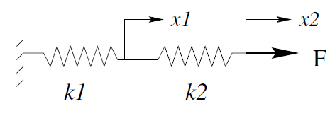
Translational Spring
Given two springs with spring constant k₁ and k₂, obtain the equivalent spring constant k_{eq} for the two springs connected in:
(1) Parallel
(2) Series

Slide 9
Translational Spring
The two springs have same displacement therefore:
(1) Parallel
If n springs are connected in parallel then:

Slide 10
Translational Spring
The forces on two springs are same, F, however displacements are different therefore:
(2) Series
Since the total displacement is , and we have

Slide 11
Translational Spring
Then we can obtain
If n springs are connected in series then:

Slide 12







Translational Spring
Exercise: Obtain the equivalent stiffness for the following spring networks.
i)
ii)

Slide 13
Translational Mass
Translational Mass is an inertia element.
A mechanical system without mass does not exist.
If a force F is applied to a mass and it is displaced to x meters then the relation b/w force and displacements is given by Newton’s law.
Translational Mass
ii)
M

Slide 14
Translational Damper
When the viscosity or drag is not negligible in a system, we often model them with the damping force.
All the materials exhibit the property of damping to some extent.
If damping in the system is not enough then extra elements (e.g. Dashpot) are added to increase damping.
Translational Damper
iii)

Slide 15
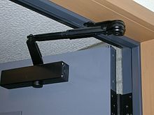
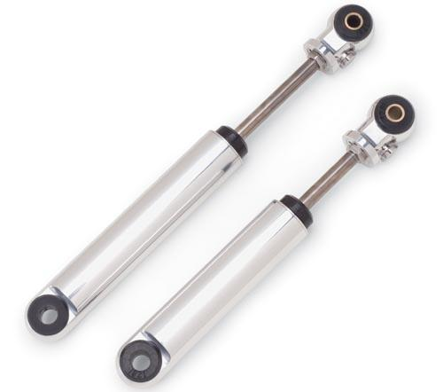
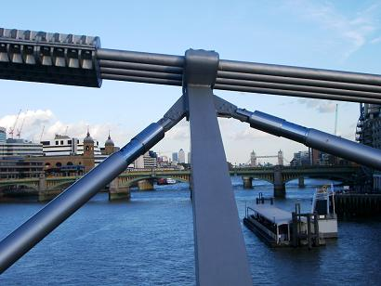
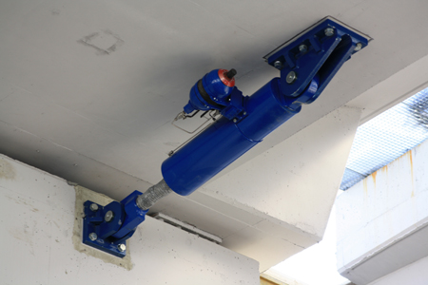
Common Uses of Dashpots
Door Stoppers
Vehicle Suspension
Bridge Suspension
Flyover Suspension

Slide 16

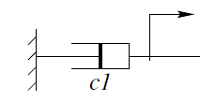
Translational Damper
Where C is damping coefficient (N/ms⁻¹).

Slide 17
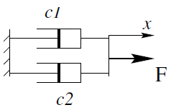
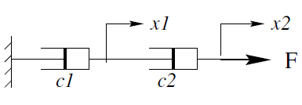
Translational Damper
Translational Dampers in series and parallel.

Slide 18
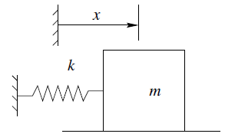
Modeling a simple Translational System
Example-1: Consider a simple horizontal spring-mass system on a frictionless surface, as shown in figure below.
or

Slide 19
Example-2
Consider the following system (friction is negligible)
Free Body Diagram
M
Where and are force applied by the spring and inertial force respectively.

Slide 20
Example-2
M
Then the differential equation of the system is:
Taking the Laplace Transform of both sides and ignoring initial conditions we get

Slide 21
Example-2
The transfer function of the system is
if

Slide 22
Example-2
The pole-zero map of the system is

Slide 23
Example-3
Consider the following system
Free Body Diagram
M

Slide 24
Example-3
Differential equation of the system is:
Taking the Laplace Transform of both sides and ignoring
Initial conditions we get

Slide 25
Example-3
if

Slide 26
Example-4
Consider the following system
Free Body Diagram (same as example-3)
M

Slide 27
Example-5
Consider the following system
Mechanical Network
↑
M

Slide 28
Example-5
Mechanical Network
↑
M
At node
At node

Slide 29
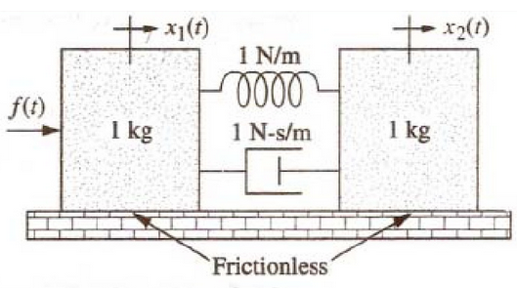
Example-6
Find the transfer function X₂(s)/F(s) of the following system.

Slide 30
Example-7
↑
M₁
M₂

Slide 31
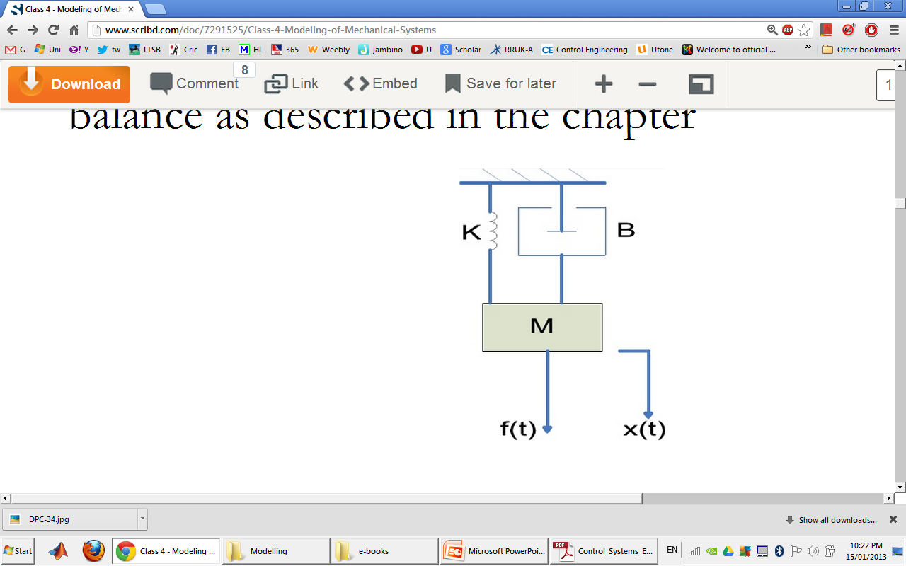
Example-8
Find the transfer function of the mechanical translational system given in Figure-1.
Free Body Diagram
Figure-1
M

Slide 32
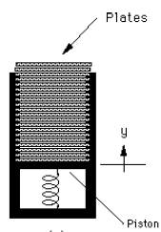
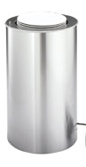
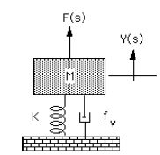
Example-9
Restaurant plate dispenser

Slide 33
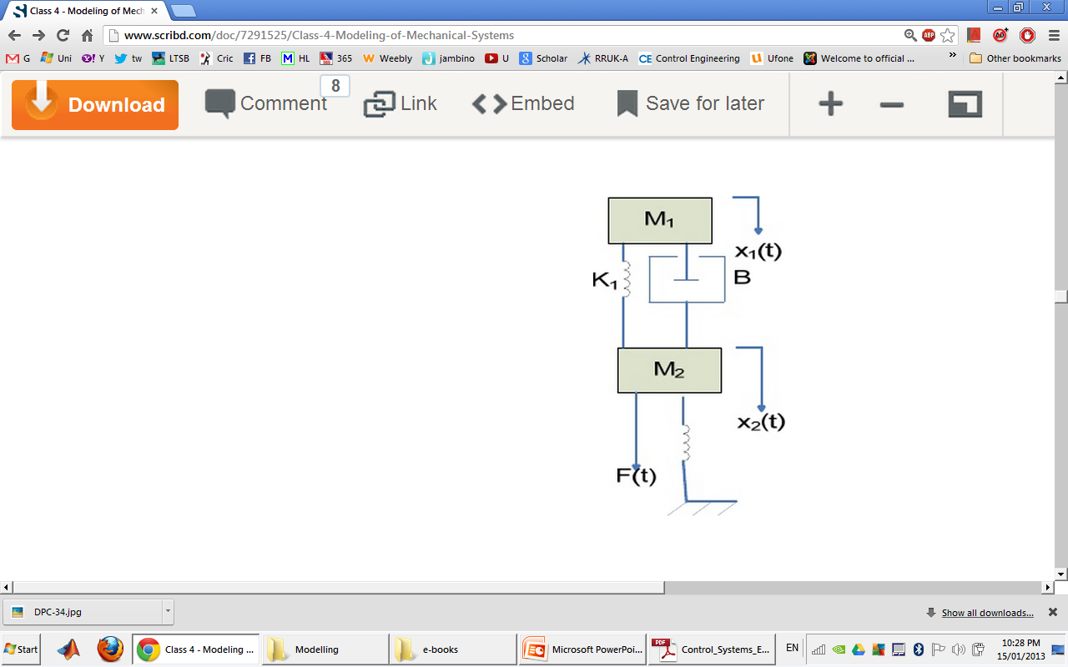
Example-10
Find the transfer function X₂(s)/F(s) of the following system.
Free Body Diagram
M₂
M₁

Slide 34
Example-11

Slide 35
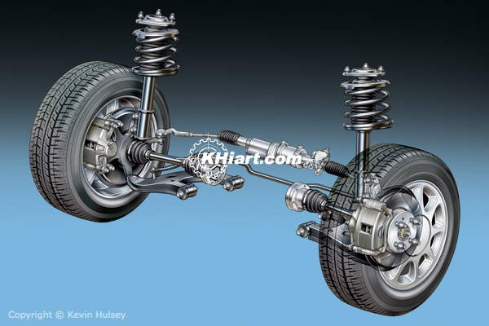
Example-12: Automobile Suspension

Slide 36
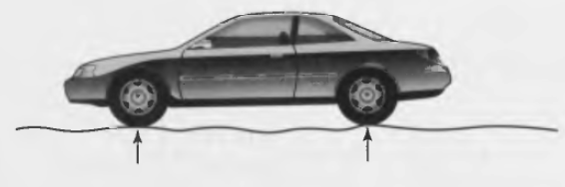
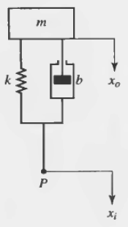
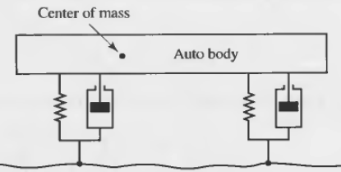
Automobile Suspension

Slide 37
Automobile Suspension
Taking Laplace Transform of the equation (2)

Slide 38
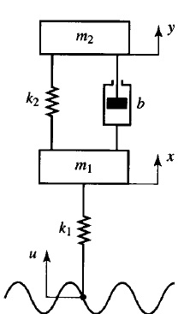
Example-13: Train Suspension
Car Body
Bogie-1
Bogie-2
Secondary
Suspension
Bogie
Frame
Wheelsets
Primary
Suspension

Slide 39


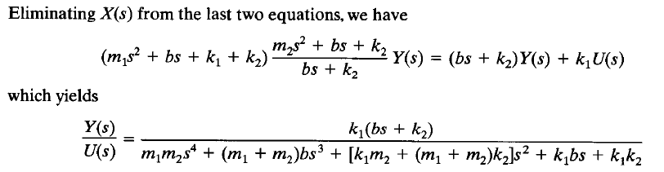
Example: Train Suspension

Slide 40
Rotational Mechanical Systems
Part-I

Slide 41

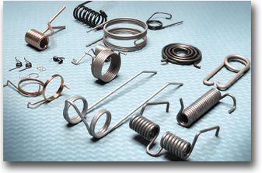
Basic Elements of Rotational Mechanical Systems
Rotational Spring

Slide 42
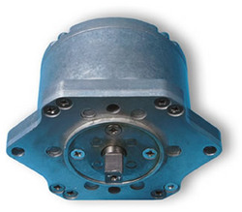
Basic Elements of Rotational Mechanical Systems
Rotational Damper

Slide 43
Basic Elements of Rotational Mechanical Systems
Moment of Inertia

Slide 44
Example-1
↑
J₁
J₂

Slide 45
Example-2
↑
J₁
J₂

Slide 46
Example-3

Slide 47
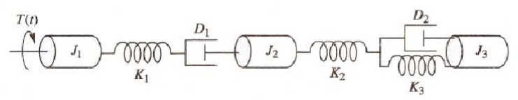
Example-4

Slide 48
Mechanical Linkages
Part-III

Slide 49

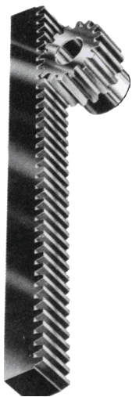
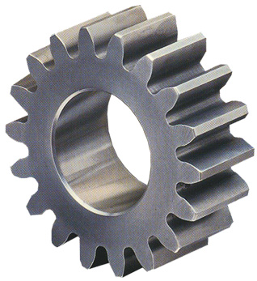
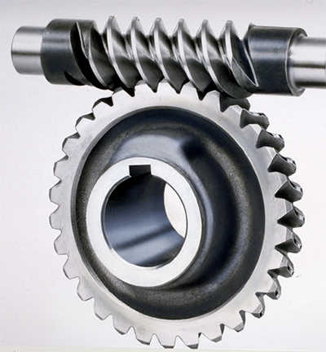
Gear
Gear is a toothed machine part, such as a wheel or cylinder, that meshes with another toothed part to transmit motion or to change speed or direction.

Slide 50
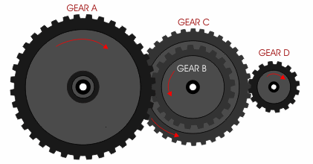
Fundamental Properties
The two gears turn in opposite directions: one clockwise and the other counterclockwise.
Two gears revolve at different speeds when number of teeth on each gear are different.

Slide 51
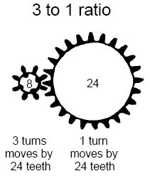
Gearing Up and Down
Gearing up is able to convert torque to velocity.
The more velocity gained, the more torque sacrifice.
The ratio is exactly the same: if you get three times your original angular velocity, you reduce the resulting torque to one third.
This conversion is symmetric: we can also convert velocity to torque at the same ratio.
The price of the conversion is power loss due to friction.

Slide 52
Why Gearing is necessary?
A typical DC motor operates at speeds that are far too high to be useful, and at torques that are far too low.
Gear reduction is the standard method by which a motor is made useful.

Slide 53
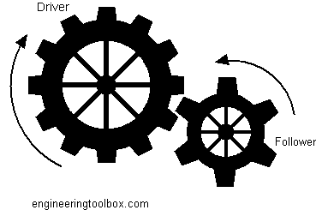
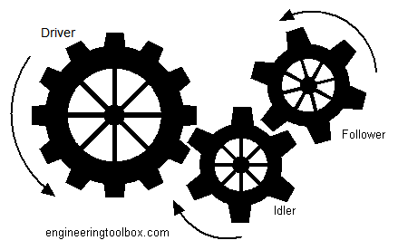
Gear Trains

Slide 54
Gear Ratio
You can calculate the gear ratio by using the number of teeth of the driver divided by the number of teeth of the follower.
We gear up when we increase velocity and decrease torque.
Ratio: 3:1
We gear down when we increase torque and reduce velocity.
Ratio: 1:3
Driver
Follower
Gear Ratio = # teeth input gear / # teeth output gear
= torque in / torque out = speed out / speed in

Slide 55
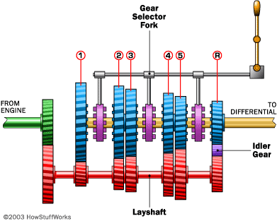
Example of Gear Trains
A most commonly used example of gear trains is the gears of an automobile.

Slide 56
Mathematical Modelling of Gear Trains
Gears increase or reduce angular velocity (while simultaneously decreasing or increasing torque, such that energy is conserved).
Energy of Driving Gear = Energy of Following Gear
Number of Teeth of Driving Gear
Angular Movement of Driving Gear
Number of Teeth of Following Gear
Angular Movement of Following Gear

Slide 57
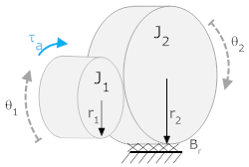
Mathematical Modelling of Gear Trains
In the system below, a torque, τ_{a}, is applied to gear 1 (with number of teeth N₁, moment of inertia J₁ and a rotational friction B₁).
It, in turn, is connected to gear 2 (with number of teeth N₂, moment of inertia J₂ and a rotational friction B₂).
The angle θ₁ is defined positive clockwise, θ₂ is defined positive clockwise. The torque acts in the direction of θ₁.
Assume that T_{L} is the load torque applied by the load connected to Gear-2.
N₂
N₁
B₁
B₂

Slide 58
Mathematical Modelling of Gear Trains
For Gear-1
For Gear-2
Since
therefore
Eq (1)
Eq (2)
N₂
N₁
B₁
B₂
Eq (3)

Slide 59
Mathematical Modelling of Gear Trains
Gear Ratio is calculated as
Put this value in eq (1)
Put T₂ from eq (2)
Substitute θ₂ from eq (3)
N₂
N₁
B₁
B₂

Slide 60
Mathematical Modeling of Gear Trains
After simplification

Slide 61
Mathematical Modelling of Gear Trains
For three gears connected together

Slide 62
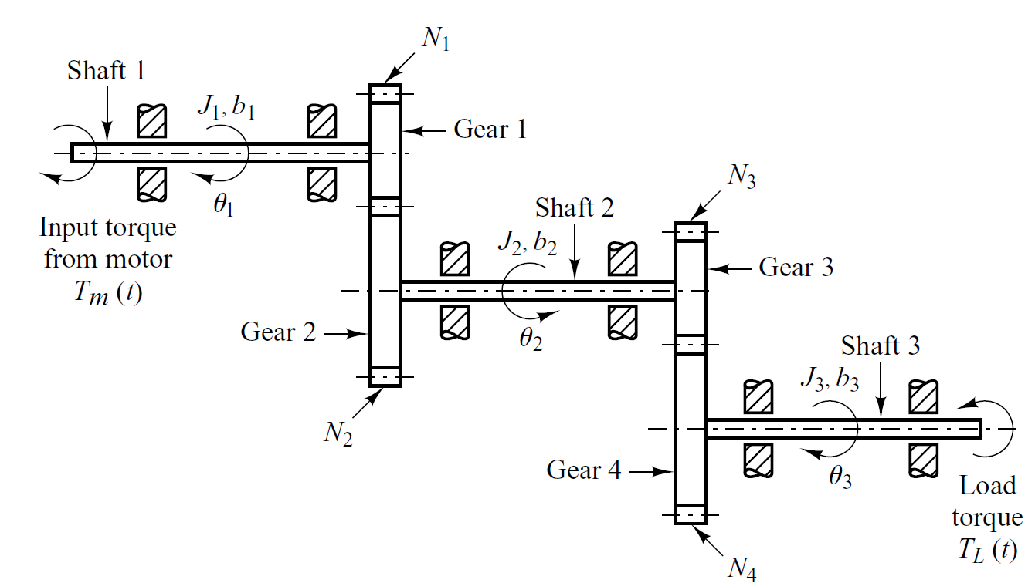

Home Work
Drive relation between applied torque $T_{m}(t)$ and load torque $T_{L}(t)$ for four gears connected together.

Slide 63
End of Lecture-2
To download this lecture visit
http://imtiazhussainkalwar.weebly.com/

