Slide 1


Digital Signal Processing (EE-332)
Lecture-2
Discrete-Time Signals
Dr. Imtiaz Hussain
Associate Professor (Control Systems),
Department of Electrical Engineering
DHA Suffa University, Karachi, Pakistan
email: imtiaz.hussain@dsu.edu.pk
URL :http://imtiazhussainkalwar.weebly.com/
6th Semester (BE-EE-6A)

Slide 2
Lecture Outline
Discrete-Time Signals
  Basic Sequences and Sequence operations
Combining Sequences

Slide 3

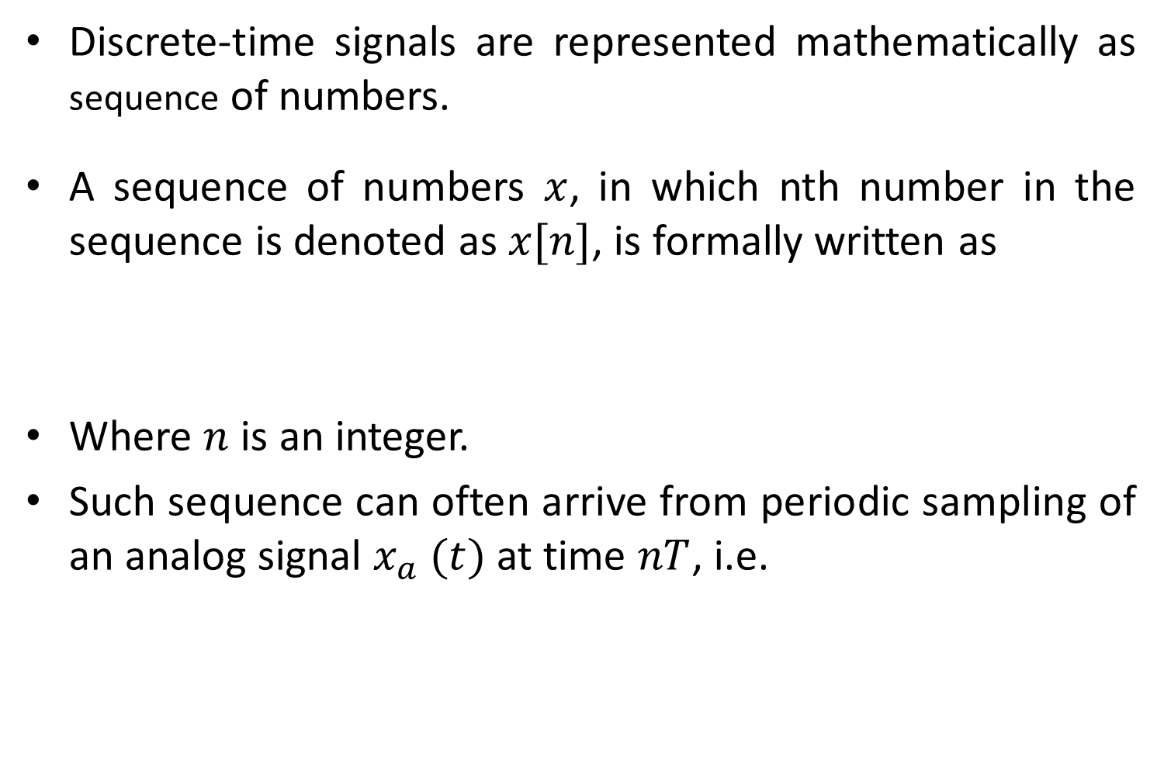
Discrete-Time Signals (Sequences)
Discrete-time signals are represented mathematically as sequence of numbers.
A sequence of numbers $x$, in which nth number in the sequence is denoted as $x[n]$, is formally written as
Where $n$ is an integer.
Such sequence can often arrive from periodic sampling of an analog signal $x_{a} (t)$ at time $nT$, i.e.
$$x=\left\{x[n]\right\}, −∞<n<∞$$
$$x[n]=x_{a}(nT), −∞<n<∞$$

Slide 4

Discrete-Time Signals (Sequences)
$$x[n]=x_{a}(nT), −∞<n<∞$$
The quantity $T$ is called the sampling period, and it is reciprocal to sampling frequency.
Discrete-time signals (i.e. sequences) are often depicted graphically as

Slide 5
Discrete-Time Signals (Sequences)
A segment of a speech signal corresponding to acoustic pressure variation as function of time is shown below
Following figure shows sequence of samples of this speech signal.

Slide 6
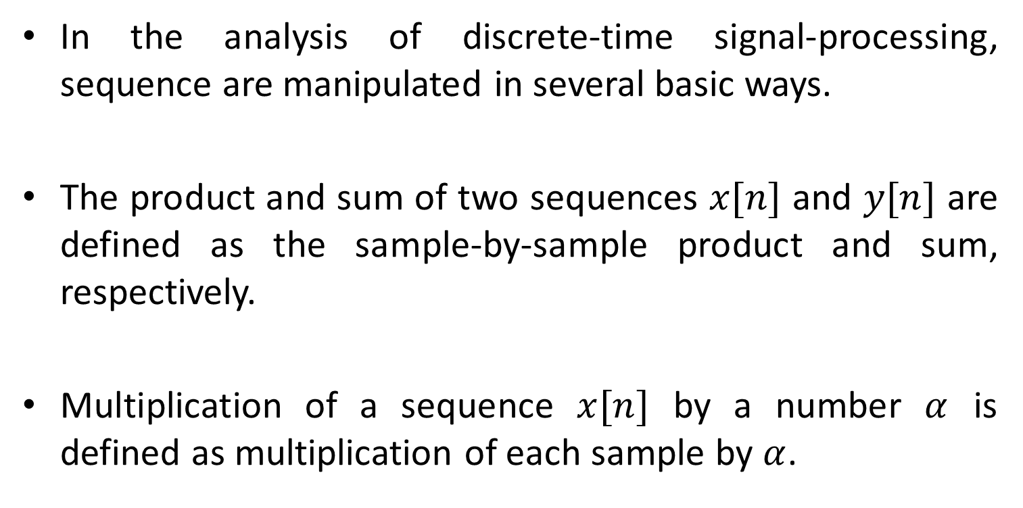
Basic Sequences and Sequence operations
In the analysis of discrete-time signal-processing, sequence are manipulated in several basic ways.
The product and sum of two sequences $x[n]$ and $y[n]$ are defined as the sample-by-sample product and sum, respectively.
Multiplication of a sequence $x[n]$ by a number $α$ is defined as multiplication of each sample by $α$.

Slide 7


Basic Sequences and Sequence operations
A sequence $y[n]$ is said to be a delayed or shifted version of a sequence $x[n]$ if
Where $n_{o}$ is an integer
$$y\left[n\right]=x[n−n_{o}]$$

Slide 8
Basic Sequences (Unit-sample sequence)
Unit-sample sequence
Unit-sample sequence is often referred to as discrete-time impulse or simply an impulse.

Slide 9

Basic Sequences (Unit-sample sequence)
One of the important aspect of the impulse sequence is that an arbitrary sequence can be represented as sum of scaled, delayed impulses.
Sequence $p\left[n\right]$ can be expressed as

Slide 10
Basic Sequences (Unit-sample sequence)
More generally any sequence can be expressed as

Slide 11
Basic Sequences (Unit Step sequence)
The unit step sequence is shown in following figure

Slide 12

Basic Sequences (Unit Step sequence)
An alternative representation of unit step in terms of impulse is obtained as
$$u\left[n\right]=\sum_{k=0}^{n}{δ[n−k]}$$

Slide 13
Basic Sequences (Unit Step sequence)
Conversely, the unit impulse sequence can be expressed as the first backward difference of the unit step sequence.

Slide 14

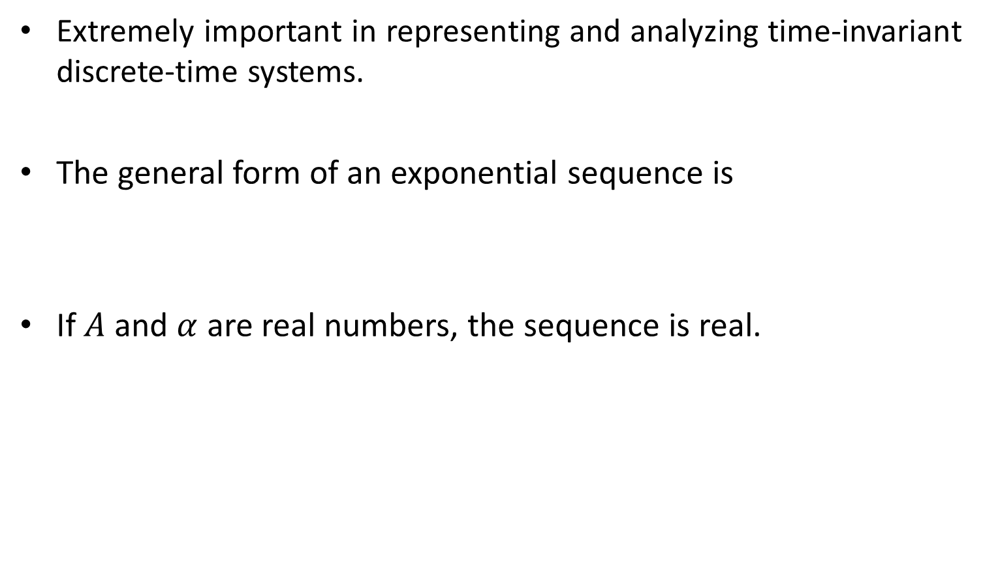
Basic Sequences (Exponential sequence)
Extremely important in representing and analyzing time-invariant discrete-time systems.
The general form of an exponential sequence is
If $A$ and $α$ are real numbers, the sequence is real.
$$x\left[n\right]=A{α }^{n}$$

Slide 15



Basic Sequences (Exponential sequence)
If $0<α<1$ and $A>0$, then sequence values are positive and decrease with increasing $n$.
$$x\left[n\right]=A{α }^{n}$$
$α$=0.5, A=1

Slide 16


Basic Sequences (Exponential sequence)
If $α>1$ and $A>0$, then sequence values are positive and increase with increasing $n$.
$$x\left[n\right]=A{α }^{n}$$
$α$=2, A=1

Slide 17


Basic Sequences (Exponential sequence)
If $α<0$ and $A>0$, then sequence values are positive and increase with increasing $n$.
$$x\left[n\right]=A{α }^{n}$$
$α$=-1.2, A=1

Slide 18


Basic Sequences (Exponential sequence)
If $α=1$ and $A>0$, then sequence values are positive and increase with increasing $n$.
$$x\left[n\right]=A{α }^{n}$$
$α$=1, A=1

Slide 19



Basic Sequences (Sinusoidal sequence)
Sinusoidal sequences are very important
A sinusoidal sequence has a general form
If $A$ and $∅$ as real numbers, the sequence is depicted below.
$$x\left[n\right]=A\cos\left(ω_{o}n+φ\right)$$
$ω_{o}=0.5, ∅$=0, A=3

Slide 20
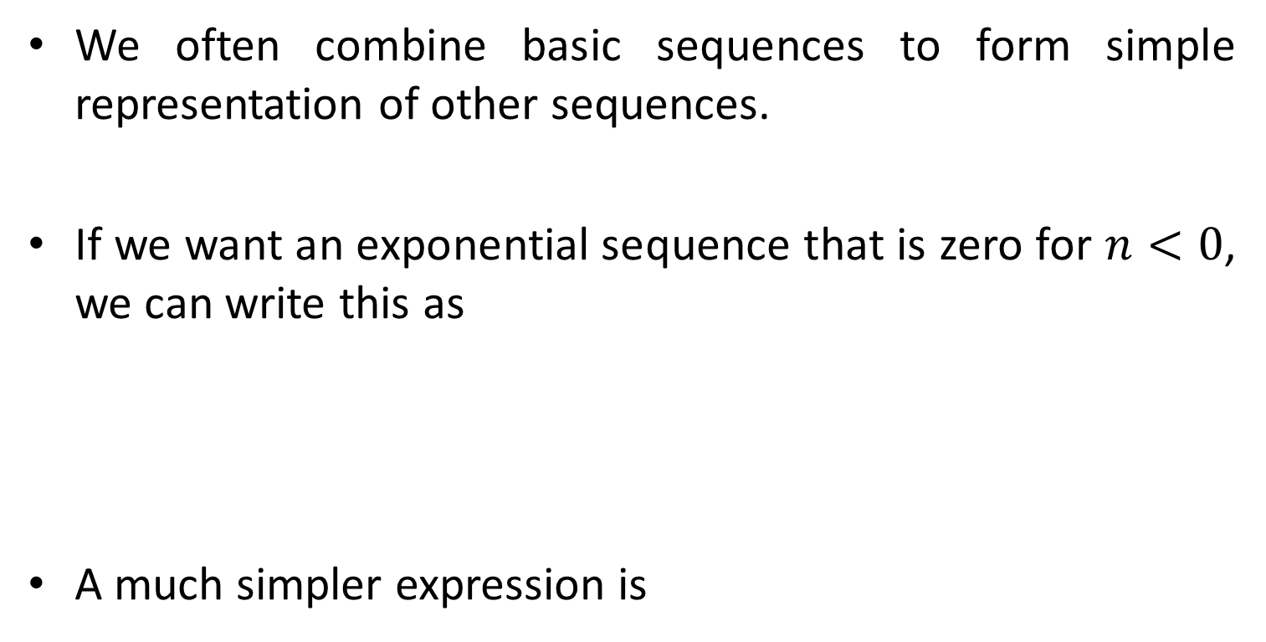

Combining Sequences
We often combine basic sequences to form simple representation of other sequences.
If we want an exponential sequence that is zero for $n<0$, we can write this as
A much simpler expression is
$$x\left[n\right]=A{α }^{n}u[n]$$

Slide 21

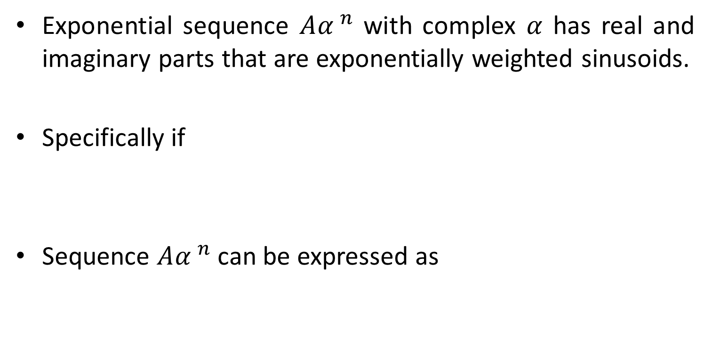

Complex Exponentials
Exponential sequence $A{α }^{n}$ with complex $α$ has real and imaginary parts that are exponentially weighted sinusoids.
Specifically if
Sequence $A{α }^{n}$ can be expressed as
$$α=\left|α\right|{ \text{e}}^{jω_{o}}$$
$$A=\left|A\right|{ \text{e}}^{j∅}$$
$$x\left[n\right]=A{α }^{n}=\left|A\right|{ \text{e}}^{j∅}{ {\left|α\right|}^{n}\text{e}}^{jω_{o}n}$$
$$x\left[n\right]=\left|A\right|{\left|α\right|}^{n}{ \text{e}}^{j{(ω}_{o}n+∅)}$$
$$x\left[n\right]=\left|A\right|{\left|α\right|}^{n}\cos{(ω_{o}n+∅)}\text{+}\left|A\right|{\left|α\right|}^{n}\text{j}\sin{(ω_{o}n+∅)}$$

Slide 22



Complex Exponentials
$$x\left[n\right]=\left|A\right|{\left|α\right|}^{n}\cos{{(ω}_{o}n+∅)}\text{+}\left|A\right|{\left|α\right|}^{n}\text{j}\sin{(ω_{o}n+∅)}$$
The sequence oscillates with an exponentially growing envelope if $\left|α\right|>1$ and with exponentially decaying envelope if $\left|α\right|<1$.
$$\left|α\right|>1$$
$$\left|α\right|<1$$

Slide 23


Complex Exponentials
When $\left|α\right|=1$ the sequence is referred to as complex exponential sequence and has form.
$$x\left[n\right]=\left|A\right|\cos{({(ω}_{o}n+∅)}\text{+}\left|A\right|\text{j}\sin{(ω_{o}n+∅)}$$
$$\left|α\right|=1$$

Slide 24
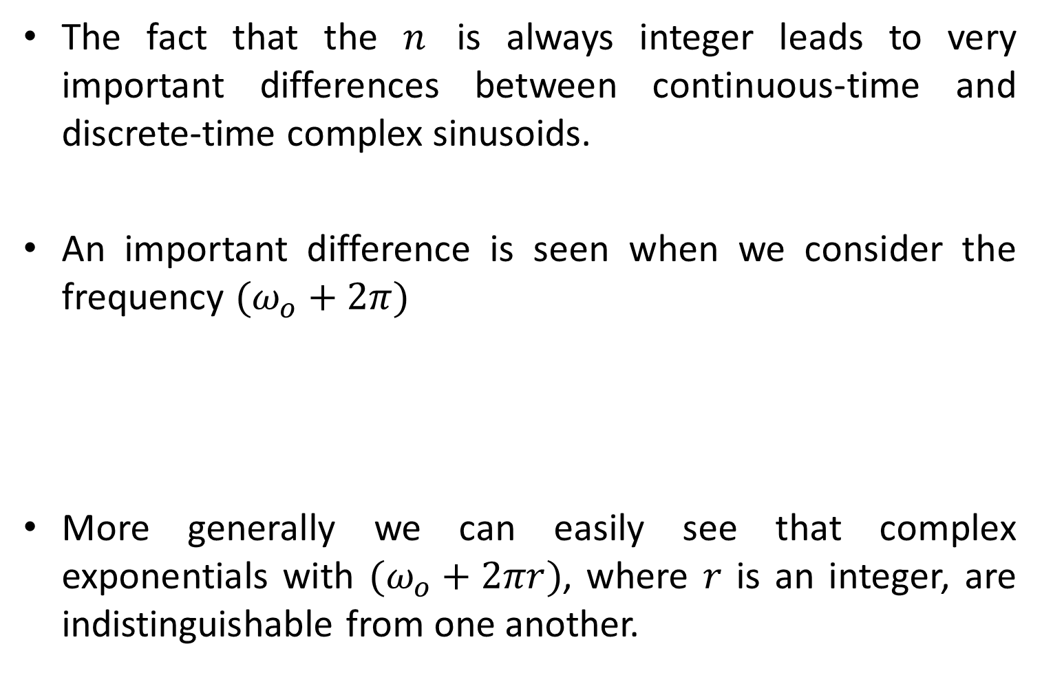
CT vs DT Sinusoids
The fact that the $n$ is always integer leads to very important differences between continuous-time and discrete-time complex sinusoids.
An important difference is seen when we consider the frequency $(ω_{o}+2π)$
More generally we can easily see that complex exponentials with $(ω_{o}+2πr)$, where $r$ is an integer, are indistinguishable from one another.
$$x\left[n\right]=A{ \text{e}}^{j{(ω}_{o}+2π)n}$$
$$x\left[n\right]=A{ \text{e}}^{jω_{o}n}$$

Slide 25



CT and DT Sinusoids
It can be easily verified as
$$x\left[n\right]=A\cos{[\left(ω_{o}+2πr\right)n+∅}\text{]}$$
$$x\left[n\right]=A\cos\left(ω_{o}n+∅\right)$$
$$2\cos{[\left(0.3\right)n+∅}\text{]}$$
$$2\cos{[\left(0.3+2π\right)n+∅}\text{]}$$
$$2\cos{[\left(0.3+4π\right)n+∅}\text{]}$$

Slide 26




CT and DT Sinusoids
Therefore, when discussing complex exponentials of the form $A{ \text{e}}^{jω_{o}n}$ or real sinusoidal signals of the form $A\cos\left(ω_{o}n+∅\right)$ we will consider only frequencies in an interval of length $2π$, such as, $−π<ω_{o}≤π$ or $0≤ω_{o}<2π$.
$$2\cos{[3t+∅}\text{]}$$
$$2\cos{[\left(3+2π\right)t+∅}\text{]}$$
$$2\cos{[\left(3+4π\right)t+∅}\text{]}$$

Slide 27

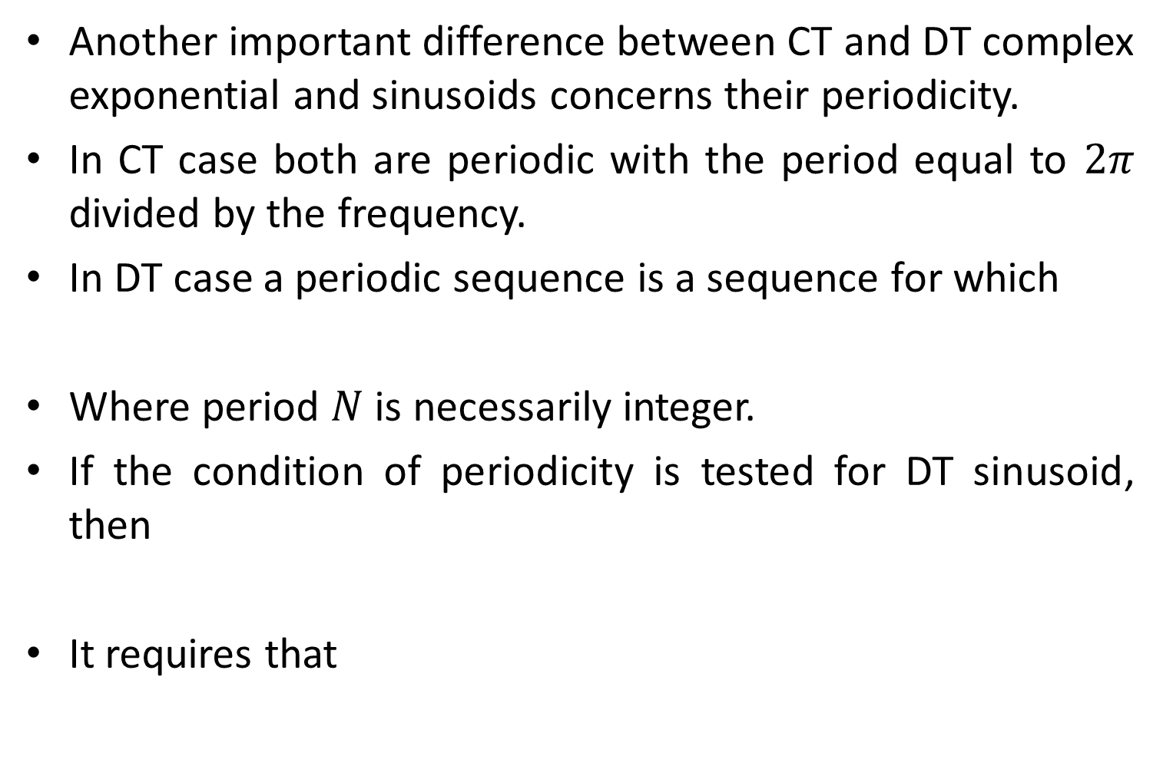


CT and DT Sinusoids
Another important difference between CT and DT complex exponential and sinusoids concerns their periodicity.
In CT case both are periodic with the period equal to $2π$ divided by the frequency.
In DT case a periodic sequence is a sequence for which
Where period $N$ is necessarily integer.
If the condition of periodicity is tested for DT sinusoid, then
It requires that
$$x\left[n\right]=x\left[n+N\right] for all n$$
$$A\cos\left(ω_{o}n+∅\right)=A\cos\left(ω_{o}n+ω_{o}N+∅\right)$$
$$ω_{o}N=2πk$$
Where $k$ is an integer

Slide 28



CT and DT Sinusoids
$$ω_{o}N=2πk$$
Where $k$ is an integer
Therefore complex exponential and sinusoidal sequences are not necessarily periodic in $n$ with period $\frac{2π}{ω_{o}}$.

Slide 29

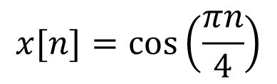




Periodic and Aperiodic DT Sinusoids
Consider following signal
The signal has period of
If $x[n]$ is periodic with period N=8 then
$$x[n]=cos\left(\frac{πn}{4}\right)$$
$$N=\frac{2π}{ω_{o}}=\frac{2π}{π/4}$$
$$N=8$$
$$x[n]=x[n+8]$$
$$x[n+8]=cos[π\left(n+8\right)/4]$$

Slide 30
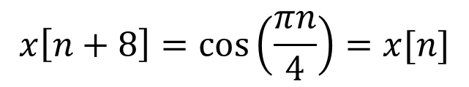

Periodic and Aperiodic DT Sinusoids
$$x[n+8]=cos[π\left(n+8\right)/4]$$
$$x\left[n+8\right]=cos\left(\frac{πn}{4}\right)=x[n]$$

Slide 31
Basic Operations on Signals
(a) Operations performed on dependent
variables
1. Amplitude Scaling:
let x(t) denote a continuous time signal. The signal y(t) resulting from amplitude scaling applied to x(t) is defined by
y(t) = cx(t)
where c is the scale factor.
In a similar manner to the above equation, for discrete time signals we write
y[nT] = cx[nT]
2x(t)
x(t)

Slide 32
2. Addition:
Let x₁ [n] and x₂[n] denote a pair of discrete time signals. The signal y[n] obtained by the addition of x₁[n] + x₂[n] is defined as
y[n] = x₁[n] + x₂[n]
Example: audio mixer
3. Multiplication:
Let x₁[n] and x₂[n] denote a pair of discrete-time signals. The signal y[n] resulting from the multiplication of the x₁[n] and x₂[n] is defined by
y[n] = x₁[n].x₂[n]
Example: AM Radio Signal

Slide 33
(b) Operations performed on independent variable
Time Scaling:
Let y(t) is a compressed version of x(t). The signal y(t) obtained by scaling the independent variable, time t, by a factor k is defined by
y(t) = x(kt)
  if k > 1, the signal y(t) is a compressed version of x(t).
  If, on the other hand, 0 < k < 1, the signal y(t) is an expanded (stretched) version of x(t).

Slide 34
Time scaling of discrete time systems
10
x[n]
5
0
-3
-2
-1
0
1
2
3
10
x[0.5n]
5
0
-1.5
-1
-0.5
0
0.5
1
1.5
5
x[2n]
0
-6
-4
-2
0
2
4
6
n

Slide 35
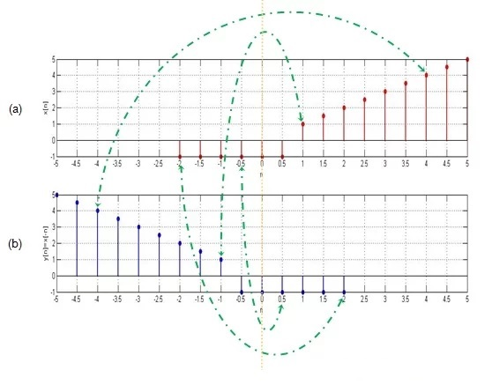
Time Reversal
This operation reflects the signal about t = 0 and thus reverses the signal on the time scale.

Slide 36
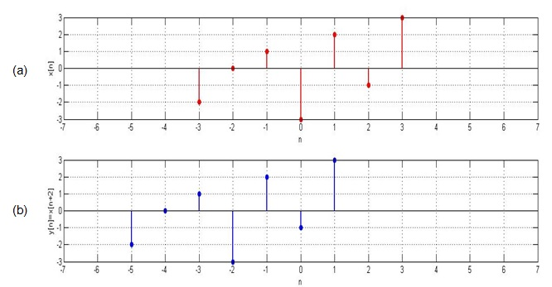
Time Shift
A signal may be shifted in time by replacing the independent variable n by n-k, where k is an integer. If k is a positive integer, the time shift results in a delay of the signal by k units of time. If k is a negative integer, the time shift results in an advance of the signal by |k| units in time.

Slide 37
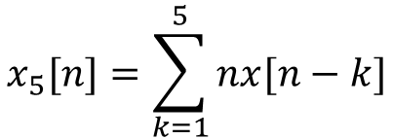
Examples Problems
For the following sequence
Generate and plot the samples of following sequences.
$$x\left[n\right]=\left\{1, −2, 4, 6, −5, 8, 10\right\}$$
(a)
$$x_{1}\left[n\right]=3x\left[n+2\right]+x\left[n−4\right]−2x[n]$$
(b)
$$x_{2}\left[n\right]=5x\left[5+n\right]+4x\left[n+4\right]+3x[n]$$
(c)
$$x_{3}\left[n\right]=x\left[n+4\right]x\left[n−1\right]+x[2−n]x[n]$$
(d)
$$x_{4}\left[n\right]=2e^{0.5n}x\left[n\right]+\cos\left(0.1πn\right)x\left[n+2\right], −10≤n≤10$$
$$x_{5}[n]=\sum_{k=1}^{5}{nx[n−k]}$$
(e)

Slide 38


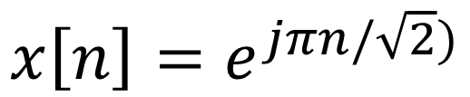
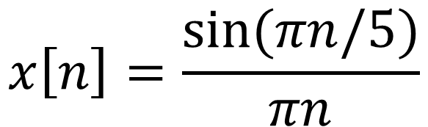
Examples Problems
Determine whether each if the following signals is periodic. If the signal is periodic, state its period.
$$x\left[n\right]=e^{j(πn/6)}$$
(a)
(b)
$$x\left[n\right]=e^{j(3πn/4)}$$
$$x\left[n\right]=\frac{\sin{(πn/5)}}{πn}$$
(c)
$$x\left[n\right]=e^{jπn/\sqrt{2})}$$
(d)

Slide 39

Practice Problems
Given that X[n] = $\frac{n}{1+n^{4}}$ Plot the following, considering T as 1:
X[1.5nT]
X[0.8nT]
X[-n]
X[n-3]
X[n+2]
Also plot the same for X[n] = $\frac{4n}{2+n^{2}}$
Plot : X[n] = u[n-2] – u[n-4]

Slide 40
End of Lecture-2
To download this lecture visit
http://imtiazhussainkalwar.weebly.com/

