Slide 1


Signals & Systems (EE-2043)
Lecture-1
Introduction
Dr. Imtiaz Hussain
Associate Professor (Control Systems),
Department of Electrical Engineering
DHA Suffa University, Karachi, Pakistan
email: imtiaz.hussain@dsu.edu.pk
URL :http://imtiazhussainkalwar.weebly.com/
Spring 2020
4th Semester (BE-EE-4A)

Slide 2
Lecture Outline
Scope
The course
Course contents
Recommended books
Course structure
Assessments breakdown
Before we start…
Introduction to signals and systems
Signal Types

Slide 3
Scope
The concepts of signals and systems arise in diverse areas of science and technology
  Communications
  Aeronautics and astronautics
  Circuit design
  Acoustics
  Seismology
  Biomedical engineering
  Energy generation and distribution systems
  Chemical process control
  Speech processing.
Although the physical nature of the signals and systems that arise in these various disciplines may be drastically different, they all have two very basic features in common.

Slide 4
The Course
Core course
First course in Telecommunication Engineering
A strong foundation for advanced courses
and research
What the course is about
  Analysis and processing of information
  System design for required processing
Mathematical & theoretical
  Calculus, Linear Algebra, Differential
Expectations
Extensive and tough

Slide 5
Course contents
Introduction to Signals and Systems
Sinusoids
Spectrum Representation
Analysis of Periodic Waveforms
Sampling and Aliasing
Filters
Convolution
Frequency response
Fourier Series and Transforms
Continuous-time & Discrete-time Systems

Slide 6
Books
Signal Processing First → Text book
by
James H. McClellan, Ronald W. Schafer,
Mark A. Yoder
Signals & Systems (Second Edition) → Reference book
by
Alan V. Oppenheim, Alan S. Willsky,
S. Hamid Nawab

Slide 7
Assessments
Quizzes 10%
Assignments 2%
Sessional 36%
Matlab 2%
Final Exam 50%

Slide 8
Signal
Any time-varying physical phenomenon that is intended to convey information is a signal.
  Examples of signals are the human voice, sign language, Morse code, traffic signals, voltages on telephone wires, electric fields emanating from radio or television transmitters and variations of light intensity in an optical fiber on a telephone or computer network.

Slide 9
Signal
  The Speech Signal
  The ECG Signal

Slide 10

Signal
  The image

Slide 11
Signal
It is the variation pattern that conveys the information, in a signal
Signal may exist in many forms like acoustic, image, video, electrical, heat & light signal

Slide 12
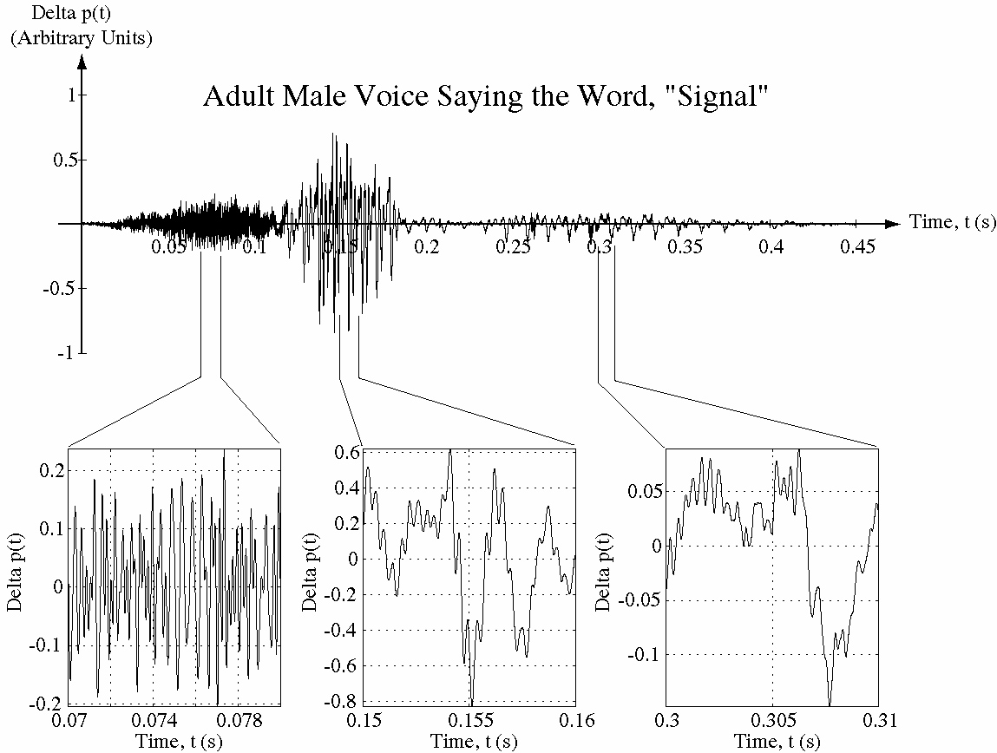
Recorded Sound as a Signal Example
“s” “i” “gn” “al”

Slide 13
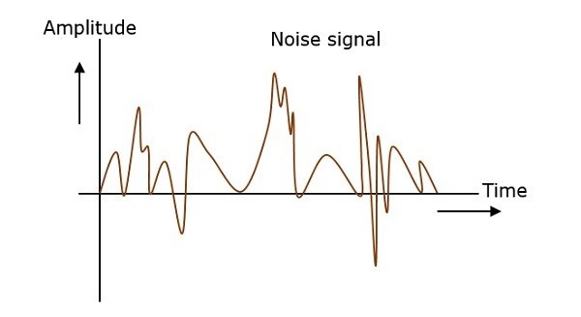
Noise
Noise is like a signal in that it is a time-varying physical phenomenon, but it usually does not carry useful information and is considered undesirable.

Slide 14
System
An entity that responds to a signal
Examples
  Circuit
input
system
output

Slide 15
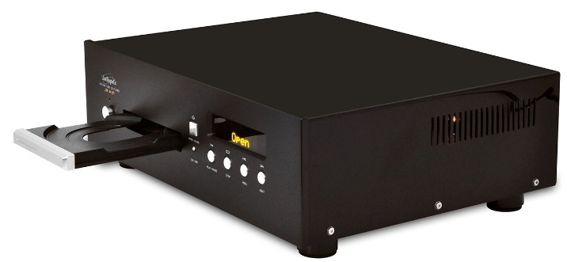
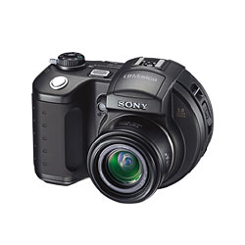

System
  The camera
  The Speech Recognition System
  The audio CD-player
Image
Identified

Slide 16
System
Block Diagram representation of a system
  Visual representation of a system
  Shows inter-relations of many signals involved in the implementation of a complex system
Look at everything around and try to identify the signals and systems !!
system
Input Signal
Output Signal

Slide 17
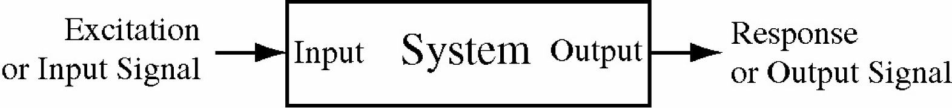
Signals and Systems Defined
A signal is any physical phenomenon which conveys information
Systems respond to signals and produce new signals
Excitation signals are applied at system inputs and response signals are produced at system outputs

Slide 18
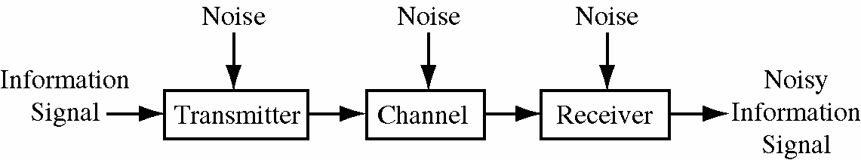
Communication System
A communication system has an information signal plus noise signals
This is an example of a system that consists of an interconnection of smaller systems

Slide 19
Signal Types
There are several broad classifications of signals: continuous-time, discrete-time, continuous-value, discrete-value, random and nonrandom.
All analog signals are continuous-time signals but not all continuous-time signals are analog signals

Slide 20
Continuous-time signals
A continuous-time signal is defined at every instant of time over some time interval.
Another common name for some continuous-time signals is analog signal, in which the variation of the signal with time is analogous (proportional) to some physical phenomenon.
Independent variable

Slide 21
Discrete-time signals
The value of signal exists only at discrete points in time.
Independent variable

Slide 22
Continuous-Time Discrete Value Signals

Slide 23
Notation
A continuous-time signal is represented by enclosing the independent variable (time) in parentheses ()
A discrete-time signal is represented by enclosing the independent variable (index) in square brackets []

Slide 24
Mathematical Representation
A signal can be represented as a function of one or more independent variables
Examples
t

Slide 25
Mathematical Representation
  The image is a function of two spatial variables

Slide 26
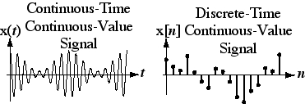
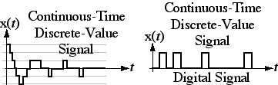
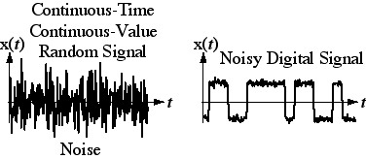
Signal Types

Slide 27
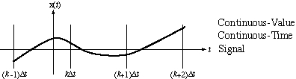
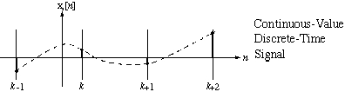
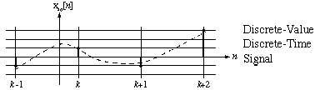
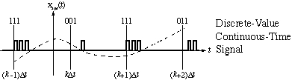
Conversions Between Signal Types
Sampling
Quantizing
Encoding

Slide 28
End of Lecture-1
To download this lecture visit
http://imtiazhussainkalwar.weebly.com/

