Slide 1
Modelling & Simulation of Semiconductor Devices
Lecture 1 & 2
Introduction to Modelling & Simulation

Slide 2
Systems
What is System?
  Components
  relationship
  objective

Slide 3
Systems
What is System
  A system is a set of components which are related by some form of interaction and which act together to achieve some objective or purpose
    Components are the individual parts or elements that collectively make up the system
    Relationships are the cause-effect dependencies between components
    Objective is the desired state or outcome which the system is attempting to achieve

Slide 4
Types of Systems
Static System: If a system does not change with time, it is called a static system.
Dynamic System: If a system changes with time, it is called a dynamic system.

Slide 5
Dynamic Systems
A system is said to be dynamic if its current output may depend on the past history as well as the present values of the input variables.
Mathematically,
Example: A moving mass
y
u
Model: Force=Mass x Acceleration
M

Slide 6
Ways to Study a System
System
Experiment with actual System
Experiment with a model of the System
Physical Model
Mathematical Model
Analytical Solution
Simulation
Frequency Domain
Time Domain
Hybrid Domain

Slide 7
Model
A model is a simplified representation or abstraction of reality.
Reality is generally too complex to copy exactly.
Much of the complexity is actually irrelevant in problem solving.

Slide 8
Types of Models
Model
Physical
Mathematical
Computer
Static
Dynamic
Static
Dynamic
Static
Dynamic
Notes:
8

Slide 9
What is Mathematical Model?
A set of mathematical equations (e.g., differential eqs.) that describes the input-output behavior of a system.
What is a model used for?
Simulation
Prediction/Forecasting
Prognostics/Diagnostics
Design/Performance Evaluation
Control System Design

Slide 10
Classification of Mathematical Models
Linear vs. Non-linear
Deterministic vs. Probabilistic (Stochastic)
Static vs. Dynamic
Discrete vs. Continuous
White box, black box and gray box

Slide 11
Black Box Model
When only input and output are known.
Internal dynamics are either too complex or unknown.
Easy to Model
Input
Output

Slide 12
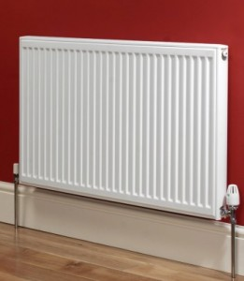
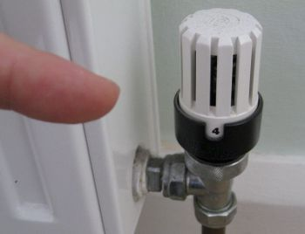
Black Box Model
Consider the example of a heat radiating system.

Slide 13
Black Box Model
Consider the example of a heat radiating system.
Valve Position | Room Temperature (ºC)
0 | 0
2 | 3
4 | 6
6 | 12
8 | 20
10 | 33

Slide 14
Grey Box Model
When input and output and some information about the internal dynamics of the system is known.
Easier than white box Modelling.
u(t)
y(t)
y[u(t), t]

Slide 15
White Box Model
When input and output and internal dynamics of the system is known.
One should know have complete knowledge of the system to derive a white box model.
u(t)
y(t)

Slide 16
Mathematical Modelling Basics
Mathematical model of a real world system is derived using a combination of physical laws and/or experimental means
Physical laws are used to determine the model structure (linear or nonlinear) and order.
The parameters of the model are often estimated and/or validated experimentally.
Mathematical model of a dynamic system can often be expressed as a system of differential (difference in the case of discrete-time systems) equations

Slide 17
Different Types of Lumped-Parameter Models
System Type
Model Type
Nonlinear
Input-output differential equation
Linear
State equations
Linear Time Invariant
Transfer function

Slide 18
Approach to dynamic systems
    Define the system and its components.
    Formulate the mathematical model and list the necessary assumptions.
    Write the differential equations describing the model.
    Solve the equations for the desired output variables.
    Examine the solutions and the assumptions.
    If necessary, reanalyze or redesign the system.
Notes:
18

Slide 19
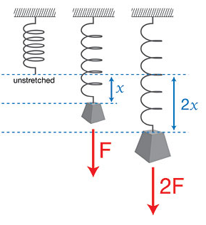
F_{spring}
The amount spring is stretched
spring constant
F_{spring}
F_{Spring} = -k∙x
x= -F_{Spring}/k
Hooke’s Law

Slide 20
Simulation
Computer simulation is the discipline of designing a model of an actual or theoretical physical system, executing the model on a digital computer, and analyzing the execution output.
Simulation embodies the principle of ``learning by doing'' --- to learn about the system we must first build a model of some sort and then operate the model.

Slide 21
Advantages to Simulation
Can be used to study existing systems without disrupting the ongoing operations.
Proposed systems can be “tested” before committing resources.
Allows us to control time.
Allows us to gain insight into which variables are most important to system performance.
Notes:
21

Slide 22
Disadvantages to Simulation
Model building is an art as well as a science. The quality of the analysis depends on the quality of the model and the skill of the modeler.
Simulation results are sometimes hard to interpret.
Simulation analysis can be time consuming and expensive.
Should not be used when an analytical method would provide for quicker results.
Notes:
22

Slide 23
Model Development: A case study
LECTURE – II

Slide 24
An Example of Model Building (continued)
Problem
  You are the owner of a new take-out restaurant, McBurgers, currently under construction
  You want to determine the proper number of checkout stations needed
  You decide to build a model of McBurgers to determine the optimal number of servers

Slide 25
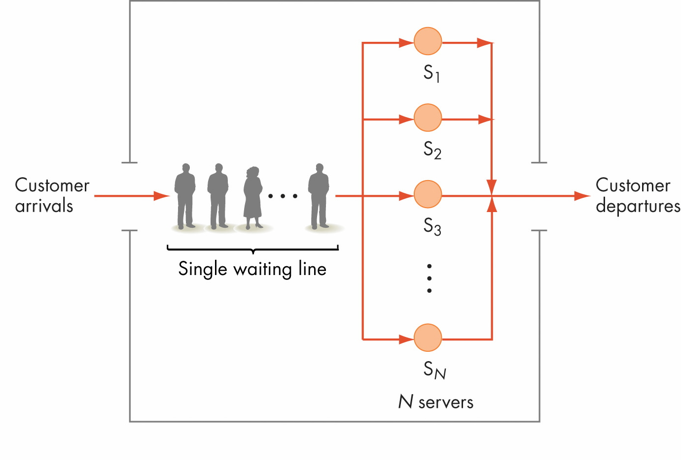
Figure 12.3
System to Be Modeled

Slide 26
An Example of Model Building (continued)
First: Identify the events that can change the system
  A new customer arriving
  An existing customer departing after receiving food and paying
Next: Develop an algorithm for each event
  Should describe exactly what happens to the system when this event occurs

Slide 27
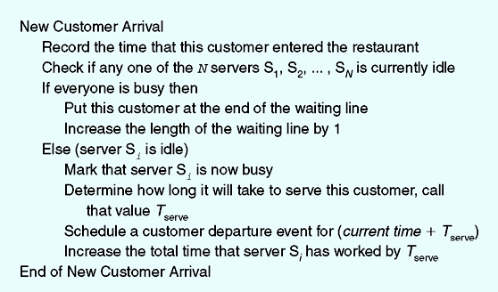
Figure 12.4
Algorithm for New Customer Arrival

Slide 28
An Example of Model Building (continued)
The algorithm for the new customer arrival event uses a statistical distribution (Figure 12.5) to determine the time required to service the customer
Can model the statistical distribution of customer service time using the algorithm in Figure 12.6

Slide 29
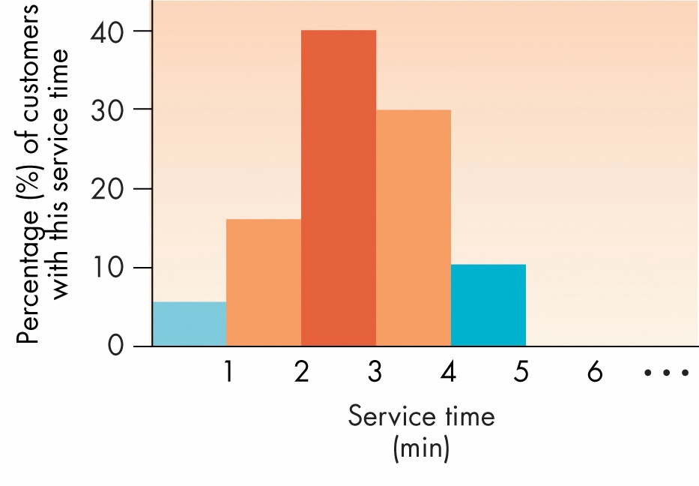
Figure 12.5
Statistical Distribution of Customer Service Time

Slide 30
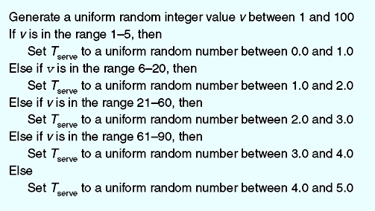
Figure 12.6
Algorithm for Generating Random Numbers That Follow the Distribution Given in Figure 12.5

Slide 31
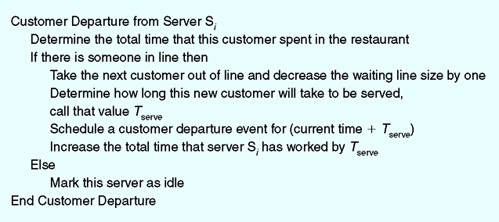
Figure 12.7
Algorithm for Customer Departure Event

Slide 32
An Example of Model Building (continued)
Must initialize parameters to the model
Model must collect data that accurately measures performance of the McBurgers restaurant

Slide 33
An Example of Model Building (continued)
When simulation is ready, the computer will
  Run the simulation
  Process all M customers
  Print out the results

Slide 34
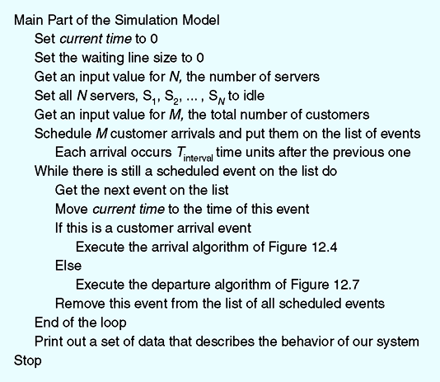
Figure 12.8
The Main Algorithm of Our Simulation Model

Slide 35
Running the Model and Visualizing Results
Scientific visualization
  Visualizing data in a way that highlights its important characteristics and simplifies its interpretation
  An important part of computational modeling
  Different from computer graphics

Slide 36
Running the Model and Visualizing Results (continued)
Scientific visualization is concerned with
  Data extraction: Determine which data values are important to display and which are not
  Data manipulation: Convert the data to other forms or to different units to enhance display

Slide 37
Running the Model and Visualizing Results (continued)
Output of a computer model can be represented visually using
  A two-dimensional graph
  A three-dimensional image
Visual representation of data helps identify important features of the model’s output

Slide 38
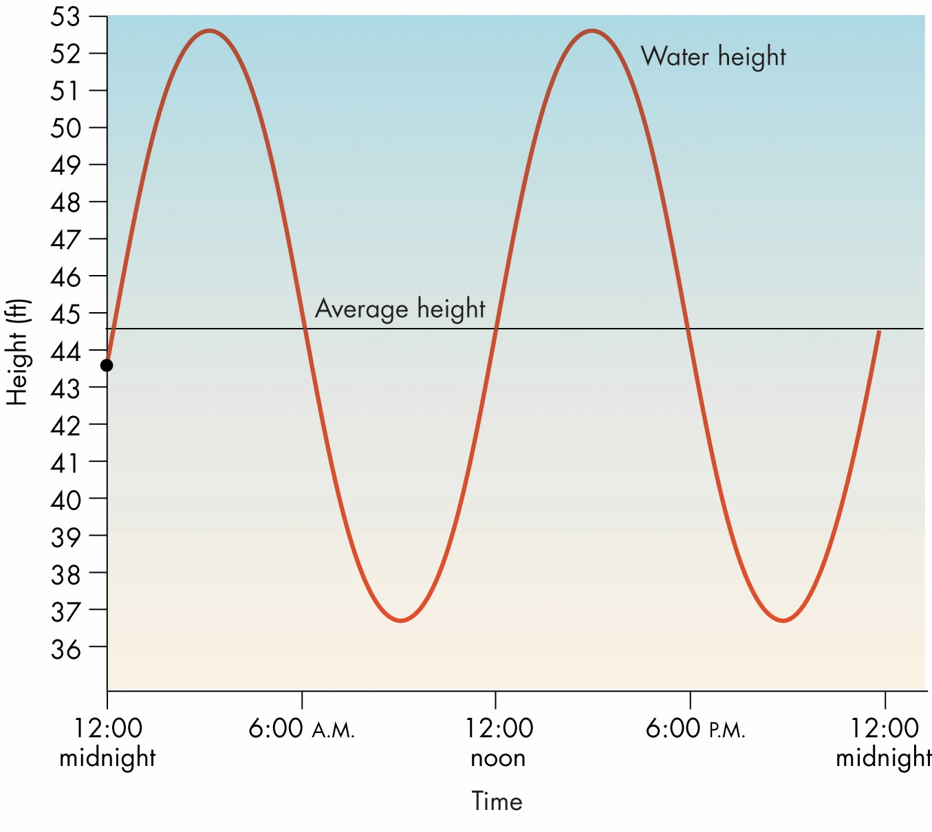
Figure 12.9
Using a Two-Dimensional Graph to Display Output

Slide 39
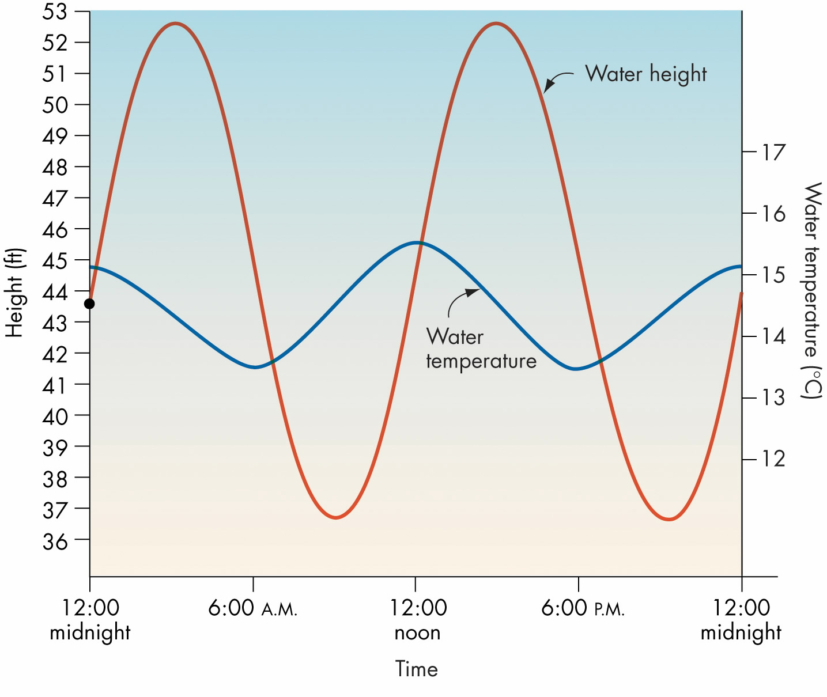
Figure 12.10: Using a Two-Dimensional Graph to Display and Compare Two Data Values

Slide 40
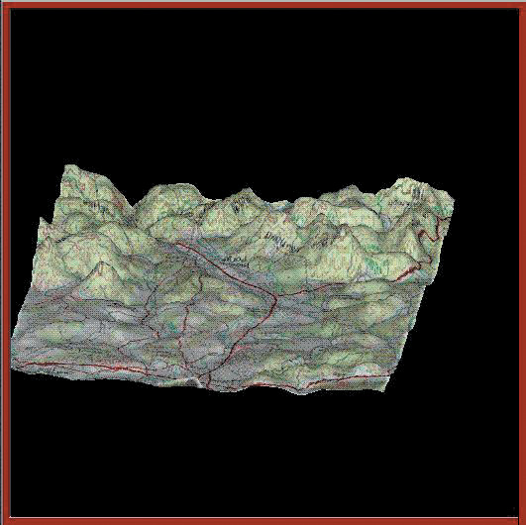
Figure 12.11
Three-Dimensional Image of a Region of the Earth’s Surface

Slide 41
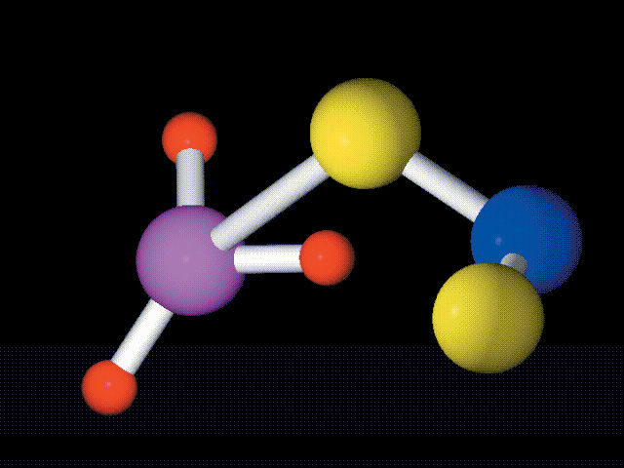
Figure 12.12
Three-Dimensional Model of a Methyl Nitrite Molecule

Slide 42
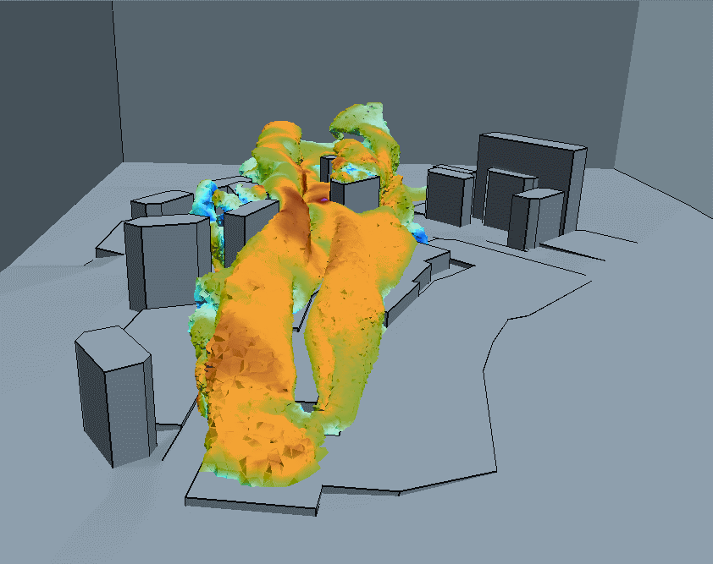
Figure 12.13
Visualization of Gas Dispersion

Slide 43
Running the Model and Visualizing Results (continued)
Image animation
  One of the most powerful and useful forms of visualization
  Shows how model’s output changes over time
  Created using many images, each showing system state at a slightly later point in time

Slide 44
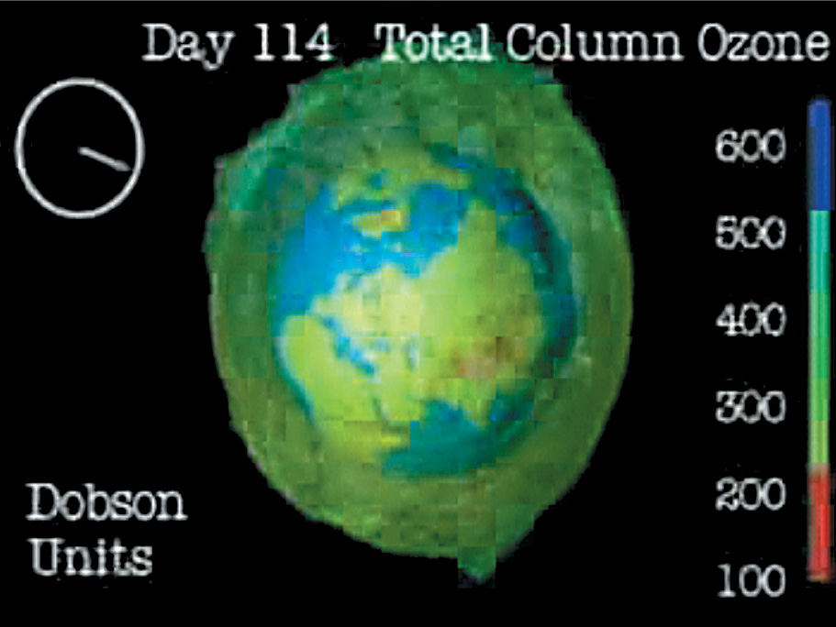
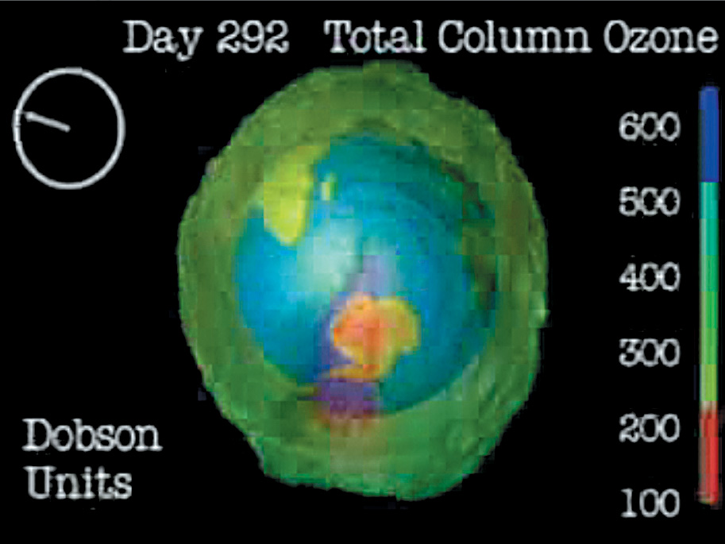
Figure 12.14
Use of Animation to Model Ozone Layers in the Atmosphere

Slide 45
End of Lectures 1-2
To download this lecture visit
http://imtiazhussainkalwar.weebly.com/

