Slide 1
Modeling & Simulation of Mechanical Systems in MATLAB
Advanced Control Systems
Dr. Imtiaz Hussain
email: imtiaz.hussain@faculty.muet.edu.pk
URL :http://imtiazhussainkalwar.weebly.com/

Slide 2
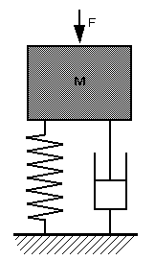
Example-1
In this example, we are going to model a simple mechanical system and observe its behavior under various conditions

Slide 3
Transfer Function Model
Differential Equation of the systems is
Transfer function is obtained as
$$F\left(t\right)=m\ddot{x}+kx+b\dot{s}$$
$$x(t)$$
$$\frac{X(s)}{F(s)}=\frac{1}{ms^{2}+bs+k}$$
$$k$$
$$b$$

Slide 4
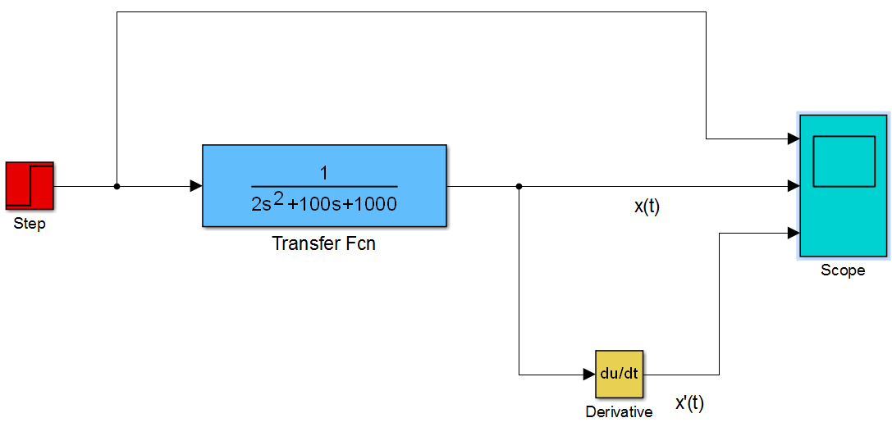
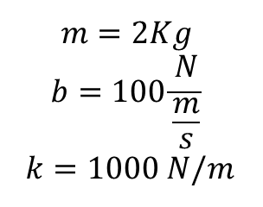
Transfer Function Model
$$m=2Kg$$
$$b=100\frac{N}{\frac{m}{s}}$$
$$k=1000 N/m$$

Slide 5
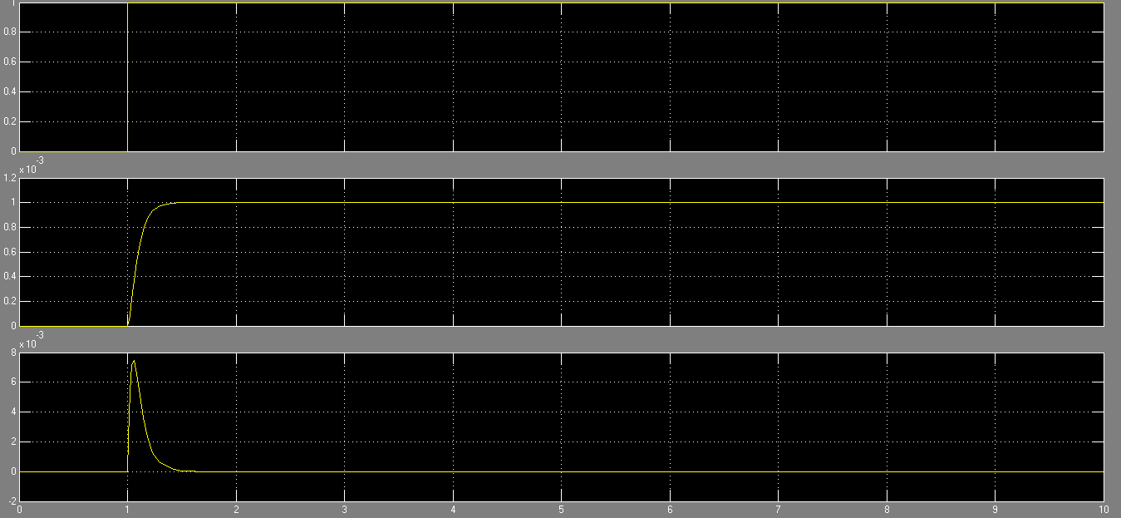
Transfer Function Model
Input Force
Displacement x(t)
Velocity v(t)

Slide 6
Differential Equation Model
Differential Equation of the systems is
$$x(t)$$
$$F\left(t\right)=m\ddot{x}+kx+b\dot{s}$$
$$k$$
$$b$$

Slide 7
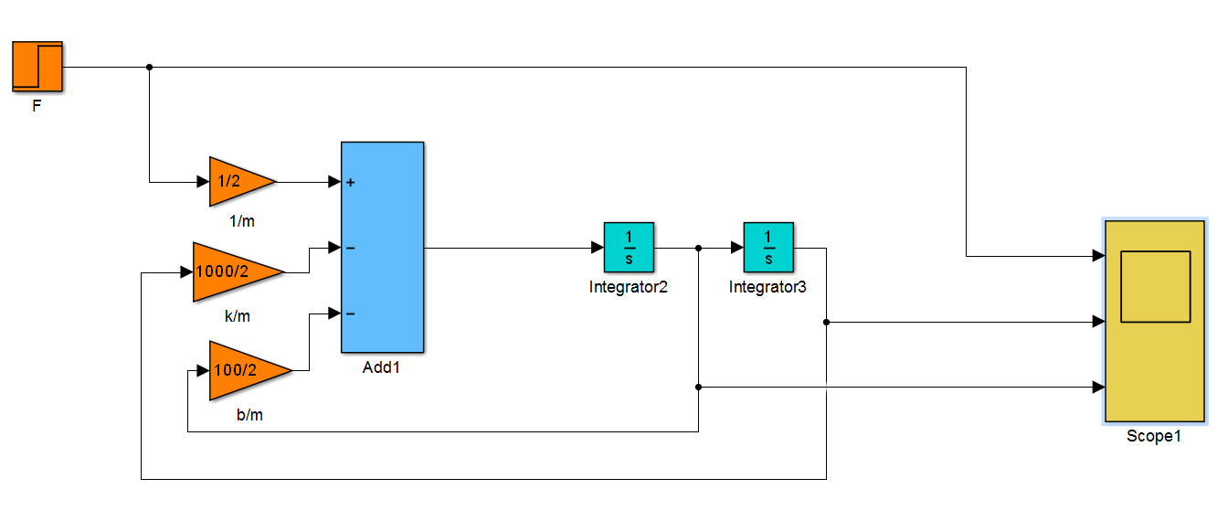
Differential Equation Model

Slide 8
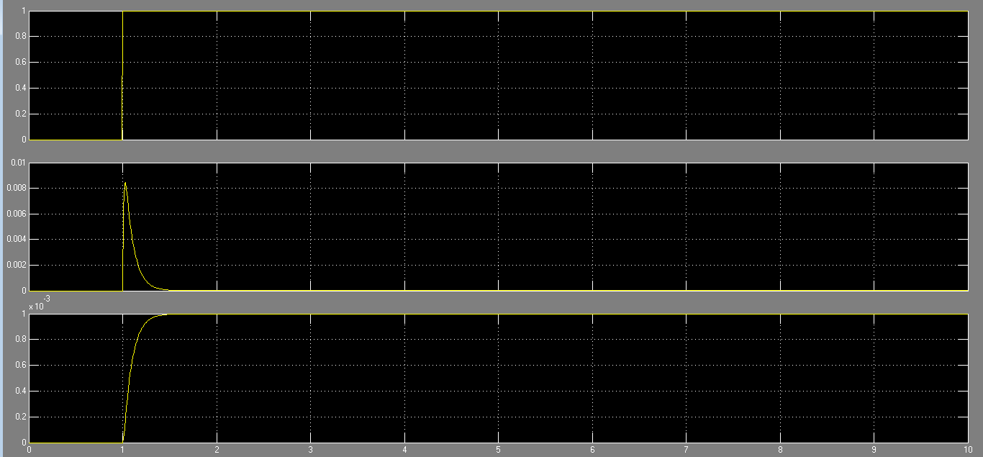
Differential Equation Model

Slide 9
Simscape Model
Recommended Version Matlab 2014
To create an equivalent Simscape model, follow these steps:
Open the Simscape > Foundation Library > Mechanical > Translational Elements library.
Drag the Mass, Translational Spring, Translational Damper, and two Mechanical Translational Reference blocks into the model window.
$$x(t)$$
$$k$$
$$b$$

Slide 10
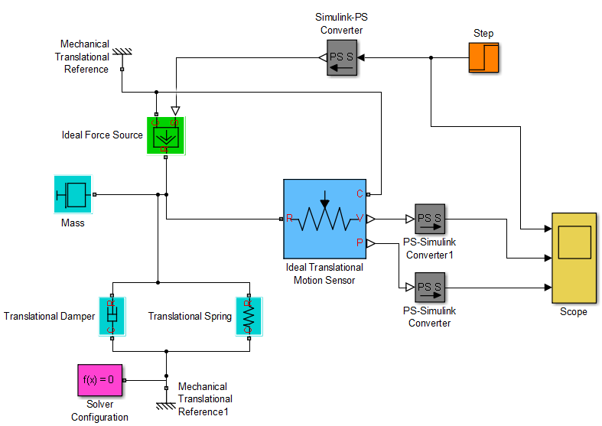
Simscape Model

Slide 11
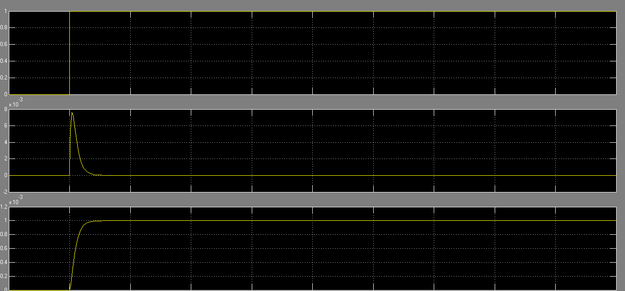
Simscape Model

Slide 12
Exercise-1
Create Simscape model of the following system.
Car Body
Bogie-1
Bogie-2
Secondary
Suspension
Bogie
Frame
Wheelsets
Primary
Suspension

