Slide 1
Advanced FPGA Based System Design
Lecture-3-4
Logic Implementation
By: Dr Imtiaz Hussain
imtiaz.hussain@faculty.muet.edu.pk

Slide 2
Logic Implementation
General Purpose Integrated Circuits
Special Purpose ICs
Programmable Logic Devices (PLDs)

Slide 3
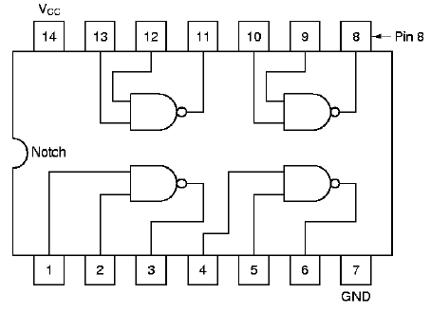
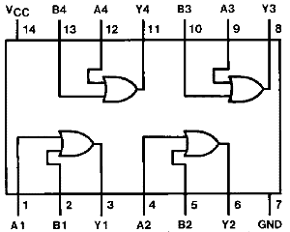
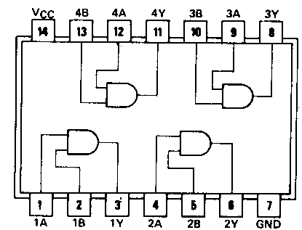
Logic Implementation
General Purpose Integrated Circuits
7400
7432
7408

Slide 4
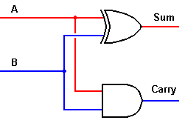
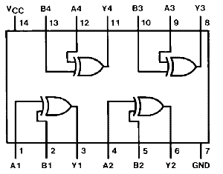
Logic Implementation
1-bit Adder using general purpose ICs
A | B | Q | CO
0 | 0 | 0 | 0
0 | 1 | 1 | 0
1 | 0 | 1 | 0
1 | 1 | 0 | 1
7408
7402

Slide 5
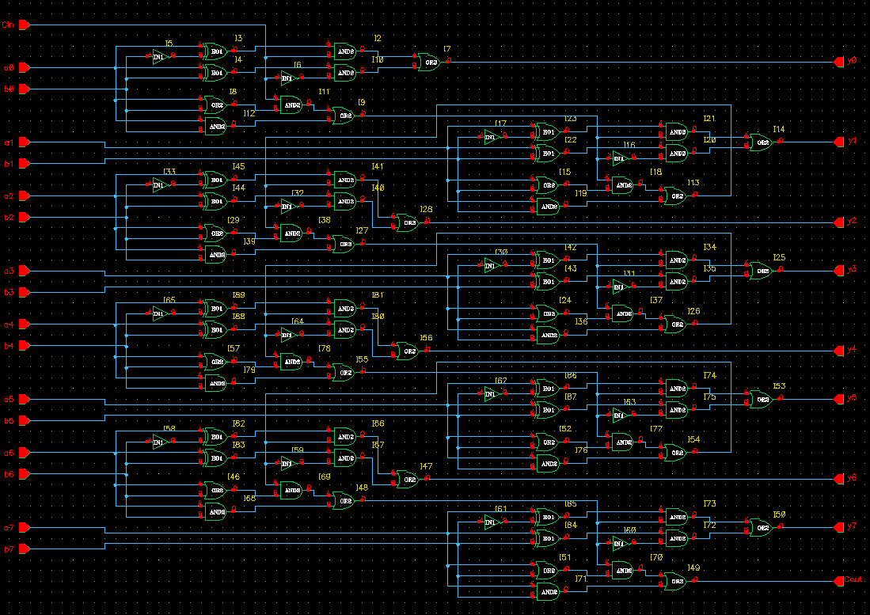
Logic Implementation
8-Bit adder using General purpose ICs

Slide 6
Logic Implementation
8-bit adder require
  16 XOR gates (Four 74266 Ics)
  29 AND gates (Eight 7408 ICs)
  24 OR gates (Six 7432 ICs)
  16 NOT gates (Four 7404 Ics)
And plenty of wires e.t.c

Slide 7
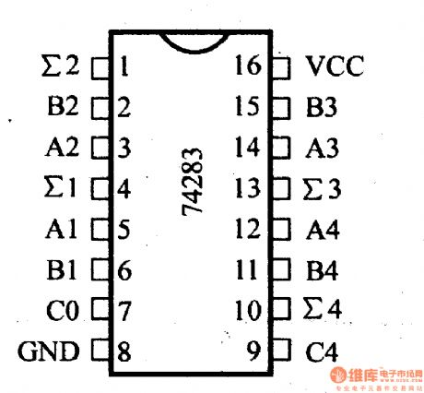
Logic Implementation
Special purpose ICs are used to solve this problem

Slide 8
Why Make ICs
Integration improves
  size
  speed
  power
Integration reduce manufacturing costs
  (almost) no manual assembly

Slide 9
IC Evolution
SSI – Small Scale Integration (early 1970s)
  contained 1 – 10 logic gates
MSI – Medium Scale Integration
  logic functions, counters
LSI – Large Scale Integration
  first microprocessors on the chip
VLSI – Very Large Scale Integration
  now offers 64-bit microprocessors,
  complete with cache memory (L1 and often L2),
  floating-point arithmetic unit(s), etc.

Slide 10
Moore’s Law
Gordon Moore: co-founder of Intel
Predicted that the number of transistors per chip would grow exponentially (double every 18 months)
Exponential improvement in technology is a natural trend:
  e.g. Steam Engines - Dynamo - Automobile

Slide 11
Moore’s Law

Slide 12
The Cost of Fabrication
Current cost $2 - 3 billion
Typical fab line occupies 1 city block, employees a few hundred employees
Most profitable period is first 18 months to 2 years
For large volume IC’s packaging and testing is largest cost
For low volume IC’s, design costs may swamp manufacturing costs

Slide 13
Programmable Logic Devices
PLDs
  Programmable Logic Devices (PLD)
    General purpose chip for implementing circuits
    Can be customized using programmable switches
  Main types of PLDs
    PLA
    PAL
    ROM
    CPLD
    FPGA
  Custom chips: standard cells, sea of gates

Slide 14
PLD Advantages
Short design time
Less expensive at low volume
Nonrecurring engineering cost
PLD
ASIC
Cost
Volume

Slide 15
PLD Categorization
PLD
SPLD
HCPLD
Simple PLD
High Capacity PLD
PLA
PAL
Programmable Logic Array
Programmable Array Logic
CPLD
FPGA
Complex PLD
Field Programmable Gate Array

Slide 16
PLD as a Black Box
Logic gates
Inputs
and
Outputs
(logic variables)
programmable
(logic functions)
switches

Slide 17
Logic Implementation with PLA
Finite number of AND gates => simplify function to minimum number of product terms
Number of literals in a product term is not important since we have all the input variables
Sharing of product terms between outputs => multiple-output minimization

Slide 18
Programmable Logic Array
n x k links
k AND
gates
m OR gates
k X m links
m outputs
n inputs
n x k links
Programmable AND array + programmable OR array
n x k x m PLA has 2n x k + k x m links
Sum of products

Slide 19
Programmable Logic Array (PLA)
  Use to implement
  circuits in SOP form
  The connections in
  the AND plane are
  programmable
  The connections in
  the OR plane are
  programmable
x
1
x
2
x
n
Input buffers
and
inverters
x
1
x
1
x
n
x
n
P
1
AND plane
OR plane
P
k
f
f
m
1

Slide 20
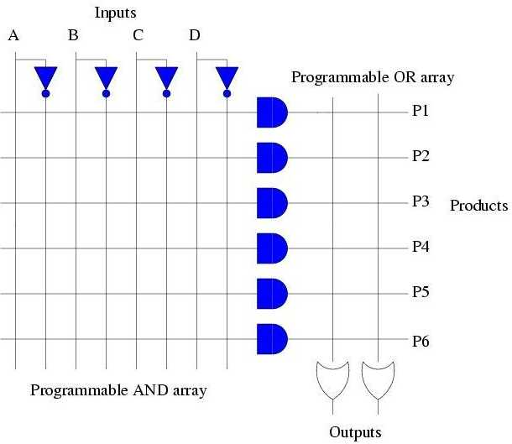
PLA 4 X 6 X 2

Slide 21
Gate Level Version of PLA
x
1
x
2
x
3
Programmable
connections
f₁ = x₁x₂+x₁x₃'+x₁'x₂'x₃
OR plane
P
1
f₂ = x₁x₂+x₁'x₂'x₃+x₁x₃
P
2
P
3
P
4
AND plane
f
1
f
2

Slide 22
Customary Schematic of a PLA
x
1
x
x
2
3
f₁ = x₁x₂+x₁x₃'+x₁'x₂'x₃
OR plane
P
1
f₂ = x₁x₂+x₁'x₂'x₃+x₁x₃
P
2
P
3
P
4
x marks the connections left in place after programming
AND plane
f
f
1
2

Slide 23
Limitations of PLAs
  PLAs come in various sizes
    Typical size is 16 inputs, 32 product terms, 8 outputs
      Each AND gate has large fan-in → this limits the number of inputs that can be provided in a PLA
      16 inputs → 3¹⁶ = possible input combinations; only 32 permitted (since 32 AND gates) in a typical PLA
      32 AND terms permitted → large fan-in for OR gates as well
        This makes PLAs slower and slightly more expensive than some alternatives to be discussed shortly
      8 outputs → could have shared minterms, but not required

Slide 24
Programmable Array Logic (PAL)
Programmable AND array
Fixed OR array
  Each output line permanently connected to a specific set of product terms
Number of switching functions that can be implemented with PAL are more limited than PROM and PLA

Slide 25
Programmable Array Logic (PAL)
  Also used to implement
  circuits in SOP form
  The connections in
  the AND plane are
  programmable
  The connections in
  the OR plane are
  NOT programmable
x
1
x
2
x
n
Input buffers
and
fixed connections
inverters
x
1
x
1
x
n
x
n
P
1
AND plane
OR plane
P
k
f
f
m
1

Slide 26
Example Schematic of a PAL
x
x
x
1
2
3
f₁ = x₁x₂x₃'+x₁'x₂x₃
f₂ = x₁'x₂'+x₁x₂x₃
P
1
f
1
P
2
P
3
f
2
P
4
AND plane

Slide 27
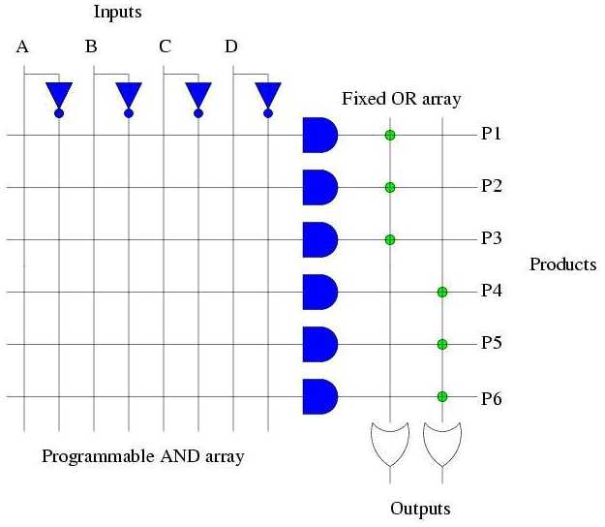
PAL Logic Diagram

Slide 28
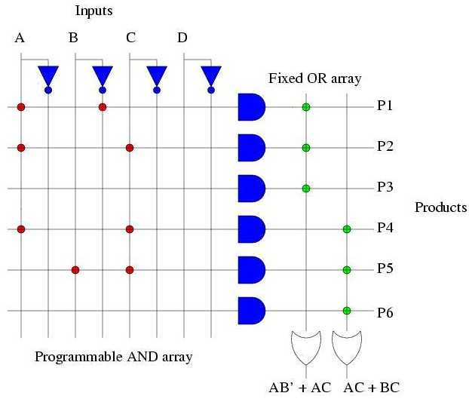
Design with PAL

Slide 29
Comparing PALs and PLAs
  PALs have the same limitations as PLAs (small number of allowed AND terms) plus they have a fixed OR plane → less flexibility than PLAs
  PALs are simpler to manufacture, cheaper, and faster (better performance)
  PALs also often have extra circuitry connected to the output of each OR gate
    The OR gate plus this circuitry is called a macrocell

Slide 30
Multi-Level Design with PALs
  f = A'BC + A'B'C' + ABC' + AB'C = A'g + Ag'
    where g = BC + B'C' and C = h below
A
B
Sel = 0
En = 0
0
1
h
D
Q
Clock
Sel = 0
En = 1
0
1
g
D
Q
Clock
Select
0
1
f
D
Q
Clock

Slide 31
ROM
  A ROM (Read Only Memory) has a fixed AND plane and a programmable OR plane
  Size of AND plane is 2^{n} where n = number of input pins
    Has an AND gate for every possible minterm so that all input combinations access a different AND gate
  OR plane dictates function mapped by the ROM

Slide 32
Programmable ROM (PROM)
2 ^{N} x M
ROM
N input
M output
Address: N bits; Output word: M bits
ROM contains 2 ^{N} words of M bits each
The input bits decide the particular word that becomes available
on output lines

Slide 33
4x4 ROM
  2²x4 bit ROM has 4 addresses that are decoded
a
0
-to-4 decoder
a
1
2
d
3
d
2
d
1
d
0

Slide 34
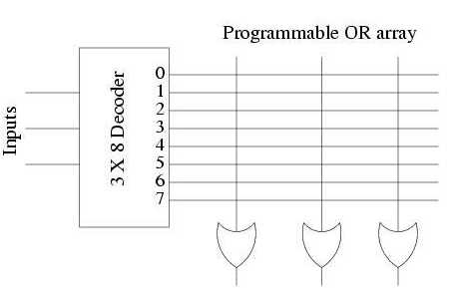
Logic Diagram of 8x3 PROM
Sum of minterms

Slide 35
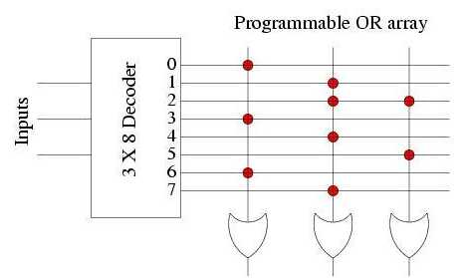
Combinational Circuit Implementation using PROM
I₀ I₁ I₂ F₀ F₁ F₂
0 | 0 | 0 | 1 | 0 | 0
0 | 0 | 1 | 0 | 1 | 0
0 | 1 | 0 | 0 | 1 | 1
0 | 1 | 1 | 1 | 0 | 0
1 | 0 | 0 | 0 | 1 | 0
1 | 0 | 1 | 0 | 0 | 1
1 | 1 | 0 | 1 | 0 | 0
1 | 1 | 1 | 0 | 1 | 0
F₀ F₁ F₂

Slide 36
PROM Types
Programmable PROM
  Break links through current pulses
  Write once, Read multiple times
Erasable PROM (EPROM)
  Program with ultraviolet light
  Write multiple times, Read multiple times
Electrically Erasable PROM (EEPROM)/ Flash Memory
  Program with electrical signal
  Write multiple times, Read multiple times

Slide 37
PROM: Advantages and Disadvantages
Widely used to implement functions with large number of inputs and outputs
Design of control units (Micro-programmed control units)
For combinational circuits with lots of don’t care terms, PROM is a wastage of logic resources

Slide 38
Programming SPLDs
  PLAs, PALs, and ROMs are also called SPLDs – Simple Programmable Logic Devices
  SPLDs must be programmed so that the switches are in the correct places
    CAD tools are usually used to do this
      A fuse map is created by the CAD tool and then that map is downloaded to the device via a special programming unit
    There are two basic types of programming techniques
      Removable sockets on a PCB
      In system programming (ISP) on a PCB
        This approach is not very common for PLAs and PALs but it is quite common for more complex PLDs

Slide 39
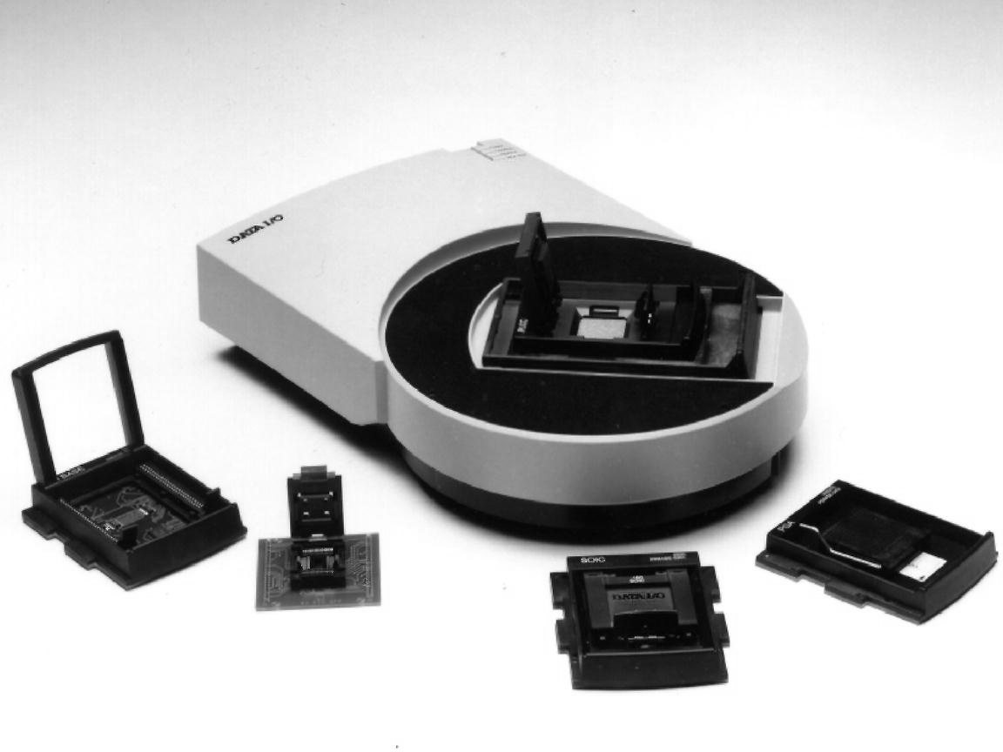
An SPLD Programming Unit
  The SPLD is removed from the PCB, placed into the unit and programmed there

Slide 40
Removable SPLD Socket Package
  PLCC (plastic-leaded chip carrier)
PLCC socket soldered to the PCB

Slide 41
In System Programming (ISP)
  Used when the SPLD cannot be removed from the PCB
  A special cable and PCB connection are required to program the SPLD from an attached computer
  Very common approach to programming more complex PLDs like CPLDs, FPGAs, etc.

Slide 42
CPLD
  Complex Programmable Logic Devices (CPLD)
  SPLDs (PLA, PAL) are limited in size due to the small number of input and output pins and the limited number of product terms
    Combined number of inputs + outputs < 32 or so
  CPLDs contain multiple circuit blocks on a single chip
    Each block is like a PAL: PAL-like block
    Connections are provided between PAL-like blocks via an interconnection network that is programmable
    Each block is connected to an I/O block as well

Slide 43
Structure of a CPLD
I/O block
PAL-like
PAL-like
block
block
I/O block
Interconnection wires
I/O block
PAL-like
PAL-like
block
block
I/O block

Slide 44
Internal Structure of a PAL-like Block
  Includes macrocells
    Usually about 16 each
  Fixed OR planes
    OR gates have fan-in
    between 5-20
  XOR gates provide
  negation ability
    XOR has a control
    input
PAL-like block
PAL-like block
D
Q
D
Q
D
Q

Slide 45
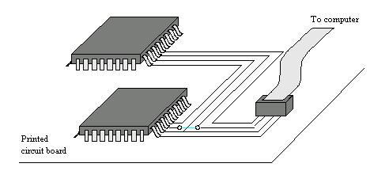
Programming a CPLD
  CPLDs have many pins – large ones have > 200
    Removal of CPLD from a PCB is difficult without breaking the pins
    Use ISP (in system programming) to program the CPLD
    JTAG (Joint Test Action Group) port used to connect the CPLD to a computer

Slide 46
Example CPLD
  Use a CPLD to implement the function
    f = x₁x₃x₆' + x₁x₄x₅x₆' + x₂x₃x₇ + x₂x₄x₅x₇

Slide 47
FPGA
  SPLDs and CPLDs are relatively small and useful for simple logic devices
    Up to about 20000 gates
  Field Programmable Gate Arrays (FPGA) can handle larger circuits
    No AND/OR planes
    Provide logic blocks, I/O blocks, and interconnection wires and switches
    Logic blocks provide functionality
    Interconnection switches allow logic blocks to be connected to each other and to the I/O pins

Slide 48
Structure of an FPGA
I/O block
interconnection
switch
I/O block
I/O block
logic block
I/O block

Slide 49
LUTs
  Logic blocks are implemented using a lookup table (LUT)
    Small number of inputs, one output
    Contains storage cells that can be loaded with the desired values
    A 2 input LUT uses 3 MUXes
    to implement any desired function
    of 2 variables
      Shannon's expansion at work!
x
1
0/1
0/1
f
0/1
0/1
x
2

Slide 50
Example 2 Input LUT
x₁ | x₂ | f
0 | 0 | 1
0 | 1 | 0
1 | 0 | 0
1 | 1 | 1
f = x₁'x₂' + x₁x₂, or using Shannon's expansion:
f = x₁'(x₂') + x₁(x₂)
= x₁'(x₂'(1) + x₂(0)) + x₁(x₂'(0) + x₂(1))
x
1
1
0
f
0
1
x
2

Slide 51
3 Input LUT
  7 2x1 MUXes and
  8 storage cells are
  required
  Commercial LUTs have
  4-5 inputs, and 16-32
  storage cells
x
1
x
2
0/1
0/1
0/1
0/1
f
0/1
0/1
0/1
0/1
x
3

Slide 52
Programming an FPGA
  ISP method is used
  LUTs contain volatile storage cells
    None of the other PLD technologies are volatile
    FPGA storage cells are loaded via a PROM when power is first applied
  The UP2 Education Board by Altera contains a JTAG port, a MAX 7000 CPLD, and a FLEX 10K FPGA
    The MAX 7000 CPLD chip is EPM7128SLC84-7
    EPM7 → MAX 7000 family; 128 macrocells; LC84 → 84 pin PLCC package; 7 → speed grade

Slide 53
Example FPGA
  Use an FPGA with 2 input LUTS to implement the function f = x₁x₂ + x₂'x₃
    f₁ = x₁x₂
    f₂ = x₂'x₃
    f = f₁ + f₂

Slide 54
Another Example FPGA
  Use an FPGA with 2 input LUTS to implement the function f = x₁x₃x₆' + x₁x₄x₅x₆' + x₂x₃x₇ + x₂x₄x₅x₇
    Fan-in of expression is too large for FPGA (this was simple to do in a CPLD)
    Factor f to get sub-expressions with max fan-in = 2
      f = x₁x₆'(x₃ + x₄x₅) + x₂x₇(x₃ + x₄x₅)
      = (x₁x₆' + x₂x₇)(x₃ + x₄x₅)
    Could use Shannon's expansion instead
      Goal is to build expressions out of 2-input LUTs

Slide 55
FPGA Implementation
  f = (x₁x₆' + x₂x₇)(x₃ + x₄x₅)

Slide 56
Comparison
Technology | Performance/ Cost | Time until running | Time to high performance | Time to change code functionality
ASIC | Very High | Very Long | Very Long | Impossible
FPGA | Medium | Medium | Long | Medium
ASIP/ DSP | High | Long | Long | Long
Generic | Low-Medium | Very Short | Not Attainable | Very Short
Flexibility
Speed

Slide 57
Digital Logic Technology Tradeoffs
Full custom
VLSI design
ASICs
Speed / Density / Complexity / Likely
Market Volume
CPLDs
FPGAs
PLDs
Engineering cost / Time to develop

Slide 58
PLD Logic Capacity
SPLD: about 200 gates
CPLD
  Altera FLEX (250K logic gates)
  Xilinx XC9500
FPGA
  Xilinx Vertex-E ( 3 million logic gates)
  Xilinx Spartan (10K logic gates)
  Altera

Slide 59
FPGA Design Flow
Design Entry
Design Implementation
Design Verification
FPGA Configuration

Slide 60
Design Entry
Schematic
HDL
Compile
Logic Equations
Minimize
Test vectors
Reduced
Logic Equations
(Netlist)
Simulation

Slide 61
Design Implementation
Input: Netlist Output: bitstream
Map the design onto FPGA resources
  Break up the circuit so that each block has maximum n inputs
  NP-hard problem
  However, optimal solution is not required

Slide 62
Design Implementation (Cont.)
Place: assigns logic blocks created during mapping process to specific location on FPGA
  Goal: minimize length of wires
  Again NP-hard
Route: routes interconnect paths between logic blocks
  NP-hard

Slide 63
Design Implementation Techniques
Simulated annealing
Genetic algorithm
Mincut method
Heuristic method

Slide 64
Design Verification & FPGA Configuration
Functional Simulation
Timing Simulation
Download bitstream into FPGA

