Slide 1
Advanced FPGA Based System Design
Lecture-11 & 12
VHDL
Finite State Machines
By: Dr Imtiaz Hussain
imtiaz.hussain@faculty.muet.edu.pk

Slide 2
Contents
Finite State Machines
Design Style#1
Design Style#2
Signals & Variables

Slide 3
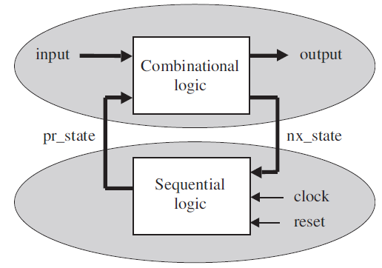
Introduction
Several approaches can be conceived to design a FSM.
We will discuss in detail one style that is well structured and easily applicable.

Slide 4
Design Style#1
In this style, the design of the lower section of the state machine is completely separated from that of the upper section.

Slide 5
Design Style#1
It contains user-defined enumerated data type (here called state), which lists all possible states of the machine.

Slide 6
Design Style#1
Design of Lower (Sequential) section
The flip-flops are in the lower section, so clock and reset are connected to it.
The other lower section’s input is nx_state (next state), while pr_state (present state) is its only output.
Being the circuit of the lower (sequential) section, a PROCESS is required, in which any of the sequential statements (IF, WAIT, CASE, or LOOP, can be employed.

Slide 7
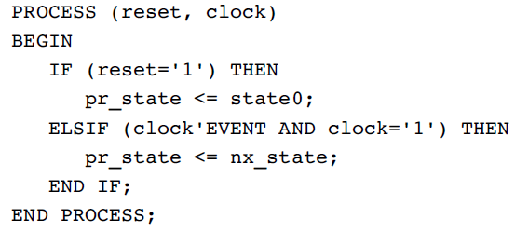
Design Style#1
Design of Lower (Sequential) section
A typical design template for the lower section is the following:

Slide 8
Design Style#1
Design of Upper (Combinational) section
The upper section is fully combinational, so its code does not need to be sequential; concurrent code can be used as well.
In the design template shown in next slide, sequential code is employed, with the CASE statement playing the central role.

Slide 9
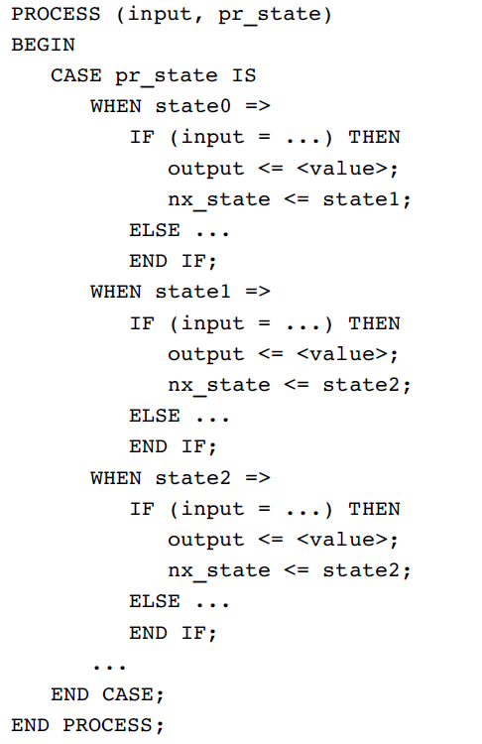

Slide 10
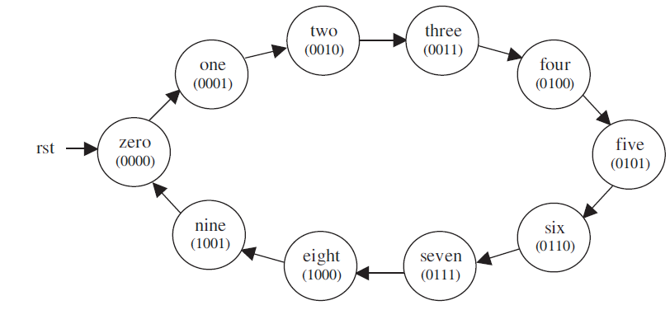
Example-1
A BCD counter is an example of Moore Machine

Slide 11
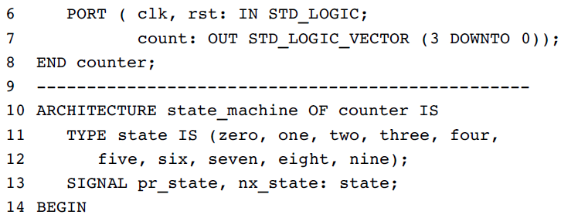
Example-1

Slide 12
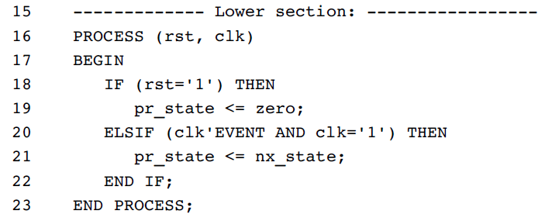
Example-1

Slide 13
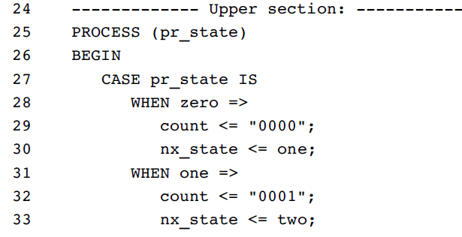
Example-1

Slide 14
Example-1

Slide 15
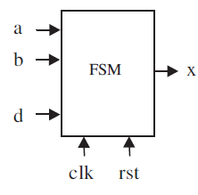
Example#2
The system has two states (state A and state B).
State must change from one to the other every time d = ‘1’ is received.
The desired output is x = a when the machine is in state A, or x =b when in state B.
The initial (reset) state is state A.

Slide 16
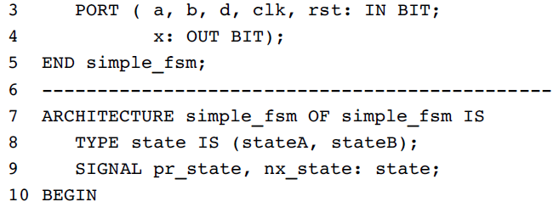
Example#2

Slide 17
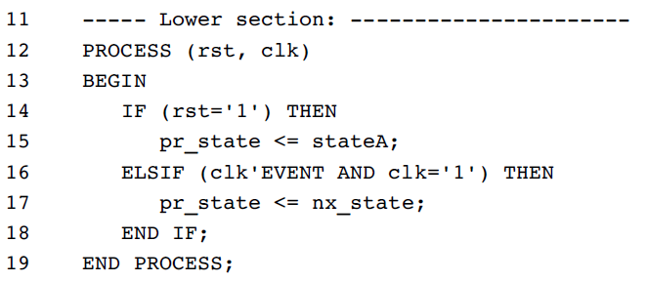
Example#2

Slide 18
Example#2

