Slide 1
Feedback Control Systems (FCS)
Lab-1-2-3-4
Introduction to Modular Servo System
Development of characteristics of D.C Motor
Formation of Error Channel
Experimental Determination of Transfer function
Dr. Imtiaz Hussain
email: imtiaz.hussain@faculty.muet.edu.pk
URL :http://imtiazhussainkalwar.weebly.com/

Slide 2
Outline
Experiment#1
  Introduction to Modular Servo system
Experiment#2
  Speed Voltage characteristics of D.C Motor
Experiment#3
  Error channel

Slide 3
Experiment#1
Introduction to Modular Servo system

Slide 4
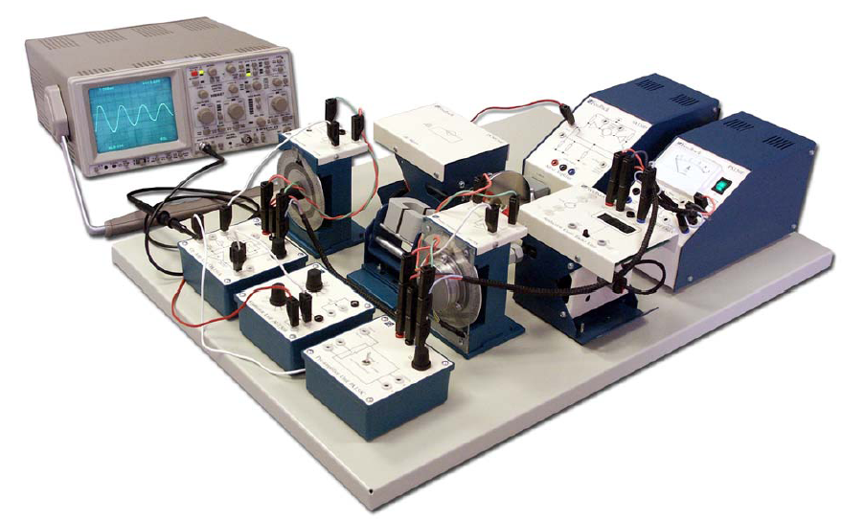
Modular Servo System (MS150)
The MS150 Modular Servo System is a unique equipment designed to study the theory and practice of automatic control systems.
Operation Amplifier Unit (OU150A)
Attenuator Unit (AU150B)
Pre-amplifier Unit (PA150C)
Servo Amplifier (SA150D)
Power Supply (PS150E)
Motor-Tacho Unit (MT150F)
Input potentiometer (IP150H)
Output Potentiometer (OP150K)
Load Unit (LU150L)

Slide 5
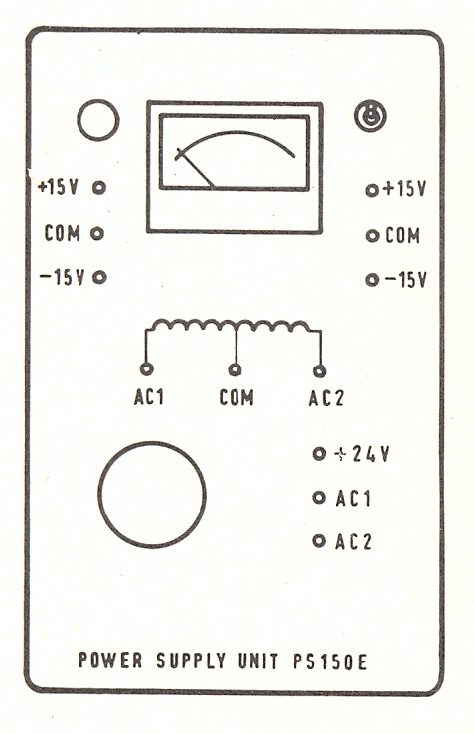
Modular Servo System (MS150)
Power Supply (PS150E)

Slide 6
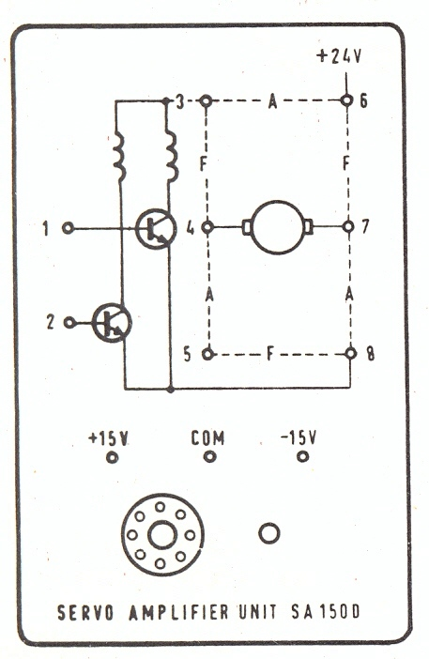
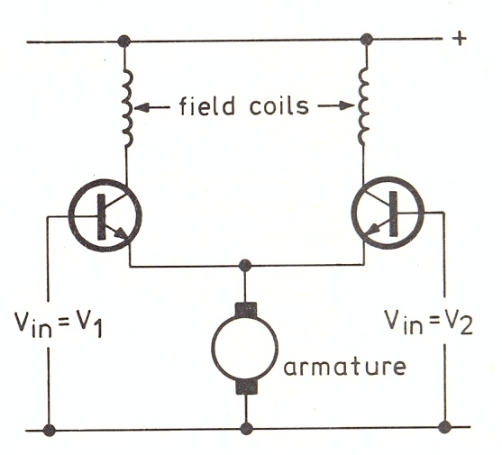
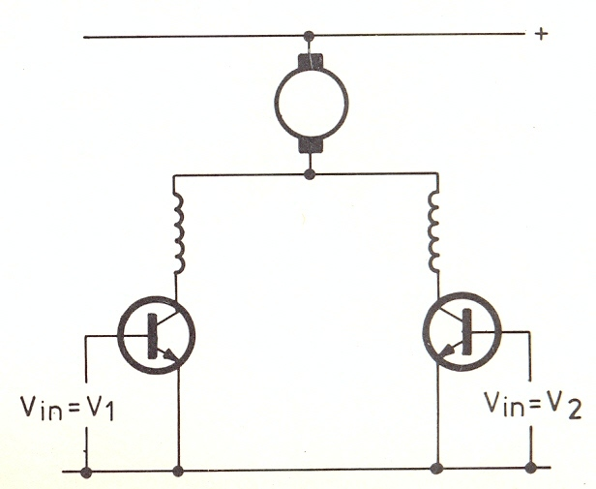
Modular Servo System (MS150)
Servo Amplifier (SA150D)

Slide 7
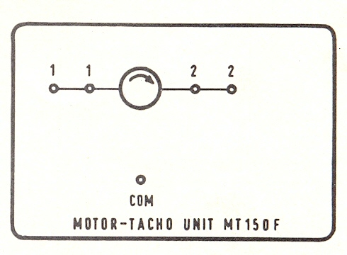
Modular Servo System (MS150)
Motor-Tacho Unit (MT150F)

Slide 8
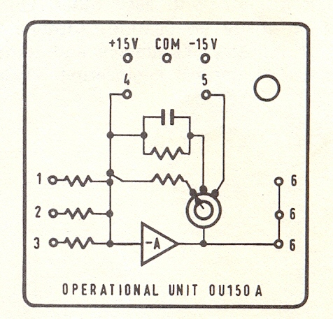
Modular Servo System (MS150)
Operation Amplifier Unit (OU150A)

Slide 9
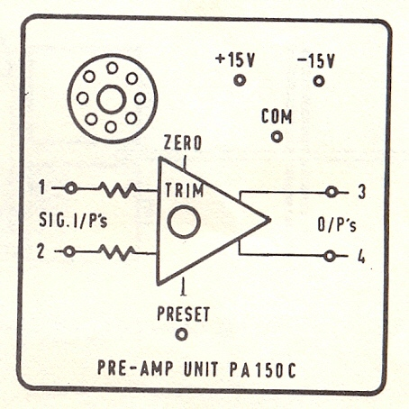
Modular Servo System (MS150)
Pre-amplifier Unit (PA150C)

Slide 10
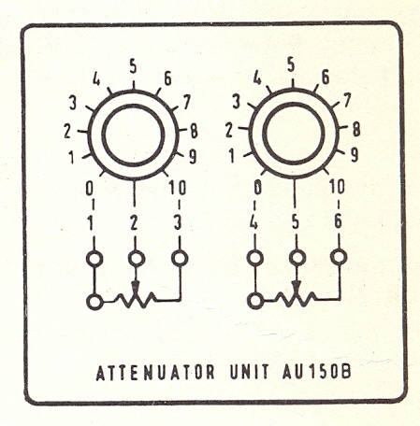
Modular Servo System (MS150)
Attenuator Unit (AU150B)

Slide 11
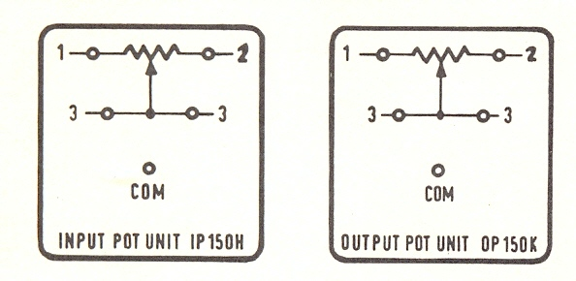
Modular Servo System (MS150)
Input potentiometer (IP150H)
Output Potentiometer (OP150K)

Slide 12
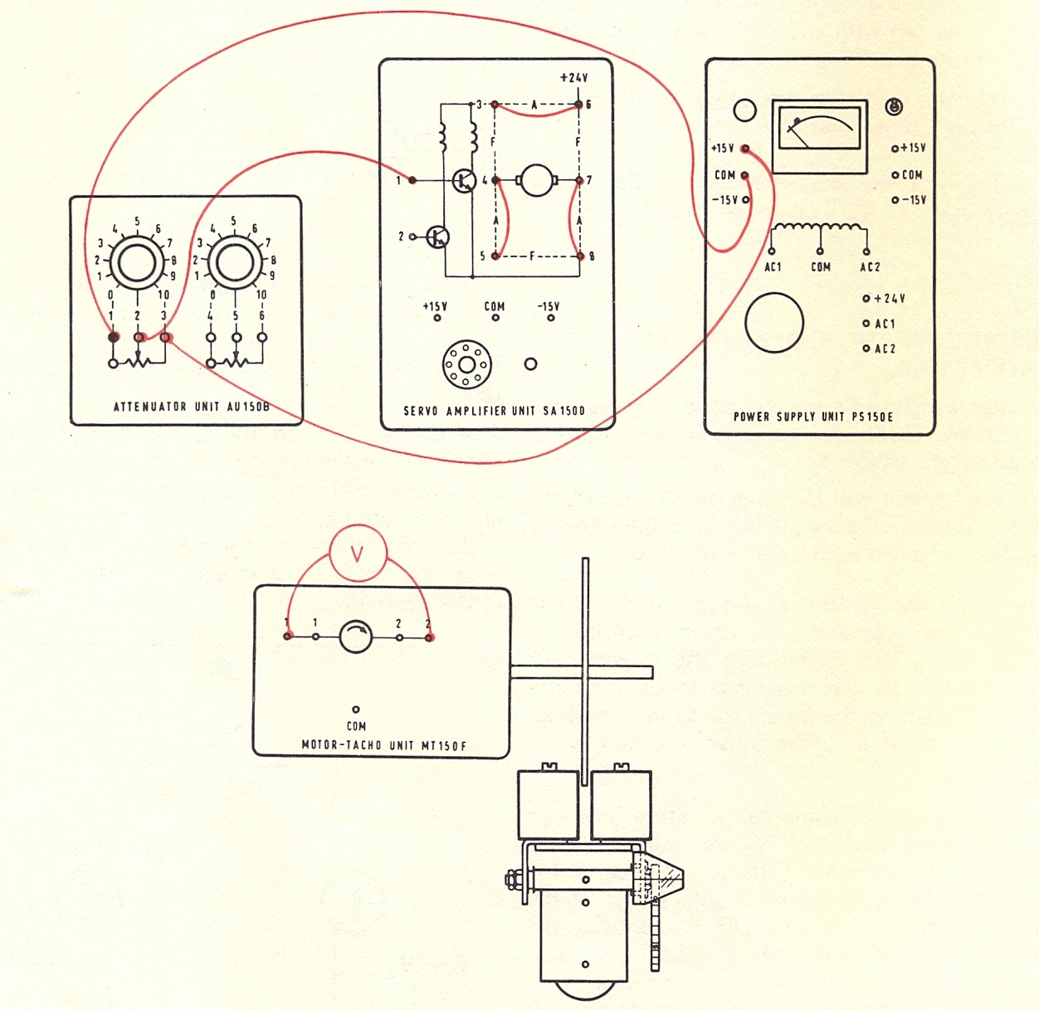
Modular Servo System (MS150)
Load Unit (LU150L)

Slide 13
Experiment#2
Development of characteristics of D.C Motor

Slide 14
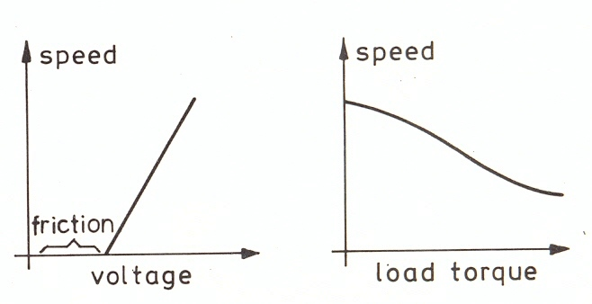
Characteristics of D.C Motor
Motor Characteristics (Armature control Mode)

Slide 15
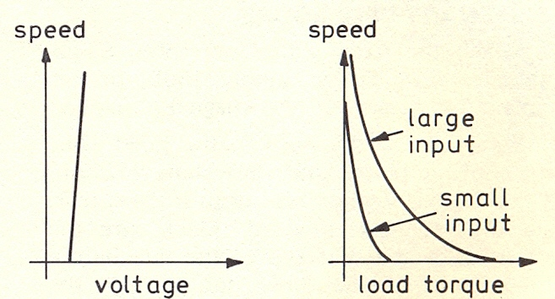
Characteristics of D.C Motor
Motor Characteristics (Field control Mode)

Slide 16
Characteristics of D.C Motor
com
+15
Experimental set up (Armature Control Mode)

Slide 17
Characteristics of D.C Motor
Connect the voltmeter across the tacho outputs and switch on the power.
Turn the slider on the potentiometer till there is a reading of 1V on the voltmeter.
Count the turns of the geared 30:1 low speed shaft in one minute.
Tabulate your result in following table.
S. No | Tachogenerator Volts (V_{g}) | V_{in} | No. of rotations of low Speed Shaft (a) | Speed in rev/min N=30×a
1 | 1
2 | 2
3 | 3
4 | 4
5 | 5
6 | 7
7 | 10

Slide 18

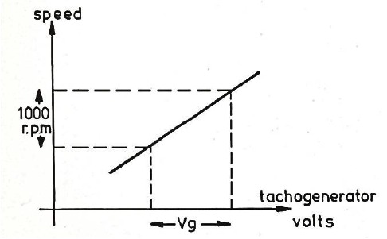
Characteristics of D.C Motor
Plot the graph of your results, as in following figure, of speed against Tachogenerator volts. The calibration factor should be about 2.5V to 3V per 1000 rev/min.
calibration factor =

Slide 19
Experiment#3
Error Channel

Slide 20
Error Channel
r
e
Controller
Plant
c
-

Slide 21
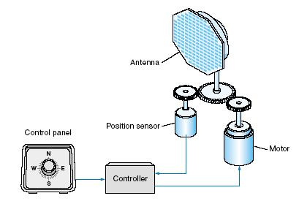
Error Channel
Closed Loop Position Control System

Slide 22
Error Channel
In a closed loop position control system reference input and output are angular positions.
e
Controller
Plant
-

Slide 23
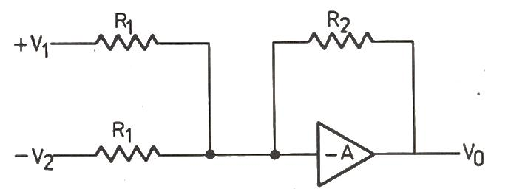
Position Control System (Block Diagram)
I/P
Potentio-meter
Summing amplifier
Attenuator
Pre-Amp
Servo-Amp
D.C Motor
O/P
Potentio-meter

Slide 24
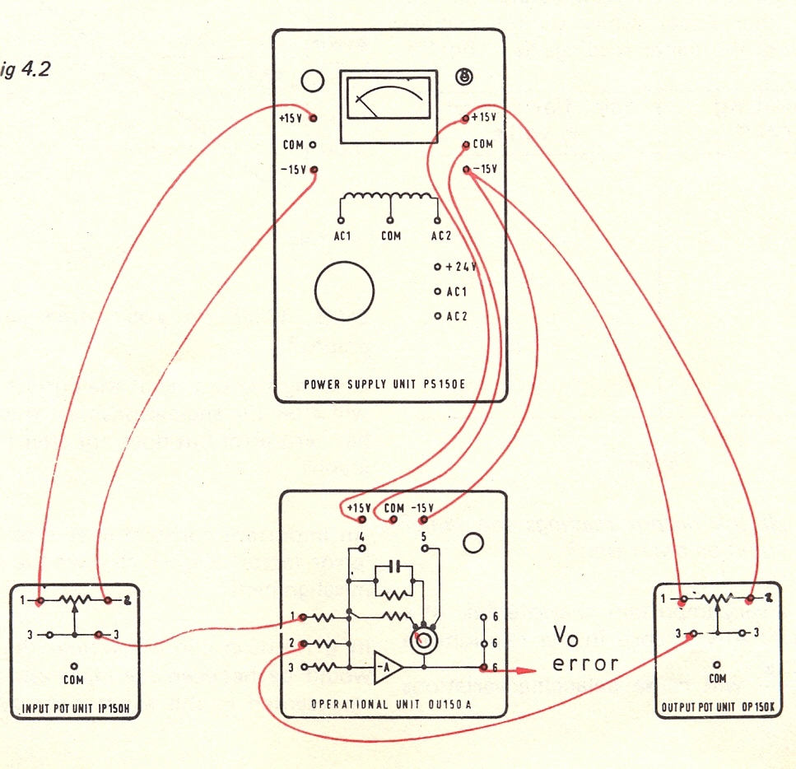

Slide 25
Calibration
Before connecting the two sliders into the operational amplifier inputs make certain that the slider resistance is same on both input and output potentiometers for all angular positions.
If not, then loosen the dial and make an adjustment.

Slide 26
Readings
S.No | Input potentiometer |  | Output potentiometer |  |  | V₁- V₂ |  | V_{o}(Measured)
 |  | V₁ |  | V₂

Slide 27
Experiment#4
Experimental Determination of Transfer Function

Slide 28
Practical Determination of Transfer Function of 1st Order Systems
Often it is not possible or practical to obtain a system's transfer function analytically.
Perhaps the system is closed, and the component parts are not easily identifiable.
The system's step response can lead to a representation even though the inner construction is not known.
With a step input, we can measure the time constant and the steady-state value, from which the transfer function can be calculated.

Slide 29
Practical Determination of Transfer Function of 1st Order Systems
If we can identify T and K from laboratory testing we can obtain the transfer function of the system.

Slide 30
First Order System With Delays

Slide 31
Determination of Transfer Function of Armature Controlled D.C Motor
Armature Controlled D.C Motor (L_{a}=0)
R_{a}
L_{a}
B
i_{a}
u
e_{b}
T
J
ω
V_{f}=constant

Slide 32
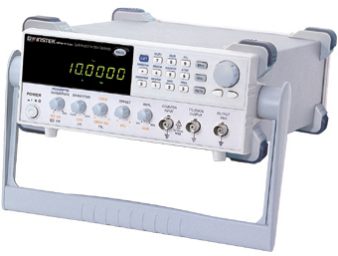
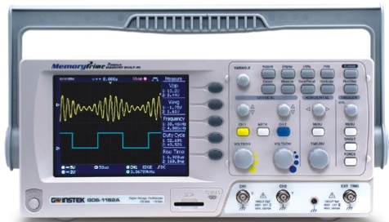
Step Response of D.C Motor
Apply square wave of amplitude 10 volts and frequency 0.1Hz.
Armature
Controlled
D.C Motor
v
10
0
-10
5
10
15
t

Slide 33
Experimental Setup

Slide 34
End of Totorials
To download this lecture visit
http://imtiazhussainkalwar.weebly.com/

