Slide 1
DC Motor Model
Using Simscape
Engr. Salim Lashari

Slide 2
Introduction to Simscape
Simscape™ provides an environment for modeling and simulating physical systems spanning mechanical, electrical, hydraulic, and other physical domains. It provides fundamental building blocks from these domains that you can assemble into models of physical components, such as electric motors, inverting op-amps, hydraulic valves. Because Simscape components use physical connections, your models match the structure of the system you are developing.
Simscape models can be used to develop control systems and test system-level performance.
You can parameterize your models using MATLAB variables and expressions, and design control systems for your physical system in Simulink®.

Slide 3
Overview of DC Motor Example
In this example, you model a DC motor driven by a constant input signal that approximates a pulse-width modulated signal and look at the current and rotational motion at the motor output.

Slide 4
Selecting Blocks to Represent System Components
Select the blocks to represent the input signal, the DC motor, and the motor output displays.
The following table describes the role of the blocks that represent the system components.

Slide 5
Block | Description
Solver Configuration | Defines solver settings that apply to all physical modeling blocks.
DC Voltage Source | Generates a DC signal.
Controlled PWM Voltage | Generates the signal that approximates a pulse-width modulated motor input signal.
H-Bridge | Drives the DC motor.
Current Sensor | Converts the electrical current that drives the motor into a physical signal proportional to the current.
Ideal Rotational Motion Sensor | Converts the rotational motion of the motor into a physical signal proportional to the motion.

Slide 6
Block | Description
DC Motor | Converts input electrical signal into mechanical motion.
PS-Simulink Converter | Converts the input physical signal to a Simulink® signal.
Scope | Displays motor current and rotational motion.
Electrical Reference | Provides the electrical ground.
Mechanical Rotational Reference | Provides the mechanical ground.

Slide 7
Building the Model
Create a Simulink model, add blocks to the model, and connect the blocks.
Create a new model.
Add to the model the blocks listed in the following table. The Library column of the table specifies the hierarchical path to each block.

Slide 8
Block | Library Path | Quantity
Solver Configuration | Simscape > Utilities | 1
DC Voltage Source | Simscape > Foundation Library > Electrical > Electrical Sources | 1
Controlled PWM Voltage | Simscape > SimElectronics > Actuators & Drivers > Drivers | 1
H-Bridge | Simscape > SimElectronics > Actuators & Drivers > Drivers | 1
Current Sensor | Simscape > Foundation Library > Electrical > Electrical Sensors | 1
Ideal Rotational Motion Sensor | Simscape > Foundation Library > Mechanical > Mechanical Sensors | 1
DC Motor | Simscape > SimElectronics > Actuators & Drivers > Rotational Actuators | 1
PS-Simulink Converter | Simscape > Utilities | 2
Scope | Simulink > Commonly Used Blocks | 2
Electrical Reference | Simscape > Foundation Library > Electrical > Electrical Elements | 1
Mechanical Rotational Reference | Simscape > Foundation Library > Mechanical > Rotational Elements | 1

Slide 9
Building the Model
Connect the blocks as shown in the following figure.

Slide 10
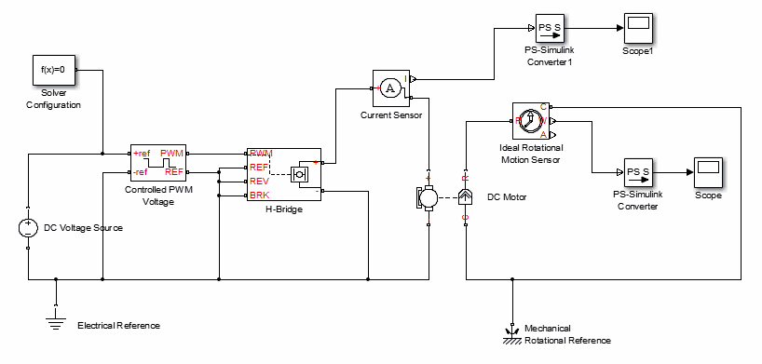

Slide 11
Specifying Model Parameters
Specify the following parameters to represent the behavior of the system components:
Motor Input Signal Parameters
Motor Parameters
Current Display Parameters
Torque Display Parameters

Slide 12
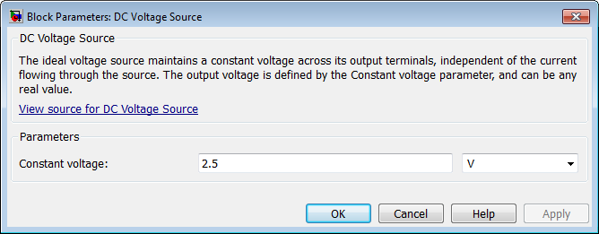
Motor Input Signal Parameters
1. Set the DC Voltage Source block parameters as follows:
Constant voltage = 2.5

Slide 13
Motor Input Signal Parameters
Set the Controlled PWM Voltage block parameters as follows:
PWM frequency = 4000
Simulation mode = Averaged
This value tells the block to generate an output signal whose value is the average value of the PWM signal. Simulating the motor with an averaged signal estimates the motor behavior in the presence of a PWM signal. To validate this approximation, use value of PWM for this parameter.

Slide 14
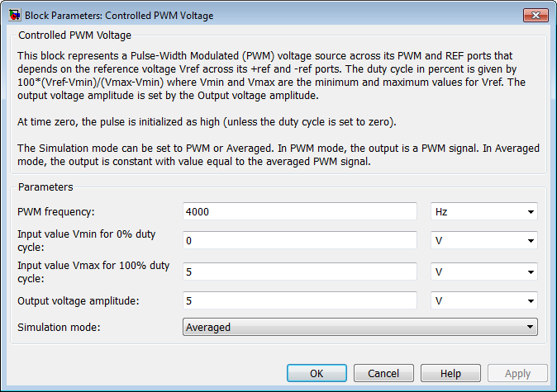

Slide 15
Motor Input Signal Parameters
Set the H-Bridge block parameters as follows:
Simulation mode = Averaged
This value tells the block to generate an output signal whose value is the average value of the PWM signal. Simulating the motor with an averaged signal estimates the motor behavior in the presence of a PWM signal. To validate this approximation, use value of PWM for this parameter.

Slide 16
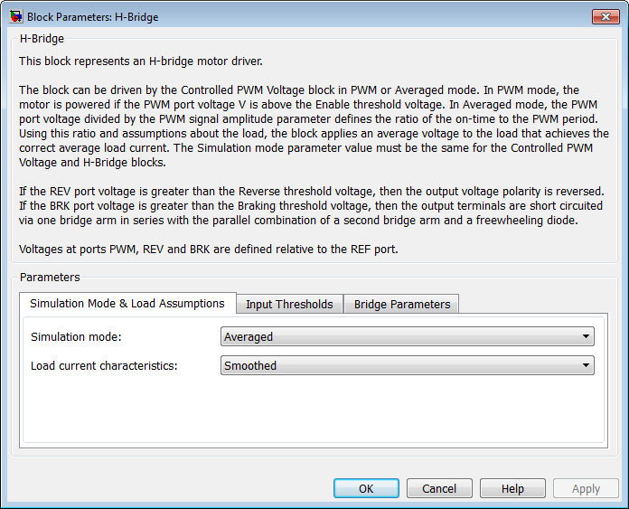

Slide 17
Motor Parameters
Configure the block that models the motor.
Set the Motor block parameters as follows, leaving the unit settings at their default values where applicable:
Electrical Torque tab:
Model parameterization = By rated power, rated speed & no-load speed
Armature inductance = 0.01
No-load speed = 4000
Rated speed (at rated load) = 2500
Rated load (mechanical power) = 10
Rated DC supply voltage = 12
Mechanical tab:
Rotor inertia = 2000
Rotor damping = 1e-06

Slide 18
Current Display Parameters
Specify the parameters of the blocks that create the motor current display:
Current Sensor block
PS-Simulink Converter1 block
Scope1 block
Of the three blocks, only the PS-Simulink Converter1 block has parameters. Set the PS-Simulink Converter1 block Output signal unit parameter to A to indicate that the block input signal has units of amperes.

Slide 19
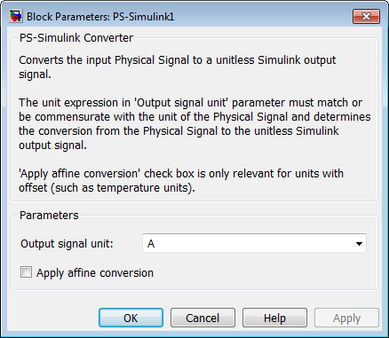

Slide 20
Torque Display Parameters
Specify the parameters of the blocks that create the motor torque display:
Ideal Rotational Motion Sensor block
PS-Simulink Converter block
Scope block
Of the three blocks, only the PS-Simulink Converter block has parameters you need to configure for this example. Set the PS-Simulink Converter block Output signal unit parameter to rpm to indicate that the block input signal has units of revolutions per minute.
Note: You must type this parameter value. It is not available in the drop-down list.

Slide 21
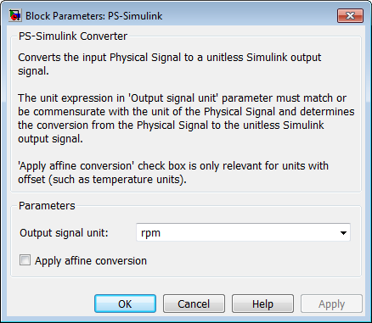

Slide 22
Configuring the Solver Parameters
Configure the solver parameters to use a continuous-time solver because SimElectronics models only run with a continuous-time solver. Increase the maximum step size the solver can take so the simulation runs faster.
In the model window, select Simulation > Model Configuration Parameters to open the Configuration Parameters dialog box.
Select ode15s (Stiff/NDF) from the Solver list.
Enter 1 for the Max step size parameter value.
Click OK.

Slide 23
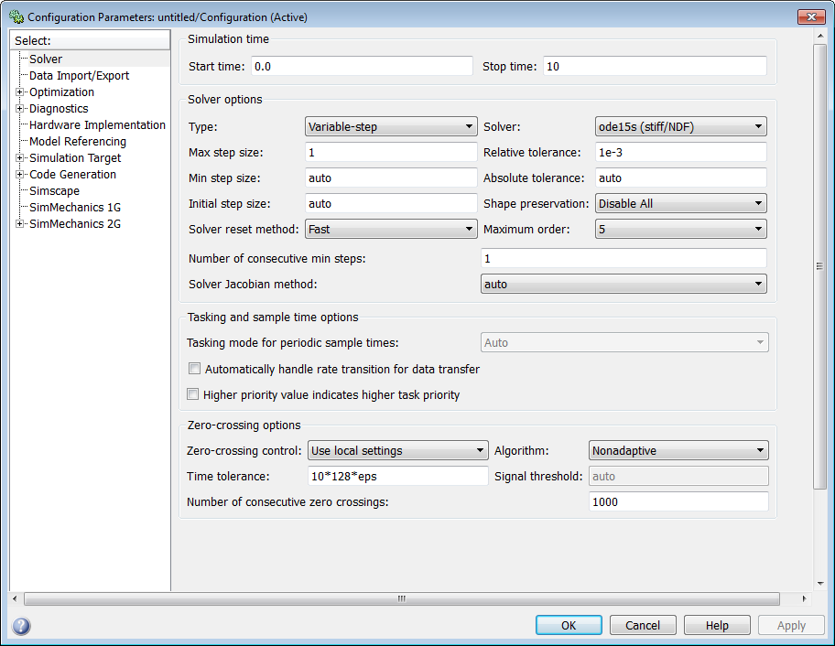

Slide 24
Running the Simulation and Analyzing the Results
In this part of the example, you run the simulation and plot the results.
In the model window, select Simulation > Run to run the simulation.
To view the motor current and torque in the Scope windows, double-click the Scope blocks. You can do this before or after you run the simulation.
The following plot shows the motor current.

Slide 25
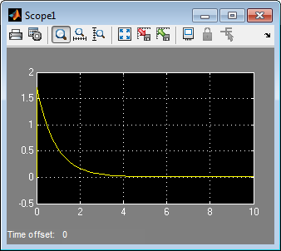
Motor Current

Slide 26
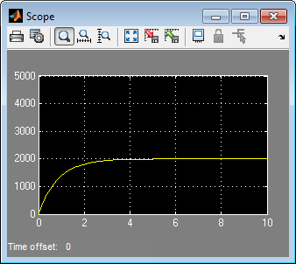
Motor RPM

Slide 27
Conclusion
As expected, the motor runs at about 2000 rpm when the applied DC voltage is 2.5 V.

