Slide 1
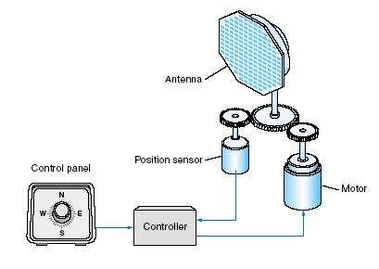
Closed Loop Position Control System
imtiaz.hussain@faculty.muet.edu.pk

Slide 2
Outline
Introduction
Modular Servo system (MS150)
Position Control System
Set Up

Slide 3
Introduction
How does a closed loop system work?
r
e
Controller
Plant
c
-

Slide 4
Introduction
In a closed loop position control system reference input and output are angular positions.
e
Controller
Plant
-

Slide 5
Introduction
Applications of Position control System
Communication
Radar Position
Satellite tracking
Energy
Solar cells position control (Sun-seeking systems)
Wind Turbine position control
Defense
Anti-aircraft guns
Anti-missiles
Medicine
Laser Surgery
Surgical Robots
Industry
Position control of robotic arm in assembling applications

Slide 6
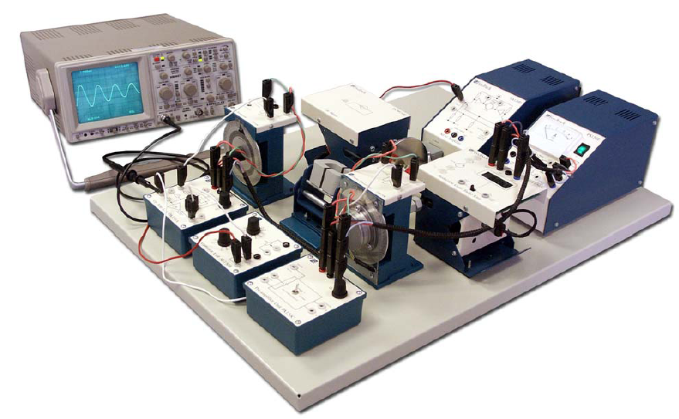
Modular Servo System (MS150)
The MS150 Modular Servo System is a unique equipment designed to study the theory and practice of automatic control systems.
Operation Amplifier Unit (OU150A)
Attenuator Unit (AU150B)
Pre-amplifier Unit (PA150C)
Servo Amplifier (SA150D)
Power Supply (PS150E)
Motor-Tacho Unit (MT150F)
Input potentiometer (IP150H)
Output Potentiometer (OP150K)
Load Unit (LU150L)

Slide 7
Position Control System (Block Diagram)
I/P
Potentio-meter
Summing amplifier
Attenuator
Pre-Amp
Servo-Amp
D.C Motor
O/P
Potentio-meter

Slide 8
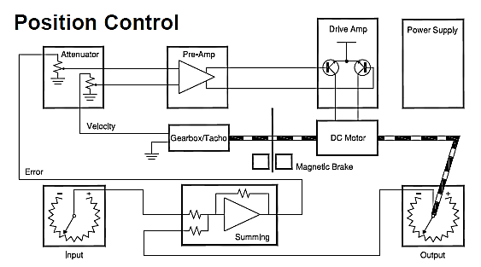
Position Control System (Schematic)

Slide 9
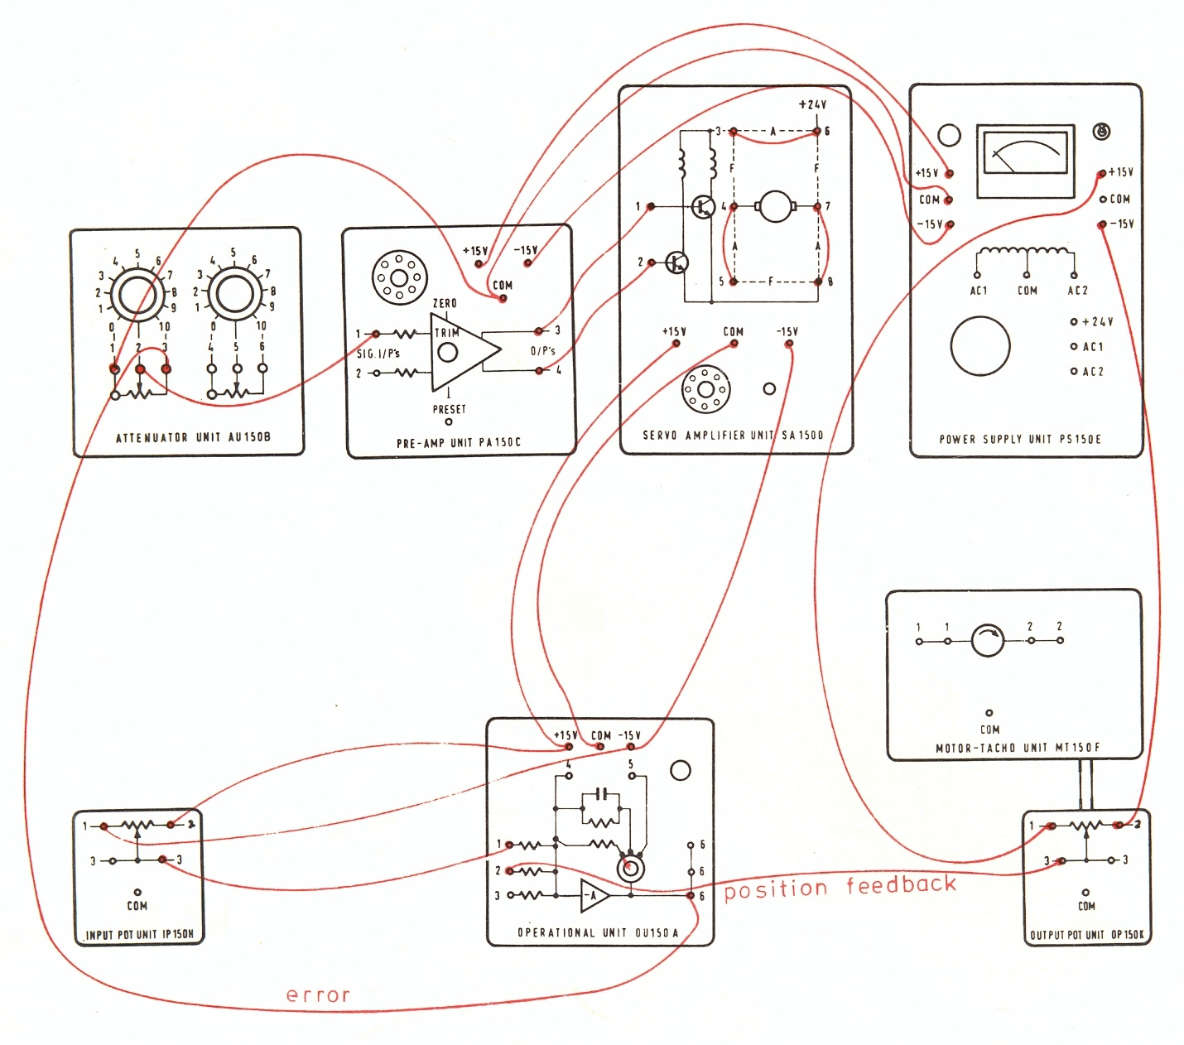
Position Control Using MS150

Slide 10
End of Tutorial
Divide yourself into groups and develop a position control system Using MS150.
You can download the handout of this and previous labs from
http://imtiazhussainkalwar.weebly.com/

